Slide 1
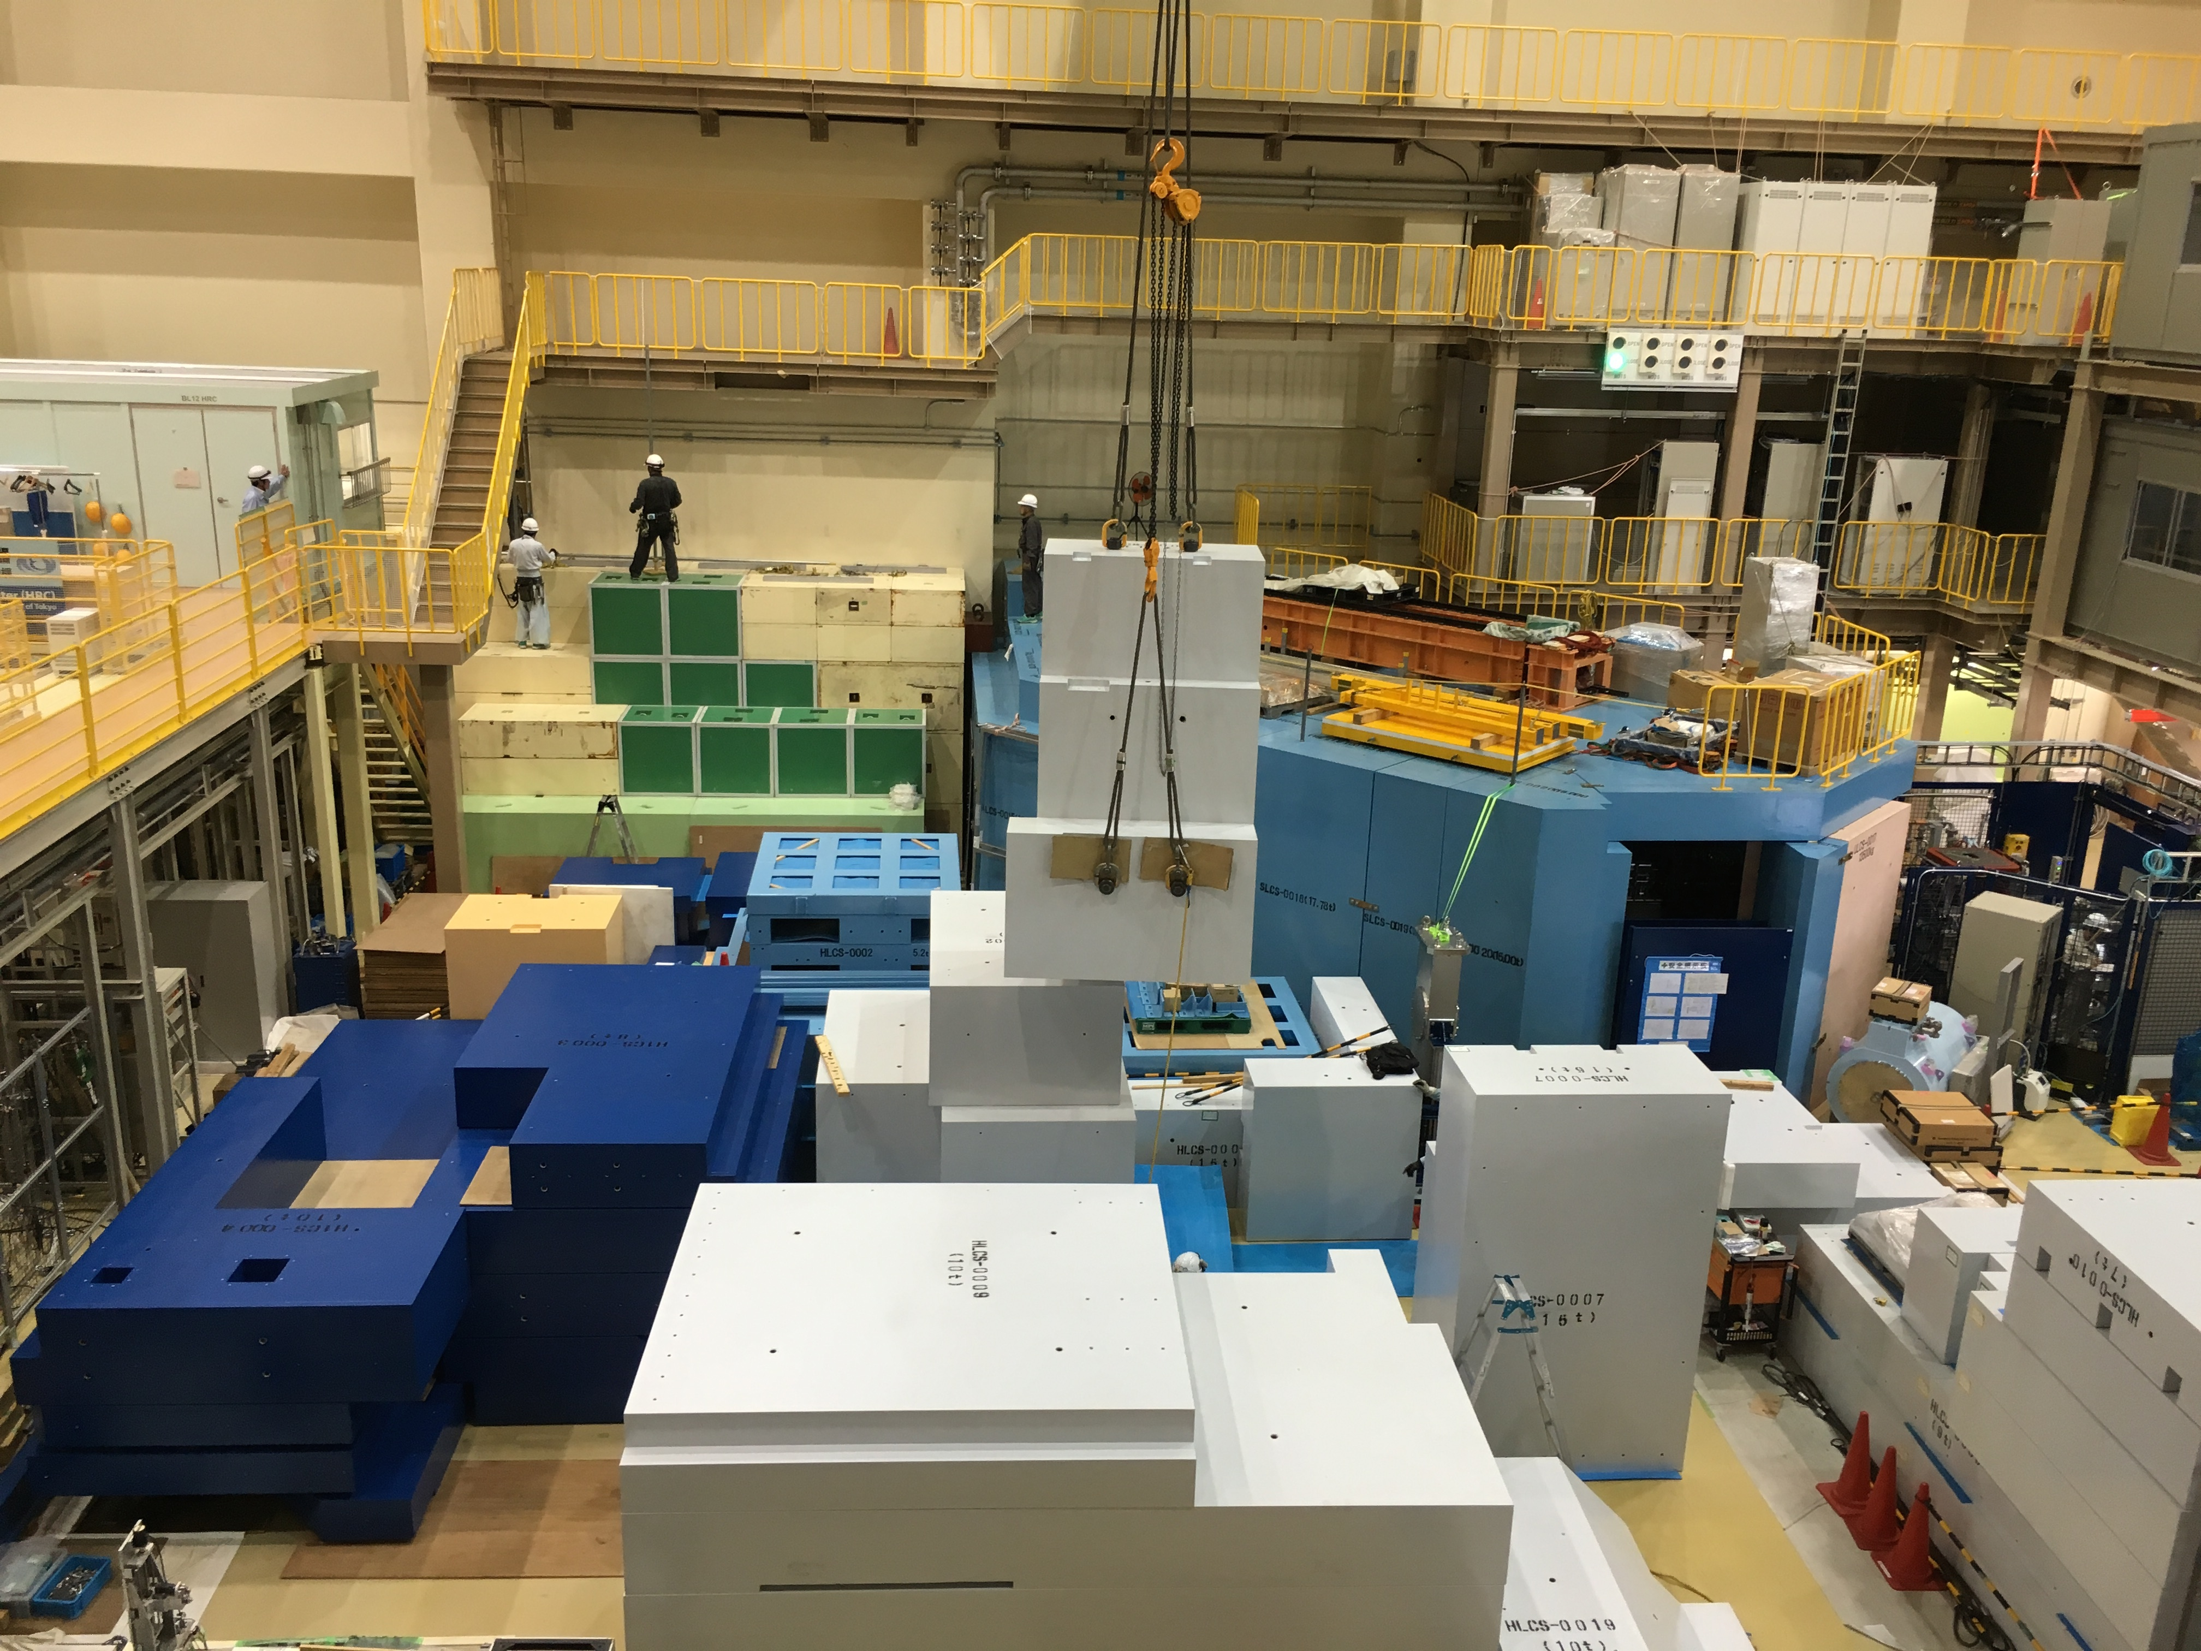
Muon g-2/EDM measurement at J-PARC
http://g-2.kek.jp
September 18, 2017
Seoul National University
Tsutomu Mibe (KEK-IPNS)

Slide 3
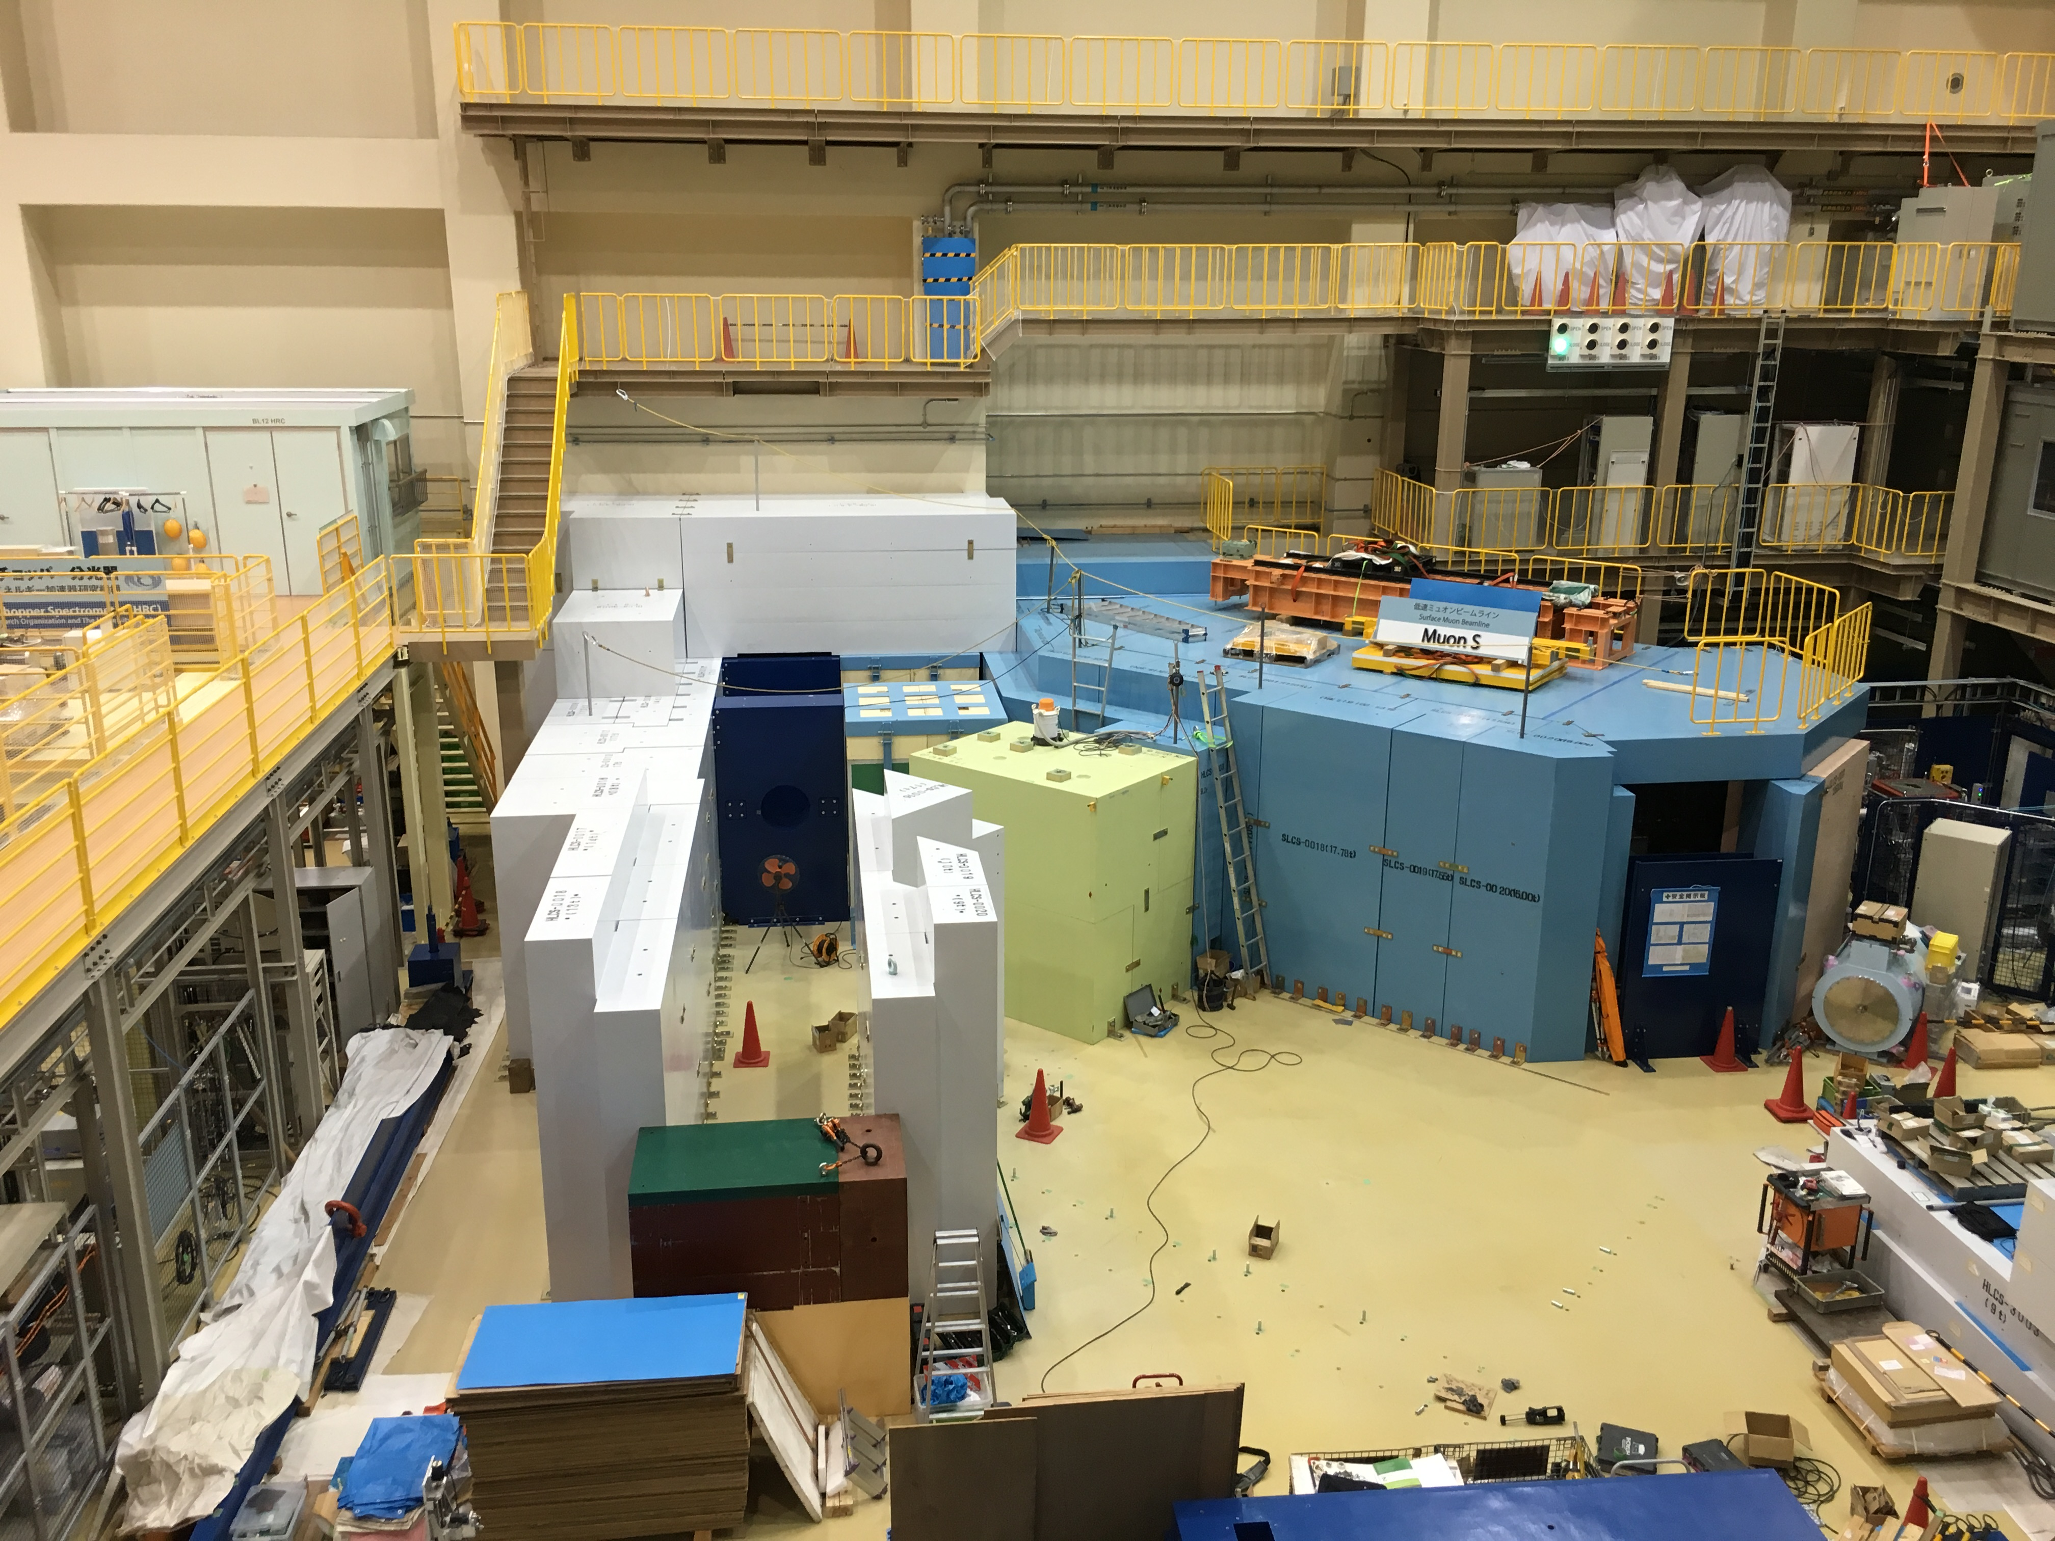
2016.8.17

Slide 4
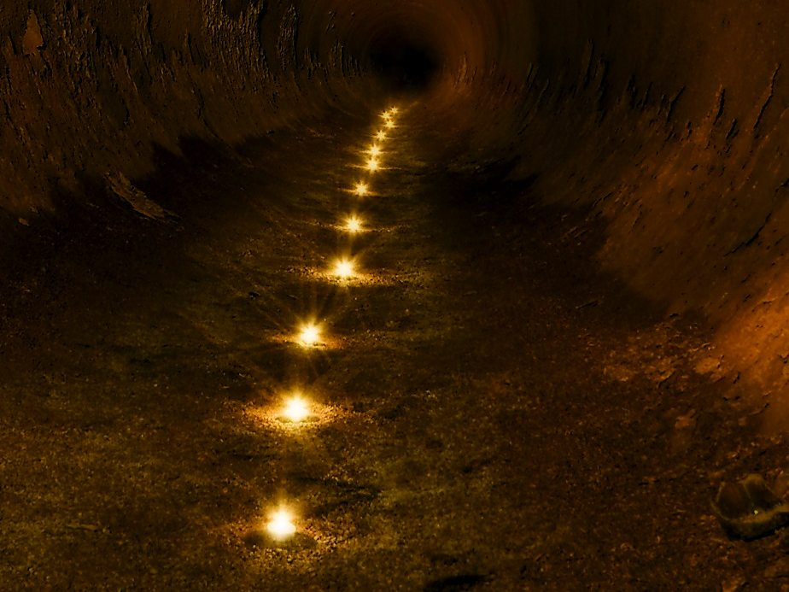
Beyond the standard model is dark.
Baryon asymmetry in the Universe
Dark matter
Hierarchy problem
…
“muon g-2 anomaly as a guiding light”
http://www.lastwordonnothing.com/

Slide 5
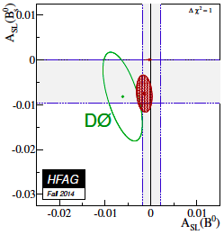

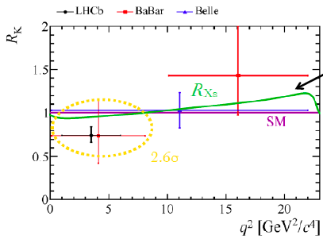
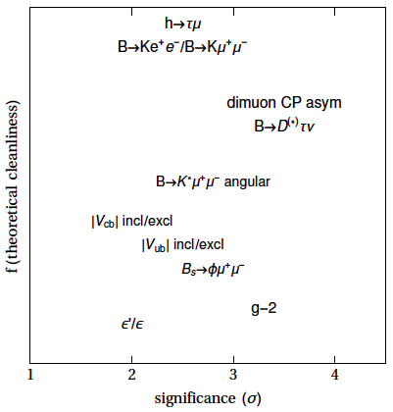
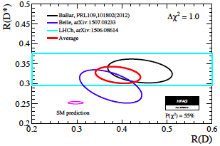
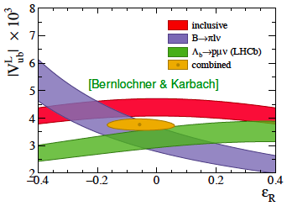
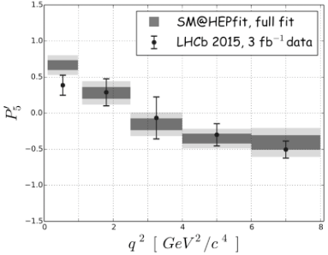
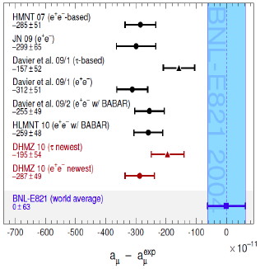
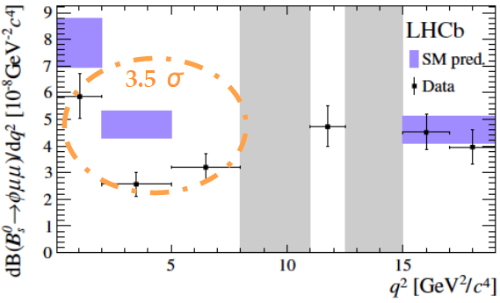
Flavour Anomalies
John Ellis, March 14, 2016 (Nagoya)
No worries
Wait & See
Serious?

Slide 6
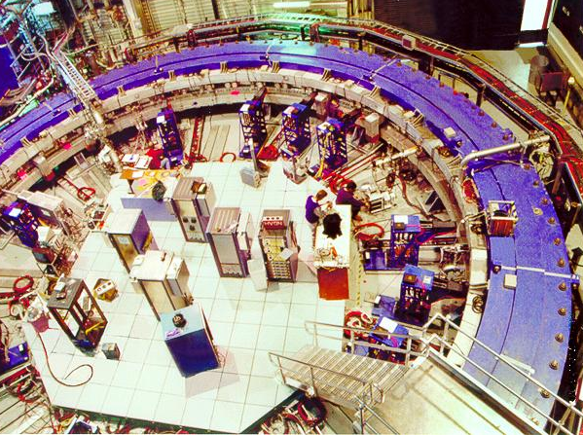
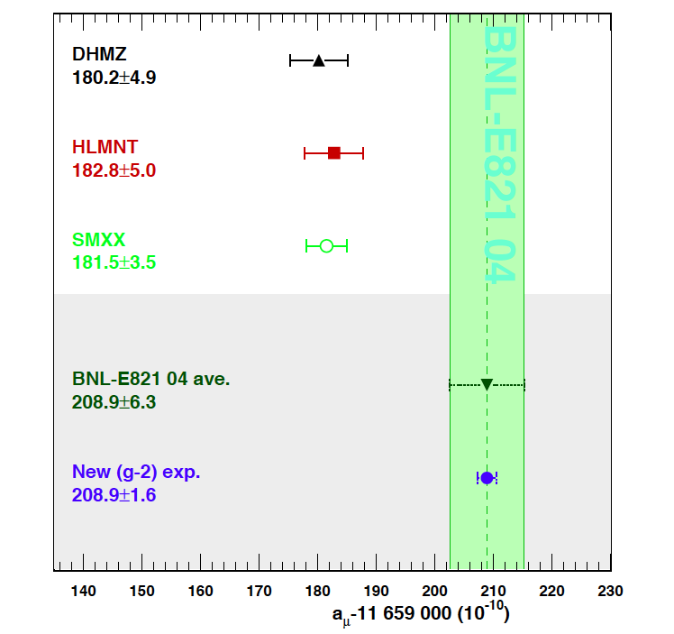
Muon anomalous magnetic moment (g-2)
Standard Model
2004
Experiment

Slide 7
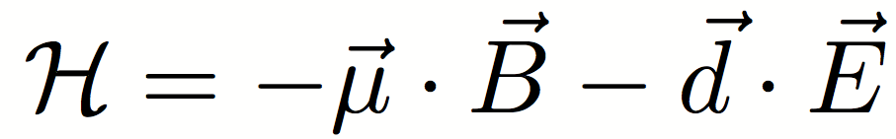
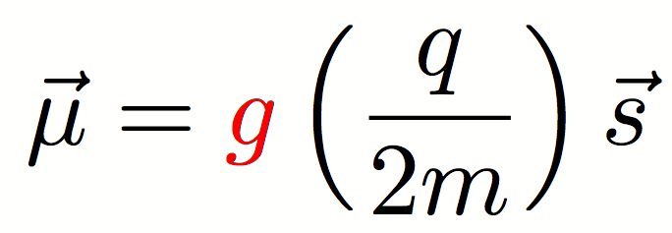
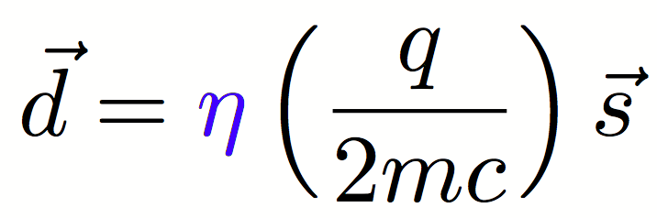
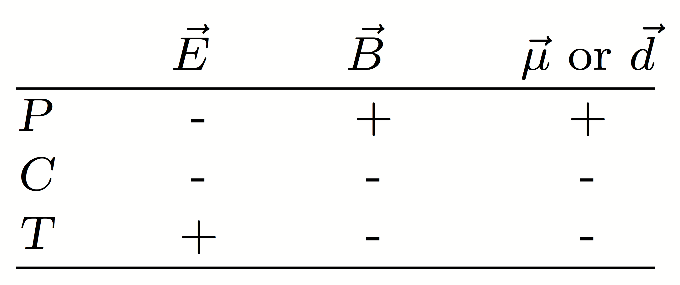
Particle dipole moments
P,C,T-even
P,T-odd (CP-odd)
Magnetic Dipole Moment
Electric Dipole Moment

Slide 8
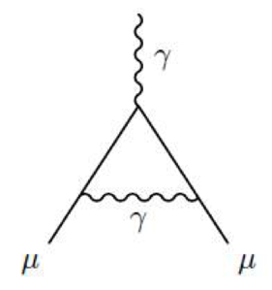
Anomalous magnetic moment
The Lande’s g factor is 2 in tree level (Dirac equation)
In quantum field theory, g factor gets corrections:
Anomalous magnetic moment
g = 2 ( 1 + a_{μ})

Slide 9
Anomalous magnetic moment
All interactions, including ones we don’t know,
appear in quantum loops, and add up to contribute a_{μ}

Slide 10
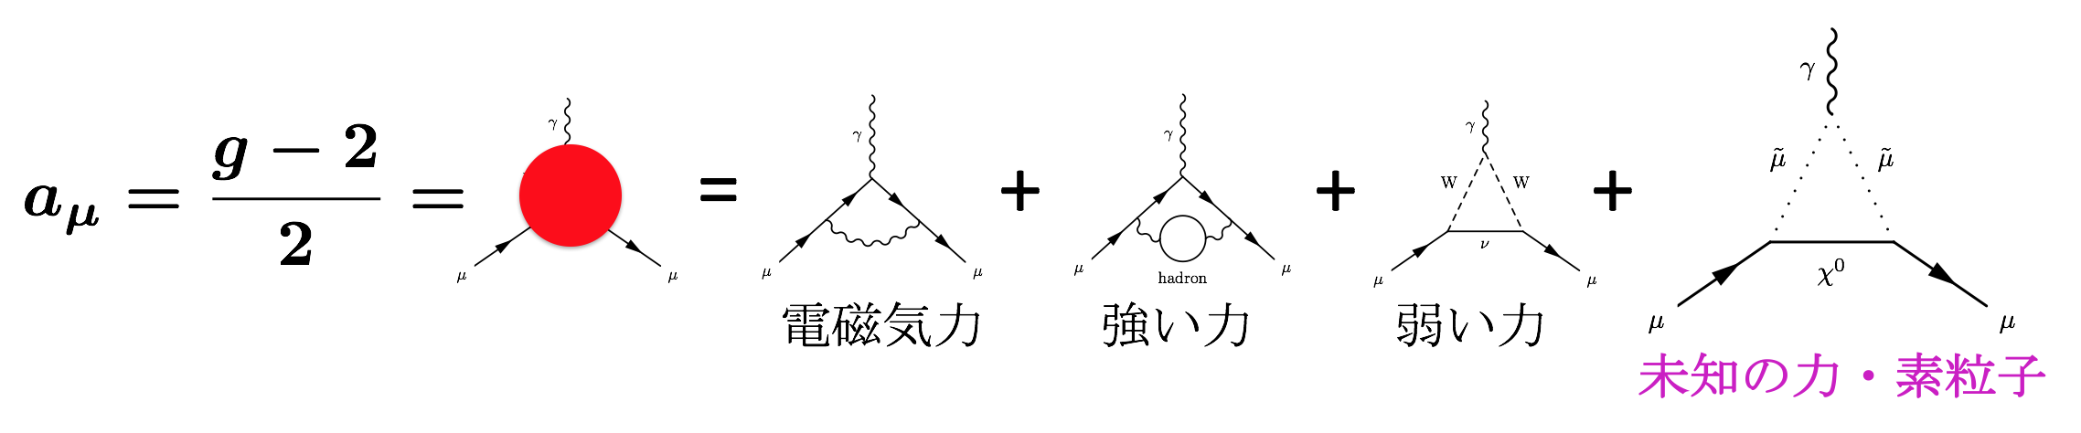
Anomalous magnetic moment
All interactions, including ones we don’t know,
appear in quantum loops, and add up to contribute a_{μ}

Slide 11
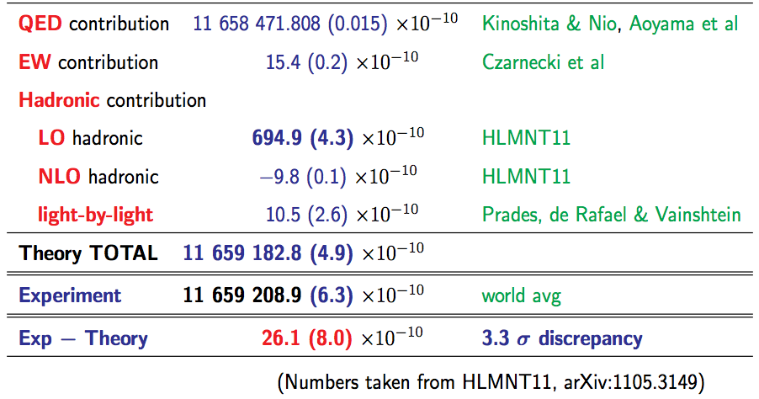
Comparison with experiments
D. Nomura (tau2012)
in consistent with
DHMZ10
〜BNL E821 (0.5ppm)
HLMNT11 : J.Phys.G38:085003,2011

Slide 13
“Muon g-2 theory initiative” formed in June 2017
“map out strategies for obtaining the best theoretical predictions for these hadronic corrections in advance of the experimental results”

Slide 14
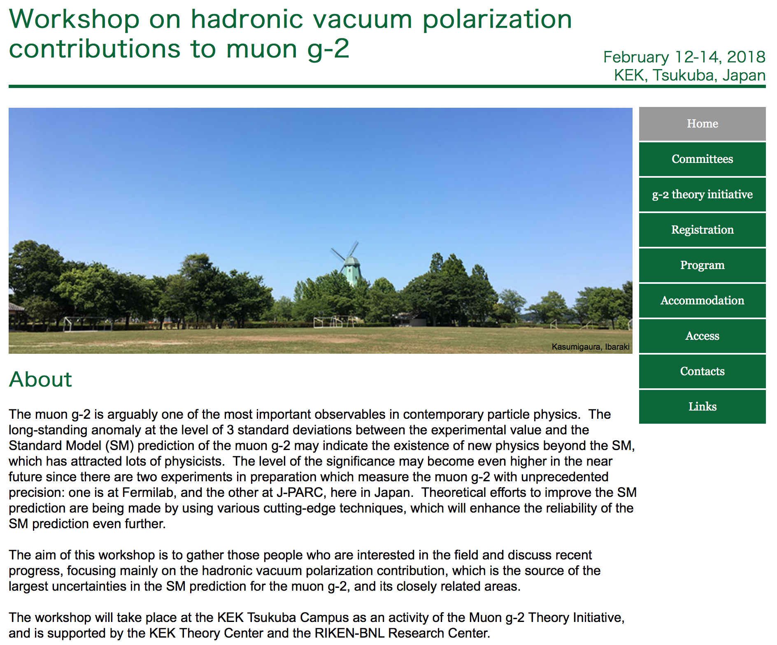
Workshop at KEK in Feb, 2018
http://www-conf.kek.jp/muonHVPws

Slide 15
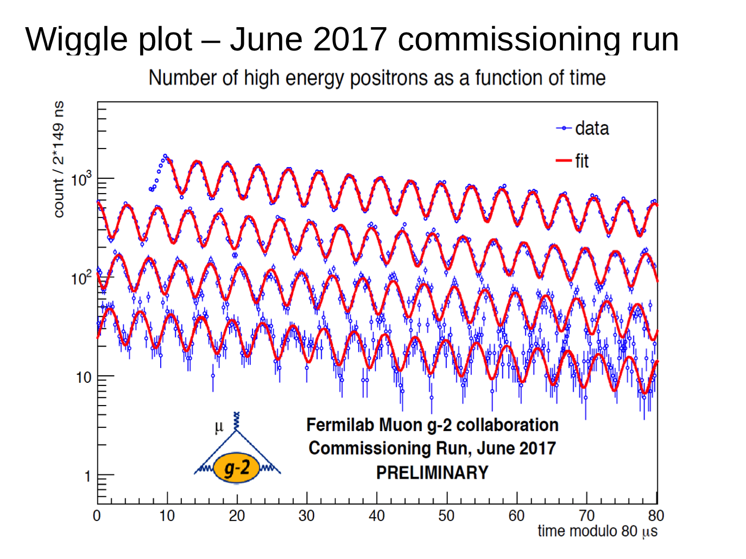
First wiggle plot at FNAL in June, 2017
FNAL g-2
Tim Gorringe (FCCP 2017)

Slide 16
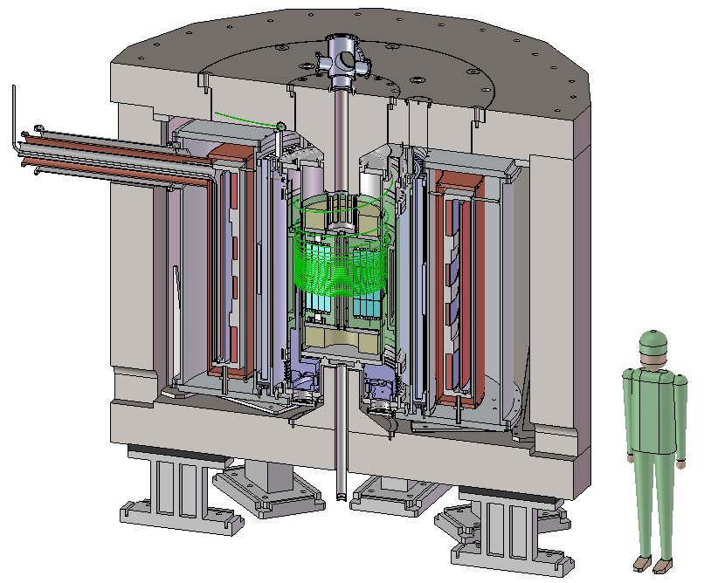
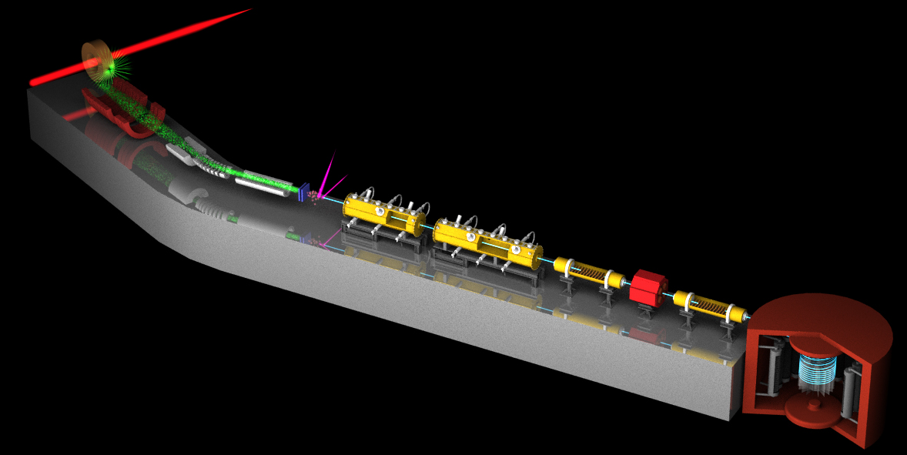
Muon g-2/EDM Experiment at
J-PARC with Ultra-Cold Muon Beam
Silicon
Tracker
3 GeV proton beam
( 333 uA)
Production target
(20 mm)
Surface muon beam
(28 MeV/c)
66 cm
Muonium Production
(300 K ~ 25 meV⇒2.3 keV/c)
Surface muon
Super Precision Storage Magnet
(3T, ~1ppm local precision)
Ultra Cold μ+ Source
Muon
storage
Features:
No strong focusing
Super-low emittance muon beam
Compact storage ring
Full tracking detector
Completely different from BNL/FNAL method
Muon LINAC (300 MeV/c)

Slide 17
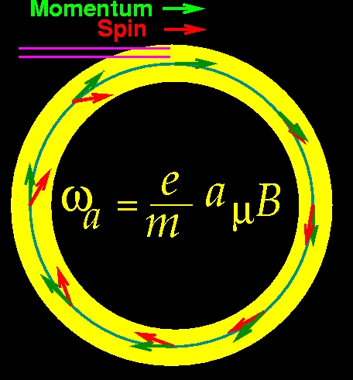
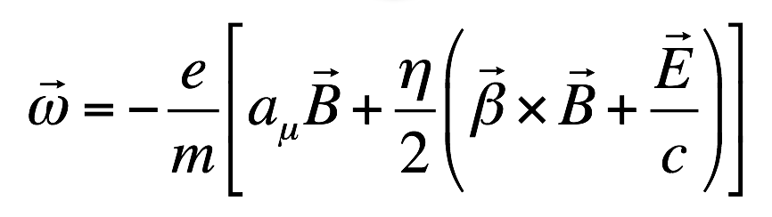
muon g-2 and EDM measurements
In uniform magnetic field, muon spin rotates ahead of momentum due to g-2 = 0
general form of spin precession vector:
BNL E821 approach
γ=30 (P=3 GeV/c)
J-PARC approach
E = 0 at any γ
FNAL E989
J-PARC E34

Slide 18
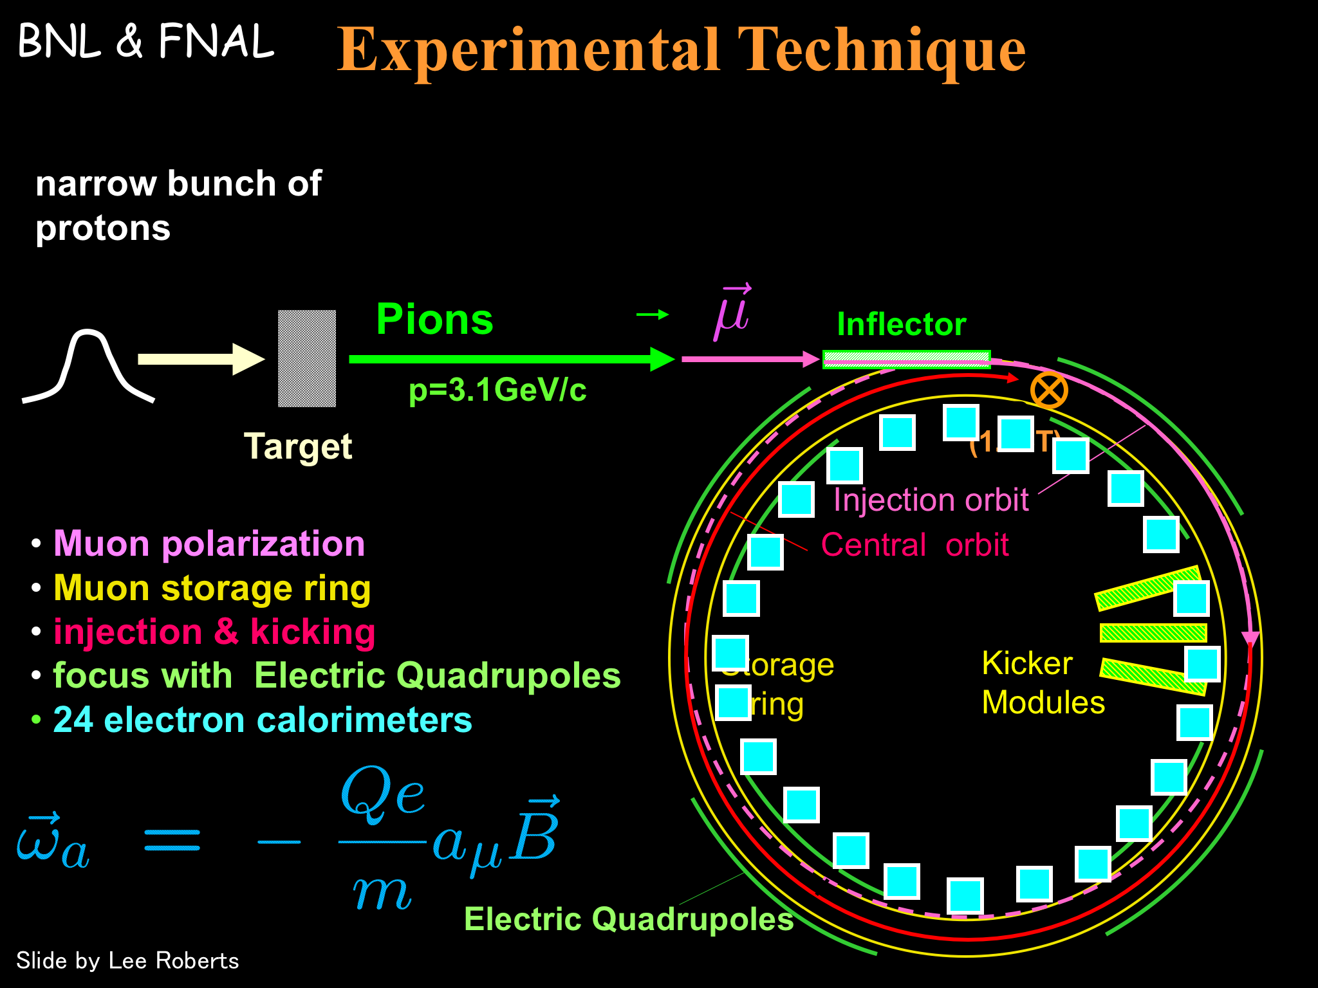

Slide 19
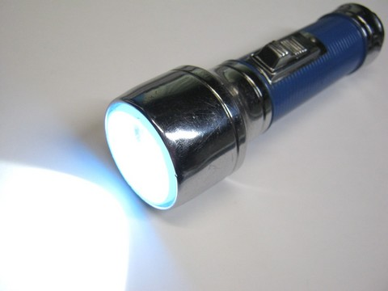
Muon beam at BNL/FNAL
Conventional muon beam
proton
π⁺
μ⁺
emittance
~1000π mm・mrad
pion
production
Strong focusing
Muon loss
BG π contamination
decay

Slide 20
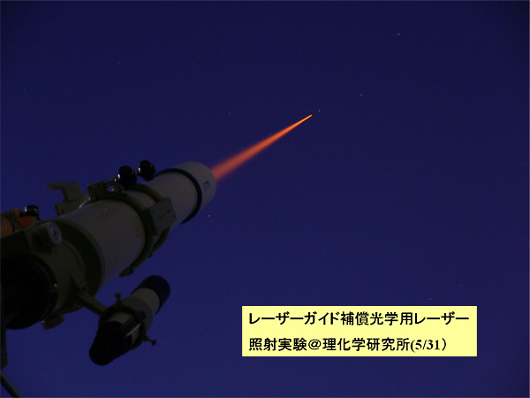
Muon beam at J-PARC
Conventional muon beam
proton
π⁺
μ⁺
emittance
~1000π mm・mrad
pion
production
Strong focusing
Muon loss
BG π contamination
decay
cooling
μ⁺
emittance
1π mm・mrad
Ultra-cold
muon beam
Free from any of these

Slide 21
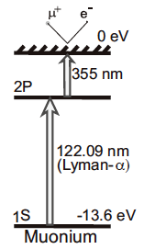
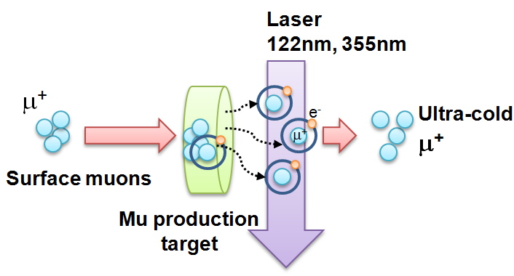
Ultra-cold Muon
Requirement for zero E-field:
Muons should be kept stored without E-focusing
→ Beam with ultra-small transverse dispersion,
i.e. Δp_{T}/p ~0
Laser resonant ionization of Mu (μ⁺e⁻)
re-acceleration
p =
28MeV/c
3 keV/c
300 MeV/c
Δp_{T}/p ~3 keV / 300 MeV =1E-5

Slide 22
Muonium production in vacuum
Target sample:
laser-ablated
silica aerogel
Data taken under
ambient B-field of
about 1.4 Gauss.
TRIUMF-S1249 data
(Online data)
TRIUMF-S1249 data
(Online data)

Slide 23
Experimental sequence
40ms (25 Hz)
Surface
muon beam
(28 MeV/c)
μ⁺
laser ionization
Mu
Thermal
muonium
(3keV/c)
~1μs
μ⁺
~1ns
Ultra-slow muon
(3keV/c)
μ⁺
~3ns
Acceleration + injection
(300 MeV/c)
40 μs
Storage and detection
(300 MeV/c)
μ⁺→e⁺

Slide 24
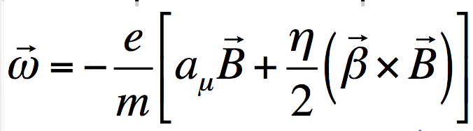
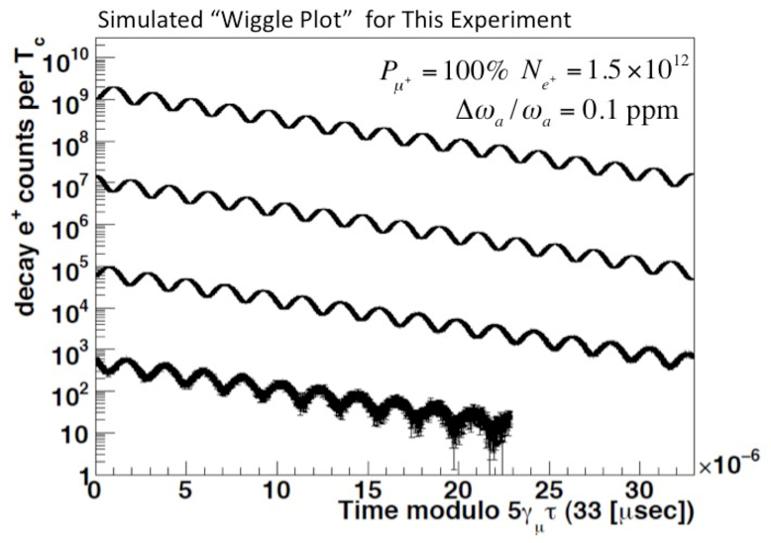
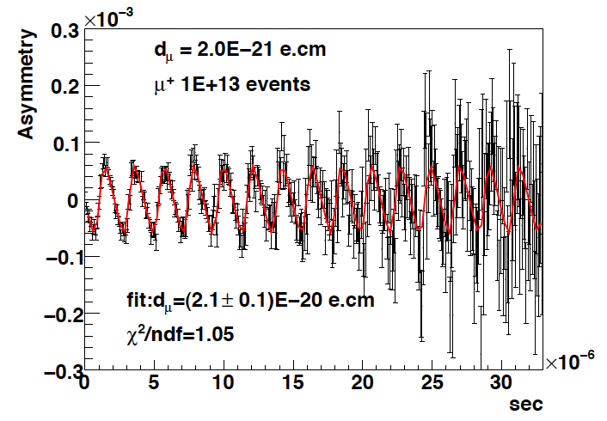
Expected time spectrum of e⁺ in μ→e⁺νν decay
p>200 MeV/c
d_{μ}=2E-20 e・cm
ω
number of e⁺
ω
Up-down asymmetry
∝EDM
e⁺ decay time (sec)
e⁺ decay time (sec)

Slide 25
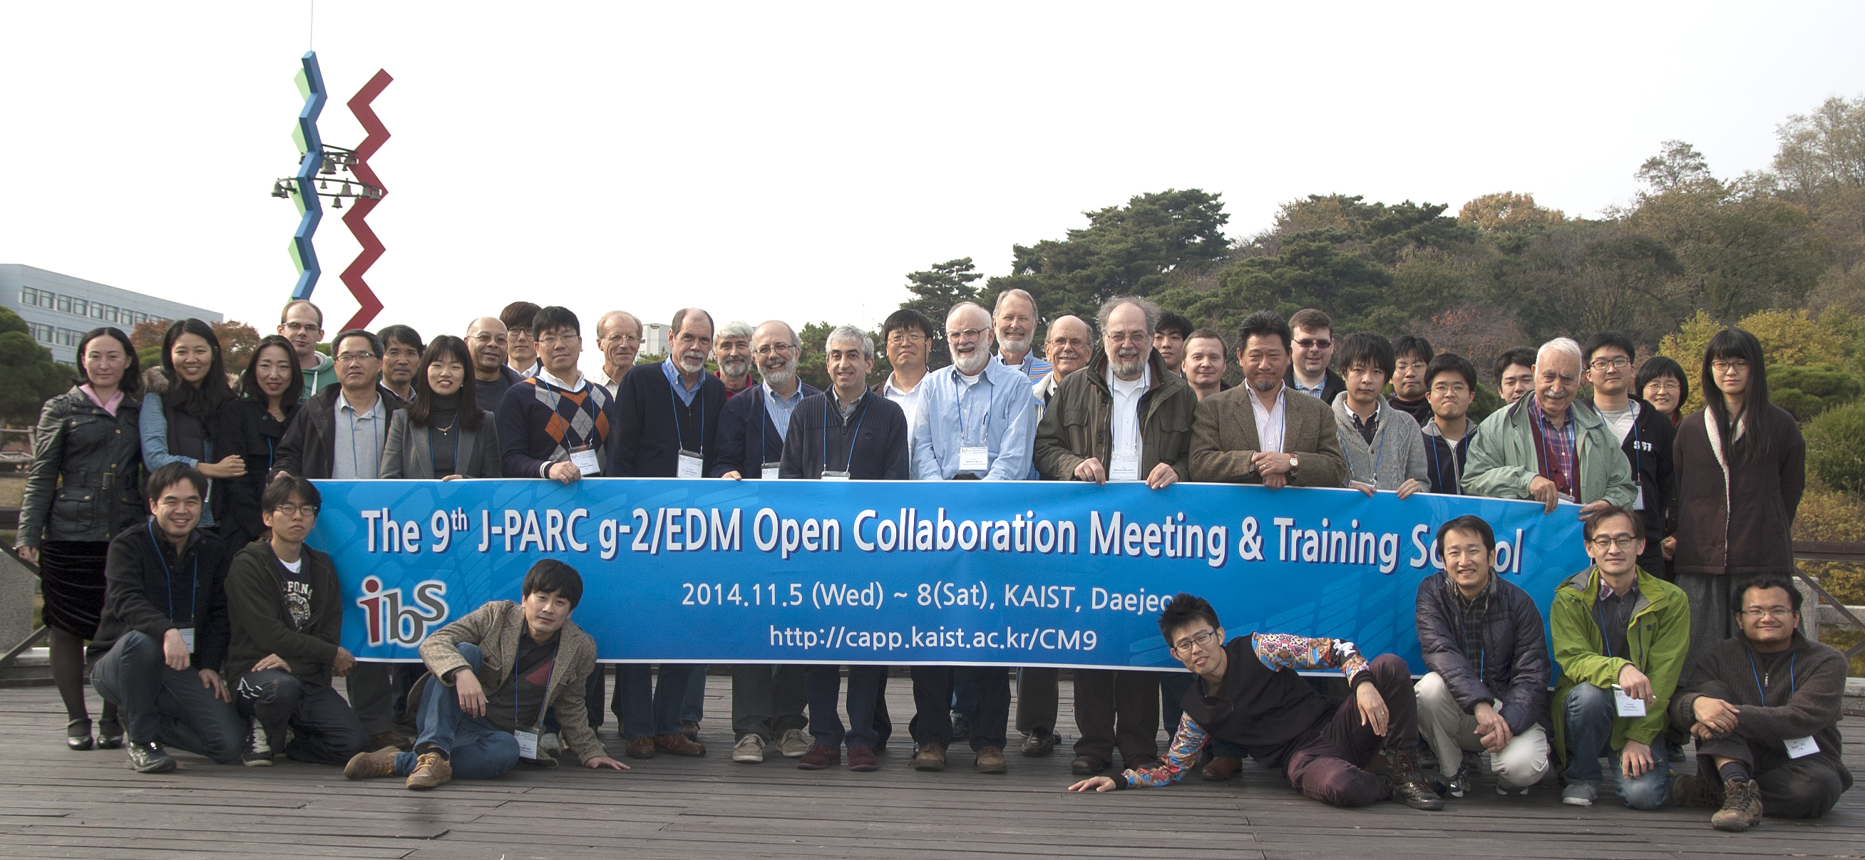
The collaboration
  Currently, 90 members from Canada, Czech, Germany, Japan, Korea, USA, France, Russia
  We look for new collaborators.

Slide 26
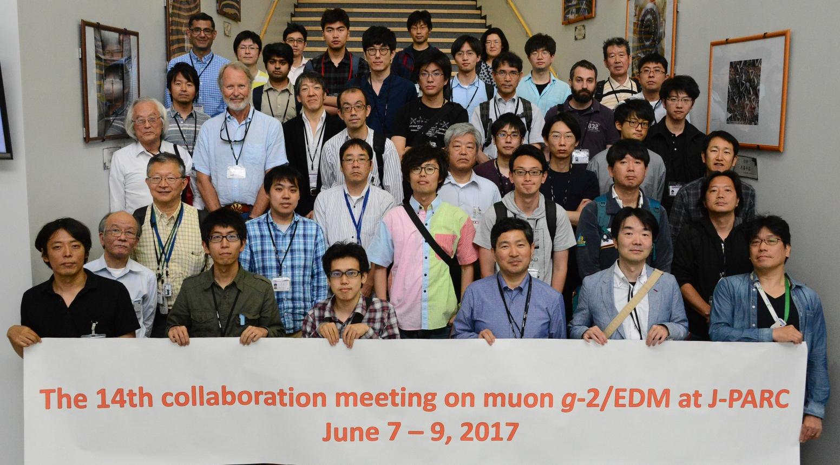
The collaboration
  Currently, 90 members from Canada, Czech, Germany, Japan, Korea, USA, France, Russia
  We look for new collaborators.

Slide 27
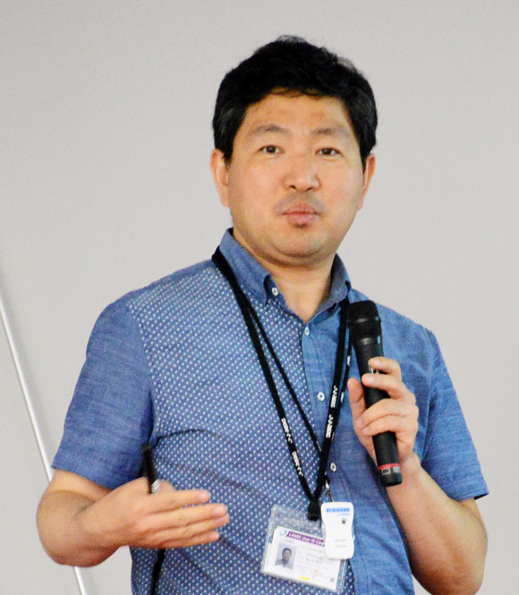
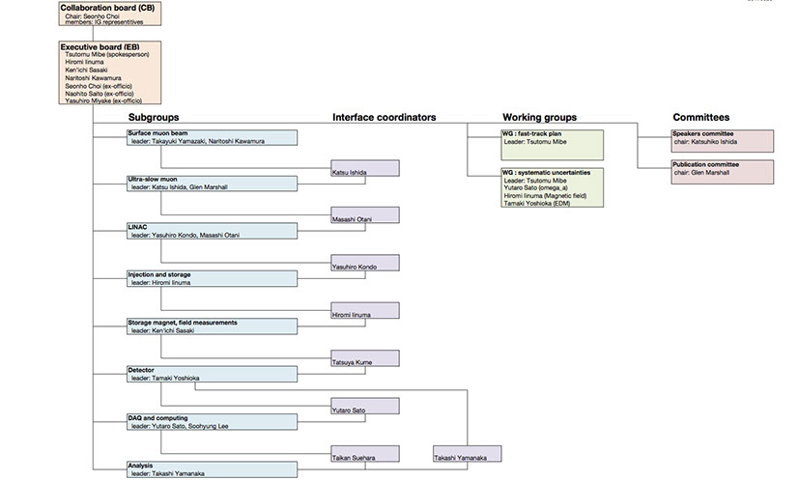
Organization
The collaboration chair
Prof. Seonho Choi (SNU)

Slide 28
Technical Design Report (2016)
TDR describes a technical design to achieve measurement of muon g-2 and EDM beyond BNL E821 precision.
  BNL E821 J-PARC E34
  g-2: 0.46 ppm → 0.37 ppm (→0.1ppm)
  EDM: 0.9 x 10⁻¹⁹ ecm → 1.3 x 10⁻²¹ ecm
prepared by 144 authors

Slide 29

TDR focused review (Nov 15-16,2016)
The reviewers including leaders of the BNL and FNAL g-2 all agree that
E34 is an exciting and valuable independent approach which should be done ASAP.
a result with the BNL sensitivity (E34 phase-I) would be a huge contribution to the field.

Slide 30
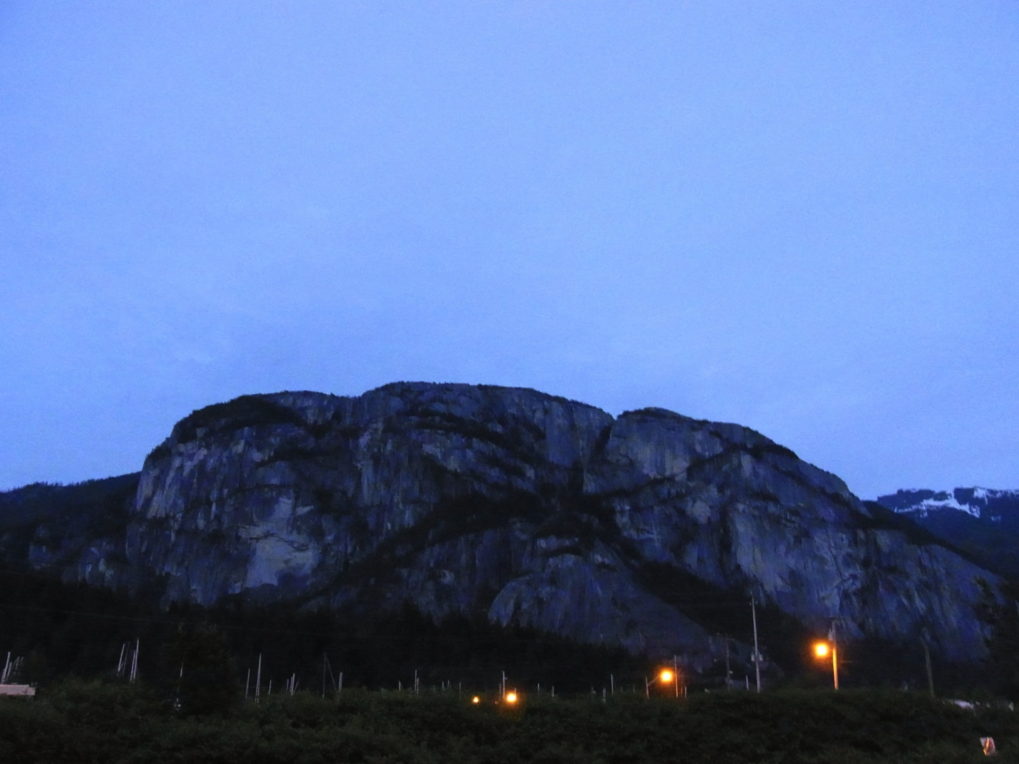
physics
data & results
construction
TDR
Squamish, BC (Canada)

Slide 31
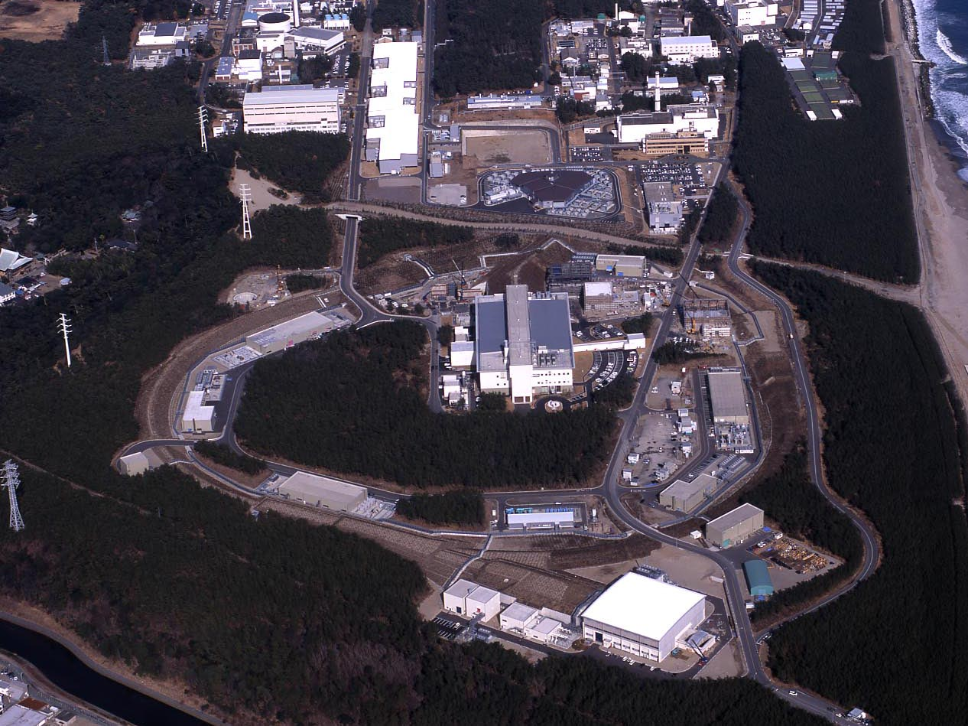
J-PARC Facility
(KEK/JAEA)
LINAC
3 GeV
Synchrotron
Neutrino Beam
To Kamioka
Material and Life Science
Facility
Main Ring
(30 GeV)
Hadron Hall
Bird’s eye photo in Feb. 2008

Slide 32
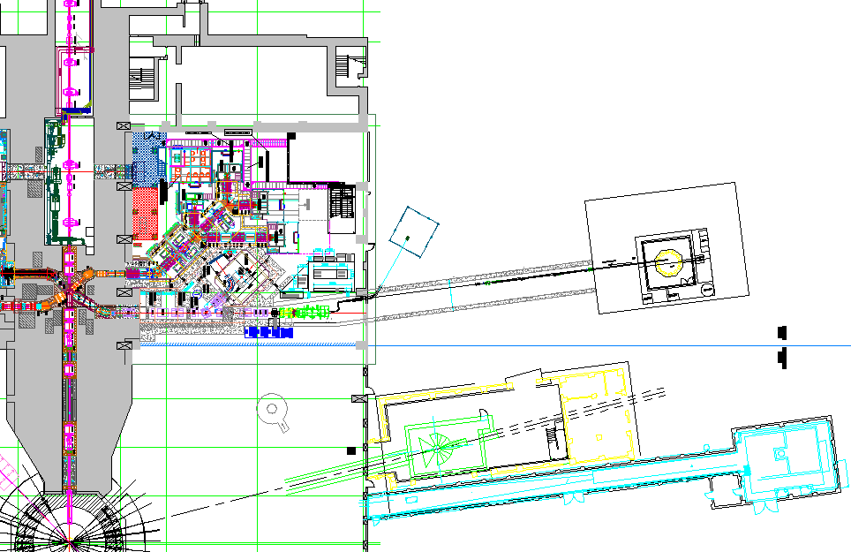
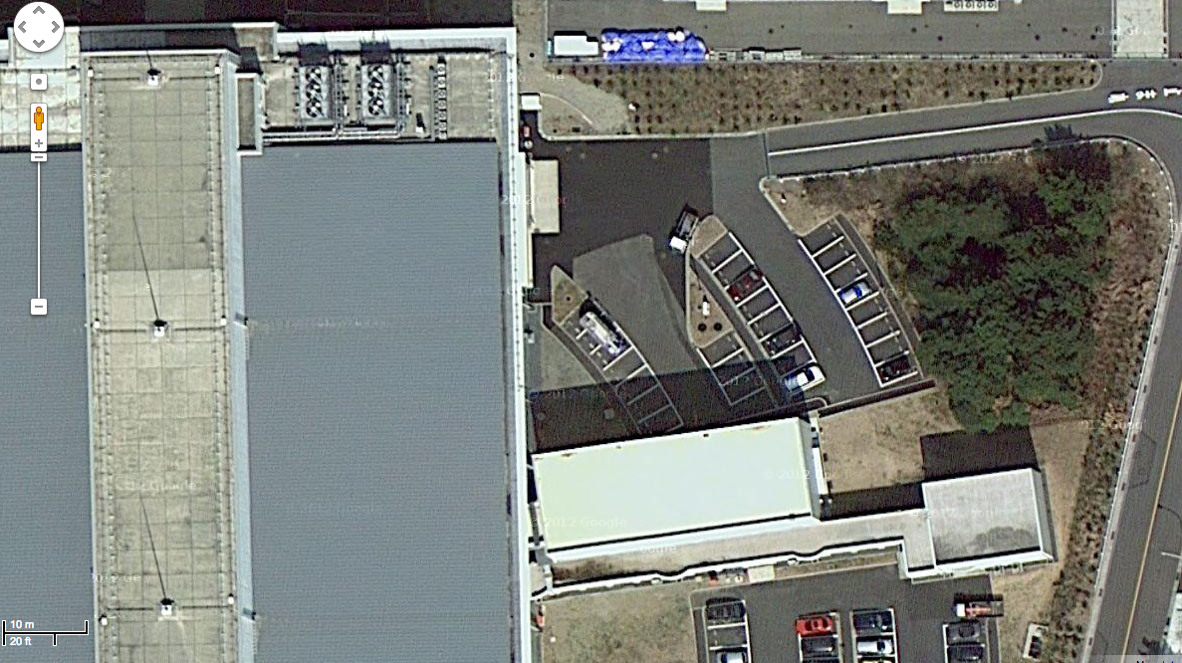
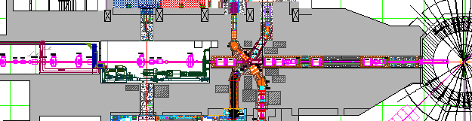
Proposed experimental site
Material and Life science Facility in J-PARC
Parking lot
g-2/EDM
storage magnet
H-Line
muon linac
muon
production
target
MuSEUM
DeeMe
sparation neutron
source

Slide 33
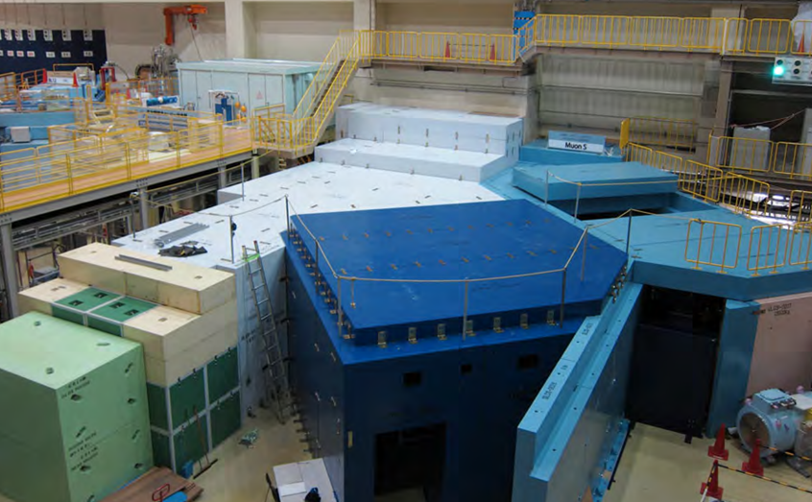
surface muon
branch
mu LINAC
MuSEUM (Mu-HFS, μ_{μ}/μ_{p})
DeeMe (mu-e conv.)

Slide 34
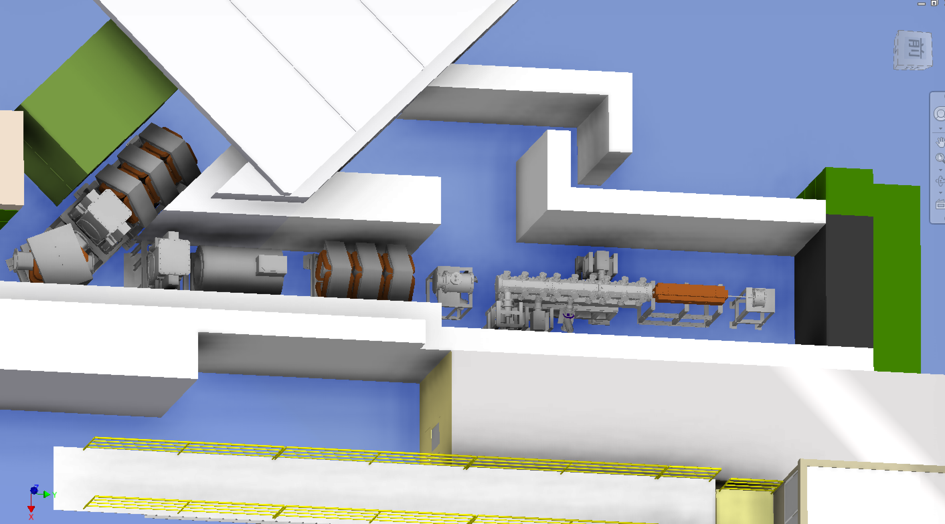
Ultra-cold muon beam at H-line
Design of H-line and the muon acceleration test
Surface muon beam
(4 MeV, ~1000π mm mrad)
1 m
blocker
Accelerated muon beam
(25meV→40 MeV, 1.5π mm mrad)
blocker
Mu
production
Bending
Magnet
Beam
Blocker
Solenoid
Initial
accel.
Beam
Profile Monitor
Q-magnet
RFQ
IH DAW
Laser room

Slide 35
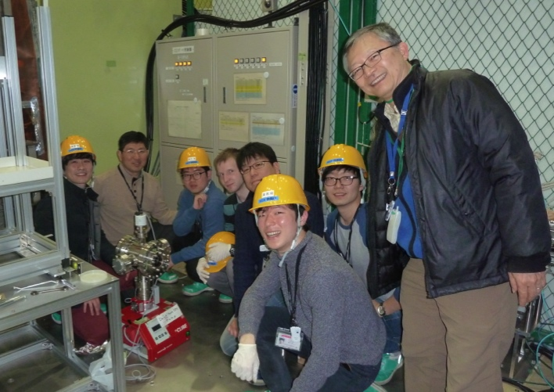
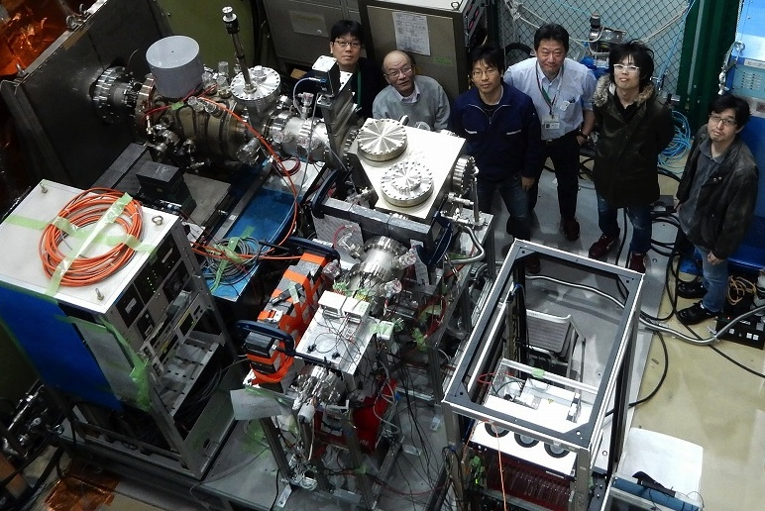
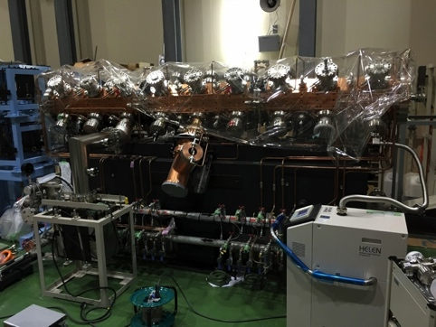
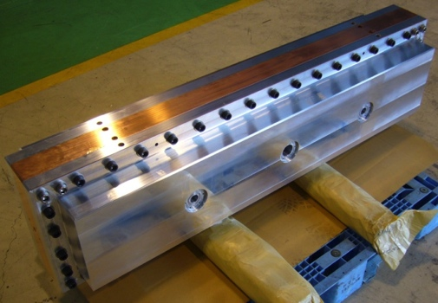
Ultra-cold muon beam at H-line
Design of H-line and the muon acceleration test
PTEP 091C01 (2014)
PTEP 103C01 (2013)
1 m
Mu production target test
BPM test
Surface muon beam
(4 MeV, ~1000π mm mrad)
1 m
blocker
Accelerated muon beam
(25meV→40 MeV, 1.5π mm mrad)
blocker
Mu production
Bending
magnet
ビーム
シャッター
ソレノイド
Initial
accel.
Beam
Profile
Monitor
四重極磁石
RFQ
IH DAW
M. Otani et al., Phys. Rev. Accel. Beams 19, 040101 (2016)
レーザー室
Electro static acceleration
IH-type DTL
J-PARC proton RFQ test

Slide 36
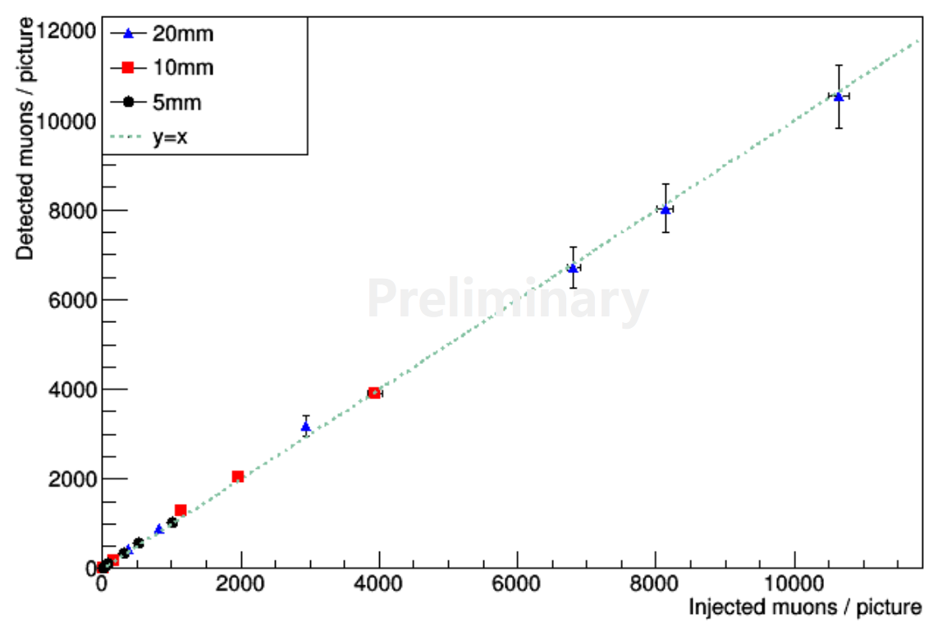
Preparation for muon acceleration test
Development of low energy muon source for muon acceleration test (2015B, 2016AB)
Test of beam profile monitor for low energy muon(2015B)
KEK-JAEA-U.Tokyo
SNU-KEK-BINP
TOF distribution of slow muon
Linearity of the BPM
Data
Feb. 2016
#event
300
Muon (7 keV)
Preliminary
Measured intensity
Simulation
#event
300
Proton
0
1
2
3
μs
muons injected

Slide 37


Muon acceleration test with RFQ
Input beam and BPM characterized by previous test experiments
Being assembled and tested at the LINAC assembly area.
Beam time (6 days) is scheduled in November, 2017
RFQ
5.6 keV
Q
Bend
μ+/Mu⁻ beam
100 keV
BPM
(to be installed)
Photo by R. Kitamura
Photo by M. Otani

Slide 38


Muon beam injection and storage
Horizontal injection + kicker
(BNL E821, FNAL E989)
3D spiral injection + kicker
(J-PARC E34)
Injection efficiency : 3-5%(*)
(*) PRD73,072003 (2006)
Injection efficiency : ~90%
A paper was submitted to NIMA in Oct 2015
by H. Iinuma et al.

Slide 39

Spiral Injection Test Experiment with low-energy electron beam
Injection angle was changed from 47 to 44 deg.
Beam track
Mirror
Reflection from
chamber wall
Injection hole
Master thesis, M. A. Rehman (2017)

Slide 40
Muon storage magnet and detector
Iron yoke
Cryogenics
Muon storage orbit
2900 mm
e+ tracking
detector
Super conducting coils

Slide 41




B-field shimming test with a medical MRI magnet (1.7 T) at J-PARC
From PAC20 report
Slide by K. Sasaki
Measurements in April, 2015

Slide 42


Cross calibration of B-field probes
MRI magnet at ANL
The NMR probes (J-PARC E34, FNAL E989)
J-PARC E34
FNAL E989
Supported by
US-Japan corporative
research program
Photo by S. Seo

Slide 43


Positron tracking detector
A tracking detector ( vs. calorimeter)
  Robust against pileups
Partial funding available to construct a part of detector system
First working test module
tested with muon beam (June 2017)
KEK
Mechanical
Engineering
Center

Slide 44
Experimental determination of a_{μ}
a_{μ} = (g-2)/2
ω_{a} : anomalous spin precession frequency
ω_{p} : proton’s Lamor precession frequency
Present : 0.54ppm (BNL)
→ 140ppb
(FNAL/J-PARC goal)
(→400ppb
(J-PARC phase-I))
Present uncertainty ~ 0.12ppm (LANL)
→ 60ppb (MuSEUM goal)

Slide 45

See you all at CM15
Dec 11-14, 2017 in Kyushu

Slide 46

See you all at CM15
Dec 11-14, 2017 in Kyushu

Slide 47
Summary
We aim to measure muon g-2 and EDM with ultra-cold muon beam at J-PARC.
  An independent measurement
R&D phase is ending.
Construction phase is starting.
Further information
  http://g-2.kek.jp

Slide 48
Comparison of experiments
 | BNL E821 | J-PARC E34
muon momentum | 3.09 GeV/c | 0.3 GeV/c
storage ring radius | 7 m | 0.33 m
storage field | 1.5 T | 3.0 T
focusing field (n-index) | 0.14 (electric) | 1.5 E-4 (magnetic)
average field uniformity | ≈1 ppm | << 1ppm
(local uniformity) | ≈50 ppm | ≈1ppm
Injection | inflector + kick | spiral + kick
Injection efficiency | 3-5% | 80%
muon spin reversal | -- | pulse-to-pulse
positron measurement | calorimeters | tracking
positron acceptance* | 65% | ≈100%
muon polarization | ≈100% | ≈50%
events to 0.46 ppm | 9 x 10⁹ | 5 x 10¹¹
* in the energy region of interest

Slide 49

Muon beam intensity
1MW, SiC target are assumed.

Slide 50

Expected statistical sensitivities

Slide 51
Systematic uncertainties on ω_{a}
Source of errors | design
Pile up | <50ppb | Estimated from detector shaping time TDR Fig.10.28
Timing shifts | <<100ppb | Test in kicker field
E-field | <10ppb | Design sensitivity of E-field monitor 1mV/cm
Pitch effect | <10ppb | Estimated by spin tracking of storage beam in very weak field
CBO | <<100ppb | Studied with beam simulation Improved spin flip and spiral injection
Track reconstruction | <<100ppb | Efficiency change within g-2 period
Others |  | B-field change, imperfect injection, vertical beam size, …
Total | <0.07

Slide 52
Systematic uncertainties on ω_{p}
Source of errors | expect
Absolute calibration of standard probe | 25ppb | 18ppb resolution & temperature measurement 10ppb & diamagnetic field shielding 2.5ppb & material uncertainties ~9ppb
Calibration of trolley probe | ~20ppb | Field gradient 0.2ppm/mm@r=400mm, position accuracy 0.1mm
Btot = Bmain + Bweak (in weak field) | 48ppb⊕TBD(=18ppb⊕45ppb⊕TBD) | Resolution >18ppb because of field gradient 45ppb=450ppb/mm*±0.1mm
Uncertainty from the muon distribution | TBD | Trace back resolution for single track is 1mm in radial, ΔB/Δz ~30ppb/5mm
Field decay measured by fixed probes | <100ppb | To be evaluated with test magnet
Total systematic error on B | _{<115ppb} _{⊕TBD}

Slide 53


Contribution from new physics
Slide by M. Endo
(dark photon)

Slide 54
Contributions to g-2
Contributions to lepton g-2 can be written as
C_{x} : Coupling strength
Λ : Mass Scale
lepton
X
lepton
Much larger contributions
to muon than electron.
True for new physics sensitivity too
Even larger for tau, but difficult to measure.

Slide 55
TDR focused review (Nov 15-16,2016)
#*
#* (spokesperson)
#
#*
#
# BNL-E821
* FNAL-E989
Gerry Bunce # (program manager)

Slide 56





Muonium production
RIKEN, TRIUMF, UVic,
Chiba, Korea U, KEK
Mu production target
(laser-ablated silica aerogel)
3x10⁸/sec
9x10⁵/sec
G. Beer et al., Prog.Theor.Exp.Phys. (2014)091C01
Laser timing
ε(surface μ→ Mu) = 3.8E-3
Simulation
in J-PARC condition
double pulses
(0.6 μs interval,25Hz)
G. Marshall
Elapsed time
1st pulse 2nd pulse

Slide 57


End-to-end simulation
Beam acceleration and transport were simulated from ultra-slow muon source to the exit of muon LINAC.
Emittance evolution
Y. Kondo
Emittance growth was not significant.
Meets the requirements for muon injection.
RFQ
IH
DAW
DLS
(Due to Inappropriate matching)

Slide 58

Spiral Injection Test Experiment(SITE) setup
Comparison of Parameters between
E34 and SITE
Storage Magnet
83 gauss
Parameters | E34 | SITE
Storage magnet field strength | 3-T | 0.0083 T
Field uniformity | 1 ppm | 100 ppm
Magnet type | Super conducting | Normal conducting
Particle specie | μ⁺ | e⁻
Momentum | 300[MeV/c] | 0.296[MeV/c]
Cyclotron period | 7.4 nsec | 5.0 nsec
Storage orbit diameter | 0.66 m | 0.24 m
Electron Gun
80 keV
e⁻
2 m long
beam line
KEK LINAC klystron gallery, north end of sector 5
Slide by M. A. Rehman

Slide 59


Construction of Silicon strip tracker in progress
(Kyushu Univ./KEK-IPNS)

