Slide 1
Precise Measurement of Muonium HFS
-MuSEUM-
K.Shimomura
KEK IMSS/J-PARC

Slide 2














MuSEUM Collaboration
Y. Fukao, Y. Ikedo, T.Ito, R. Kadono, N. Kawamura, A.Koda, K. M. Kojima, T. Mibe, Y. Miyake,
K. Nagamine, K. Nishiyama, T. Ogitsu, N. Saito,
K. Sasaki, Y. Sato K. Shimomura, P. Strasser,
A. Toyoda, K. Ueno, H. Yamaguchi,
A. Yamamoto, M. Yoshida
K. Ishida,
M. Iwasaki,
O. Kamigaito,
S. Kanda,
Y. Higashi, T. Higuchi, Y. Matsuda, T. Mizutani, S. Nishimura, S. Seo, T. Tanaka,
H. A. Torii, Y. Ueno, D. Yagi
H.M Shimizu
M. Kitaguchi
K. Kawagoe, J.Tojo, T. Yoshioka, T. Suehara
T. Yamanaka, M. Matama, T. Ito, Y. Tsutsumi
K. S. Tanaka
M. Aoki,
D. Tomono
E. Torikai
D. Kawall
K. Kubo
S. Choi
H. Iinuma

Slide 3
Contents
What is muonium ?
Physics motivation of precise measurement of HFS
Overview of Experiment at J-PARC MUSE
Experimental results for zero field measurement
R &D for High field measurement

Slide 4
Bibliography
Classical Electrodynamics Jackson
Quantum Mechanics Messiah
Story of Spin Tomonaga
Quantum Field Theory Itzykson and Zuber
All are very classic, but useful !
Or Greiner (QM, RQM, QED, EW)
Landaw Lifsitz

Slide 5
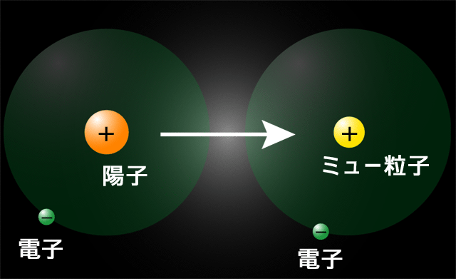
Muonium
Ｈｙｄｒｏｇｅｎ
Ｍｕｏｎｉｕｍ
Proton
Positive Muon
Electron
Electron
Pure leptonic bound system, free from finite size effect.
Good example for testing QED,
HFS,1s-2s, Lamb shift
Muonium is also useful in condensed matter physics and chemistry

Slide 6
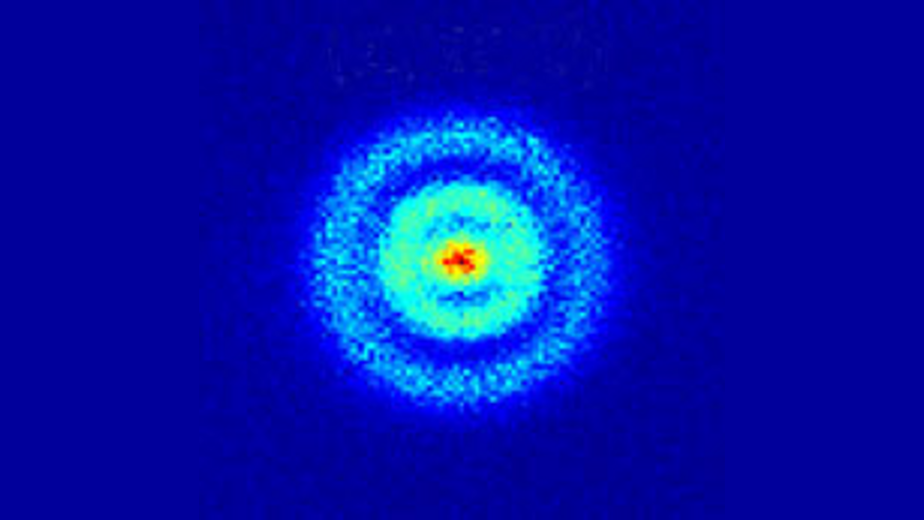
Quantum View of Hydrogen Atom
Electron Cloud

Slide 7
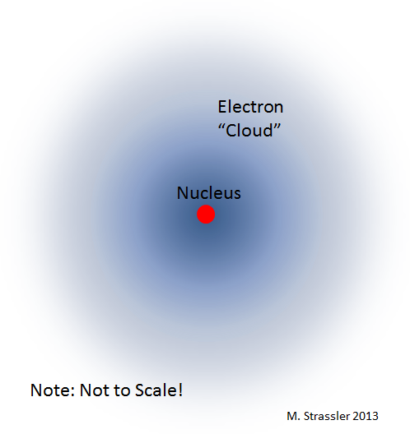
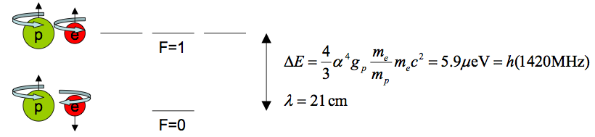
Hyperfine Structure
Dipole –Dipole term
Fermi contact term
For s-wave states, only the Fermi contact term contributes to hyperfine splitting

Slide 8
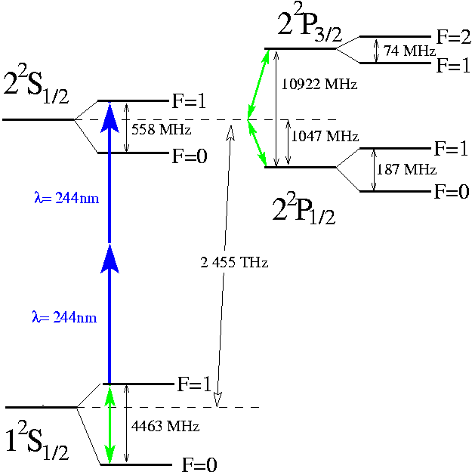

Mu(H) Energy Diagram
Fine Structure
explained by Dirac
Classical Lamb Shift
QED
Tomonaga, Shwinger,
Feynman
Not included QED weak hadronic correction

Slide 9
How to explain ?
Hyperfine structure
Classical electrodynamics
+Quantum Mechanics
Fine structure
Dirac Theory
Lamb Shift
Quantum electrodynamics
Of course higher precision calculations require more sophisticated methods.

Slide 10
Experiment

Slide 11
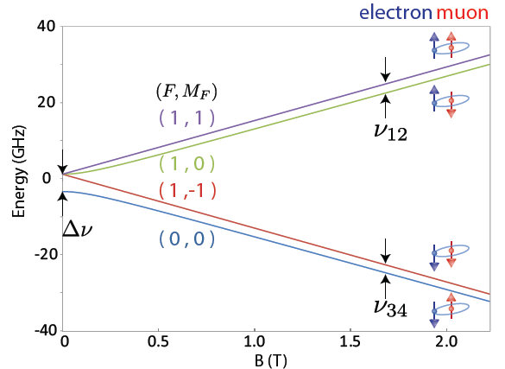
Mu Hyperfine Structure
Δν_{HFS}: Mu Hyperfine Structure
Zeeman Splitting
e⁻
μ⁺
4463 MHz
HF
e⁻
μ⁺
ZF
Pure leptonic system
(No composite particle)
ν₁₂+ν₃₄=Δν_{HFS}
ν₁₂−ν₃₄ ∝ μ_{μ}/μ_{p}

Slide 13
1. The most precise test to the bound QED
ν_{HFS}(exp) 4463.302 765(53) MHz (12 ppb]) LAMPF1999
μ_{μ}/μ_{p}=3.18334524(37) (120ppb)
m_{μ}/m_{e}=206.768277(24) (120ppb)
ν_{HFS}(theory) 4463.302 891 (272) MHz (63 ppb) D. Nomura (2013)
ν_{HFS}(QED) 4463.302 720 (253) (98) (3) MHz(m_{μ}/m_{e}) (QED) (α)
ν_{HFS}(weak) -65Hz
ν_{HFS}(had v.p) 232(1) Hz
ν_{HFS}(had. h.o) 5Hz
QED calculation →Effort for 10 Hz is in progress by Eides et al.
Phys Rev A: 86, 024501 (2012), PRL.. 112, 173004 (2014), Phys. Rev. D 89, 014034 (2014)

Slide 14
2. Strong relationship to muon g-2 measurem
g-2 E821(BNL) 0.5ppm 3~4σ deviation
-measurement of the deviation of muon spin direction(ω_{s})
and muon momentum direction(ω_{c}) ω_{a}∝(g-2)/2=a_{μ}
-The ratio to proton NMR frequency is important!
μ_{μ}/μ_{p} accuracy from direct measurement 120ppb
W. Liu et al., Phys. Rev. Lett. 82, 711 (1999).
θ
a_{μ} an ιndependent precise muon mass measurement is required
⇒
From g-2 strage ring
From Muonium HFS

Slide 15
How to improve the accuracy of μ_{μ}/μ_{p}?
Comparison between theoretical and experimental value of Δν
＋higher order
where, recoil term 800kHz(120ppm) and so on are included.
R∞＝10973731.568639(91)m⁻¹(0.09ppt)
（Ｃｓ atomic beam interferometory）
α⁻¹=137.03599958(52) (3.8ppb)
（from electron g-2）
m_{μ}/m_{e}=206.7682670(55) (27ppb), μ_{μ}/μ_{p}=3.183345396(94) (30ppb)
This value is used for the determination of g-2.

Slide 18
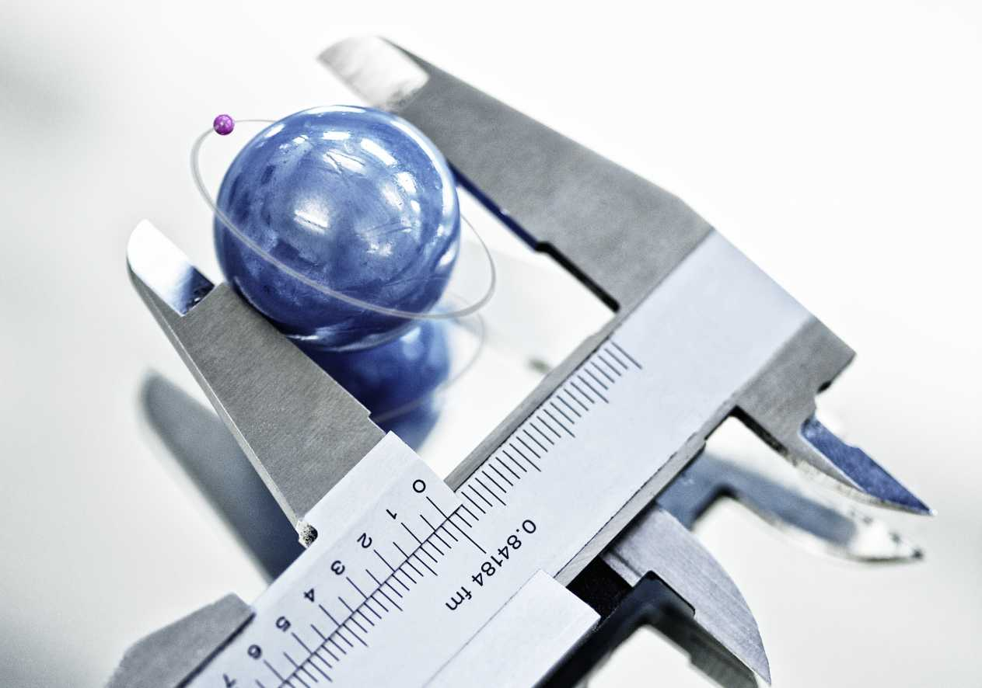
Proton radius puzzle

Slide 19
Anomaly between scattering and spectroscopy
Measurements of the proton radius:
By Randolf Pohl’ s slide
Muon atom spectroscopy
Electron scattering
0.8409 ±0.004
0.8770 ±0.0045
7.9 sigma discrepancy between the spectroscopy and scattering data with electron/positron
Anomaly appears at least H and D and low Z material, but C is insensitive in the old results. Low Z material is a key to measure nuclear radius.
Notes:
The measured value of the proton rms charge radius from muonic hydrogen μ p is 10 times more accurate, but 4% smaller than the value from both hydrogen spectroscopy and elastic electron proton scattering.
There exists a 7.9σ discrepancy between electronic (ep atomic and ep scattering)
and muonic extractions of the proton radius.

Slide 20
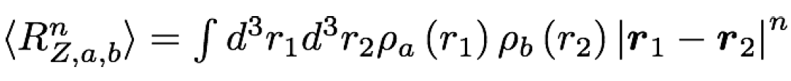
3. On proton radius puzzle
Muonic hydrogen Lamb shift measurement* results 7 σ difference from CODATA on proton radius. Related on this subject, Mu HFS measurement contributes several insights.
*R. Pohl et al., Nature 466,23(2010)
・Proton Zemach radius
can be obtained comparison of muonium HFS and hydrogen HFS*.
*SJ. Brodsy et al., PRL.. 94, 022001 (2005),

Slide 21

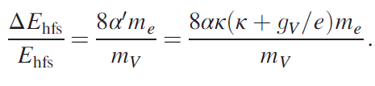
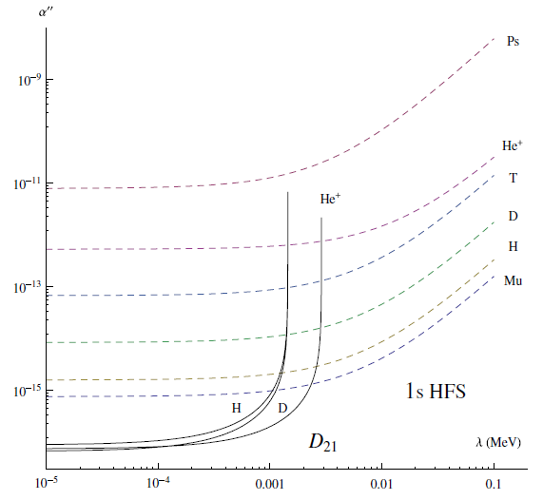
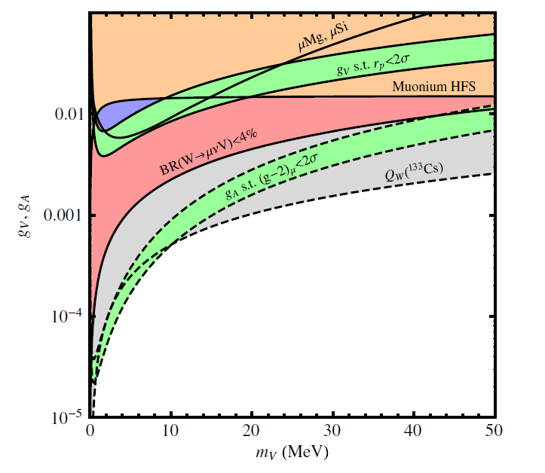
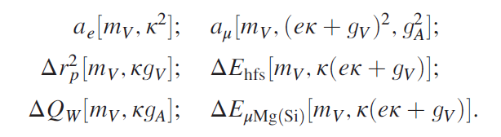
4. Exotic particle search
a pseudo vector boson
a massive vector boson
Fig. 2 on PRL 104, 220406 (2010)
Fig. 6 on PRD90, 073004(2014).
S. G. Karshenboim et al., PRL 104, 220406 (2010), PRD82, 113013(2010).
PRA 84, 064502(2011) , PRD90, 073004(2014).

Slide 22
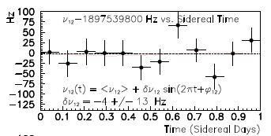
5. Test of Loentz symmetry
CPT broken Theory⇒Lorentz symmetry is broken
R.Blihm, V.A. Kosteleky and C.D. Lane PRL84,1098(2000)
V.W. Hughs et al. PRL87,111804(2000
CPT violation search
Ex., Muon difference g_{μ+} /g_{μ-} 10⁻⁸
g_{μ}-2/MuHFS precise measurement
Lorentz symmetry violating term in SME Lagrangian b
Corresponding MuHFS Δν_{12/34}
These value might change in sidereal time
(23h56m)
~
b₃^{μ}/π=-δΔν₁₂=δΔν₃₄
LAMPF Exp. Figure of Merit
Plank scale sensitivity
m_{μ}/M_{P}～10⁻²⁰
Laboratory tests of Lorentz and CPT symmetry w/ muons
A.H. Gomes et. al., Phys.Rev.D90:076009,2014

Slide 23
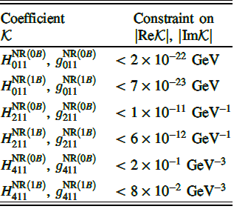
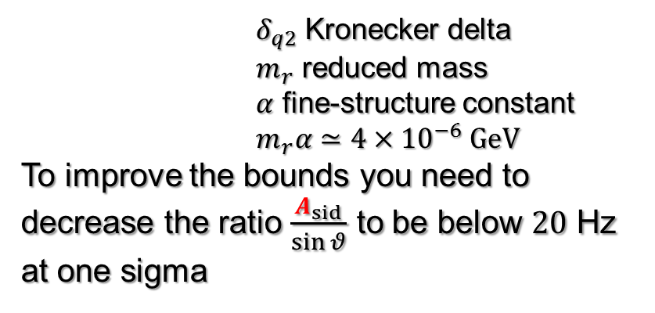
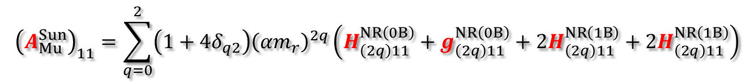
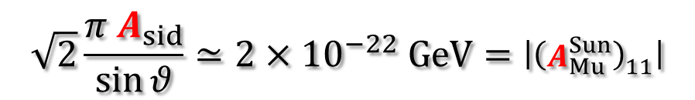
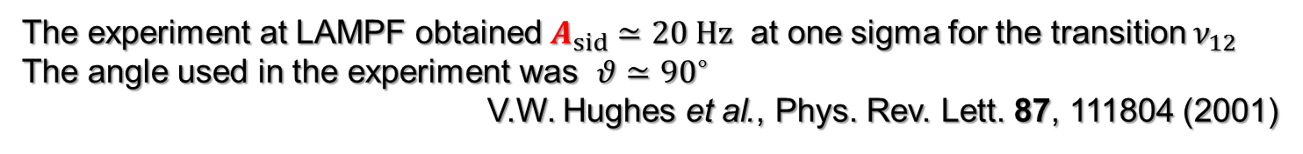
Mu hyperfine
Muon $g$-2
Perturbative shift Variations with the orientation
A.H. Gomes, V. A. Kostelecký, and AJV, Phys. Rev. D 90, 076009 (2014)
The experiment at LAMPF obtained $A_{sid}≃20 Hz$ at one sigma for the transition $ν_{12}$
The angle used in the experiment was $θ≃{90}^{∘}$
V.W. Hughes et al., Phys. Rev. Lett. 87, 111804 (2001)
$$\sqrt{2}\frac{π A_{sid}}{\sin{θ}}≃2×{10}^{−22} GeV=\left|{\left(A_{Mu}^{Sun}\right)}_{11}\right|$$
$${\left(A_{Mu}^{Sun}\right)}_{11}=\sum_{q=0}^{2}{\left(1+4δ_{q2}\right){\left(αm_{r}\right)}^{2q}\left(H_{\left(2q\right)11}^{NR\left(0B\right)}+g_{\left(2q\right)11}^{NR\left(0B\right)}+2H_{\left(2q\right)11}^{NR\left(1B\right)}+2H_{\left(2q\right)11}^{NR\left(1B\right)}\right)}$$
$δ_{q2}$ Kronecker delta
$m_{r}$ reduced mass
$α$ fine-structure constant
$m_{r}α≃4×{10}^{−6} GeV$
To improve the bounds you need to decrease the ratio $\frac{A_{sid}}{\sin{θ}}$ to be below $20$ Hz at one sigma
Nonminmal SME
Arnaldo Vargas 11th g-2/EDM CM`J-PARC

Slide 24
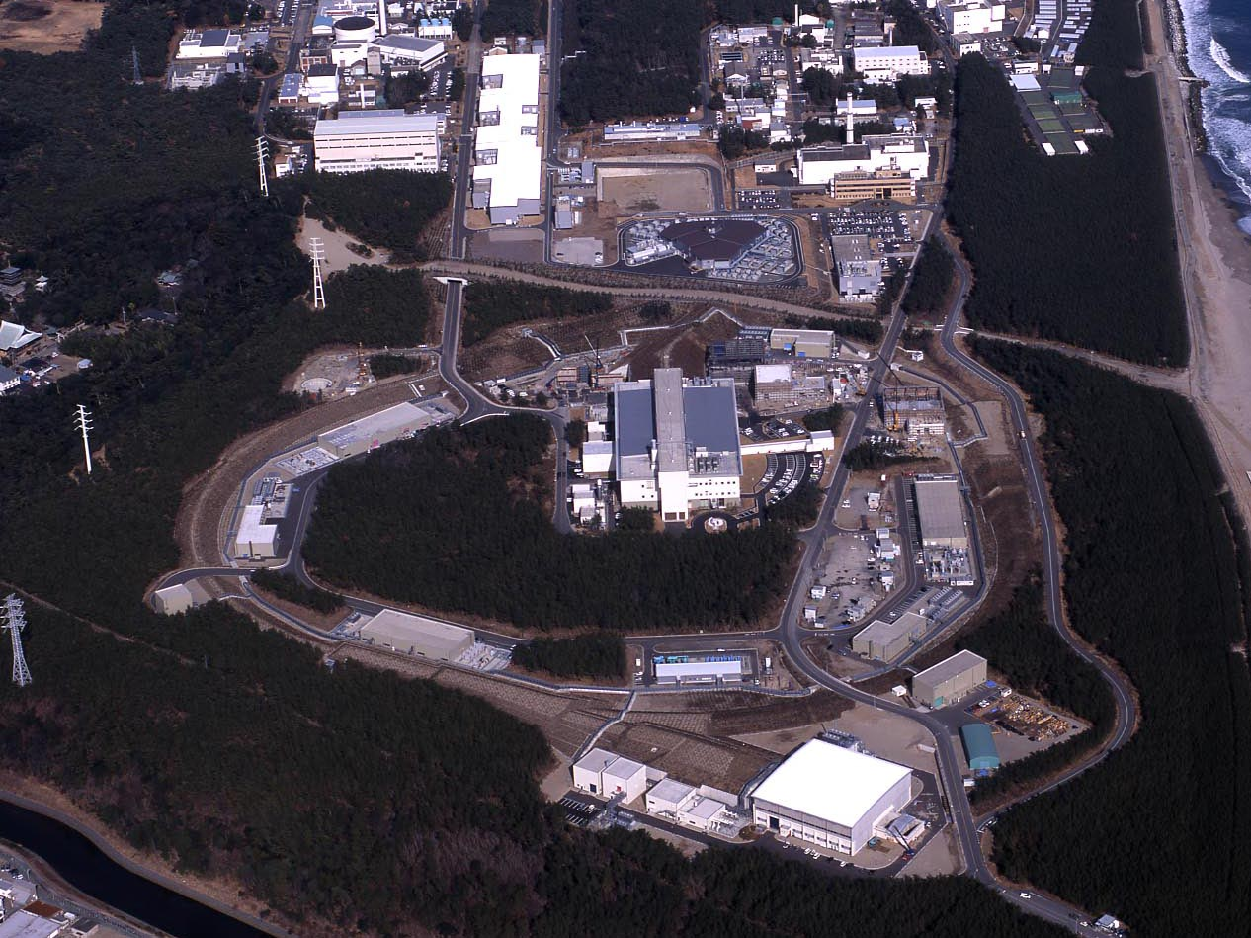
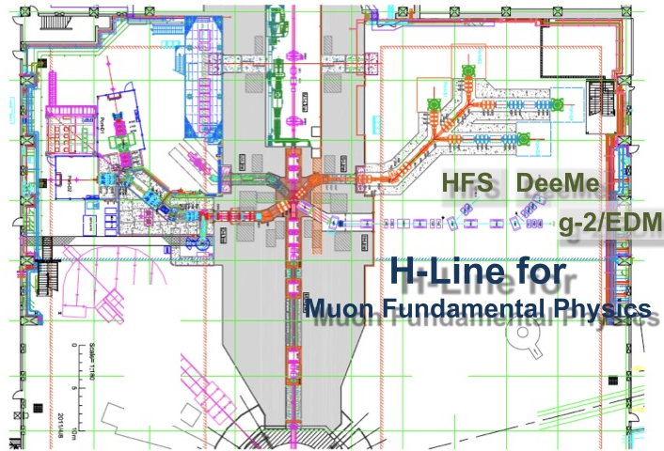
J-PARC Facility
(KEK/JAEA)
LINAC
3 GeV
Synchrotron
Neutrino Beam
To Kamioka
Material and Life Science
Facility
Main Ring
(30 GeV → 50 GeV)
Hadron Hall
Bird’s eye photo in Feb. 2008

Slide 25
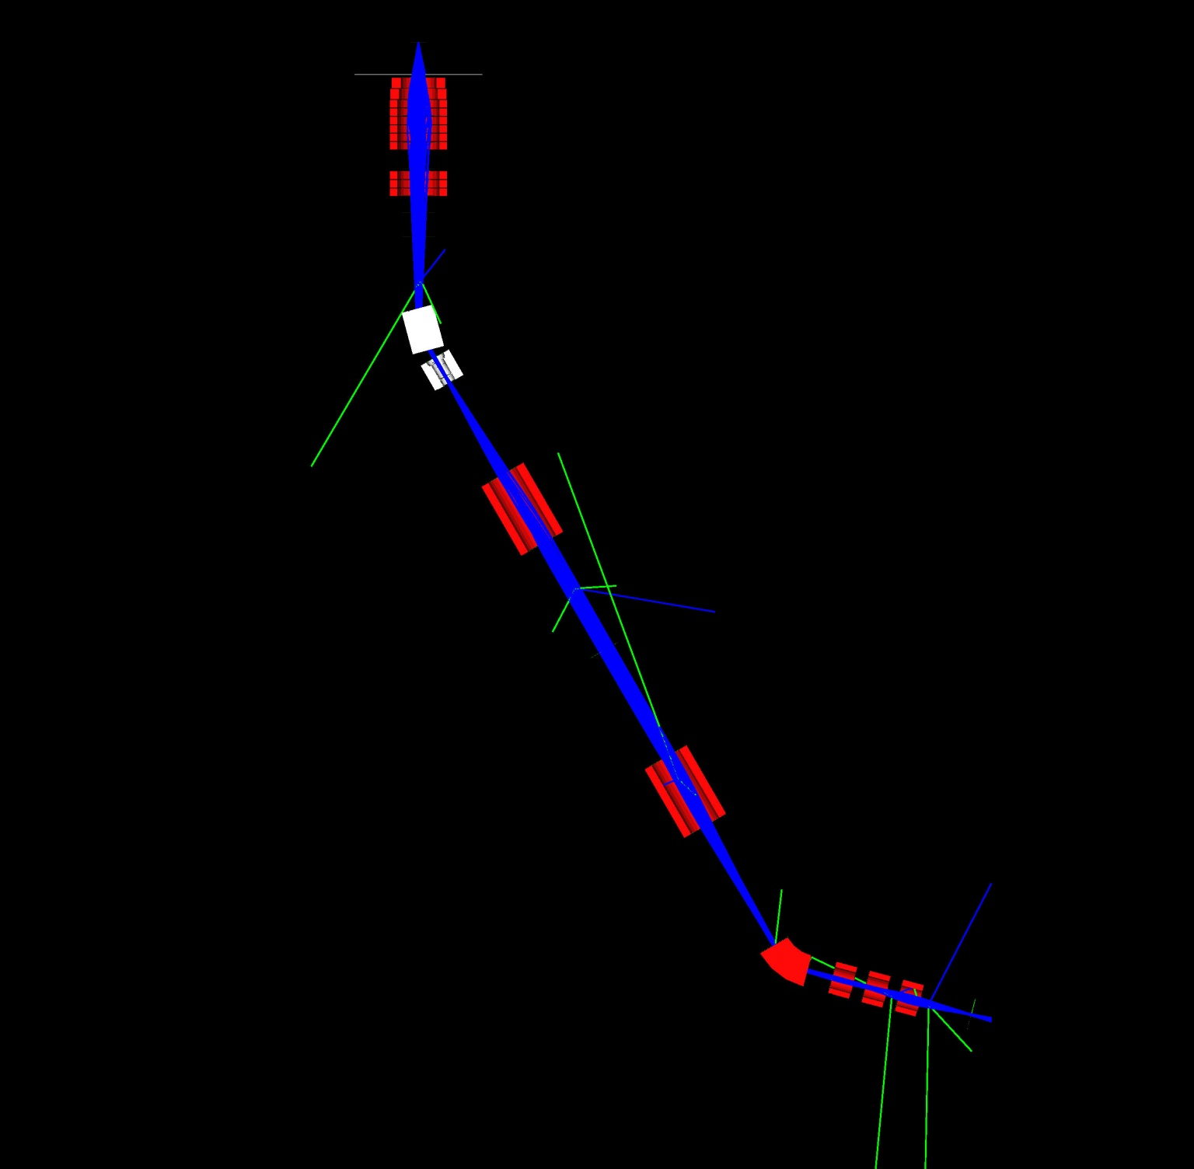
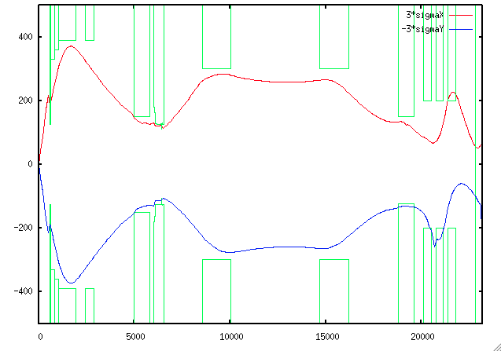
H line optics
Kawamura ,Toyoda＠KEK
Capture solenoid (HS1)
30 MeV/c mono-chromatic beam calc.
performed by a MC-code (G4beamline)
Large aperture short solenoids do not allow us to use transfer matrix calculation which use near axis assumption.
Bending magnet (HB1)
↑beam transport tunnel
Gate valve (HGV1)
Kicker magnets and/or
wien filers are installable
+B
Transport solenoid
(HS2 and HS3)
-B
Septum or bending magnet (HB2)
Experimental area #1
Conceptual design was proposed by J. Doornbos, TRIUMF.
Experimental area #2

Slide 26
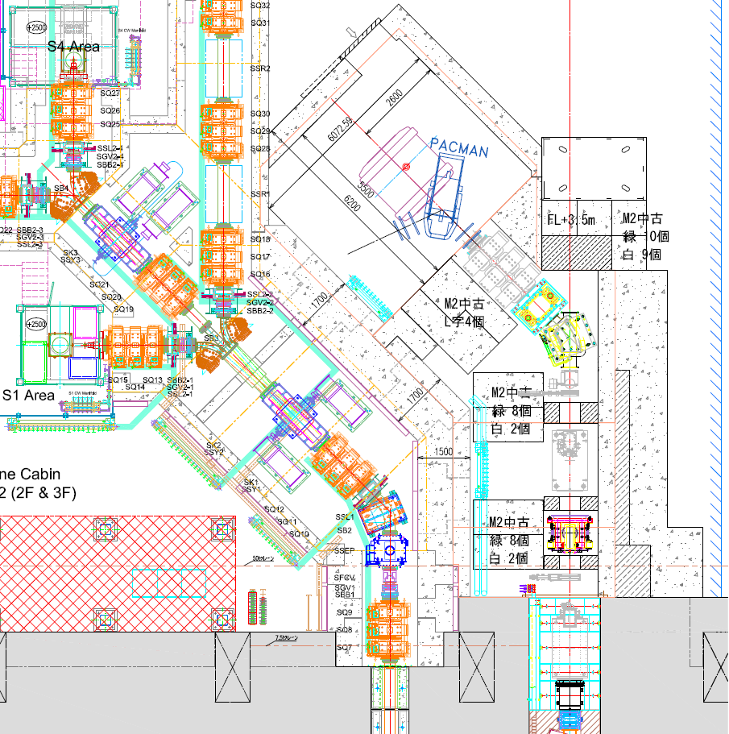
Realistic layout of H line and H1 Area is in progress
N
High intensity muon (10⁸/s)
Is available.
Recently KEK Executive
selected this project as a
one of the highest priority.

Slide 27
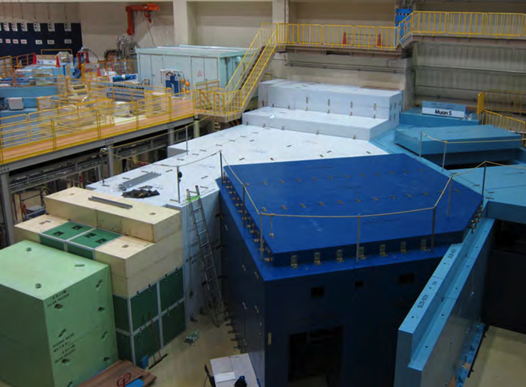
surface muon
branch
mu LINAC
MuSEUM (Mu-HFS, μ_{μ}/μ_{p})
DeeMe (mu-e conv.)

Slide 28
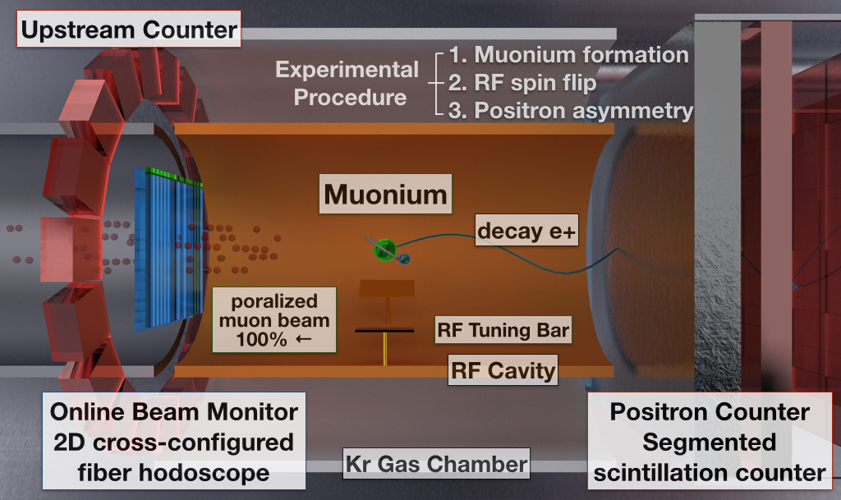
Principle of the MuSEUM
Notes:
MuSEUM実験の概要をお話します。こちらは実験の概念図で、画面左より偏極したパルスミューオンがKrガスの充満したターゲットセルに入射します。ミューオンビームのプロファイルと強度は極細のシンチファイバーによるホドスコープでパルス毎に診断し、ビームの不定性を排除します。標的セル中で熱化したミューオンは電子と束縛してミューオニウムとなり、これがRFを受けることで状態遷移を起こします。ミューオニウムはミューオンと同様の寿命で崩壊し、このとき生じる陽電子をシンチレータとMPPCを用いた検出器で数えることができます。ミューオンのスピンと崩壊陽電子の運動量ベクトルとの間には相関があり、これを用いて陽電子検出器で測定した信号の数のRF周波数依存性から、ミューオニウムの状態を分光します。

Slide 29
Key Components
Intense muon beam line
Super conducting magnet(HF)
Permalloy magnetic shield(ZF)
RF cavity
Kr chamber and gas handling
Positron detector
Beam profile monitors
Systematic error study
Kawamura ,Toyoda
Sasaki, Mizutani, Higashi, Ueno
Tanaka, Kanda, Ueno
Tanaka, Matsuda, Yoshida
Tanaka, Torii, Strasser
Kanda, Fukao, Mibe, Kojima
Ueno, Kanda, Toyoda, Ito
Tanaka, Kanda, Ishida

Slide 30
Zero Field Experiment

Slide 31
Zero field measurement at D Line
Important milestone for HF measurement-
Two additional components are required.
・Permalloy magnetic shield
・RF cavity for ZF

Slide 32
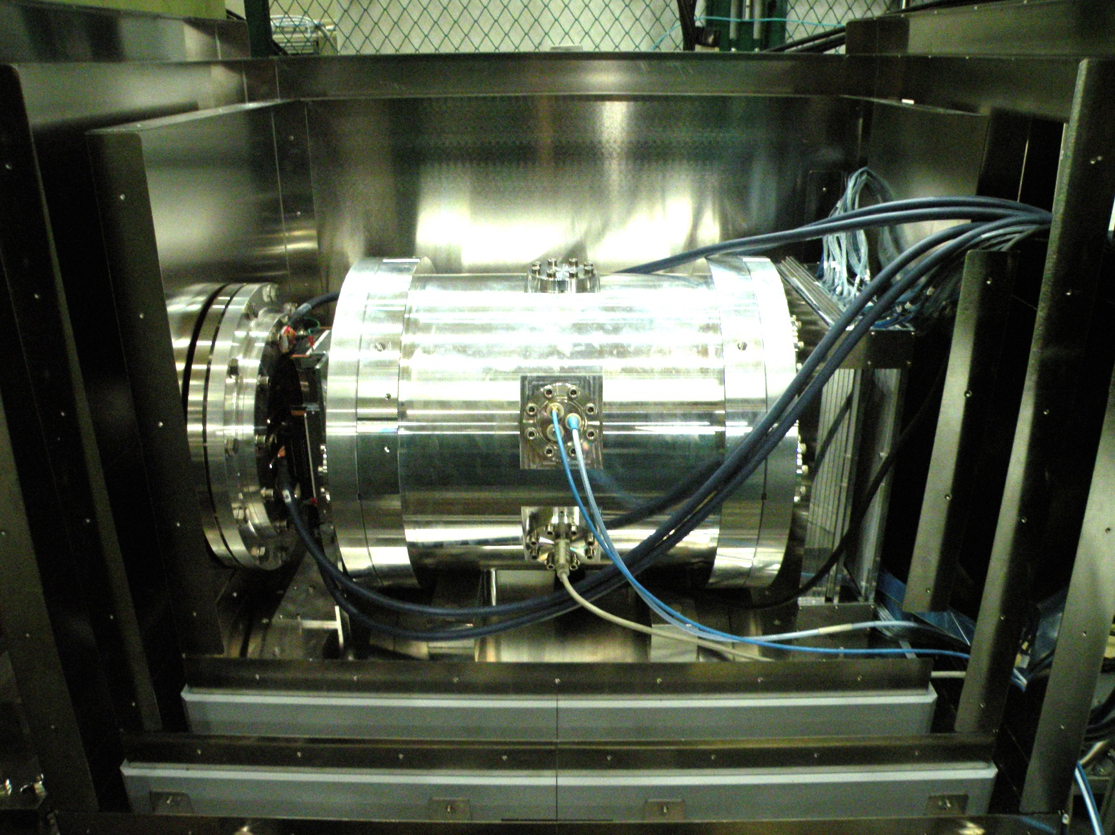
Resonance Measurement Setup
Positron Counter
w/Al Absorber
Fiber Beam Profile Monitor
Muon Beam
Kr Gas Chamber
(RF Cavity inside)
200 mm
Three layers of magnetic shield

Slide 33
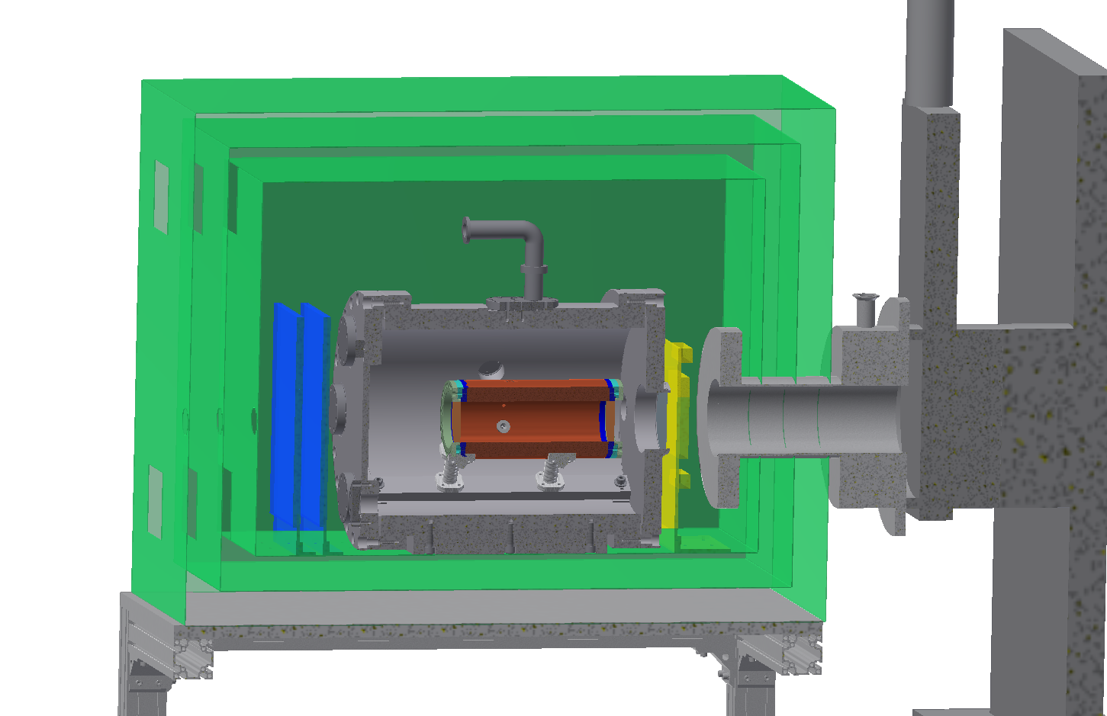
Setup for zero field measurement

Slide 34
Magnetic field simulation
Zero Field (~100nT) is established.

Slide 35
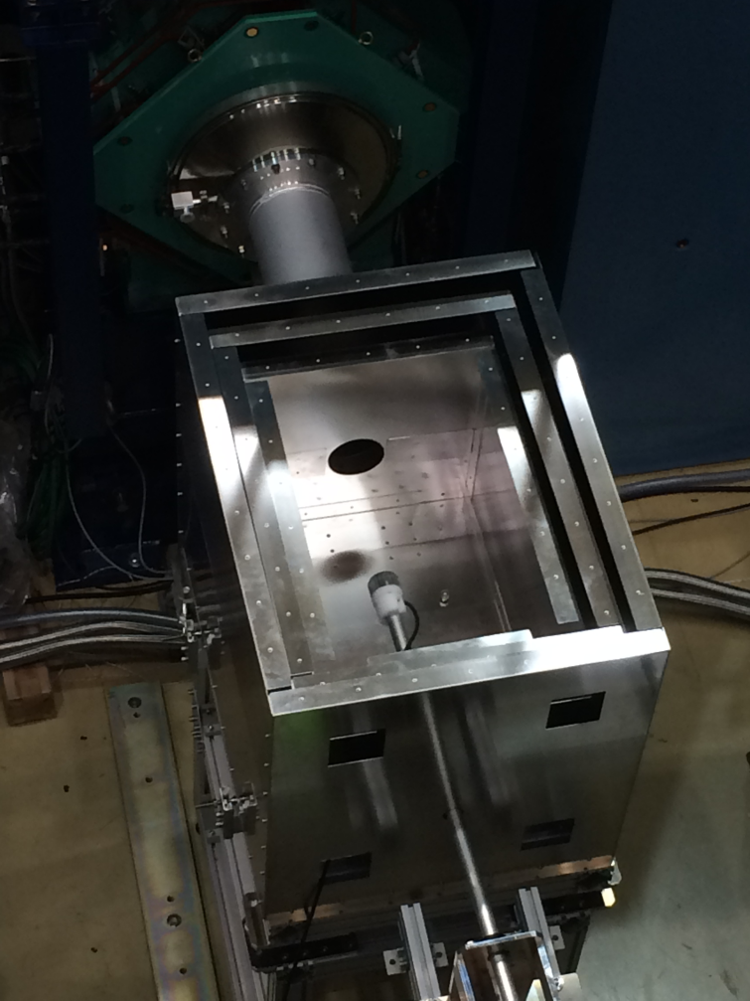
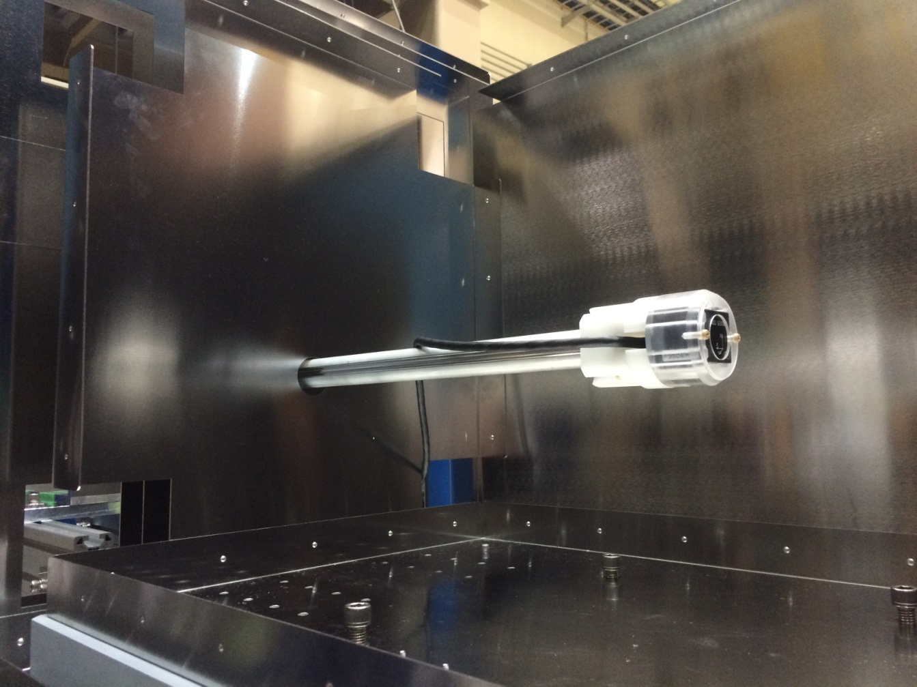
Magnetic Shield and Field Probe
Fluxgate magnetic probe
35 mm x 35 mm x 35 mm
700 mm
Assembled magnetic shield
without top boards
Magnetic field probe holder
and its moving system

Slide 36
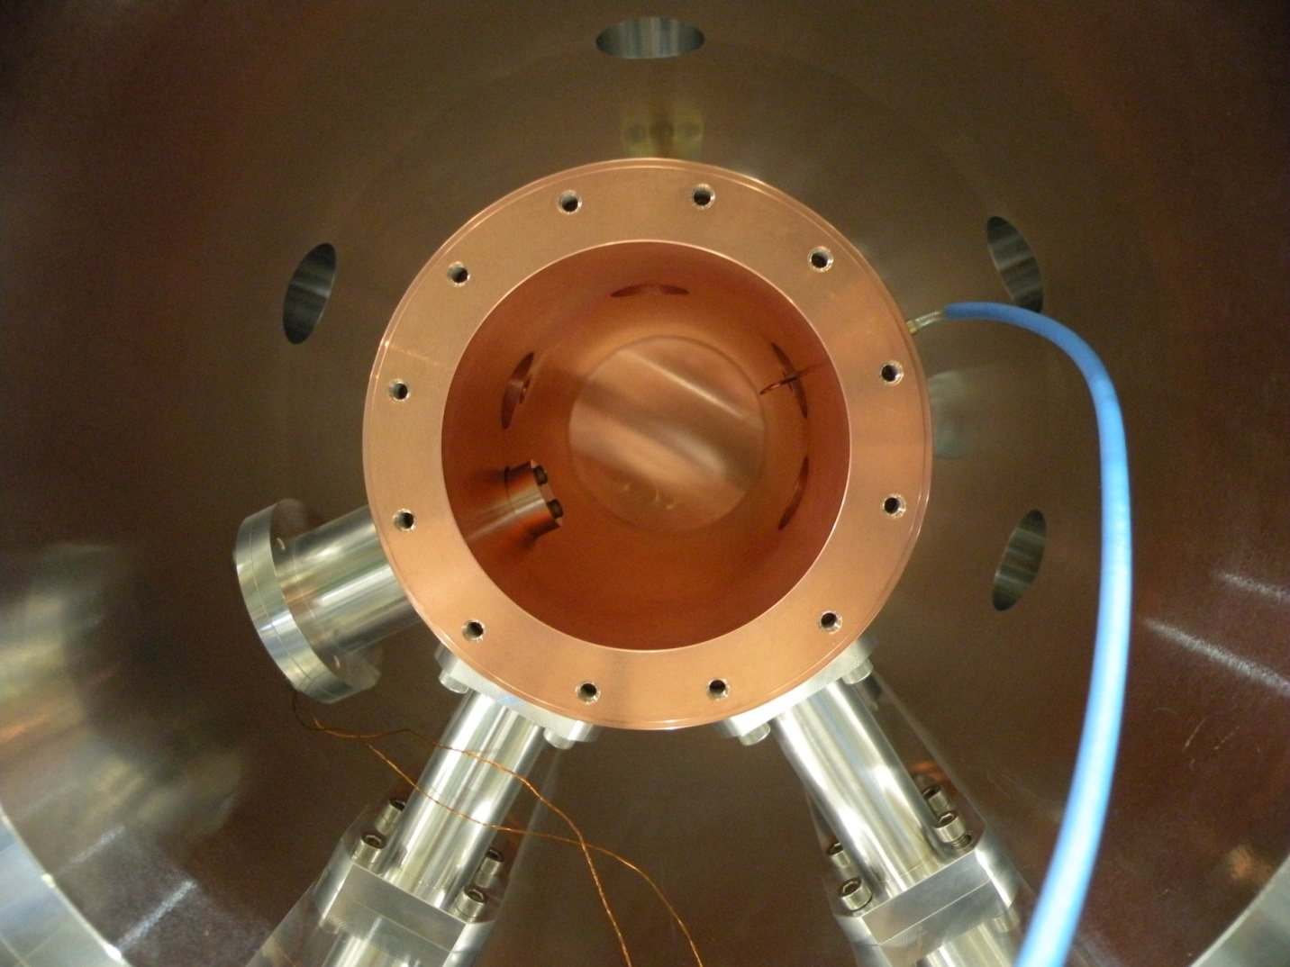
Inside of the Gas Chamber
Input antenna
Pickup antenna
81 mm
Tuning bar
Piezo positioner
Expected Q-value is 10000, microwave power is up to 3 W
TM110 mode at 4.463 GHz, +-1 MHz tuning by a piezo positioner

Slide 37
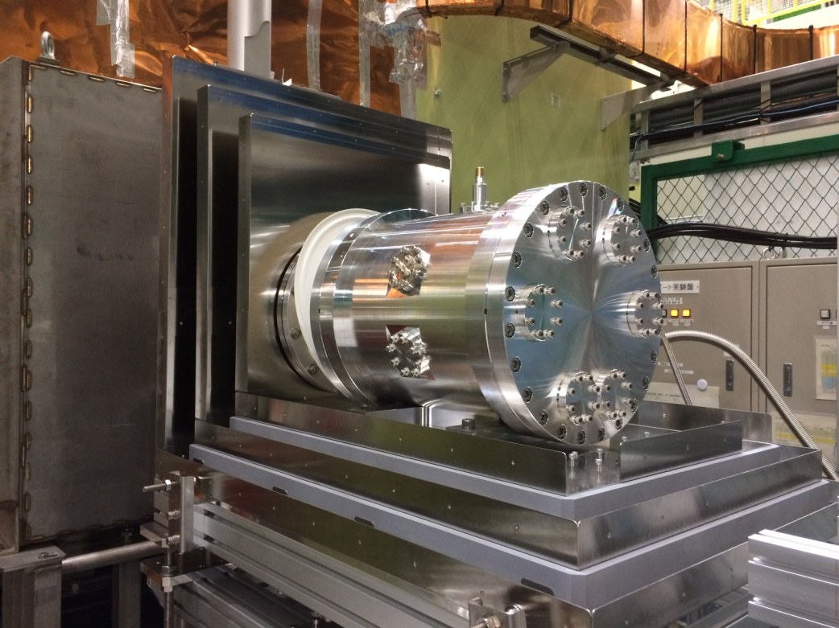
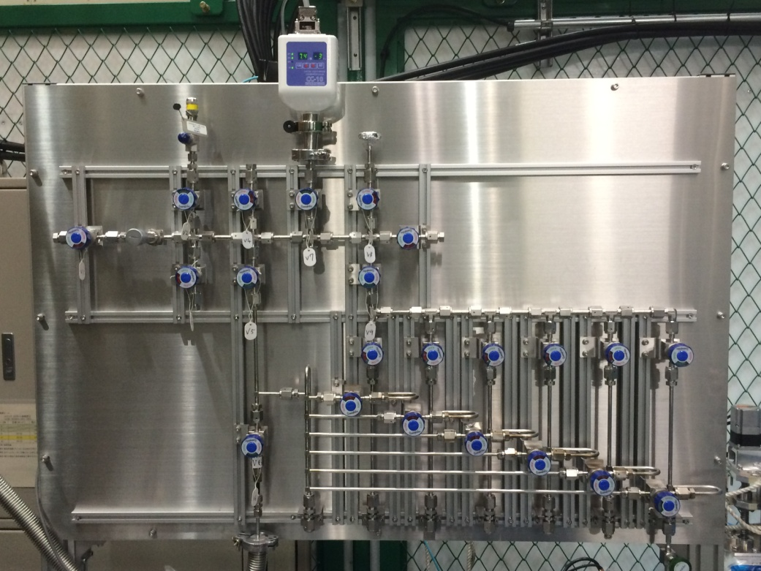
Gas Chamber and Gas Handling
425 mm length, 280 mm diameter, 100 μm Al beam window
Gas pressure is monitored by a capacitance gauge
Gas purity is measured by Q-Mass spectrometer

Slide 38
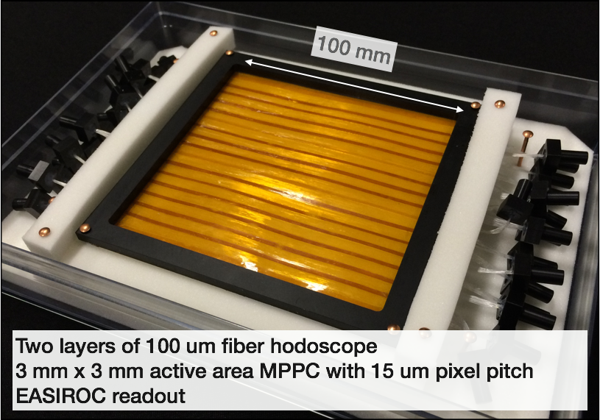
Front Beam Profile Monitor

Slide 39
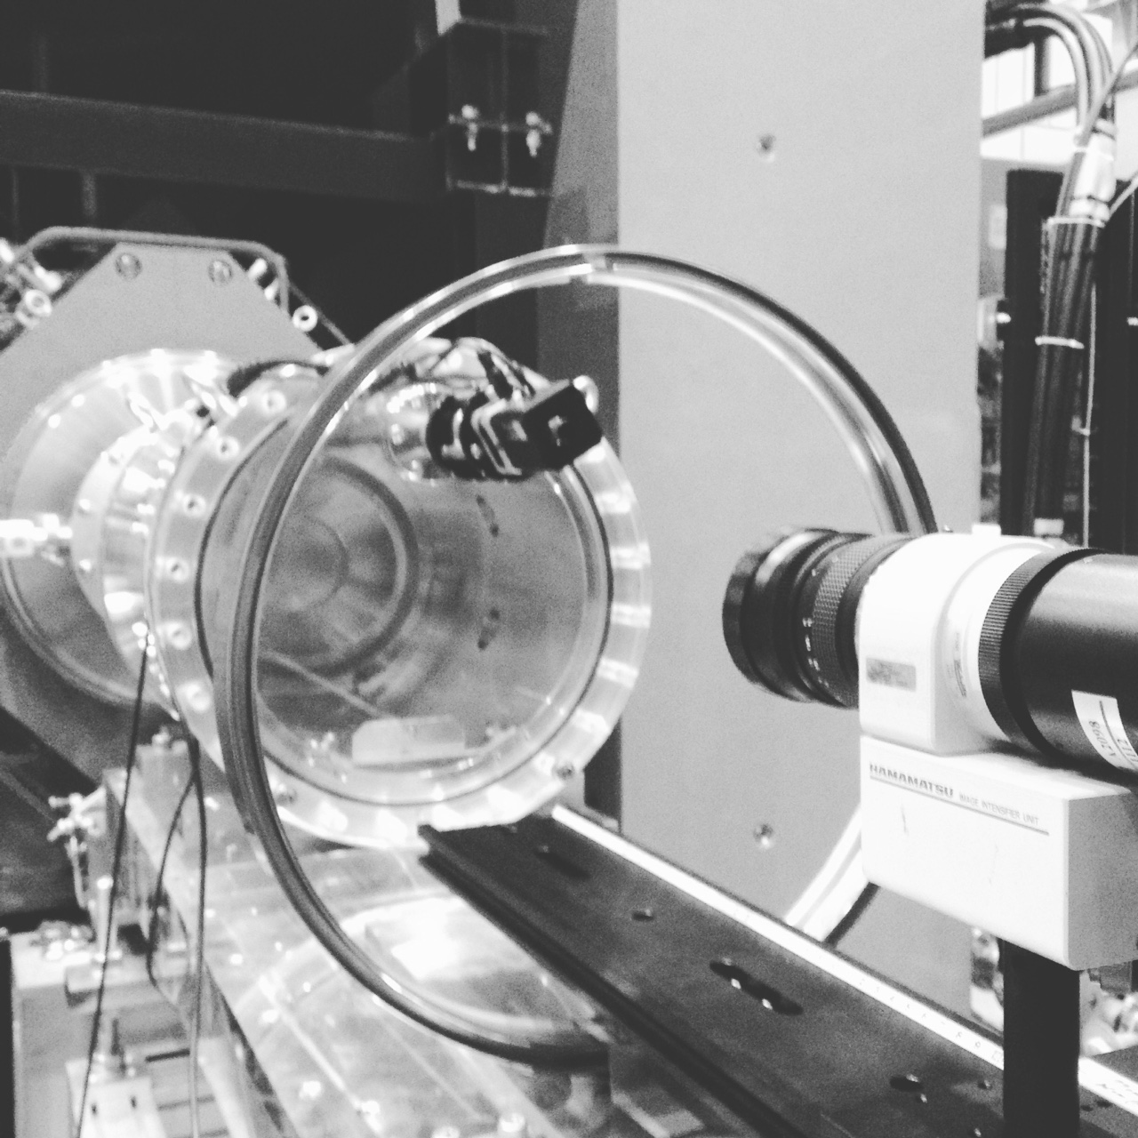
3D beam profile monitor

Slide 40
Segmented Positron Counter
3 mmt
10 mm
240 mm
Hamamatsu MPPC
1.3 mm x 1.3 mm
active area
576 ch/layer x 2 layers
Segmented scintillation counter with SiPM readout
Unit cell is 10 mm x 10 mm x 3 mmt
240 mm x 240 mm area, 1152 ch. in total
High rate capability is required (100 M muon/s at 1 MW)

Slide 41

Positron Detector
FBPM
Cavity for zero field
Muon Beam
Kr Chamber
Magnetic Shield

Slide 42
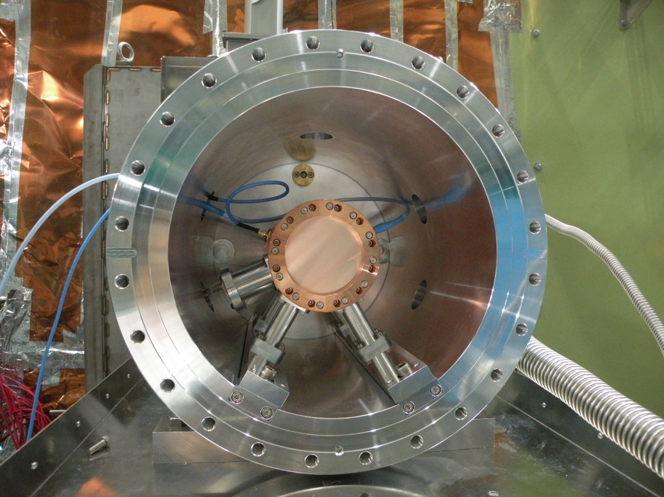
Cavity for zero field

Slide 43
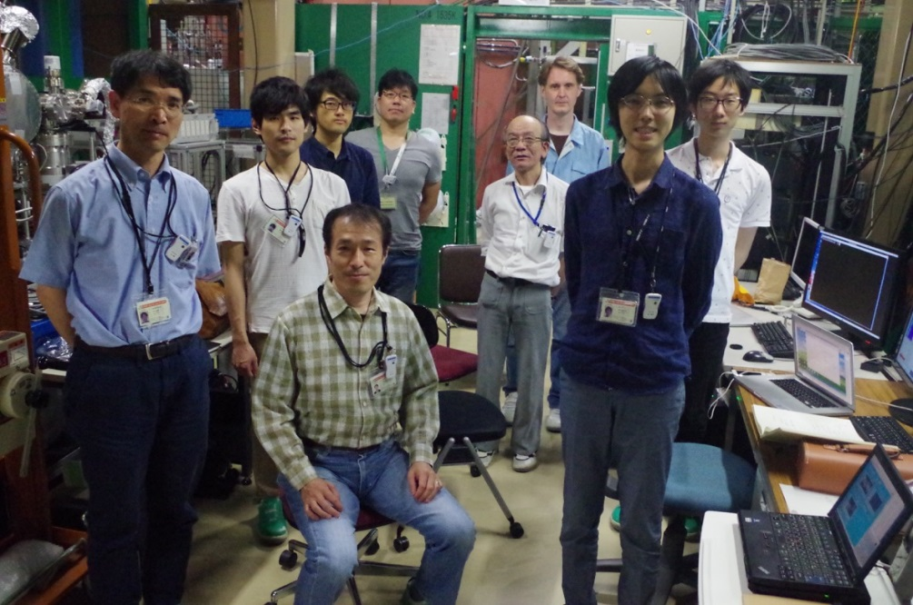
First Resonance Search
2016. June. 3(24h)
Beam profile measurement
2016. June. 12-14(60h)
Muonium Resonance Search
Results
Good zero field condition (~100nT) was obtained.
Beam profile was successfully measured.
Enough RF power and cavity Q value were obtained
All detectors were working properly.
After several trial, Muonium HFS resonaces was obtained!

Slide 44
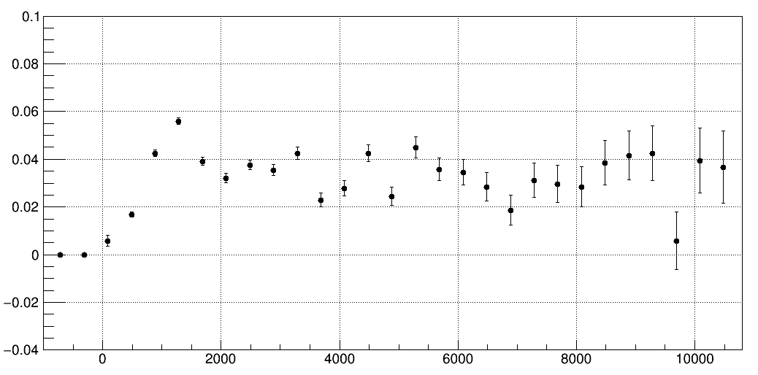
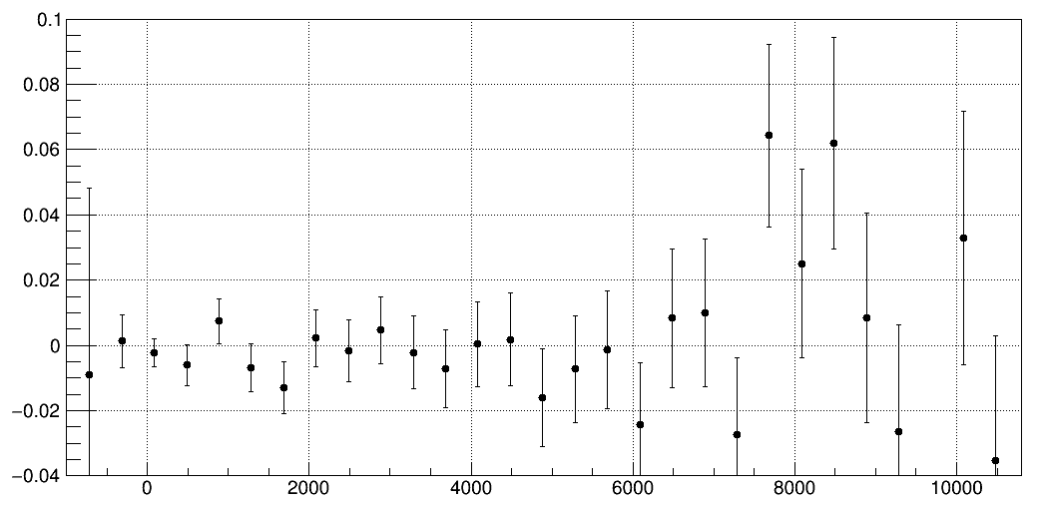
Time Dependent Spin Flip Signal
Preliminary
Near at Resonance
4463.1 MHz
RF frequency
1.0 Kr atm
27.4 MeV/c muon
Signal (a.u.)
time (ns)
Off-Resonance
RF frequency was far detuned
1.0 Kr atm
27.4 MeV/c muon
Preliminary
Signal (a.u.)
Signal = ON/OFF-1
time (ns)

Slide 45
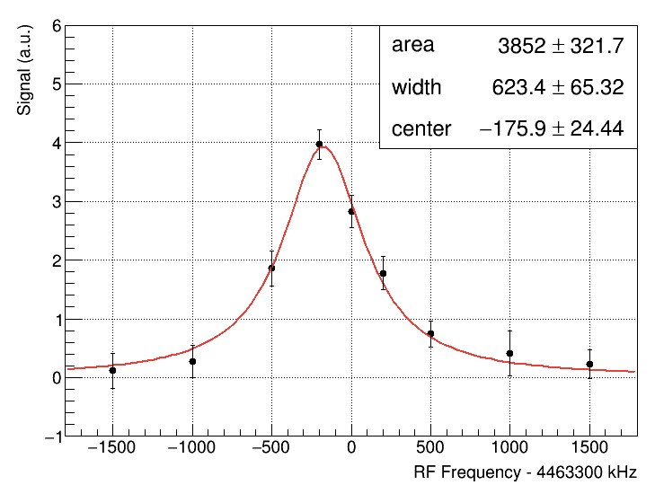
Resonance Lineshape
Preliminary
Muonium HFS resonance was observed
Fitted by Lorenzian and freq. center was 4463.1+-0.02 MHz
Expectation from precursor experiments is 4463.1 MHz

Slide 46
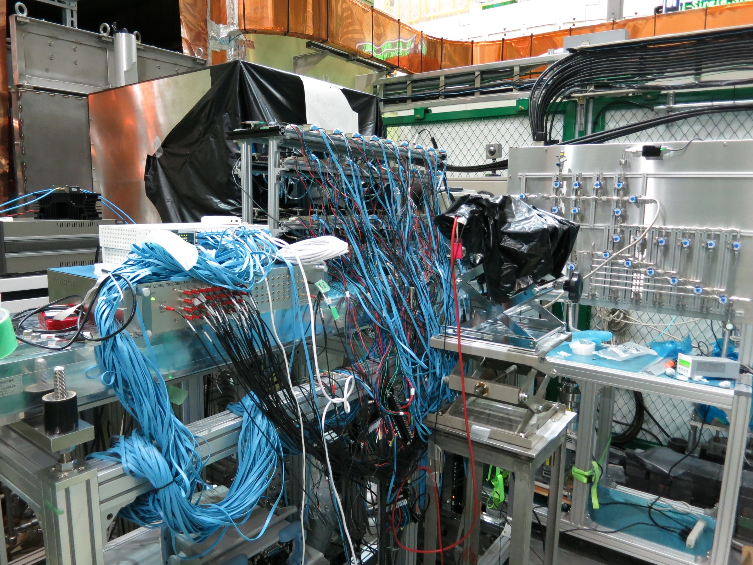

Slide 47
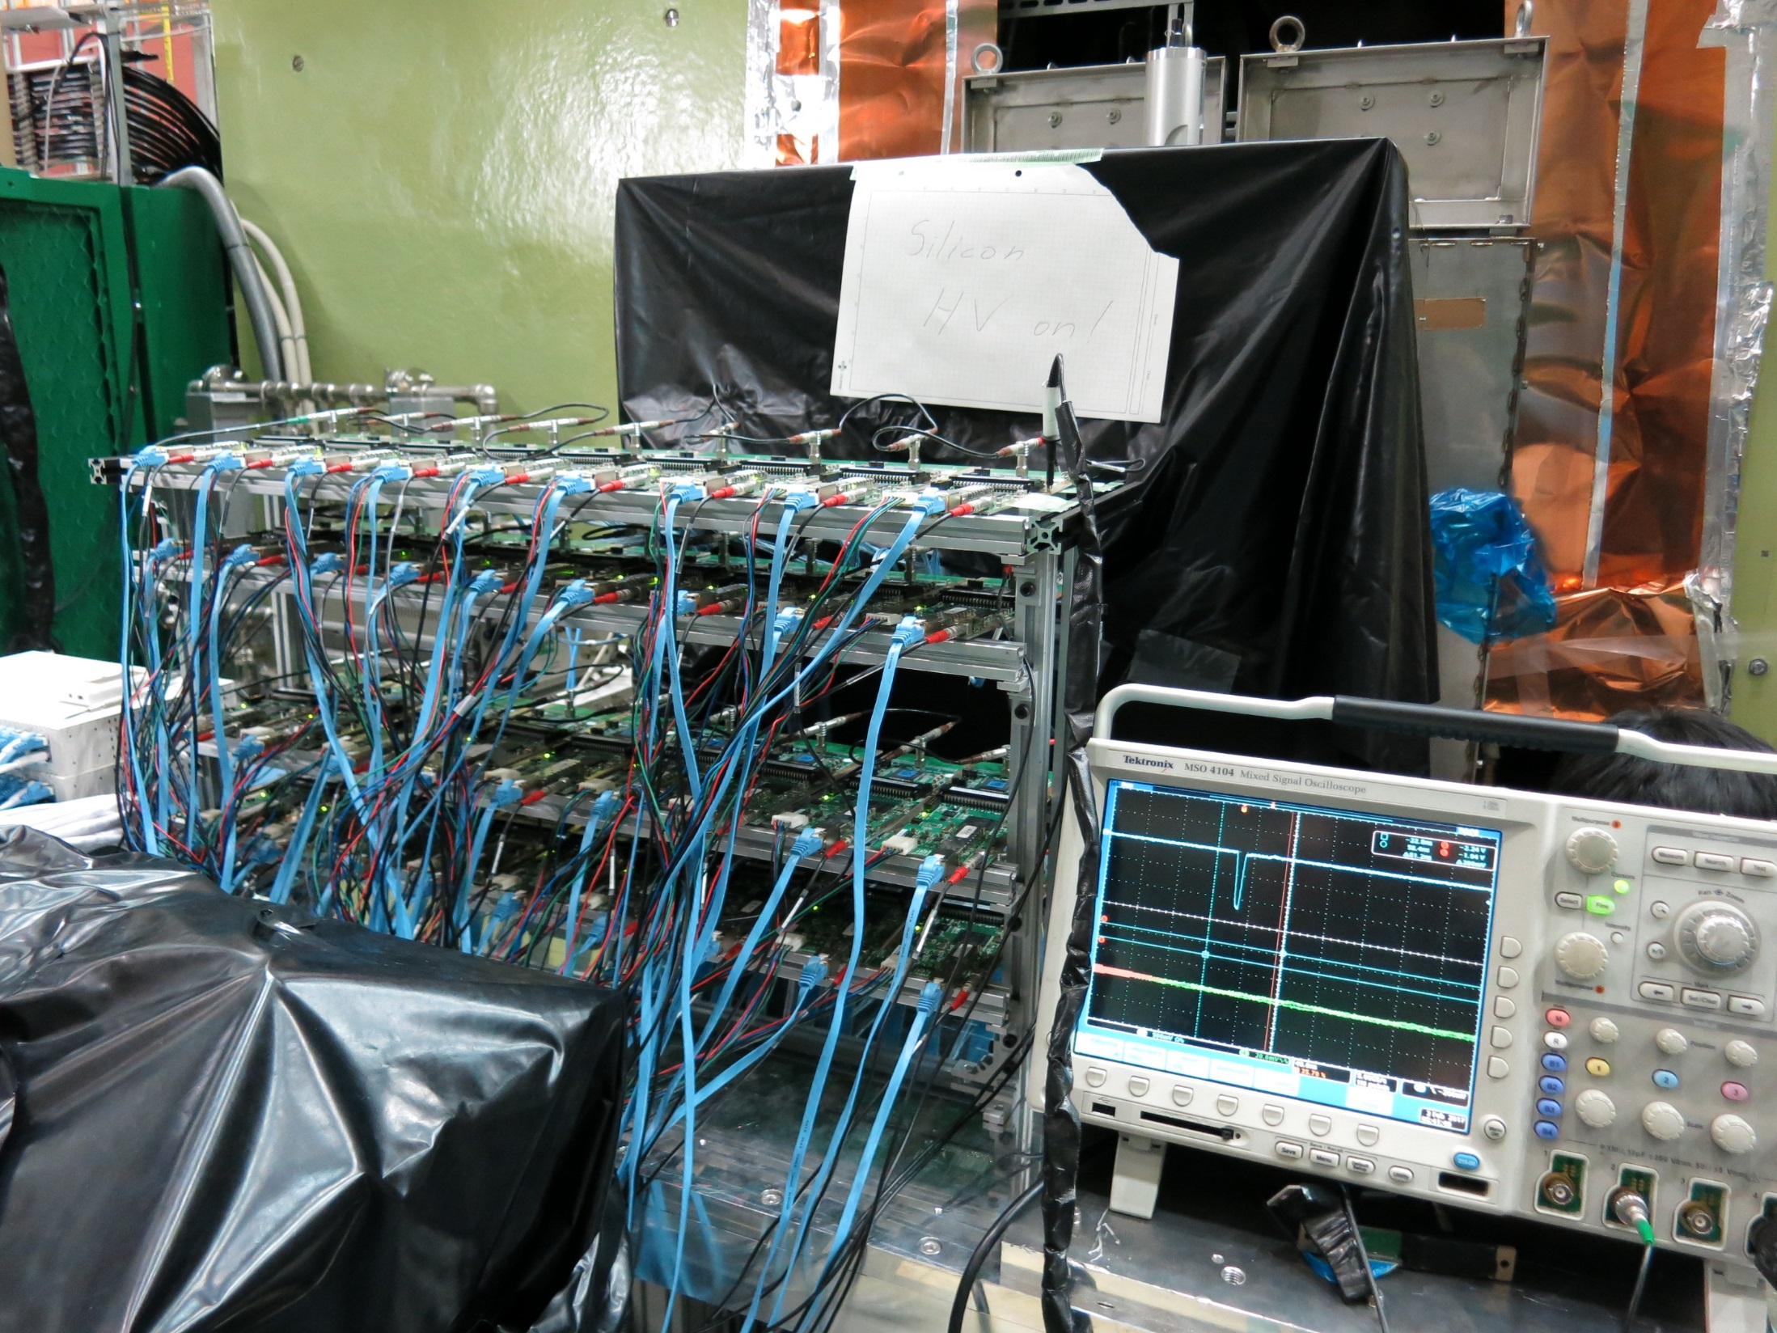

Slide 50
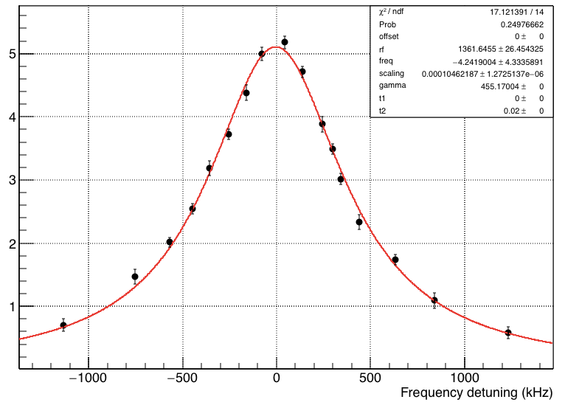
Resonance Lineshape (2017 Feb)
Spin flip signal (%)
Preliminary
Frequency detuning (kHz)
Statistical uncertainty ~ 4 kHz (x5 improvement)
Estimation of the systematic uncertainty is in progress

Slide 52
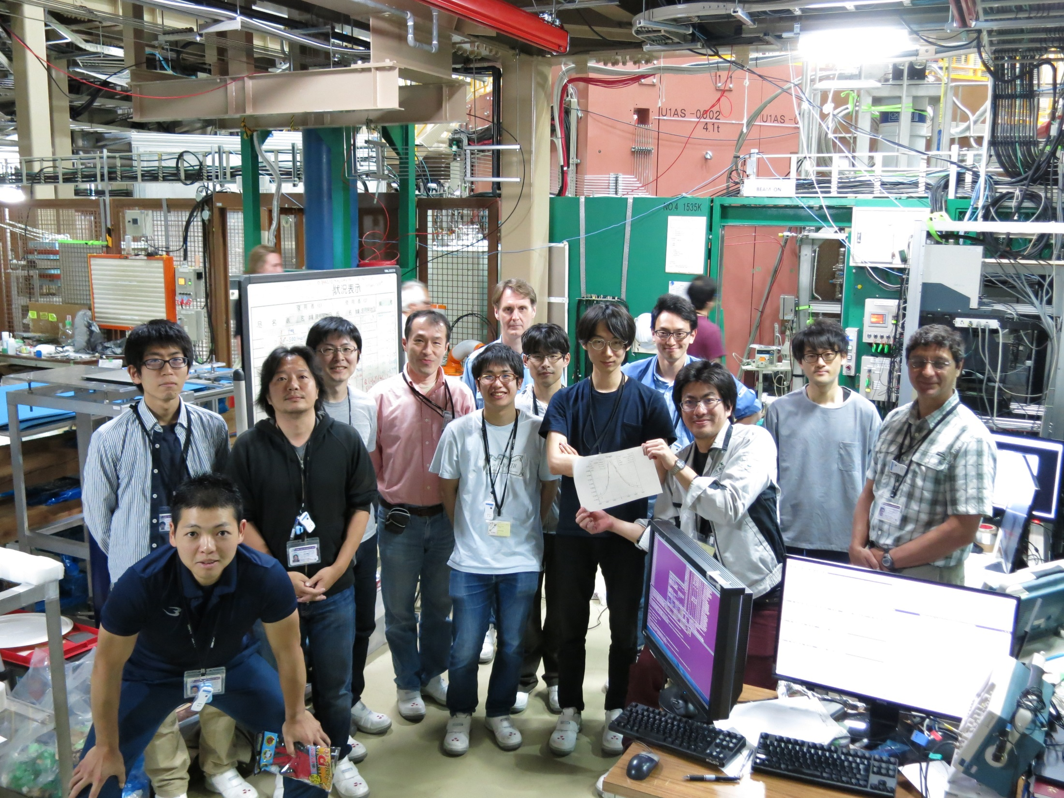

Slide 53
Resonance Lineshape (2017 June)
Preliminary
Statistical uncertainty ~ 2 kHz (x5 improvement) 8h run
Lineshape narrower !

Slide 54
Systematic Error in ZF measurement
Expected accuracy ~10ppb if we have enough muon.

Slide 55
High Field Experiment

Slide 56
Uncertainty of the previous measurement
LAMPF exp.
δ(Δν)
δ(μ_{μ}/μ_{p})
Statistics
107 ppb
Statistics
10.9 ppb
Magnetic field
56 ppb
Kr Density/Pressure
4.4 ppb
Muon stopping
13 ppb
Muon stopping
1.0 ppb
Kr Density/Pressure
11 ppb
RF power
0.96 ppb
RF power
9.6 ppb
x200
J-PARC/MUSE Pulse 1x10⁸ /s
H-Line total 2x10¹⁵
LAMPF DC 10⁷ /s
total 10¹³

Slide 57
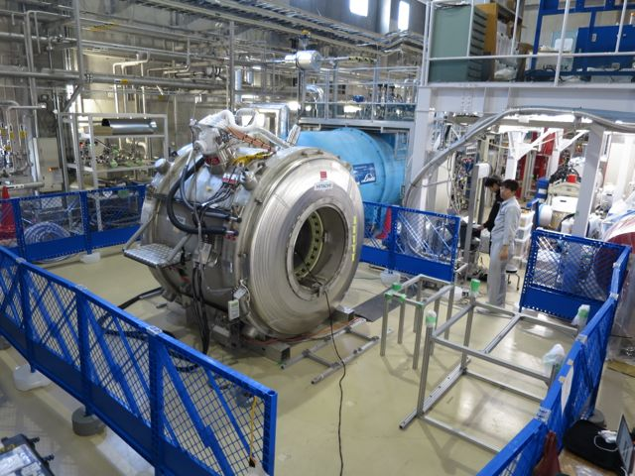
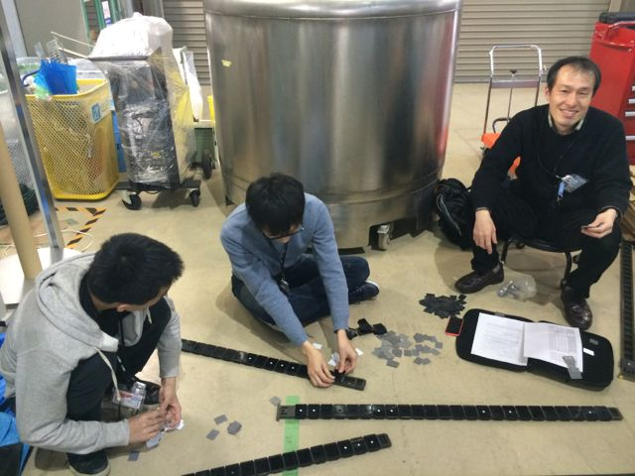
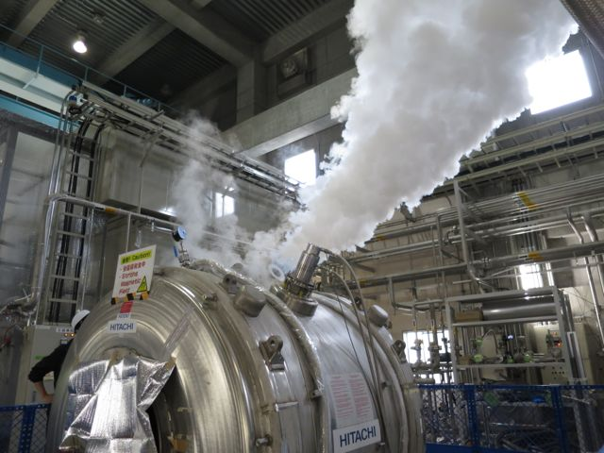
MRI magnet for MuSEUM experiment
Second-hand 2.9 T MRI magnet (March 2013)
Performance test at NU1 in 2015
  Feb. 2-16
    Cooling from R. T.
  Feb. 24-26
    Shimming test #1
      at 1.5 T, by Oxford (Hitachi medical)
  Feb. 27 - Apr. 20
    Measure
      He evaporation rate
      Long term stability
  Apr. 21-23
    Shimming test #2
      at 1.7 T, by KEK
  Jun. 17
    Quench test
Magnet at NU1
Shimming
Quench

Slide 58
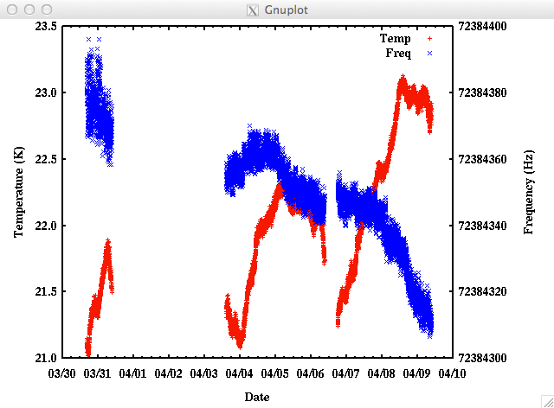
Long Term Stability
2015/3/30 - 4/9
Mod. field : 20 μT p-p,
Mod. span : 200 ms
Temperature calibration
64 Hz / 9.7 days
0.003 ppm /h
Water temp. depend.
10.36e-9/℃
Magnet spec.
< 0.03 ppm/h

Slide 59
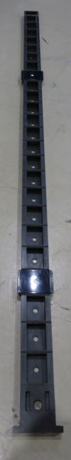
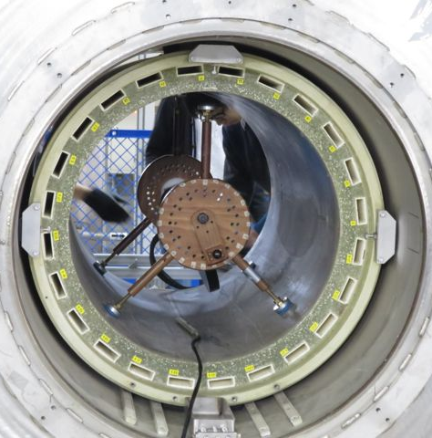
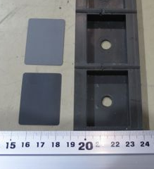
Shim tray, Iron piece
24 trays
  24 pockets per each tray (576 pockets in total)
Iron piece
  W 40 mm, D 30 mm
  Thick and Thin piece (t : 25 μm, 5 μm)
8
7
6
5
9
4
10
3
11
2
t 5 um
12
1
13
24
t 25 um
14
23
15
22
16
21
17
18
20
19

Slide 60



Shimming work
Measure magnetic field at 576 points ( < 3 hour )
Calculate optimum arrangement of iron shim ( < 1 hour )
Down magnetic field to Zero ( ~1 hour )
  don’t need if small amount of iron piece would be installed
Put iron pieces into pockets according to calculation results ( < 3-4 hours )
Excite magnet up to 1. 7 T (~ 1 hour )
4
1
4

Slide 61
After shimming #3
Measured by single probe system
  Spheroid : r=100 mm, z=300 mm
1.4 ppm p-p
(ppm)

Slide 62

NMR field monitoring system
＋δ_{e}
Analog process + Constant RF
  Offset caused by voltage threshold
  Variation of modulation coil field
  Fluctuation of measured value by circuit noise
Digital process + RF tuning
  improve S/N ratio and minimize offset by data-fitting process
  minimize variation of modulation coil
threshold
Notes:
In the previous two collaboration meetings,
we have already reported that we build the prototype of the field monitoring system,
and also reported he first test results at NIRS.
In the end of last year, we did the second test at NIRS with NMR system improved on the stability and the accuracy.

Slide 63


NMR measurement @Argone
Modulation : triangle wave
Glass tube : In φ 7mm, Out φ10 mm, RoundEnd
Sample : Ultra pure water (supplied by Milli-Q at KEK)
100 pt meas (20 times improvement!)
1st Ramp
2nd Ramp
sigma ~ 3.3 ppb
sigma ~ 0.88 ppb
Notes:
左右のズレ：
1stRamp: 0.00184202
2ndRamp : 0.00184938

Slide 64


Slide 65



RF cavity
MWS simulation
3D CAD
Test Cavity

Slide 66
Q value (for HF)

Slide 67
Systematic Error (Preliminary)
 | Accuracy | ν12 ν34 | HFS | μ_{μ}/μ_{p}
Magnetic Field* | 30 ppb |  | 0.0 ppb | 15 ppb
RF power | 0.2% | 4Hz | 0.8 ppb | 8 ppb
Kr gas temp. | 0.2 K | < 2Hz | 0.4 ppb | 4 ppb
Kr gas pressure | 0.01 hPa | 1Hz | 0.2 ppb | 0 ppb
H impurity | <50 ppm | 1Hz | 0.5 ppb | 0 ppb
Quadratic pressure dependence |  | 5Hz | 1.0 ppb | 5 ppb
Muonium Position (x,y) | 1mm | 3 Hz | 0.6ppb | 6 ppb
Muonium position(z) | 1mm | < 1 Hz | 0.2ppb | 2 ppb
Beam intensity | 1e-4 | < 1 Hz | 0.2ppb | 2 ppb
Detector pile up |  | 2.8 Hz 0.3 Hz | 0.5 ppb <0.1 ppb | 3 ppb <1 ppb | Without ab. With ab.
*should be re-estimated by latest progress.
Total Systematic Error of HFS ~2 ppb, μ_{μ}/μ_{p} ~ 25 ppb

Slide 68
Summary and Prospects
Muonium HFS measurement is one of the high sensitivity experiments for beyond standard model physics
The first physics measurement of muonium HFS at “zero” magnetic field was performed
Muonium HFS resonance was observed at 1.0 atm Kr gas pressure with 27.4 MeV/c muon beam
Obtained HFS frequency was 4463 MHz and consistent w/previous experimental result
B-field uniformity, RF stability, gas purity were good enough.
Data analysis improvement is under study
Next zero field experiment is scheduled after summer shut down
R&D for High Field Experiment is now in progress

Slide 70


Magnetic Dipole Moment

Slide 71

Magnetic dipole moment with loop current
μ=IS

Slide 72
Orbital magnetic dipole moments
Consider electron moving with velocity (v) in a circular Bohr orbit of radius r. Produces a current
where T is the orbital period of the electron.
Current loop produces a magnetic field, with a moment
Specifies strength of magnetic dipole.
Magnitude of orbital angular momentum is L = mvr = mωr². Combining with Eqn. 1 =>
An electron in the first Bohr orbit with has a magnetic moment defined as
= 9.27x10⁻²⁴ Am²
μ_{l}
r
e⁻
L
v
(1)
(2)
Bohr Magneton

Slide 73

Particle Spin produce Magnetic Moment
Electrons (and other particles) have an intrinsic property called spin that also contributes to their magnetic moment
  The electron is not physically spinning
  It has an intrinsic angular momentum as if it were spinning
  Spin angular momentum is actually a relativistic effect
  g factor should be multiplied ! g=2 for electron and muon.
  g=5.58 for proton

Slide 82
Derivation of hyperfine structure in hydrogen atom

Slide 83
Magnetic Moments – Classical
The magnetic moment is
The magnetic moment can also be expressed in terms of the angular momentum

Slide 84
Classical Electrodynamics
Magnetic Dipole Moment

Slide 85
Magnetic Dipole Moment

Slide 86
Hyperfine Splitting
Magnetic Dipole Moment
The proton is itself a rotating electric charge
We would expect it would have a magnetic
dipole moment in the direction it is spinning:
  Where I is the spin of the proton
If the proton were elementary, we
would predict g_{p}≈ 2, but actually
We will approximate the proton as a uniformly
magnetized sphere of radius a:
Magnetization:
Vector potential, Jackson eq. (5.111):
  μ₀ is magnetic permeability of free space
Magnetic field:
a

Slide 87
Shrinking the Nucleus
Again, the nucleus is small, so we’d like to take the limit a → 0
  Can we just always use the lower formula?
How large is the magnetic field integrated just over the volume of the nucleus?
In the limit a → 0, must add a contribution of this magnitude right at the origin
No comparable contribution from A, since it is smaller by factor of r near origin

Slide 88
The Hyperfine Perturbation for Hydrogen
Recall the Hamiltonian for
electromagnetic interactions:
Drop A², and approximate g = 2:
Compare to unperturbed Hamiltonian
The perturbation is therefore:

Slide 89
Hyperfine Perturbation for s-Waves
Replace
R × P = L:
We first need unperturbed states
  Have to include nuclear spin now!
  m_{I} is eigenvalue associated with I_{z}
Because of spin-orbit coupling, it is better to add L and S to get total electron angular momentum J = L + S
So better choice of basis states would be
Degenerate perturbation theory again
So we will need matrix elements
For l = 0 (s-waves), the angular momentum operator always vanishes
Less obvious: for l = 0, the next two terms also vanish
  Next slide from now, plus proof by homework problem

Slide 90
Sample Problem
Prove that for s-wave states, only the final term contributes to hyperfine splitting
All s-waves (l = 0) have no angular dependence, so
So contributions to perturbation theory from this term will be
For the other two terms, write it out as
Because the wave function has no angular
dependence, the angular integral is
This can be shown to always vanish (nine expressions, six independent)
For example, let j = k = z, then

Slide 91
Total Atomic Angular Momentum
We are still working in basis states of J² and J_{z}, where J = L + S
But as before, we could then combine the electron angular momentum with the proton’s spin to get the total internal
angular momentum of the atom:
Eigenstates of H₀ will now look like:
  These are eigenstates of
Since we have l = 0, ignore L and so F = S + I
Since electron has s = ½ and proton has i = ½, total spin is f = 0 or f = 1
Use addition of angular
momentum trick to write
Therefore,

Slide 92
Hyperfine Splitting for Hydrogen s-waves
We need matrix elements
Energy is
now diagonal
Most important effect is difference between f = 0 and f = 1 energy

Slide 93
Comments on Hyperfine Splitting
Permittivity of free space is
related to Coulomb’s constant by
Therefore
By comparison, spin-orbit coupling is of order α²E_{1s}
  So hyperfine is suppressed by m/m_{p}
But this is the only contribution that distinguishes these spin states
Transition from f = 1 to f = 0 generates electromagnetic radiation with a wavelength of 21 cm.
The 21 cm line is used to track atomic hydrogen throughout the galaxy
The comparable transition in Cesium is used for atomic clocks

Slide 112
Short course for QM solution for Hydrogen Aom

Slide 113
The Hydrogen Atom
The only atom that can be solved exactly.
The results become the basis for understanding all other atoms and molecules.
Nucleus charge +Ze mass m₁
coordinates x₁, y₁, z₁
Electron charge –e mass m₂
coordinates x₂, y₂, z₂
The potential arises from the Coulomb interaction between the charged particles.
Copyright – Michael D. Fayer, 2007

Slide 114
The Schrödinger equation for the hydrogen atom is
kinetic energy of nucleus
kinetic energy of electron
potential
energy eigenvalues
Can separate translational motion of the entire atom from relative motion
of nucleus and electron.
Introduce new coordinates
x, y, z - center of mass coordinates
r, θ, ϕ - polar coordinates of second particle relative to the first
Copyright – Michael D. Fayer, 2007

Slide 115

center of mass coordinates
relative position – polar coordinates
Copyright – Michael D. Fayer, 2007

Slide 116
Substituting these into the Schrödinger equation. Change differential operators.
This term only depends on
center of mass coordinates.
Other terms only on relative
coordinates.
reduced mass
Try solution
Substitute and divide by
Copyright – Michael D. Fayer, 2007

Slide 117
Gives two independent equations
Depends only on center of mass
coordinates. Translation of entire
atom as free particle. Will not
treat further.
With
Relative positions of particles. Internal
“structure” of H atom.
In absence of external field
V = V(r)
Try
Substitute this into the Ψ equation and dividing by yields
Copyright – Michael D. Fayer, 2007

Slide 118
Multiply by . Then second term only depends .
Therefore, it must be equal to a constant – call constant –m².
and
Dividing the remaining equation by leaves
Copyright – Michael D. Fayer, 2007

Slide 119
The second and third terms dependent only on θ.
The other terms depend only on r.
The θ terms are equal to a constant. Call it -β.
Multiplying by Θ and transposing -βΘ, yields
Replacing the second and third terms in the top equation by -β and
multiplying by R/r² gives
Copyright – Michael D. Fayer, 2007

Slide 120
The initial equation in 3 polar coordinates has been separated into three
one dimensional equations.
Solve Φ equation. Find it is good for only certain values of m.
Solve Θ equation. Find it is good for only certain values of β.
Solve R equation. Find it is good for only certain values of E.
Copyright – Michael D. Fayer, 2007

Slide 121
Solutions of the Φ equation
Second derivative equals function times negative constant.
Solutions – sin and cos. But can also use
Must be single valued (Born conditions).
For arbitrary value of m, but = 1 for ϕ = 0.
if n is a positive or negative integer or 0.
Therefore,
and wavefunction is single valued only if
m is a positive or negative integer or 0.
Copyright – Michael D. Fayer, 2007

Slide 122
m is called the magnetic quantum number.
The functions having the same |m| can be added and subtracted to
obtain real functions.
The cos function is used for positive m’s and the sin function is
used for negative m’s.
Copyright – Michael D. Fayer, 2007

Slide 123
Solution of the Θ equation.
Substitute
z varies between +1 and –1.
Making these substitutions yields
Copyright – Michael D. Fayer, 2007

Slide 124
The differential equation in terms of P(z)
This equation has a singularity. Blows up for z = ±1.
Singularity called Regular Point. Standard method for resolving singularity.
Making the substitution
removes the singularity and gives a new equation for G(z).
with
Copyright – Michael D. Fayer, 2007

Slide 125
Use the polynomial method (like in solution to harmonic oscillator).
and are found by term by term differentiation of G(z).
Like in the H. O. problem, the sum of all the terms with different powers of z
equals 0.
Therefore, the coefficients of each power of z must each be equal to .
Let
Then
odd and even series
Pick a₀ – get even terms.
Pick a₁ – get odd terms.
a₀ and a₁ determined by
normalization.
Copyright – Michael D. Fayer, 2007

Slide 126
The recursion formula is
Solution to differential equation, but not good wavefunction if infinite
number of terms in series (like H. O.).
To break series off after term
This quantizes β. The series is
even or odd as ν´ is even or odd.
Let
Then
G(z) are defined by the recursion relation.
s, p, d, f orbitals
are the associated
Legendre functions
Copyright – Michael D. Fayer, 2007

Slide 127
Since , we have
The potential only enters into the R(r) equation. Z is the
charge on the nucleus. One for H atom. Two for He⁺, etc.
Make the substitutions
Introduce the new independent variable
ρ is the the distance variable in units of 2α.
Copyright – Michael D. Fayer, 2007

Slide 128
Making the substitutions and
with
yields
To solve - look at solution for large ρ, (like H. O.).
Consider the first term in the equation above.
This term goes to zero as
The terms in the full equation divided by ρ and ρ² also go to zero as .
Copyright – Michael D. Fayer, 2007

Slide 129
Then, as
The solutions are
This blows up as
Not acceptable wavefunction.
The full solution is
Substituting in the original equation, dividing by and rearranging gives
The underlined terms blow up at ρ = 0. Regular point.
Copyright – Michael D. Fayer, 2007

Slide 130
Singularity at ρ = 0 - regular point,
to remove, substitute
Gives
Equation for L. Find L, get F. Know F, have .
Solve using polynomial method.
Copyright – Michael D. Fayer, 2007

Slide 131
Polynomial expansion for L.
Get L' and L'' by term by term
differentiation.
Following substitution, the sum of all the terms in all powers of ρ equal 0.
The coefficient of each power must equal 0.
Note not separate odd
and even series.
Recursion formula
Given a₀, all other terms coefficients
determined. a₀ determined by
normalization condition.
Copyright – Michael D. Fayer, 2007

Slide 132
Provides solution to differential equation,
but not good wavefunction if infinite
number of terms.
Need to break off after the n' term by taking
or
integers
n is an integer.
n' radial quantum number
n total quantum number
Copyright – Michael D. Fayer, 2007

Slide 133
Thus,
with
L(ρ)
defined by the recursion relation,
and
integers
Copyright – Michael D. Fayer, 2007

Slide 134
Energy levels of the hydrogen atom.
Z is the nuclear charge. 1 for H; 2 for He⁺, etc.
Copyright – Michael D. Fayer, 2007

Slide 135
Bohr radius - characteristic length in H atom problem.
In terms of Bohr radius
Lowest energy, 1s, ground state energy, -13.6 eV.
Rydberg constant
Rydberg constant if proton had infinite mass.
Replace μ with m_{e}. R∞ = 109,737 cm⁻¹.
Copyright – Michael D. Fayer, 2007

Slide 136
Have solved three one-dimensional equations to get
The total wavefunction is
Copyright – Michael D. Fayer, 2007

Slide 137
is given by the simple expressions in exponential form or
in terms of sin and cos.
Copyright – Michael D. Fayer, 2007

Slide 138
and
can be obtained from generating functions (like H. O.).
See book.
With normalization constants
Copyright – Michael D. Fayer, 2007

Slide 139
Total Wavefunction
1s function
for Z = 1
No nodes.
2s function
Node at r = 2a₀.
Copyright – Michael D. Fayer, 2007

Slide 140
H atom wavefunction - orbital
1s orbital
a₀ = 0.529 Å the Bohr radius
The wavefunction is the probability amplitude. The probability is the absolute
valued squared of the wavefunction.
This is the probability of finding the electron a distance
r from the nucleus on a line where the nucleus is at r = 0.
ψ
ψ²
note scale difference
r (Å)
r (Å)
Copyright – Michael D. Fayer, 2007

Slide 141
The 2s Hydrogen orbital
Probability
amplitude
When r = 2a₀, this term goes to zero.
There is a “node” in the wave function.
a₀ = 0.529, the Bohr radius
Absolute value of the wavefunction
squared – probability distribution.
ψ²
ψ
node
node
r (Å)
r (Å)
Copyright – Michael D. Fayer, 2007

Slide 142
Radial distribution function
Probability of finding electron distance r from the nucleus in a thin spherical shell.
1s
0.4
0.2
4π[R_{n}(r)]r²dr
0.0
1
2
3
4
5
6
7
2s
0.2
0.1
0
0
2
4
6
8
10
12
14
16
r/a
0
Copyright – Michael D. Fayer, 2007

Slide 143

s orbitals -  = 0
1s – no nodes
2s – 1 node
3s – 2 nodes
The nodes are
radial nodes.
Oxtoby, Freeman, Block
Copyright – Michael D. Fayer, 2007

Slide 144

Probability Distribution Functions
The probability density for the hydrogen atom for three different electron states.

Slide 146
Short course for Relativistic Quantum Mechanics

Slide 147
Non relativistic Q.M.

Slide 148
Formalism

Slide 149
Formalism

Slide 150
Formalism

Slide 151
Formalism

Slide 152
Starting point

Slide 153
Klein Gordon Equation

Slide 154
Klein Gordon Equation

Slide 155
Problems of Klein Gordon Equation

Slide 156
Dirac Equations

Slide 157
Properties of α and β

Slide 158
Dirac Eq. with External Electromagnetic Fields

Slide 159
Covariant Dirac Eq.

Slide 160
Covariant Dirac Eq.

Slide 161
α and β are Matrices !

Slide 162
Representation of α and β

Slide 163
Representation of γ

Slide 164
Solutions with negative Energy

Slide 165
Electron g factor

Slide 166
Electron g factor

Slide 167
Hydrogen atom

Slide 168
Hydrogen atom

Slide 169
Hydrogen atom

Slide 170
Hydrogen atom

Slide 171
Hydrogen atom

Slide 172
Hydrogen atom

Slide 173
Hydrogen atom

Slide 175
Full course !!

Slide 176
The Dirac Equation
The Klein-Gordon Equation
How we got the free Schrödinger Equation:
Start with a classical equation relating momentum and energy
Multiply by a wave function on the right
Replace E by i∂/∂t, and p by P = -i∇
Can we do the same for relativistic?
Start with a classical equation relating momentum and energy
Multiply by a wave function on the right
Replace E by i∂/∂t, and p by P = -i∇
This is the Klein-Gordon equation
So, what’s wrong with this?
This equation is second order in time
  Bad! It means knowing Ψ(x,0) is insufficient to know Ψ(x,t)
You can find solutions for which Ψ(x,0) = 0, but Ψ(x,t) is not zero
  Bad! It means |Ψ(x,t)|² is definitely not the probability density

Slide 177
The Free Dirac Equation
Taking the Square Root
We need a first order equation, something like the square root of this equation
Try to find an expression that, when squared, yields c²P² + m²c⁴
Dirac’s idea: Try to find some matrices that would make it work
He conjectured the equation
Here α and β are four matrices
If chosen carefully, maybe we can
make Klein-Gordon come out as a consequence
Take another derivative
Can we find a set of four matrices to make this work out?

Slide 178
The Dirac Matrices
Expand out the mess on the left, and don’t forget cross-terms
They all have square one and anti-commute with each other
Can show:
Minimum size of matrices to make this work is 4 × 4
All 4 × 4 choices are mathematically equivalent
One choice that works is:
The σ_{i}’s are Pauli Matrices
This choice is called chiral representation
There are
other ways
that also work

Slide 179
More About the Free Dirac Equation
These are 4 × 4 matrices; for example
We will avoid writing these out explicitly whenever possible
Note that they are all Hermitian
Hamiltonian is:
Time-independent Dirac equation
The Dirac equation implies
the Klein-Gordon Equation

Slide 180
Solving the Free Dirac Equation
Let’s Find Some Plane Waves
Start with time-independent Dirac equation
We expect there to be plane-wave solutions of this equation
Substitute into the equation
Write it out
Dirac matrices
explicitly:
Makes sense to try to find eigenvectors of σ⋅k
Call these two component eigenvectors φ±:
They depend only on the direction of k:
Explicitly given by:

Slide 181
… And We Find Two Solutions
We now guess solutions of type:
Substitute in:
So we have:
Simplify equations to get a/b:
Cross multiply these equations:
Solve for E:
  This equation is effectively E² = p²c² + m²c⁴
This gives us a and b up to normalization:
Put it all together:
Normalization is complicated
and, for us, irrelevant

Slide 182
Why Two Solutions?
Can show spin
operator is:
Measure spin in direction of motion
Dirac equation predicts electron is spin ½!
We missed something!
We were trying to find the eigenvectors of a 4 × 4 matrix
There should generally be four of them
Yet we only found two
Which step did we miss something on?
Plus or minus

Slide 183
Two Negative Energy Solutions
We can repeat the process for energy –E
Write solution as
This time choose
Do the same work we did before …
This represents a particle with:
Momentum – k
Spin in direction k of – (±/2)
Energy less than zero
  Such a particle would have less energy than nothing!
Need to think about what this would mean …

Slide 184

The Problem and the Solution
For every momentum p, we found two solutions
with positive energy, and two with negative
Suppose we had an electron with positive energy
By emitting light, it could spontaneously convert
to a negative energy state
Dirac’s Solution
We know electrons obey Pauli exclusion principle
What if all the negative states are already filled?
We wouldn’t notice because that’s just the normal background we always see
  Like we don’t (normally) notice air
Any electron that came by would have no place to fall to
If we pumped energy into “empty space” we could bump up one of these negative energy states
Out of “nowhere” would appear an electron and a “hole”
  Hole would have positive energy and positive charge

Slide 185
The Positron
Dirac predicted:
There should be positive charge spin ½ particles
They should have the same mass as the electron
(Dirac thought it was the proton, and couldn’t
explain why the proton’s mass was different)
Dirac should have also predicted:
You can make electron/hole pairs with pure
energy (pairs of high energy photons, for example)
When electrons meet holes, they can annihilate
In 1932 Carl Anderson discovered the positron
  More properly called the anti-electron
We now believe essentially every particle has an anti-particle
  Same mass, same spin, opposite electric charge

Slide 186
EM Interactions and the Hydrogen Atom
Add in EM interactions
The free Dirac Equation:
We changed this before by changing P → π = P + eA and adding –eU to Hamiltonian
We guess:
More explicitly:
Schrödinger’s equations apply:
Can show: This leads to a prediction for the spin-magnetic field coupling
  g = 2
  Compare to experimental value g = 2.00232…
  Discrepancy is understood, but beyond our capabilities

Slide 187
The Hydrogen Atom
To leading order, hydrogen atom contains electric fields, no magnetic fields
We write
We want to solve:
Goal: find energies
  We won’t find wave functions, but we could
Spin-orbit coupling will come out of this automatically
  We don’t need to add it in
Rewrite with fine structure constant:

Slide 188
We Want to Square This Expression
Let the operator on the right act to the left on both sides:
The right side we’ve worked out before
On the left side, we’d like to reverse the order, but the operators don’t commute
So we can reverse
the order if we add
this term in:
Use expression
above on first term:

Slide 189
Divide and Conquer!
Recall: α is block-diagonal
Write ψ as two components (each
of which still has two components)
Then the equations for the two components decouple
Can show: they have the same energies, hence we need solve only one:
Now write out P² in terms of radial
derivative and angular momentum operator

Slide 190
Radial and Angular Parts
Divide the remaining wave function into a radial part and an angular part:
  R is an ordinary function, no components
  ϒ has the spin and the angular momentum, two components
Substitute in:
If we could get ϒ to
be an eigenstate of that last part,
then we could cancel it out
Define the operator:
Then we have

Slide 191
Finding Eigenvalues of A
This operator has angular momentum and spin
Can show (homework): Dirac equation commutes with
It makes sense to work in a basis of eigenstates of J², L² and J_{z}
Indeed, A can only connect states with the same value of j and m_{j}
Since j = l ± ½ , given j, there are only two values for l
Effectively, we have to diagonalize a 2 × 2 matrix
The first and second terms are diagonal in l:
The last term is off diagonal in l:
We can use a clever trick to figure it out:
This sum has two terms,
one of which is zero
The other one must have magnitude one

Slide 192
Finding Eigenvalues of A (2)
A number of magnitude 1 is pure phase
  Can show θ = 0, but we don’t need this
Now prepared to write matrix A
  For l = j – ½ and l = j + ½
Write it out explicitly
as a 2 × 2 matrix:
Use characteristic equation
to find eigenvalues x:
Solve using quadratic formula:
Helpful to define:
Then we have:

Slide 193
There is Nothing New Under the Sun
Choose ϒ as an eigenstate and
substitute, then ϒ cancels
Divide
by 2E:
Compare to hydrogen
from before:
This is the same equation
if we make the substitutions:

Slide 194
The Radial Wave Function
That last equation needs just a little bit of work:
Our radial wavefunctions before were:
Therefore, this time, our wave functions will be
The role played by n is now played by ν
Note that the values of i’s are not integers
Most importantly, ν is not an integer:
k is an integer, with k > 0 for +, and k ≥ 0 for –
Basically, there is one solution with k = 0 and two for each k > 0

Slide 195
The Energy Eigenvalues
Our old formula for energy:
Our new formula for energy:
Recall that k is an integer, two
solutions for k positive, one for k = 0
We did all calculations for hydrogen, Z = 1
You can redo it for any hydrogen-like atom
(one electron) if you replace α by Zα:

Slide 196
Relativistic vs. Non-Relativistic Expressions
To make connection with non-relativistic,
expand in the limit α <<1, to order α⁴
The result works out to be:
First term: rest energy of electron
Second term: non-relativistic energy
Note that n ≥ j + ½, where there are two solutions if greater, one if equal
This just corresponds to n > l, where j = l ± ½
The energy, to this order, is now
Third term: relativistic correction
  Note that it depends on j; it includes spin-orbit coupling

Slide 197
The Lamb Shift
Notice that energies depend only on n and j, not l
This means, for example, that
Is this exact?
No, there is a splitting caused by virtual photons
  Called Lamb shift
Requires quantizing the electromagnetic field
Then do a lot of work
Every text I’ve looked at says, basically, “go read the literature”

Slide 198
Hydrogen atom

Slide 199
Summary

Slide 200
MRI magnet for MuSEUM experiment
Second-hand 2.9 T MRI magnet (March 2013)
Performance test at NU1 in 2015
  Feb. 2-16
    Cooling from R. T.
  Feb. 24-26
    Shimming test #1
      at 1.5 T, by Oxford (Hitachi medical)
  Feb. 27 - Apr. 20
    Measure
      He evaporation rate
      Long term stability
  Apr. 21-23
    Shimming test #2
      at 1.7 T, by KEK
  Jun. 17
    Quench test
Magnet at NU1
Shimming
Quench

Slide 201
Long Term Stability
2015/3/30 - 4/9
Mod. field : 20 μT p-p,
Mod. span : 200 ms
Temperature calibration
64 Hz / 9.7 days
0.003 ppm /h
Water temp. depend.
10.36e-9/℃
Magnet spec.
< 0.03 ppm/h

Slide 202
Shim tray, Iron piece
24 trays
  24 pockets per each tray (576 pockets in total)
Iron piece
  W 40 mm, D 30 mm
  Thick and Thin piece (t : 25 μm, 5 μm)
8
7
6
5
9
4
10
3
11
2
t 5 um
12
1
13
24
t 25 um
14
23
15
22
16
21
17
18
20
19

Slide 203
Shimming work
Measure magnetic field at 576 points ( < 3 hour )
Calculate optimum arrangement of iron shim ( < 1 hour )
Down magnetic field to Zero ( ~1 hour )
  don’t need if small amount of iron piece would be installed
Put iron pieces into pockets according to calculation results ( < 3-4 hours )
Excite magnet up to 1. 7 T (~ 1 hour )
4
1
4

Slide 204
No shimming
Measured by field camera
  50cm DSV
    1.5 T : measured
    1.7 T : extrapolated from
    1.5 T field map

Slide 205
After shimming #3
Measured by single probe system
  Spheroid : r=100 mm, z=300 mm
1.4 ppm p-p
(ppm)

Slide 206
NMR field monitoring system
＋δ_{e}
Analog process + Constant RF
  Offset caused by voltage threshold
  Variation of modulation coil field
  Fluctuation of measured value by circuit noise
Digital process + RF tuning
  improve S/N ratio and minimize offset by data-fitting process
  minimize variation of modulation coil
threshold
Notes:
In the previous two collaboration meetings,
we have already reported that we build the prototype of the field monitoring system,
and also reported he first test results at NIRS.
In the end of last year, we did the second test at NIRS with NMR system improved on the stability and the accuracy.

Slide 207
NMR measurement @Argone
Modulation : triangle wave
Glass tube : In φ 7mm, Out φ10 mm, RoundEnd
Sample : Ultra pure water (supplied by Milli-Q at KEK)
100 pt meas (20 times improvement!)
1st Ramp
2nd Ramp
sigma ~ 3.3 ppb
sigma ~ 0.88 ppb
Notes:
左右のズレ：
1stRamp: 0.00184202
2ndRamp : 0.00184938

Slide 209


