Slide 1
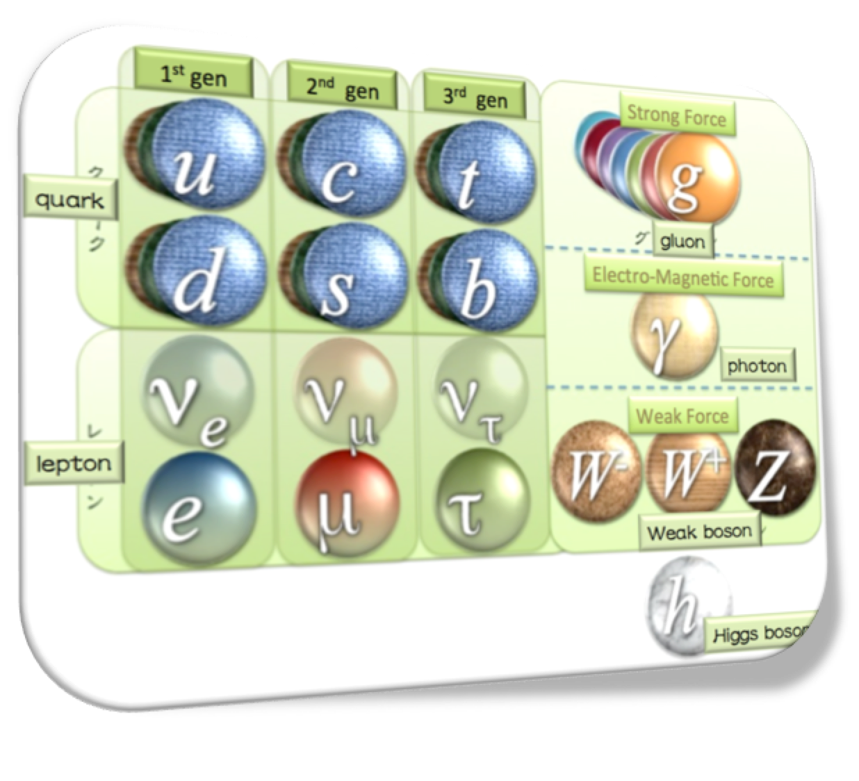
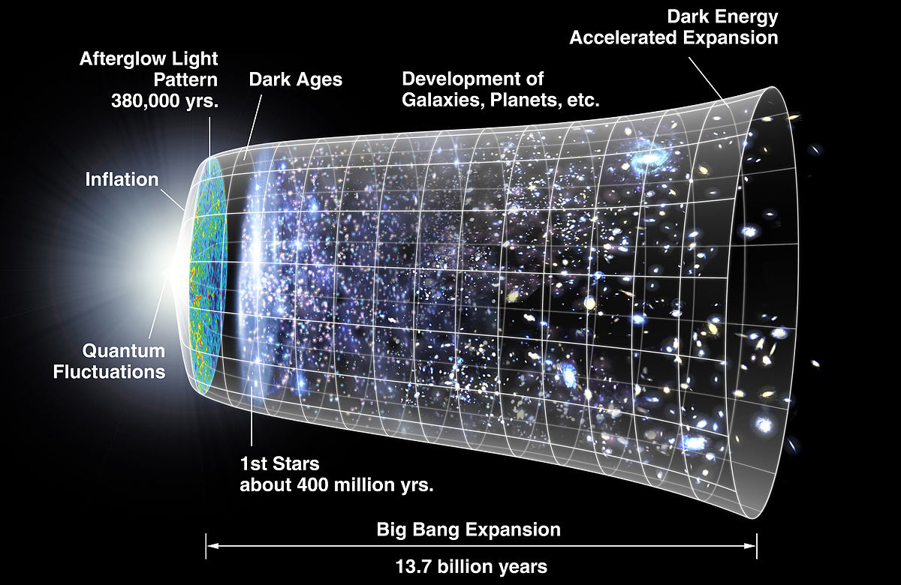

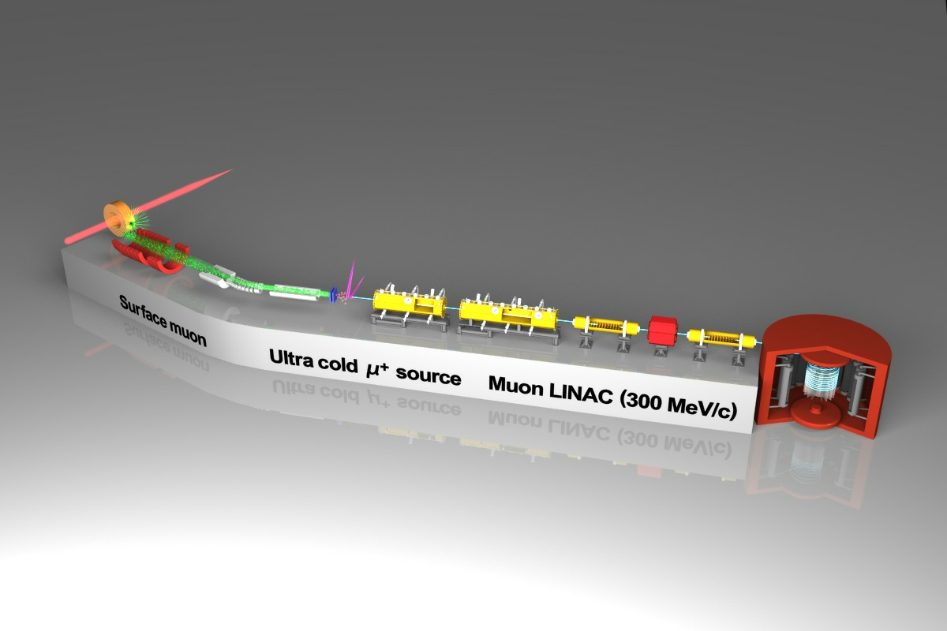



A history of universe inscribed on the elementary particle, muon
- a novel technique to measure the dipole moments (g-2/EDM) of the muon at J-PARC –
Naohito SAITO ( J-PARC / KEK / U of Tokyo)

Slide 2
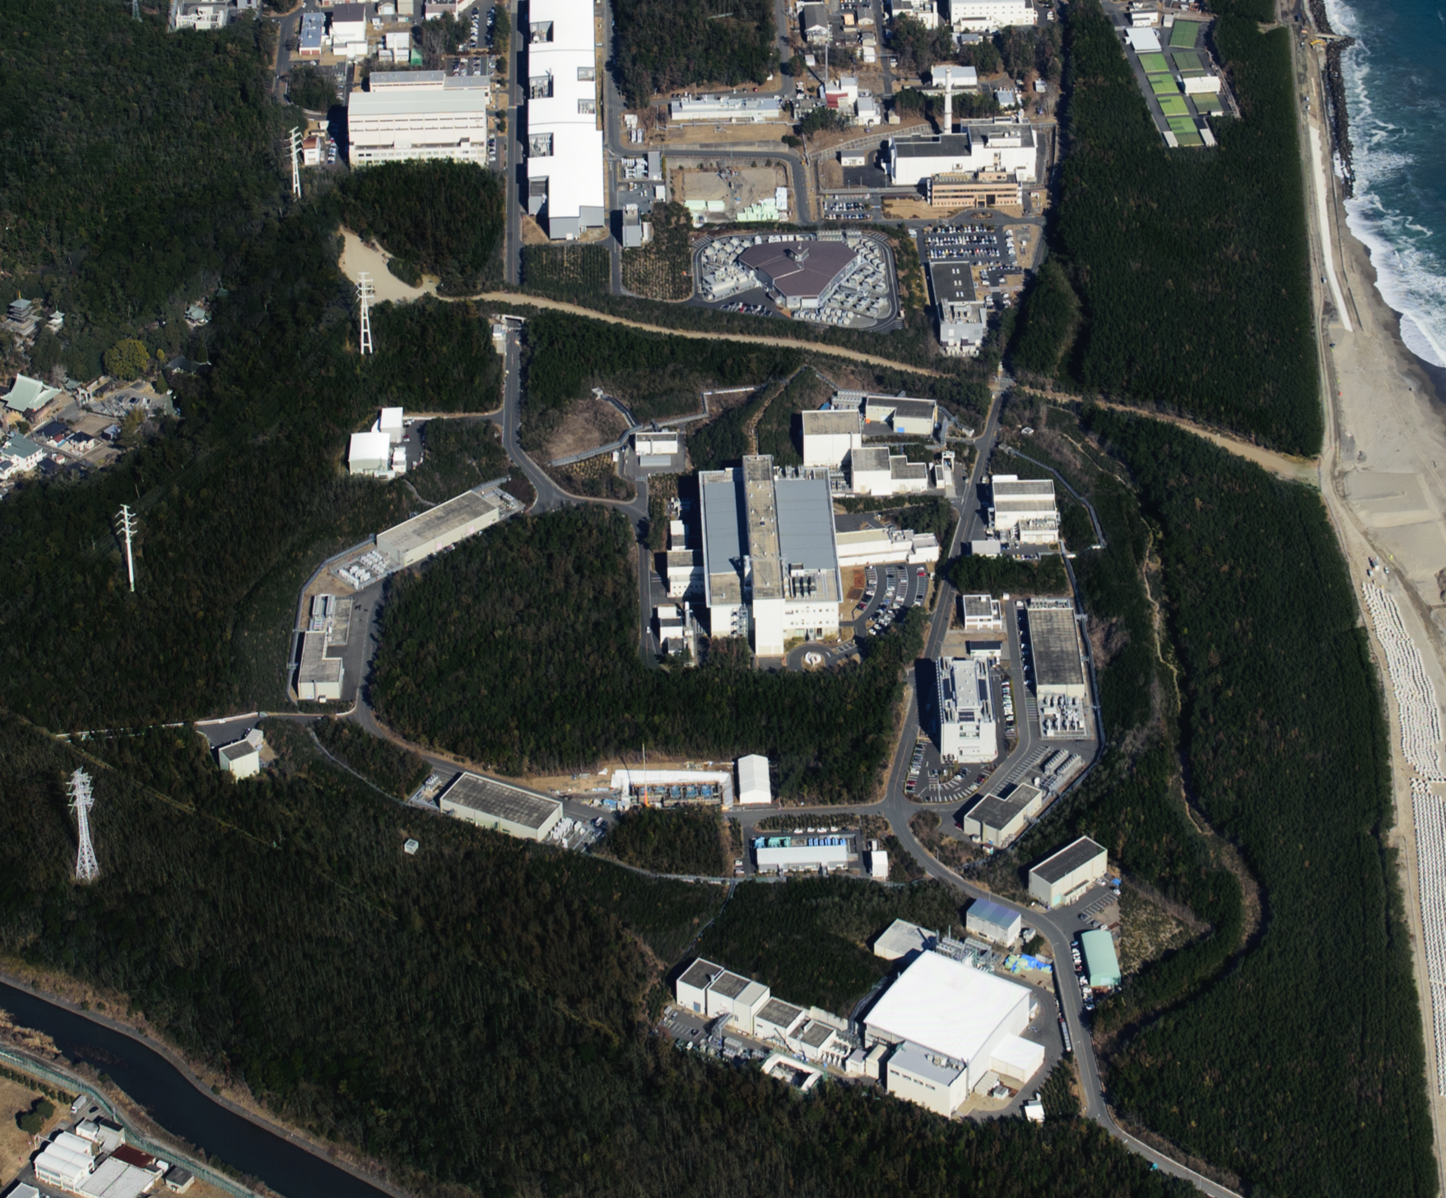


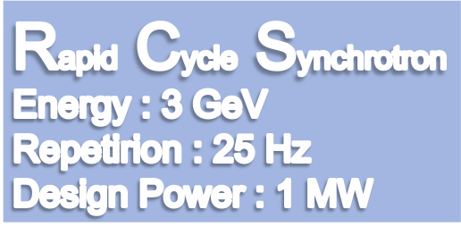


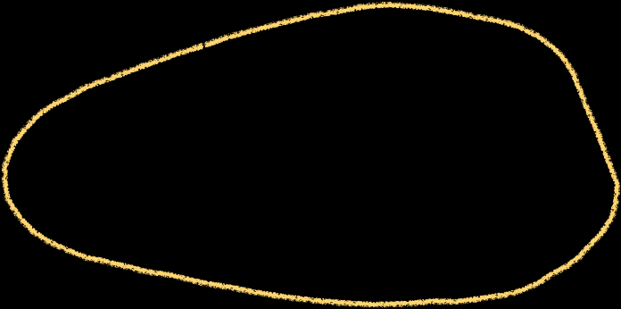

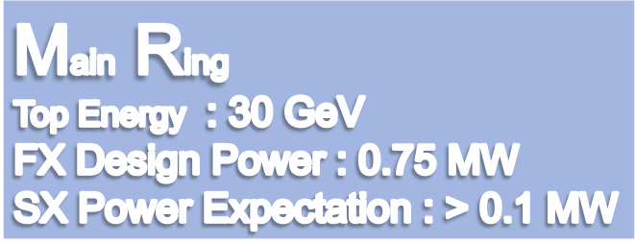
LINAC
400 MeV
Neutrino Beam to Kamioka
Material and Life Science Facility
Hadron Hall
Notes:
まず、こちらが、J-PARCの加速器複合施設です。陽子ビームを１８１MeVまで加速する（来年度以降４００ MeVになる）線形加速器ライナックがあり、その後、ビームは、40 msという短い時間の間に3 GeVまで加速されます。そのビームのほとんどは、この物質生命科学実験施設で中性子やミュオンを使った実験の為に使われています。

Slide 3

D'où venons-nous ? Que sommes-nous ?
Où allons-nous ?
Where we came from? What are we? Where we go?
P. Gauguin 1897, Boston Museum

Slide 4
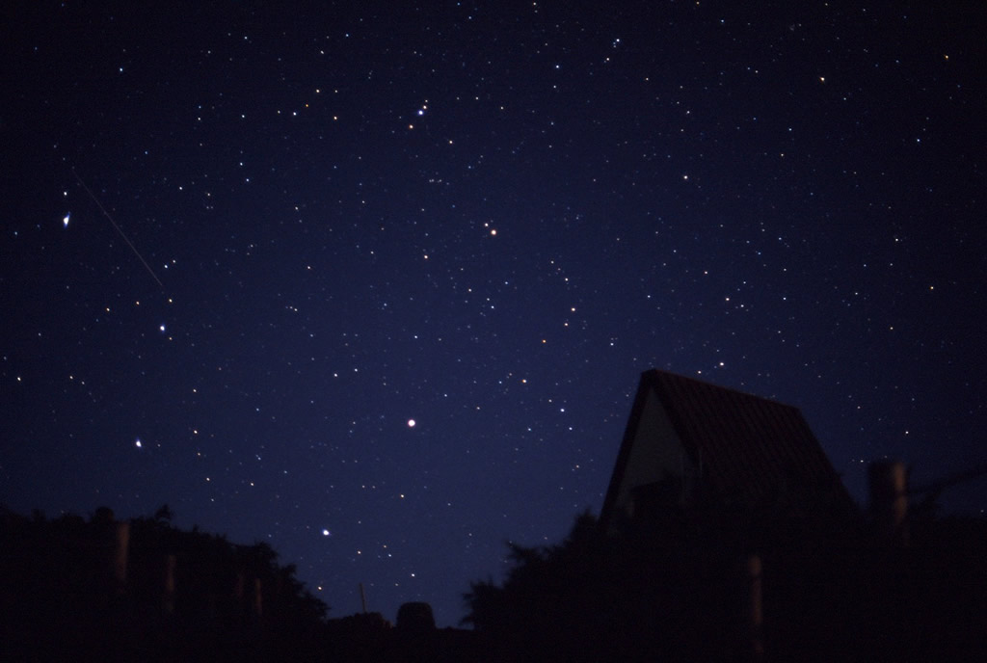
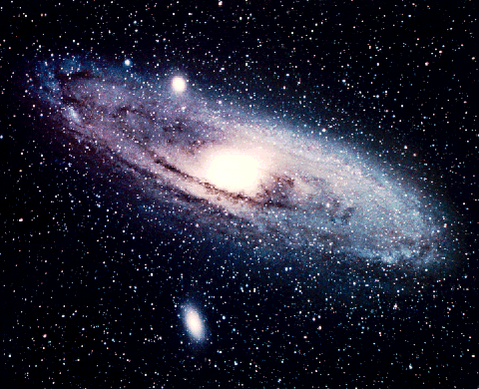
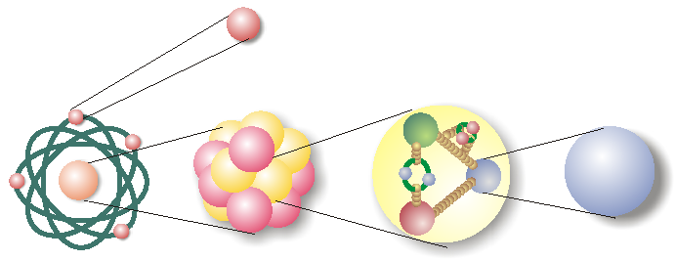


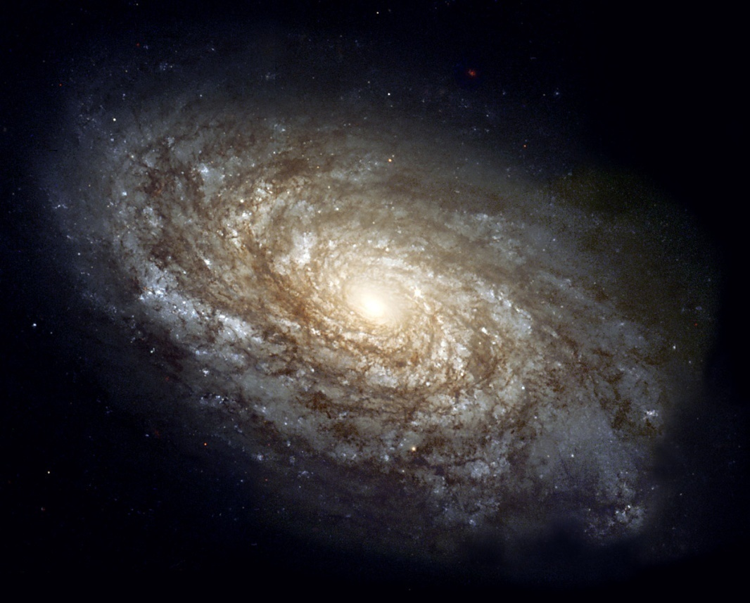


Where we came from?
electron
atom
nucleus
nucleon
quark
Origin of Matter?
Where we go?

Slide 5
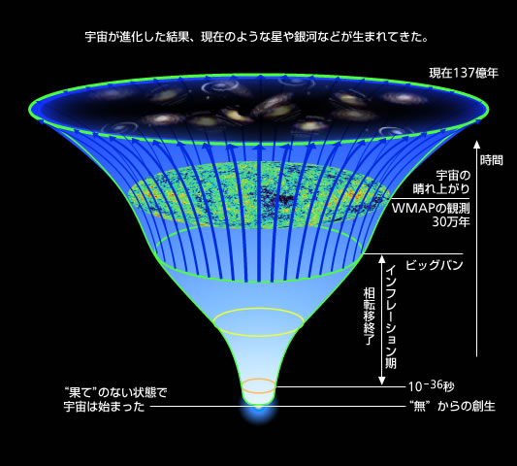
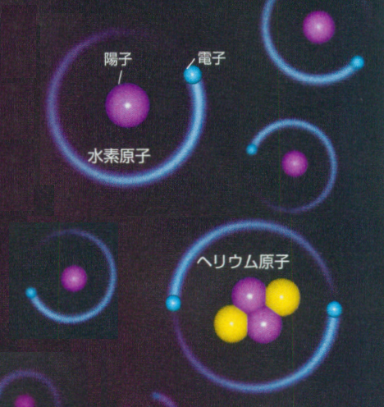
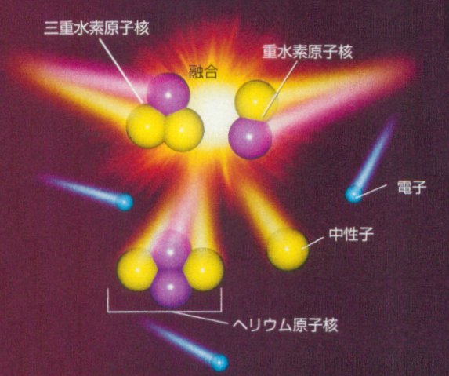
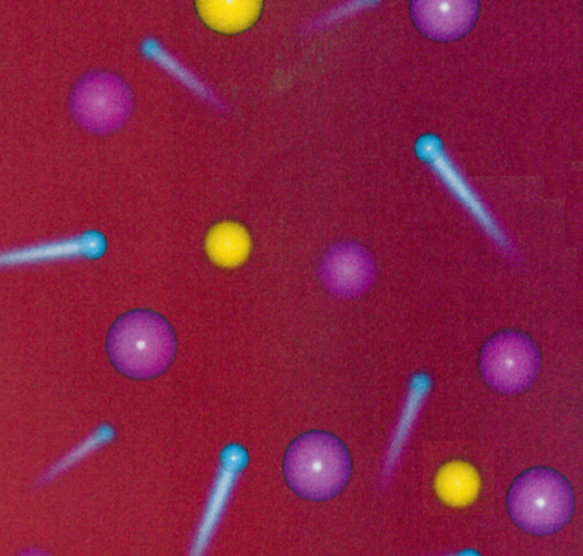
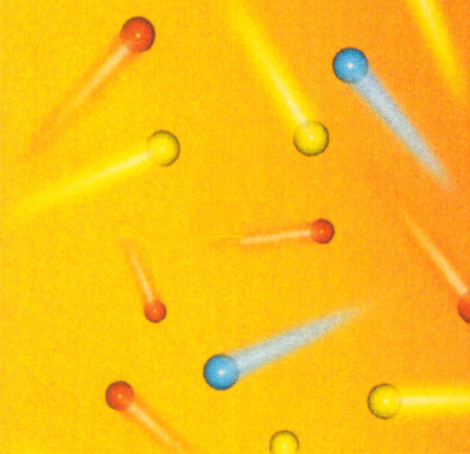
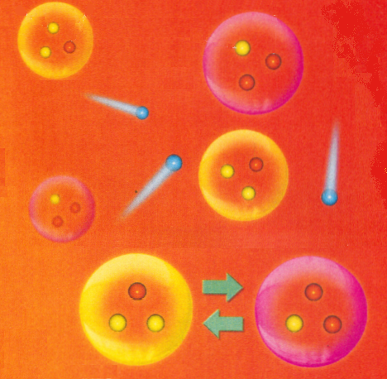
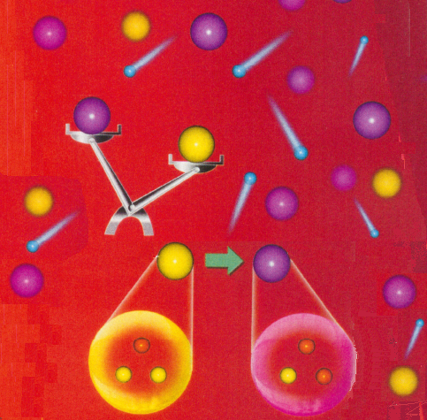
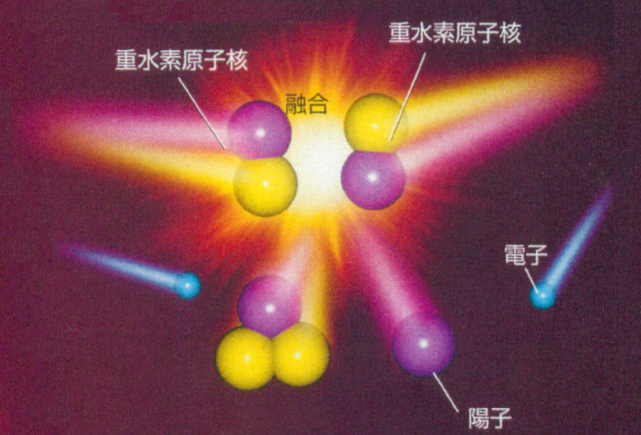
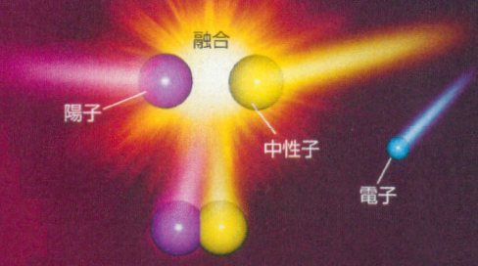
中性子は陽子に崩壊
陽子：中性子＝100：22
クォーク・電子が
自由に動き回る
クォークが核子の中に
閉じ込められる
原子が形成される
佐藤勝彦原画/横山広美改案/吉田（株）TTI制作
Notes:
Precision measurements in Particle, Nuclear and Astro physics have been revealing the close connection of these fields. Especially we have a reasonable knowledge of the history of the universe which is also the history of the fundamental force have been separated into four different interactions.

Slide 6
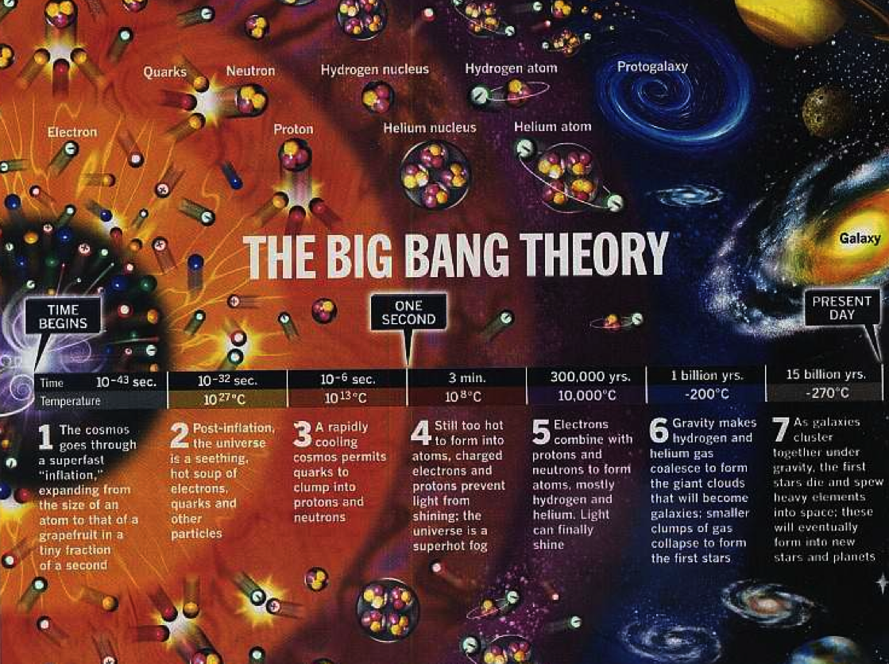

9/1 Solar System Formed
9/3 The birth of the Earth
9/22 Ocean formed;
the beginning of life?
12/16 Ice-Ball Earth
12/17 Cambrian Explosion
12/30 Extinction of Dynasour
12/31
19:33 Sahelanthropus
tchadensis appeared
21:27 Australopithecus
appeared
23:52 Homo-sapiens appeared
If we compress into a year….
The very first day of the year
Jan. 27th

Slide 7
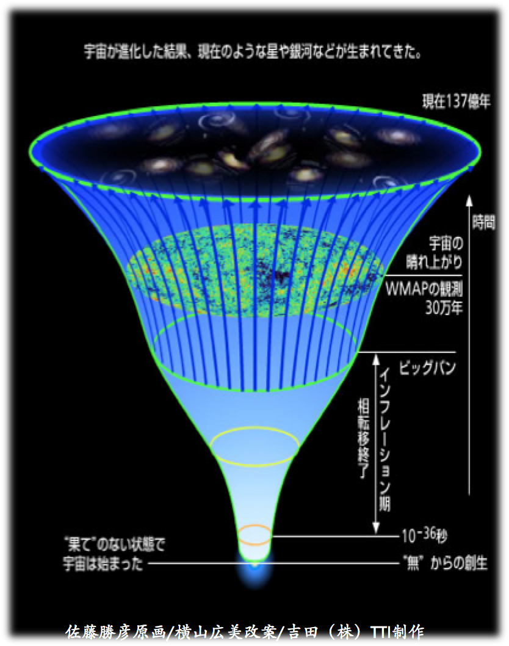
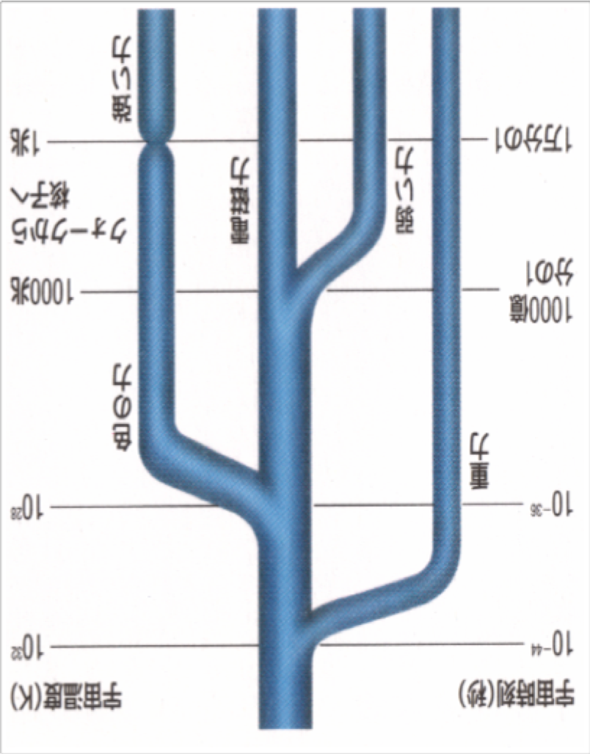
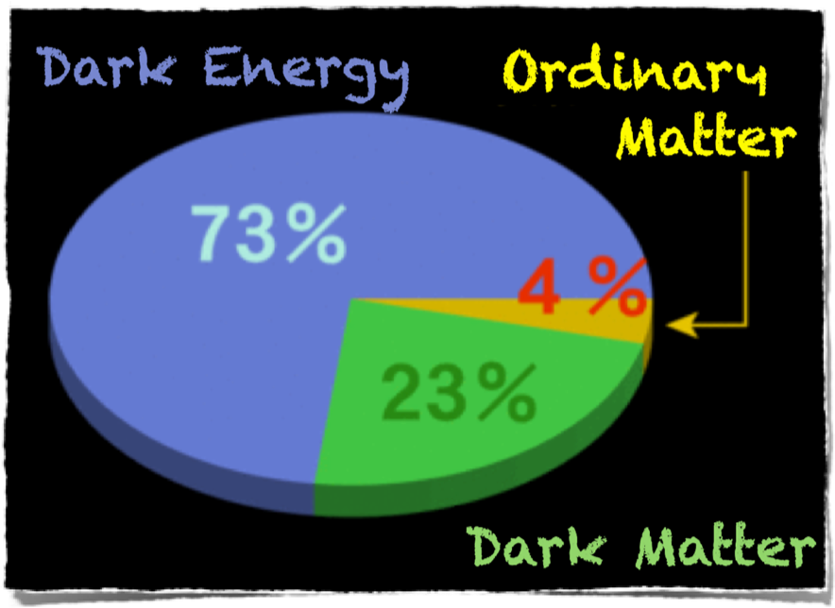

History of Universe & the Standard Model
13.8 billion
years
nuclear force
10¹²
10⁻⁶
quarks to nucleon
atom
weak force
forms
electro-magnetic
force
Time
10¹⁵
WMAP
300 K years
10⁻¹¹
The Standard Model
Big Bang!
strong force
gravity
10²⁹
10⁻³⁶
Inflation
10³²
10⁻⁴⁴
second
temperature (K)
time (sec)
birth from “nothing”
courtesy Prof. Katsuhiko SATO / Prof. Hiromi YOKOYAMA /YOSHIDA (Co.) TTI production

Slide 8


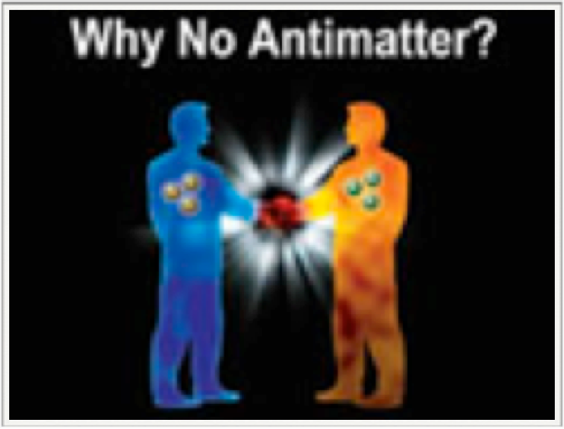


Higgs Particle Discovery
Completion of the Standard Model
Why 3 generations?
Why CP violates? (particle-anti-particle asymmetry)
Why mass distributed this way?
Baryon number, Lepton number, Lepton flavor violated?
What is Dark Matter (non-baryonic)?
What is Dark Energy?
How we should understand the gravity?
Why our Universe is matter-dominant?
Is super-symmetry real?
CP
Violation
x~100 heavier

Slide 9


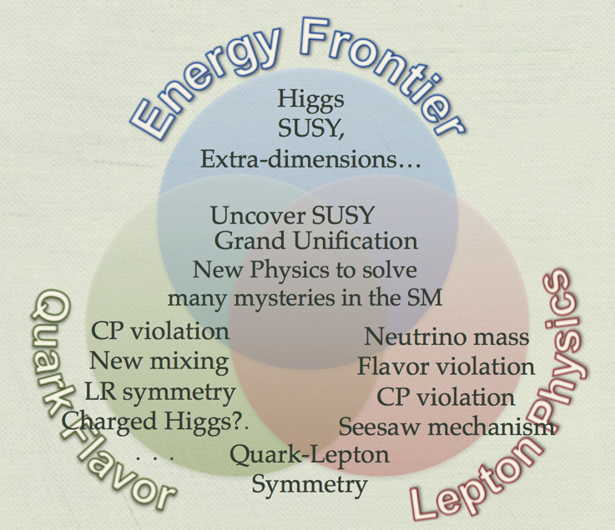
Hi-Energy Frontier
New phenomena may exist in the unprecedented energy region
→LHC, ILC and future colliders
Astrophysics
Hi-Intensity Frontier
Ultra-precision measurements may provide a hint for New Physics!
→Hi-Luminosity lepton colliders, Hi-Intensity Proton Drivers

Slide 10
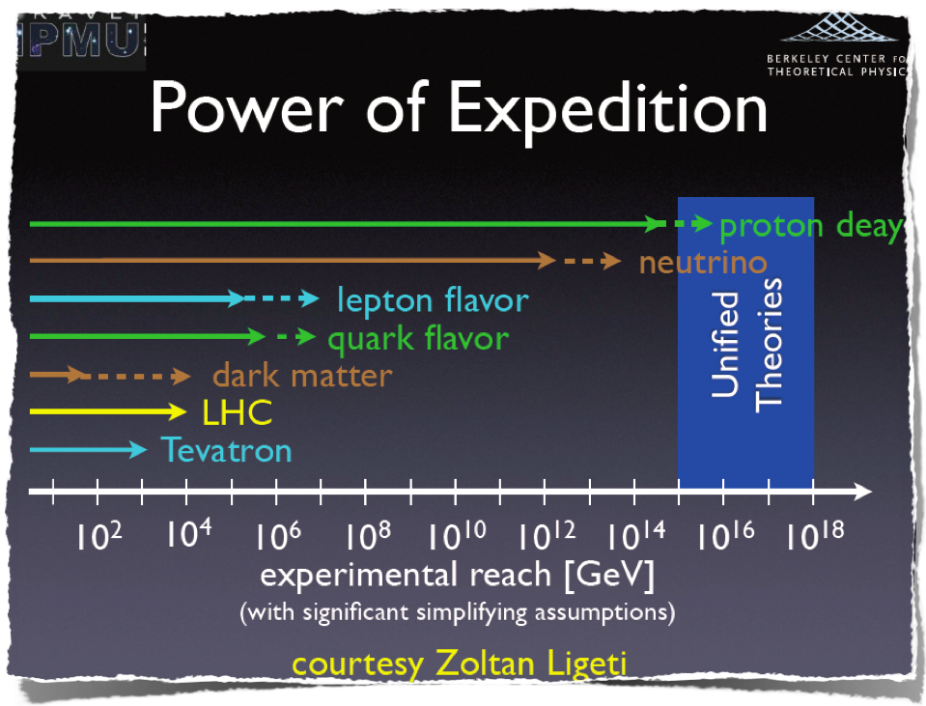
a slide by Hitoshi Murayama

Slide 11

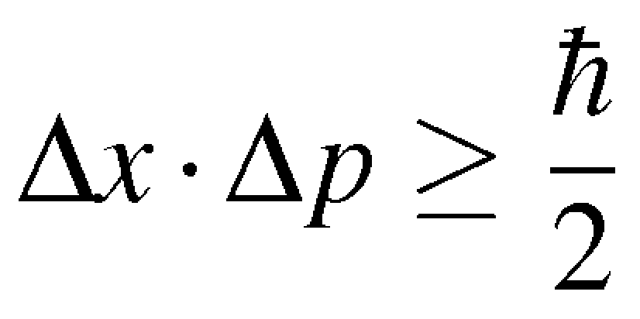

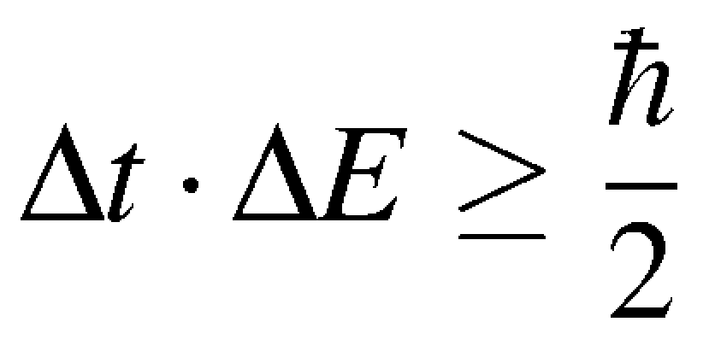
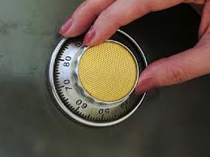
Uncertainty Principle
Position and Momentum cannot be determined simultaneously
  Measurement of position would disturb the quantum state so that momentum measurement would become inaccurate
Time and Energy cannot be determined simultaneously
  Energy conservation can be violated if in a short time interval

Slide 12
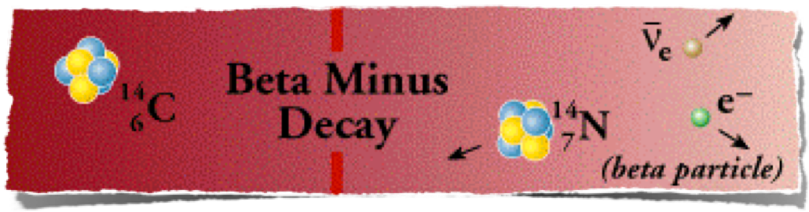
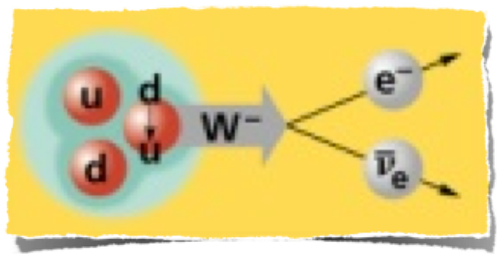
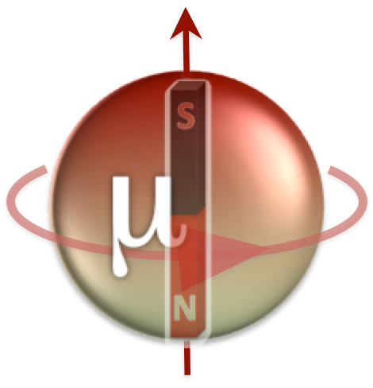
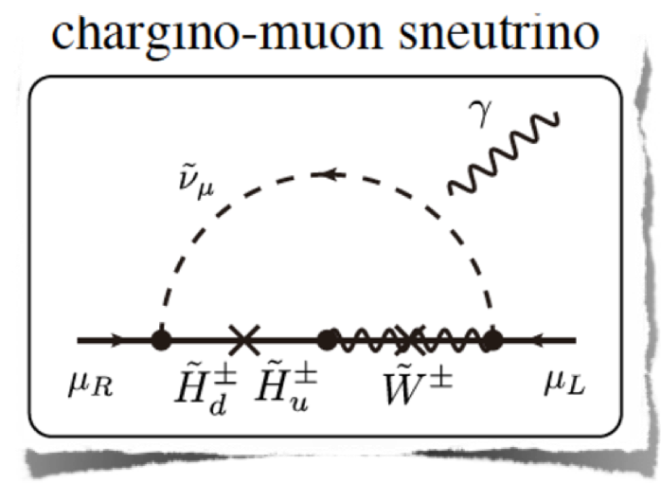
Examples
Beta decay of neutron to proton
  mediated by W boson
neutron mass ~ 1 GeV/c²
W boson mass ~ 80 GeV/c²
Muon g-2 (anomalous magnetic moment)
measured value > the SM theory by 3 standard deviation --> possible explanation is NEW PHYSICS
muon mass ~ 0.1 GeV/c²
possible new physics scale ~ 1 TeV/c²
Muon remembers the trace of new physics, or all possible new physics process which might have happened in the history of universe

Slide 13

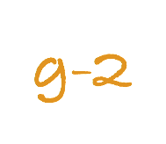


Muon Spin
+
-

Slide 14
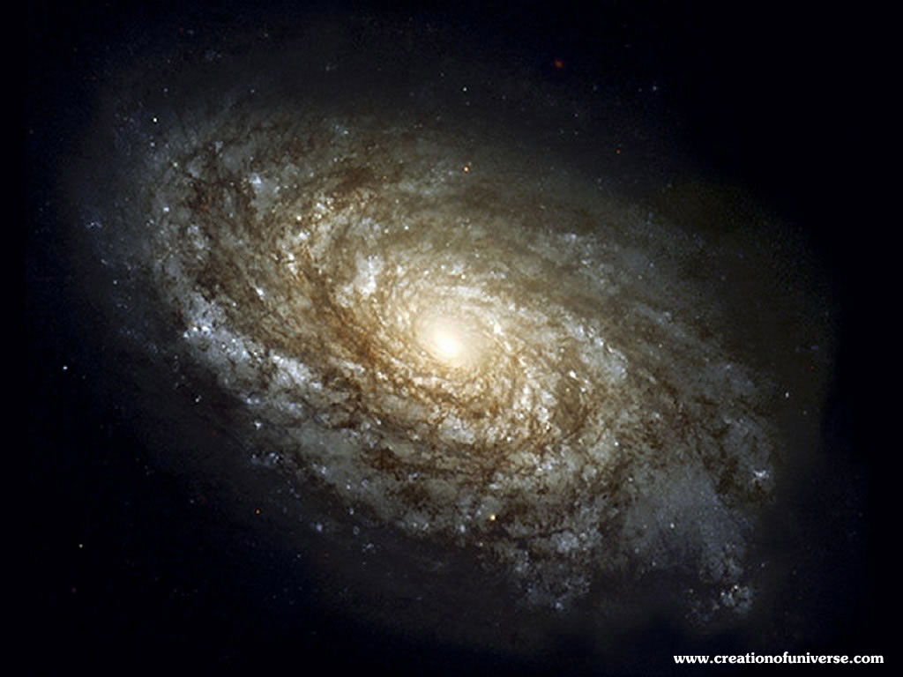

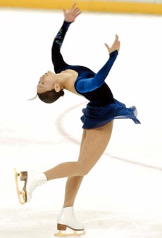

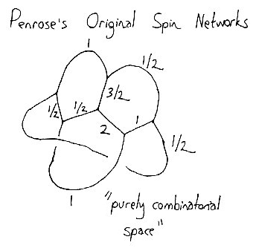
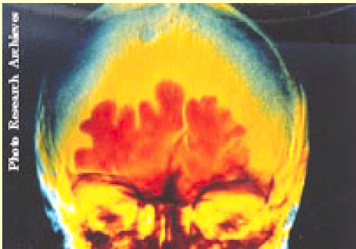
Why Spin?
Fundamental Concept in Physics
  Appears in Many Different Levels
    Galaxy to Space-Time Structure
Fundamental Quantum Number for Elementary Particles
Important in Symmetry Test
  Parity
  Time Reversal

Slide 15
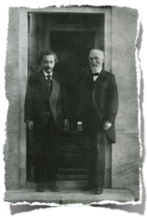
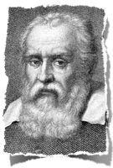
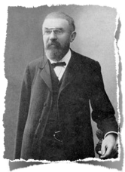
Poincaré Group
Includes Lorentz Transformation and Translational Transformation
Poincaré group is decomposed into two rotational groups
Rotational group is generated from spin : origin of spin in the quantum field theory
Spin originates in space-time symmetries e.g. Lorentz and translational symmetries
Particle is described by the basis, which has a close relation to the space-time structure.

Slide 16
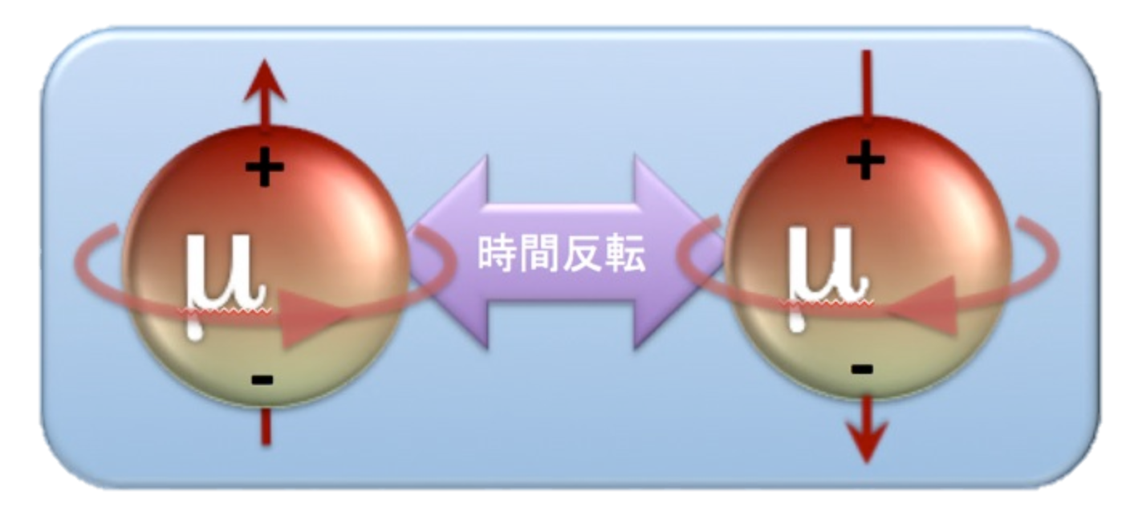
Particle Dipole Moments
Magnetic and Electric Dipole Moments are related to Spin of the Particle: axial vector
T
MDM (Magnetic Dipole Moment)
Contains contributions from ALL PHYSICS!
- EW, QCD, and New Physics
⇒ precision test of the SM
⇒ the most precise determination of α_{EM} from electron g-2 (0.37 ppb)
EDM (Electric Dipole Moment)
If EDM nonzero, T&P is violated
⇒ CP violation in the lepton
sector (CPT = 1 (theorem))
⇒ leptogenesis?
⇒ Baryon Asymmetry in the
Universe

Slide 17
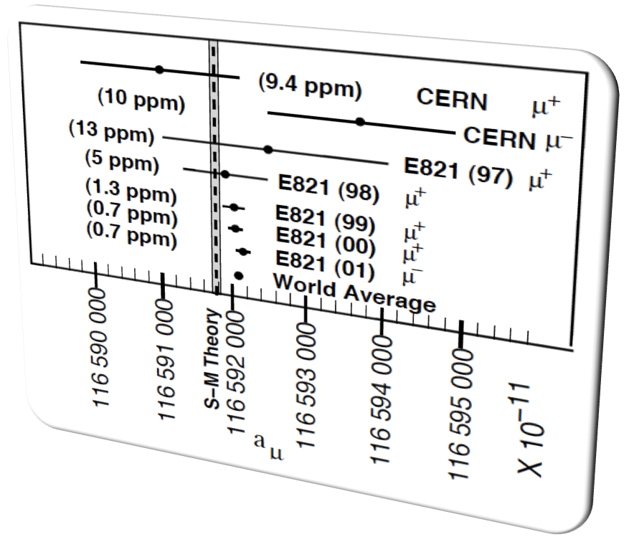
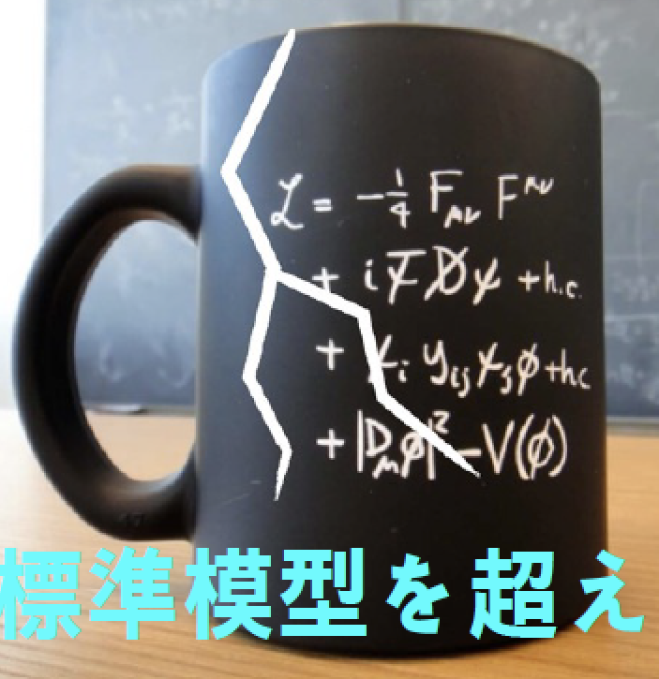
“Final Report” of Anomalous MDM BNL- E821 Experiment : Phys.Rev.D73:072003,2006.
E821 at BNL-AGS measured down to 0.7 ppm for both μ+ and μ−
3.4 sigma deviation from the SM
  SM prediction OK?
  New Physics?
Need to explore further
Preferably by
NEW METHOD!

Slide 18
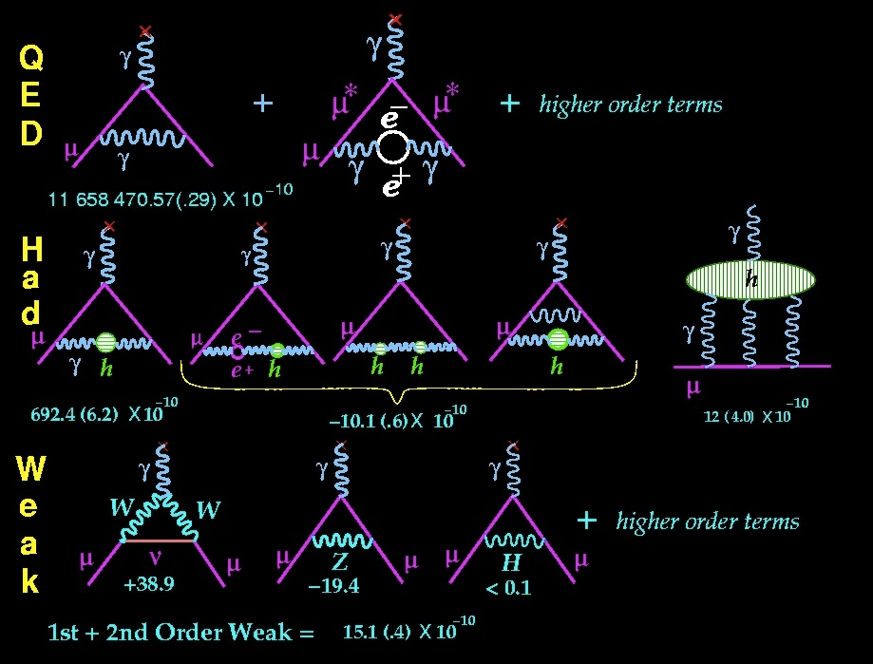
SM Contribution to
a≠0
Any particle which couples to muon/photon would contribute : QED >> Hadron > Weak
~1.2 x 10⁻³ (σ~1ppb)
~6.9 x10⁻⁸(σ~0.41ppm)
~1.5 x 10⁻⁹(σ~0.02ppm)
Courtesy Lee Roberts

Slide 19
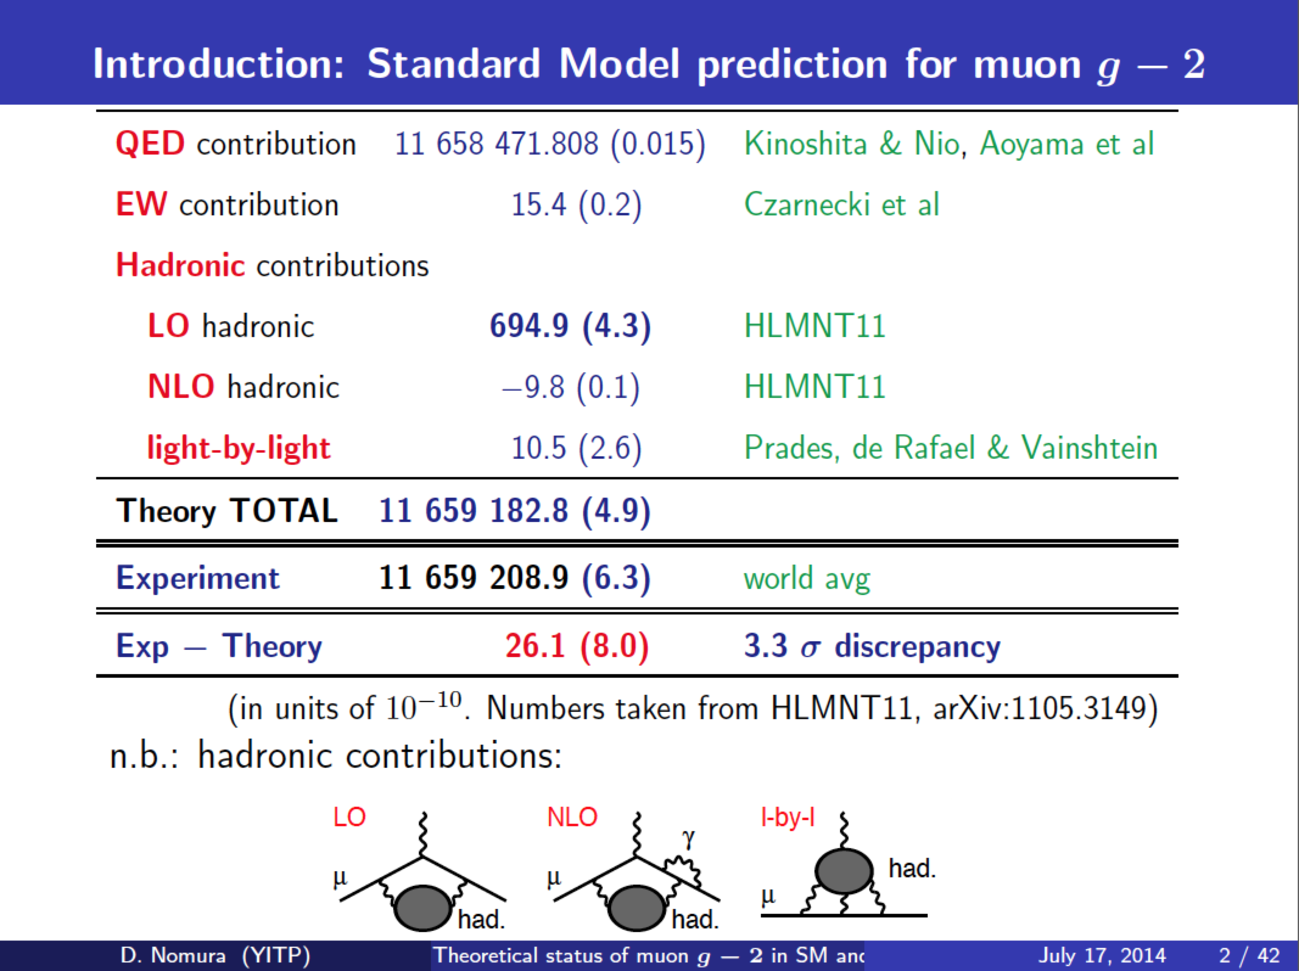
Slide by D. Nomura

Slide 20
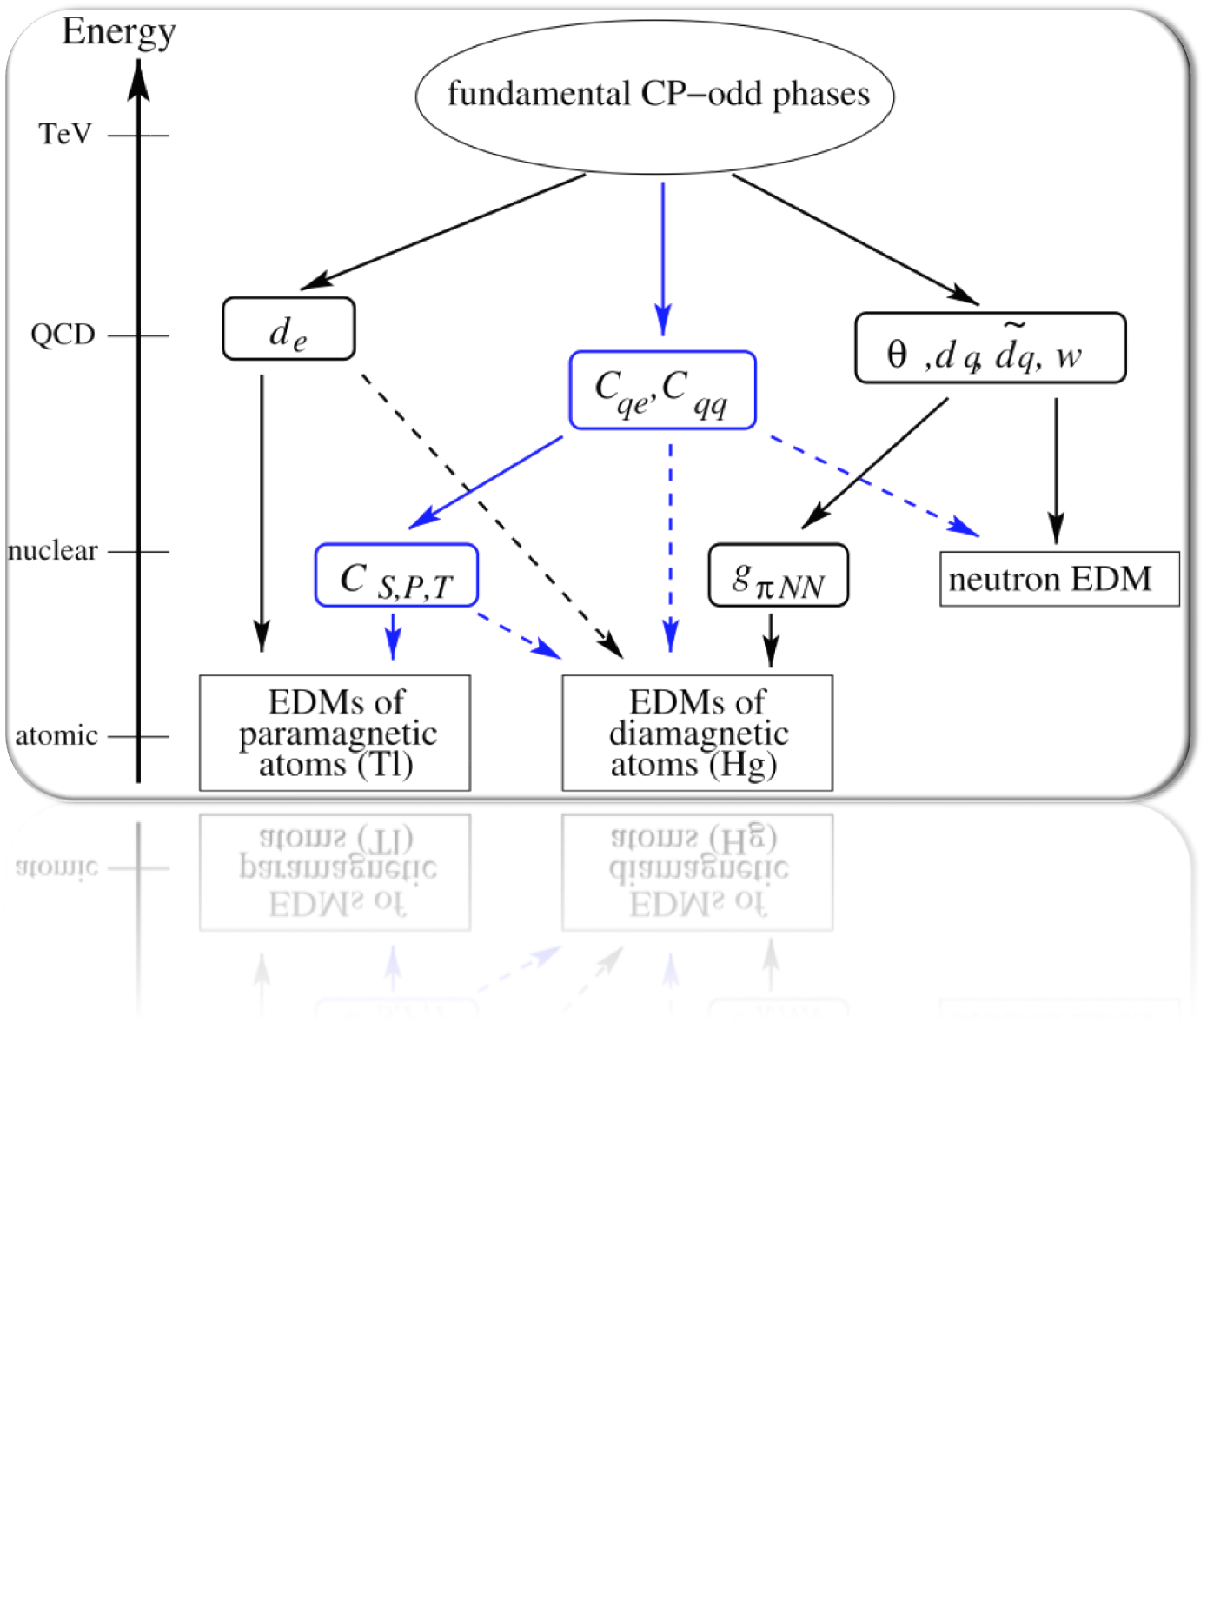
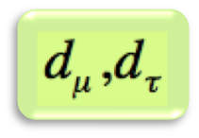
Origin of EDM and CPV
M.Pospelov and A.Ritz, Ann.Phys. 318 (2005) 119
CPV
In quark sector
CPV
in neutrino
12

Slide 21


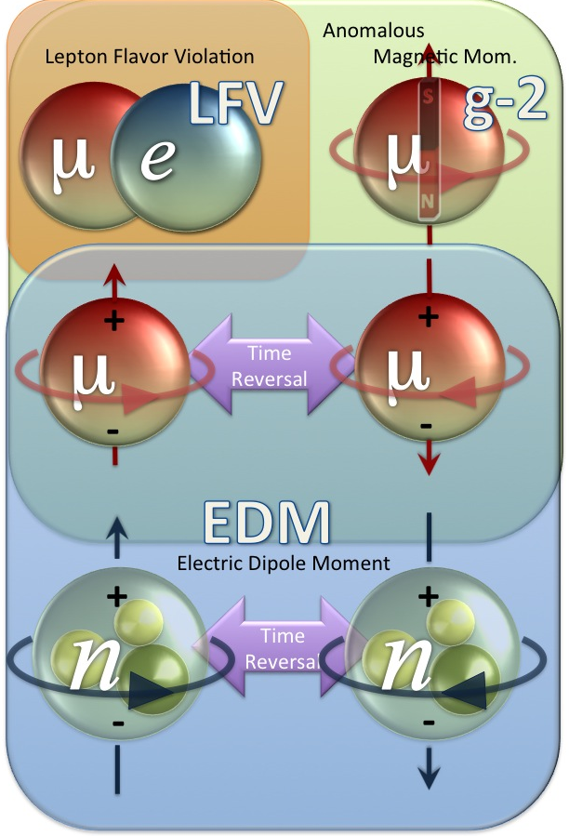





Improve by x 100
and more
(10⁻¹²--> 10^{-14; -16} )
Lepton and EDM Physics at Intensity Frontier Machine : J-PARC
cLFV
Search for Charged Lepton Flavor Mixing
Charged Lepton Flavor Mixing and Origin of Matter
g−２
Precision Measurement of Anomalous Magnetic Moment
Muon Precision Experiment to search for New Physics
Improve by x 5
(0.1 ppm )
Improve by x 100
and more
(1x10^{-21; -24} e cm )
μEDM
Search for Electric Dipole Moment
Space-time Symmetry and Origin of Matter
SUSY Mass Matrix
nEDM
Search for Electric Dipole Moment
Space-time Symmetry and Origin of Matter

Slide 22










Bird’s eye photo in Feb. 2008

Slide 23



Proposed experimental site
Material and Life science Facility
Parking lot
g-2/EDM
storage magnet
H-Line
muon linac
muon
production
target
Mu-HFS
DeeMe
sparation neutron
source

Slide 24






g-2
CP-even
3 GeV proton beam
( 333 uA)
Silicon Tracker
Surface muon beam
(28 MeV/c, 4x10⁸/s)
66 cm diameter
Muonium Production
(300 K ~ 25 meV)
Super Precision Magnetic Field
(3T, ~1ppm local precision)
Resonant Laser Ionization of Muonium (~10⁶ μ⁺/s)
EDM
CP-odd
23

Slide 25

















Magic vs “New Magic”
Complimentary!
BNL/Fermilab Approach
J-PARC Approach
14m diameter
22

Slide 26






What’s Different?
Tertiary Muon Beam
  Widely spread over phase space
  Contamination of pion
Electric Field for Focusing ⇒ Magic Momentum
Electric Focusing
~10 cm
Injection
No Focusing
⇒ Any Momentum
Ultra-Cold Muon Beam
Can be contained in the detection volume w/o focusing
Yield?
No Focusing
~10 cm
Injection
21
< 10 cm spread over 10 km travel

Slide 27


Ultra-cold Muon
Requirement for zero E-field:
Muons should be kept stored without E-focusing
→ Beam with ultra-small transverse dispersion,
i.e. Δp_{T}/p ~0
Laser resonant ionization of Mu (μ⁺e⁻)
re-acceleration
p =
28MeV/c
3 keV/c
300 MeV/c
Δp_{T}/p ~3 keV / 300 MeV =1E-5

Slide 28



“Enhancement Paper” Published!!

Slide 29

Ultra-cold Muon Beam at H-line
Design of H-line and the muon acceleration test
Surface muon beam
(4 MeV, ~1000π mm mrad)
1 m
blocker
Accelerated muon beam
(25meV→40 MeV, 1.5π mm mrad)
blocker
Mu
production
Bending
Magnet
Beam
Blocker
Solenoid
Initial
accel.
Beam
Profile Monitor
Q-magnet
RFQ
IH DAW
Laser room

Slide 30




Ultra-cold Muon Beam at H-line
Design of H-line and the muon acceleration test
PTEP 091C01 (2014)
PTEP 103C01 (2013)
1 m
Mu production target test
BPM test
Surface muon beam
(4 MeV, ~1000π mm mrad)
1 m
blocker
Accelerated muon beam
(25meV→40 MeV, 1.5π mm mrad)
blocker
Mu production
Bending
magnet
ビーム
シャッター
ソレノイド
Initial
accel.
Beam
Profile
Monitor
四重極磁石
RFQ
IH DAW
M. Otani et al., Phys. Rev. Accel. Beams 19, 040101 (2016)
レーザー室
Electro static acceleration
IH-type DTL
J-PARC proton RFQ test

Slide 31

World First Muon Acceleration to 200 MeV
Bunching
Section
External coupling
structure for low-β
Similar to electron
accelerator to obtain
high gradient.
High hunt impedance
M. Otani et al., Phys. Rev. Accel. Beams 19, 040101 (2016)

Slide 32


Muon Beam Injection and Storage
Horizontal injection + kicker
(BNL E821, FNAL E989)
3D spiral injection + kicker
(J-PARC E34)
Injection efficiency : 3-5%(*)
(*) PRD73,072003 (2006)
Injection efficiency : ~90%
A paper was submitted to NIMA in Oct 2015
by H. Iinuma et al.

Slide 33



B-field shimming test with a medical MRI magnet (1.7 T) at J-PARC
Shim tray

Slide 34

B-field uniformity
Before shimming
BNL E821 final report
370 ppm
B(μT)
-630 ppm
azimuthal angle (rad)
axial position (mm)
0.4 ppm
After shimming
B(μT)
-0.5 ppm
azimuthal angle (rad)
r = 140 mm
axial position (mm)
Submitted to IEEE Transactions of Applied Superconductivity, by K. Sasaki et al. (2016)

Slide 35



Muon storage magnet and detector
Iron yoke
Cryogenics
Muon storage orbit
2900 mm
Radial tracking vanes (Silicon strip)
e+ tracking
detector
Super conducting coils
Positron track
μ decay
vertex
666 mm
35
35
35
p(e+) > 200 MeV/c

Slide 36



Muon storage magnet
B_{r}
Injection
region
z (m)
storage
region
Muon storage
region
r
Magnet consists of four super-conducting coils surrounded by correction coils and iron yoke.
  main field : B = 3 T (local uniformity 1ppm)
  injection field : B_{r} > 0 (z > 5 cm )
  focusing field : B_{r}/B₀ = 10ppm/cm (n=1E-4) ( |z| < 5 cm )

Slide 37



Development of positron detector
First working test module
tested with muon beam (June 2017)
Test DAQ system
(DAQ middleware)
KEK
Mechanical
Engineering
Center
Y. Sato

Slide 38


Muonium HFS and μ_{μ}/μ_{p} ratio
Future g-2 experiments (~0.1ppm) require more precise determination of magnetic moment ratio μ_{μ}/μ_{p} (current uncertainty : 0.12ppm)
Photo by K. Sasaki
From g-2
measurement
From Muonium HFS
measurement
An improved measurement of Mu-HFS and μ_{μ}/μ_{p} is in preparation at J-PARC (KEK IMSS K. Shimomura et al.)
Picture by K. Tanaka

Slide 39




Summary
Muon property reflects all possible physics process including possible new physics, which happened in the history of universe.
Especially Muon g-2/EDM measurement plays important role in BSM exploration!
We are preparing a novel precision measurements at J-PARC!
There are progress in all fronts of activities
  Muon Source - strong collaboration with TRIUMF
  Magnet design and beam injection - test in progress
  Muon LINAC test in progress - team is expanding!
  Detector : the first production model is going the be readout soon
We invite YOUNG scientists to share more excitements!
Including Young at Heart!

Slide 40


Opportunities for
“REAL YOUNG” at J-PARC
For Young ONLY at Heart …
Please contact us separately
J-PARC Center

Slide 41







Opportunities
Summer student : 2-3 months for some specific activities
  G-2 related activities
    Si detector studies for g-2/EDM
    Muon acceleration studies
    Precision magnet studies
Graduate course enrollment
  Seoul National U.
    Prof. Seonho Choi
  The U. of Tokyo
    Naohito SAITO - g-2/EDM
    Yasuyuki MATSUDA - MuHFS
  Sokendai (KEK graduate course)
    Tsutomu MIBE – g-2/EDM
    Koichiro SHIMOMURA - MuHFS
    Ken-ichi SASAKI – Precision Magnet
    Masashi OTANI – Muon LINAC
  Other universities

Slide 42

http://www.s.u-tokyo.ac.jp/en/admission/
Government Support is Available!

Slide 43

http://www.soken.ac.jp/en/admission/
Government Support is Available!

Slide 44

Join Us!

