Slide 1

Review of ALICE Experiments
尹 珍 姬 (Jin-Hee Yoon)
Dept. of Physics
2017. 6. 17 @ 제 2회 대칭성 탐사단 워크샾

Slide 2
Outline
Introduction
Review of Alice Results
ITS upgrade
Conclusion

Slide 3


Objects
Searching for the initial stage of Universe
From QCD calculation,
  Confining at normal temperature
At high momentum transfer
  α_{S} becomes weak
  asymptotic freedom
  Quark-Gluon Plasma(QGP)

Slide 4

Lattice QCD Calculation
$T_{C}=173±$15 MeV $ε_{C}=0.7±0.2$ GeV/fm³

Slide 5
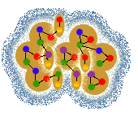
Phase Diagram
RHIC, LHC
Early universe
quark-gluon plasma (QGP)
T_{c}
hadron gas
Temperature
nuclei
Colour super
conductor
nucleon gas
neutron stars
ρ₀
net baryon density

Slide 6
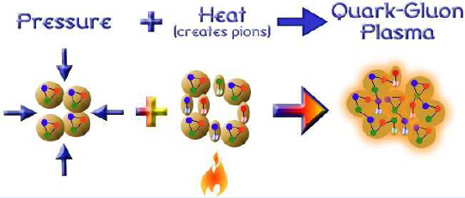
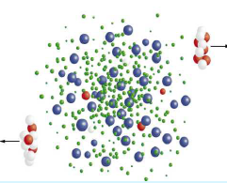
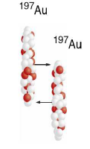
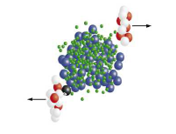
How to produce?
Theoretically
Experimentally
Heavy Ion Collision

Slide 7
Evolutions

Slide 8
QGP in the Universe

Slide 9

Observables?
High energy process
  Energy loss by quarks, gluons and other particles
  Quarkonia and heavy flavour
Low energy process
  Radiation of hadrons and photons (multiplicity, pT spectra, PDF..)
  Azimuthal asymmetry, expansion

Slide 10
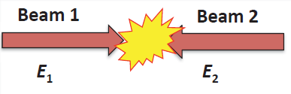

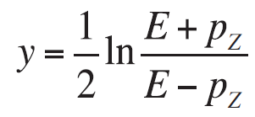
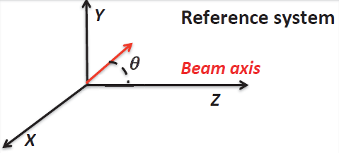

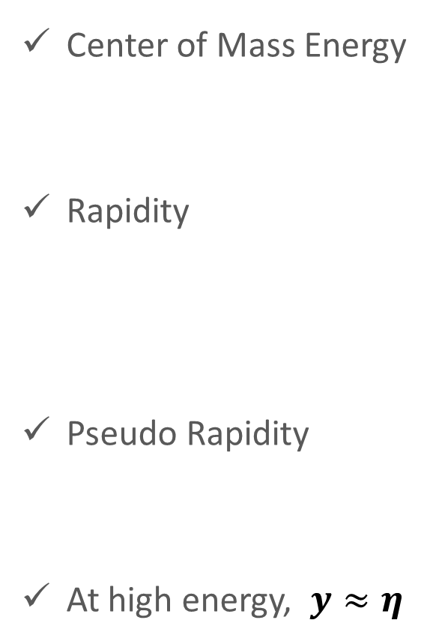
Variables
Center of Mass Energy
Rapidity
Pseudo Rapidity
At high energy, $y≈η$

Slide 11
A Large Ion Collider Experiment
Detector : 16X26 m 10000 tons
Collaborations : 1500 members,
154 institute,
37 countries

Slide 12

ALICE COLLABORATION

Slide 13









Participating Institutes
Participants (39)
6 Univs. + 1 Institute
Prof : 10
PhD : 5
Graduates : 24

Slide 14
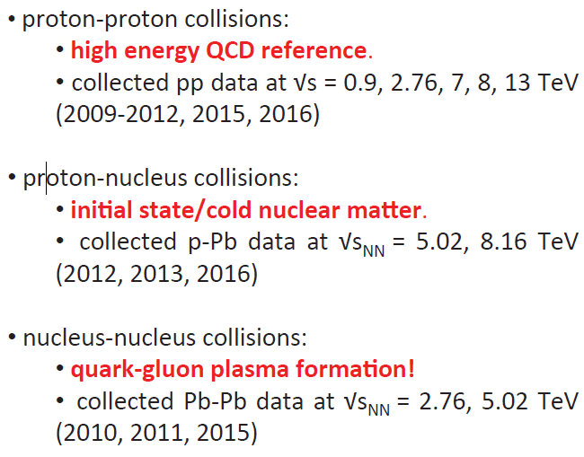
Collisions

Slide 15
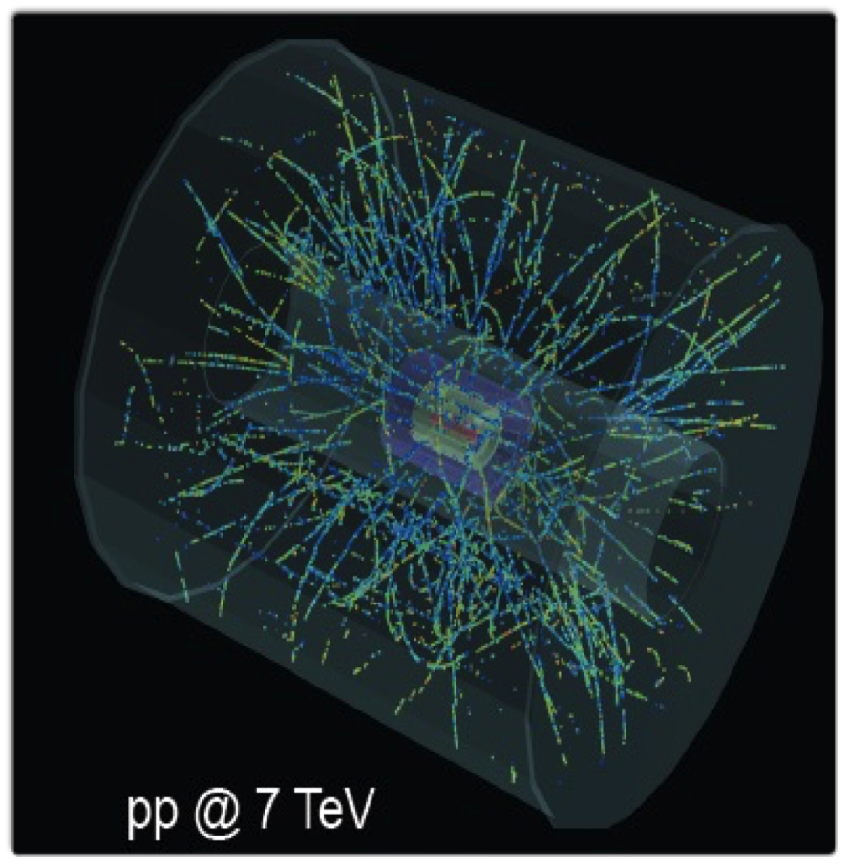
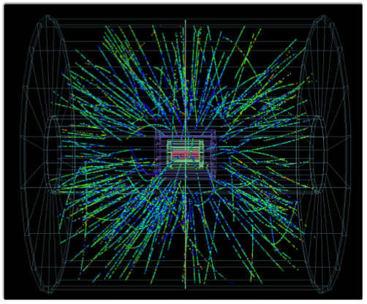
2015 Pb-Pb Event Display

Slide 16
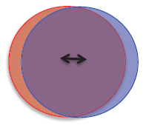
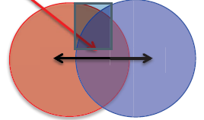
Centrality
“Central”
Small impact parameter
Large system volume
Large particle multiplicity
“Peripheral”
Large impact parameter
Small system volume
Small particle multiplicity
Map these measurements into IP using Models!

Slide 17


Charged particle multiplicity

Slide 18

Soft Probes – Direct photons
Inclusive – Decay = Direct
Prompt
  Hard scattering
  High pT
  Information on PDF, QCD…
Thermal
  Thermal production
  Low/medium pT
  Information on early thermal state(QGP?)

Slide 19
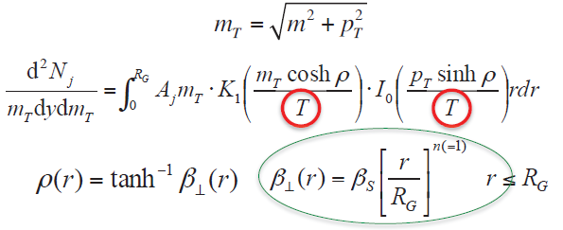
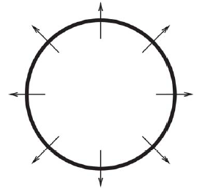
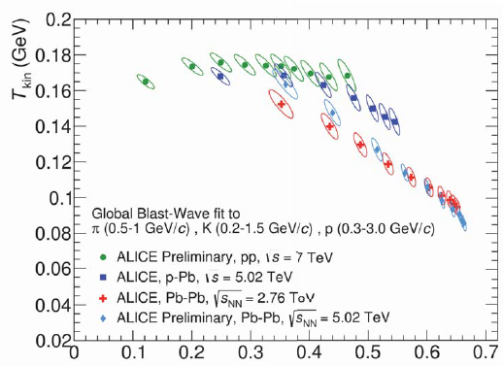

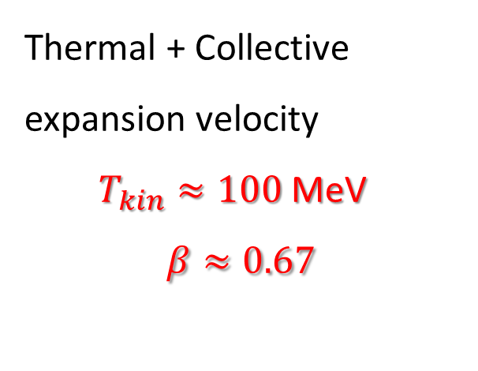
Radial Flow
Thermal + Collective expansion velocity
$T_{kin}≈100$ MeV
$$β≈0.67$$

Slide 20
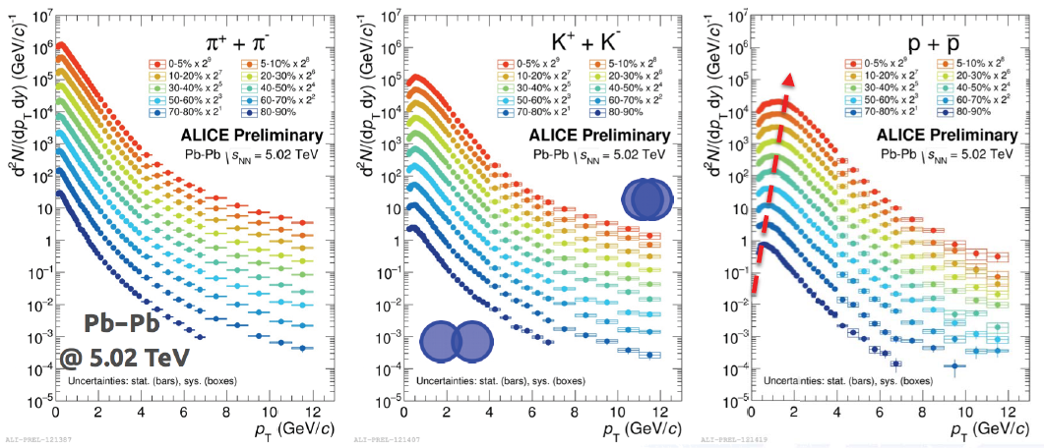
PT spectra of charged particles
Get flatten for more central
Stronger effect for heavier particles
Heavier particles have larger momentum with same velocity

Slide 21
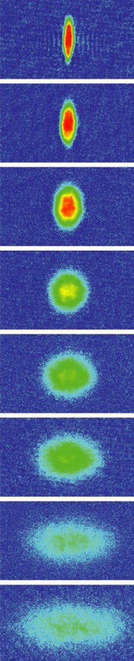
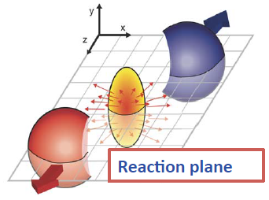
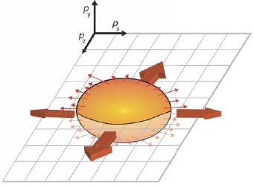


Elliptic Flow
SCIENCE Vol: 298 2179 (2002) ⁷Li
Anisotropy in momentum
space
Spatial anisotropy

Slide 22
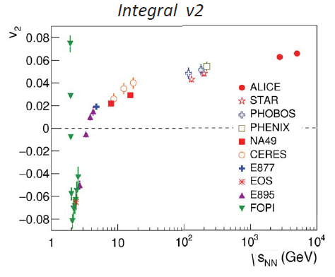
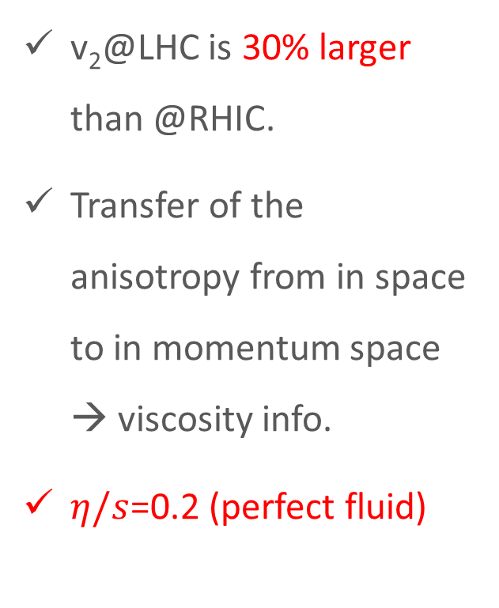
Elliptic Flow
v₂@LHC is 30% larger than @RHIC.
Transfer of the anisotropy from in space to in momentum space → viscosity info.
$η/s$=0.2 (perfect fluid)

Slide 23
Strangeness Enhancement
In elementary pp collisions,
Strangeness products are suppressed relative to the production of light flavors
For a large system, strangeness is enhanced.
How to confirm?

Slide 24
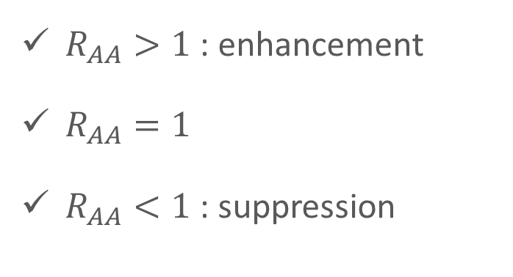
Nuclear Modification Factor
$R_{AA}>1$ : enhancement
$R_{AA}=1$
$R_{AA}<1$ : suppression

Slide 25
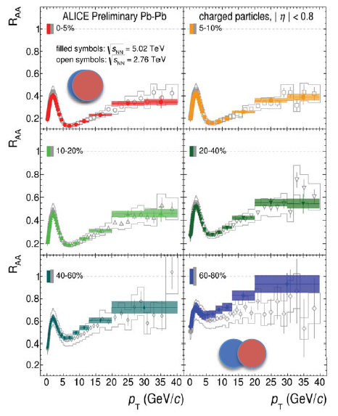
Hard Probes – Jet Quenching

Slide 26
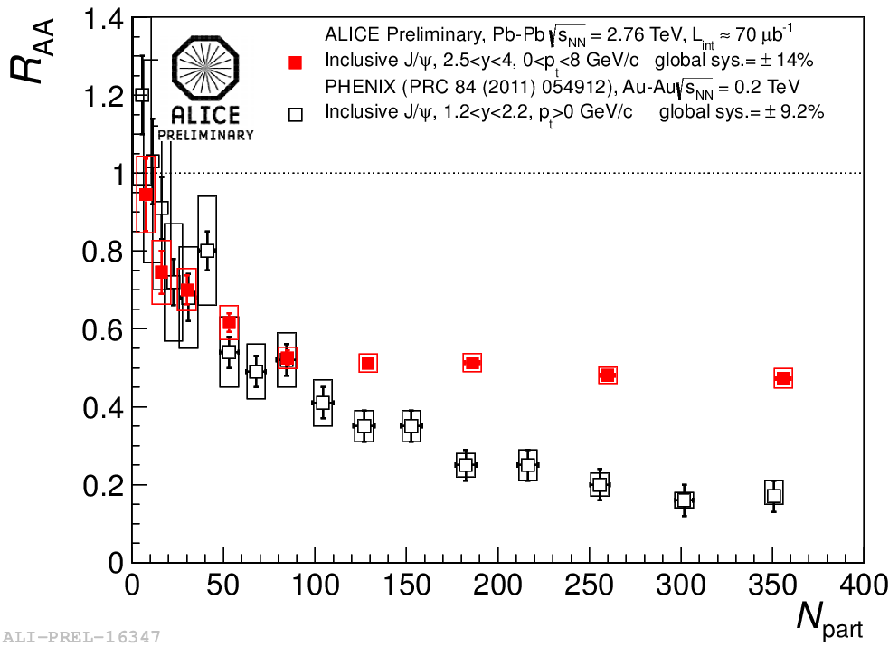

QUARKONIA
$J/ψ$ : pair of c & anti-c
  Inside the QGP, quarks are color-screened → suppression
  Debye length depends on Temp. → thermometer
Less suppression than RHIC
due to recombination
ALICE μμ
Phenix μμ

Slide 27
QUARKONIA
Suppression is independent of centrality.
Need to measure total charm production around pT~0 GeV.

Slide 28
Small systems as reference?
Nuclear initial state
Hot matter in the final state
Nuclear initial state
Cold matter in the final
Hadronic initial
& final state
No phase transition in pp or pA collisions is expected.
But striking similarity across different systems!

Slide 29

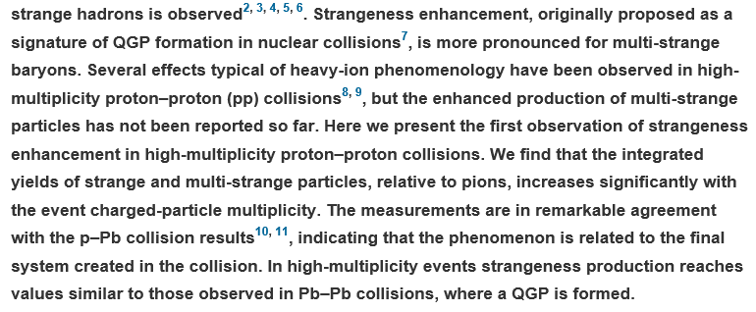
Strangeness

Slide 30
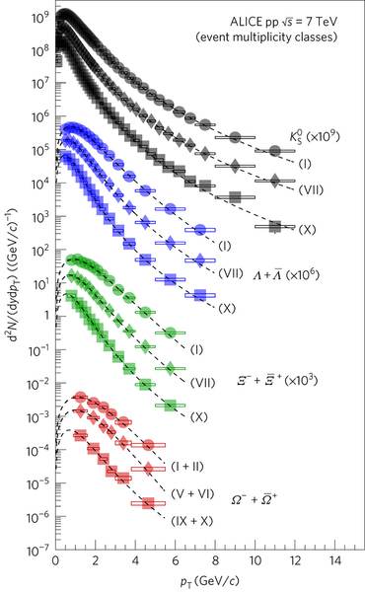
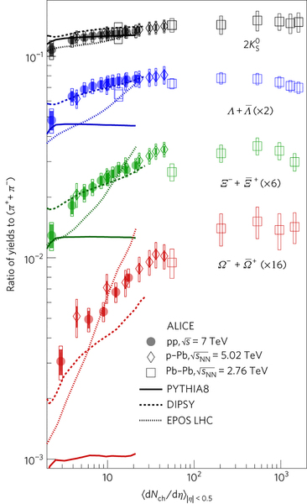
The p_{T} spectra become harder as the multiplicity increases.

Slide 31
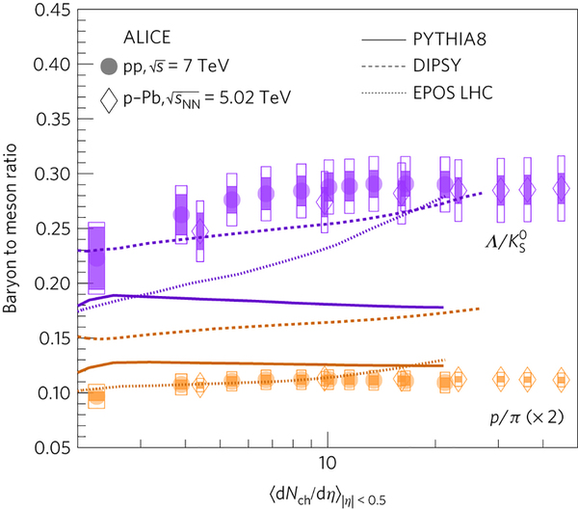
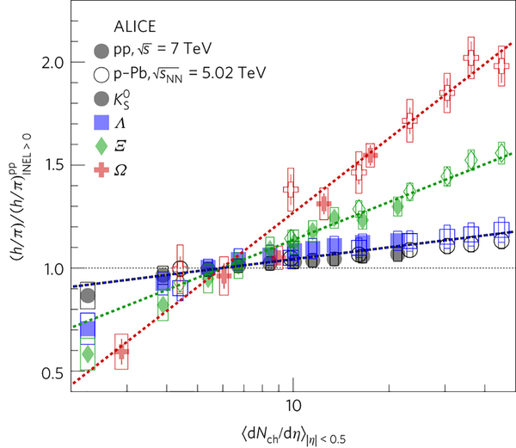
No baryon number dependency.
No mass dependency.
No MC models cannot reproduce this result.

Slide 32
ITS Upgrade
Improve IP resolution by 3~5 times
  Closer to IP : 39 mm → 23 mm
  Reduce the material budget : 1.14% → 0.3 %
  Spatial resolution : 12mmX100mm → 5mmX5mm
Improve tracking efficiency and pT resolution at low pT

Slide 33
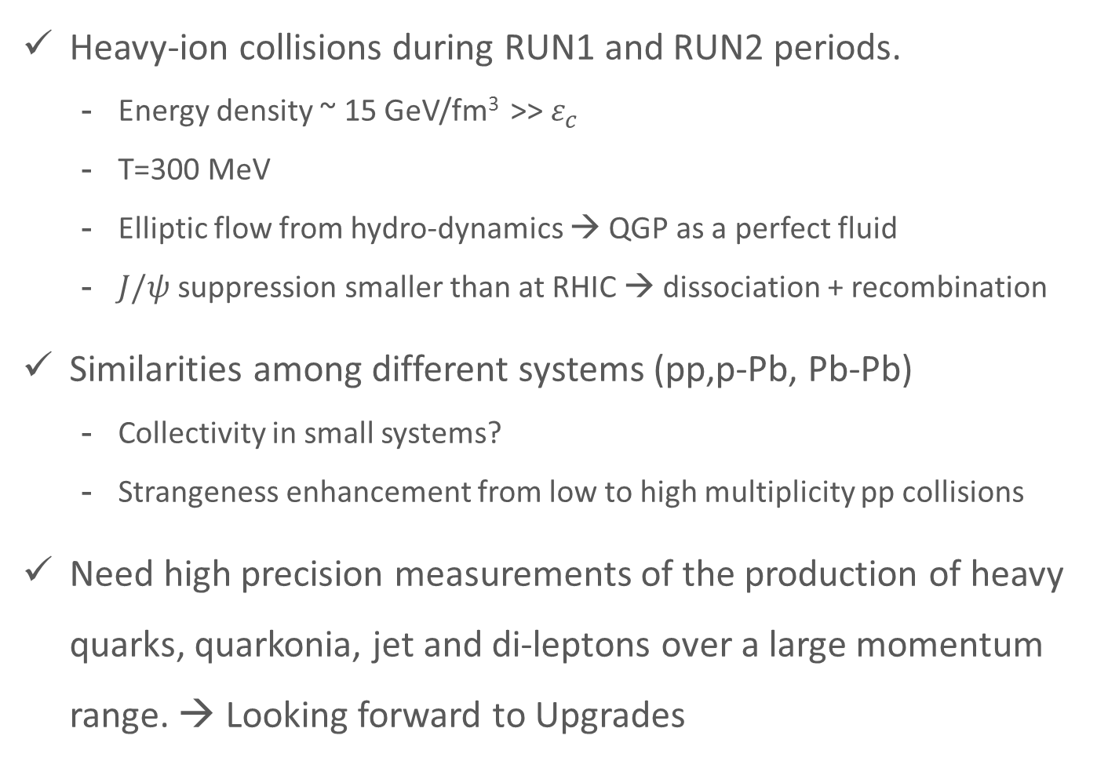
Conclusion
Heavy-ion collisions during RUN1 and RUN2 periods.
  Energy density ~ 15 GeV/fm³ >> $ε_{c}$
  T=300 MeV
  Elliptic flow from hydro-dynamics → QGP as a perfect fluid
  $J/ψ$ suppression smaller than at RHIC → dissociation + recombination
Similarities among different systems (pp,p-Pb, Pb-Pb)
  Collectivity in small systems?
  Strangeness enhancement from low to high multiplicity pp collisions
Need high precision measurements of the production of heavy quarks, quarkonia, jet and di-leptons over a large momentum range. → Looking forward to Upgrades

