Slide 1
CENNS-1ton Experiment
Haemin Jeong

Slide 2
Overview
CENNS-1ton
ton-scale Liquid Argon detector
at Spallation Neutron Source
for precise CEvNS measurment
replacing CENNS-10

Slide 3
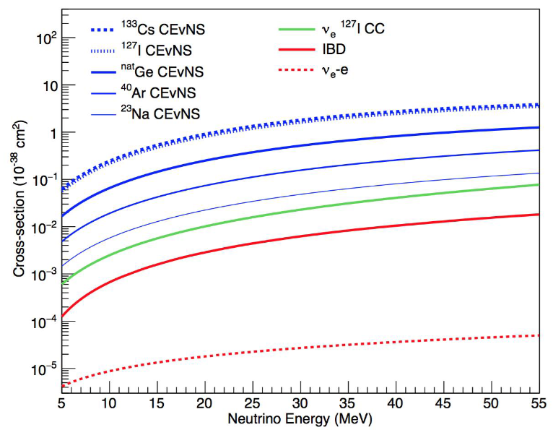
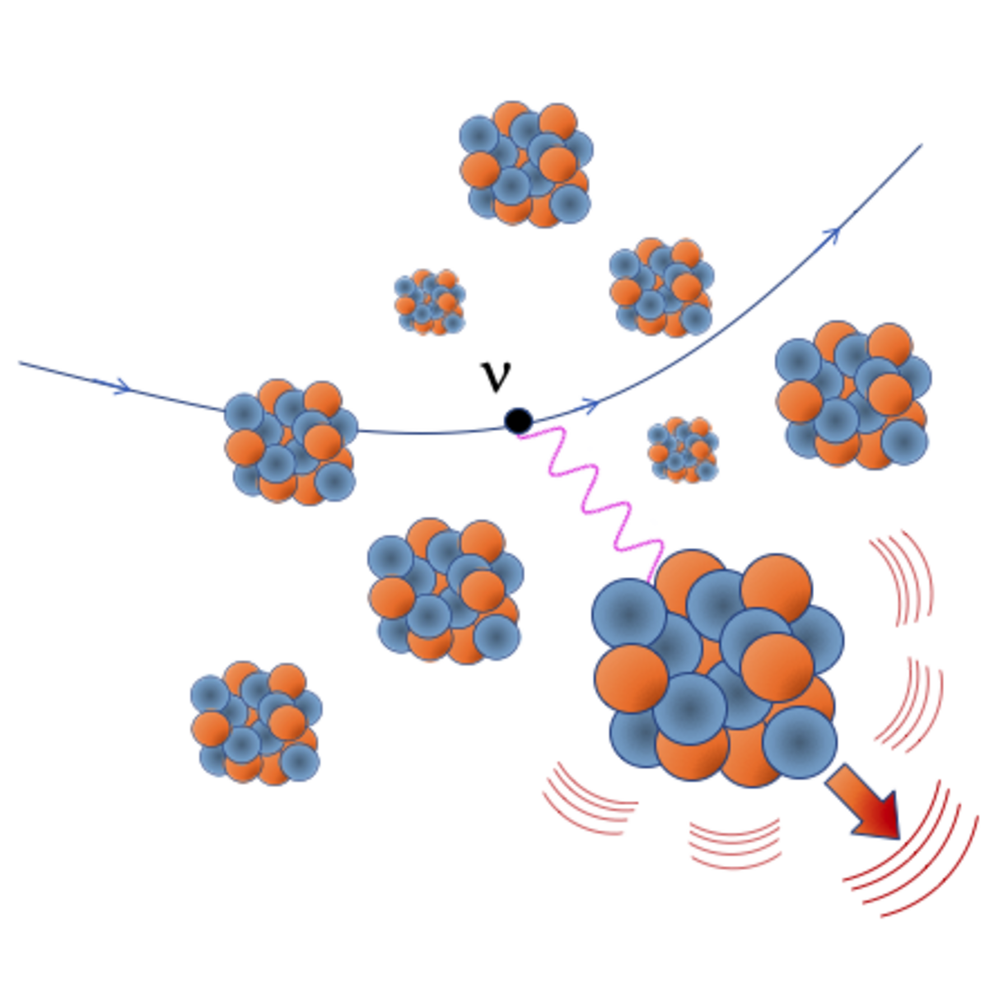

Coherent Elastic Neutrino Nucleus Scattering (CEvNS)
Neutrino interact with whole nucleus
  Coherence condition: $E_{ν}<50MeV$
  Dominant process for $E_{ν}<100MeV$
  Small recoil energy $T<50keV$

Slide 4
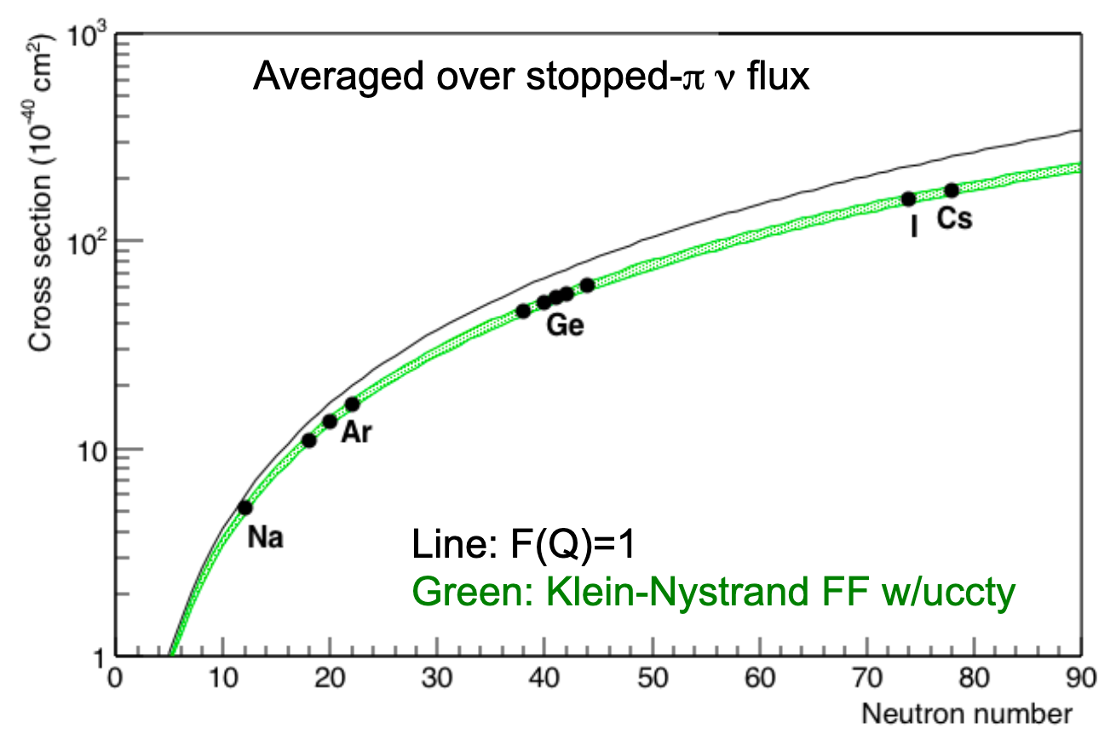
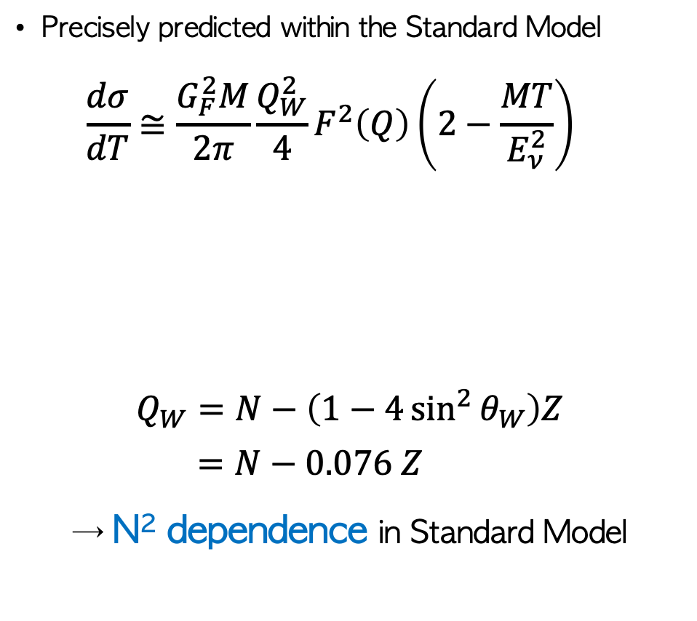
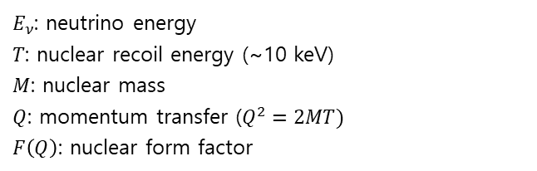
Coherent Elastic Neutrino Nucleus Scattering (CEvNS)
Precisely predicted within the Standard Model
$$\frac{dσ}{dT}≅\frac{G_{F}^{2}M}{2π}\frac{Q_{W}^{2}}{4}F^{2}\left(Q\right)\left(2−\frac{MT}{E_{ν}^{2}}\right)$$
$$Q_{W}=N−\left(1−4\sin^{2}{θ_{W}}\right)Z$$
$$=N−0.076 Z$$
→ N² dependence in Standard Model
$E_{ν}$: neutrino energy
$T$: nuclear recoil energy (~10 keV)
$M$: nuclear mass
$Q$: momentum transfer ($Q^{2}=2MT)$
$F\left(Q\right)$: nuclear form factor

Slide 5
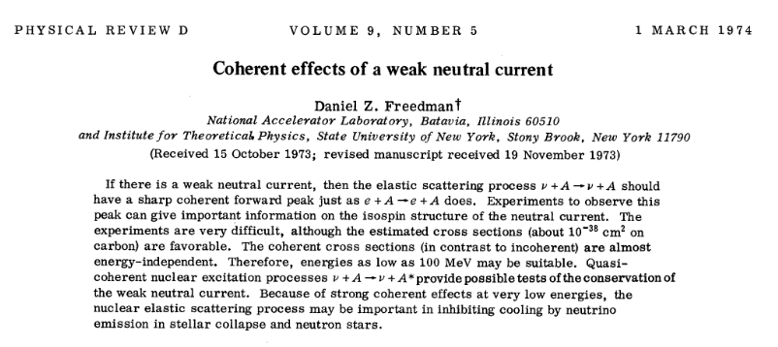
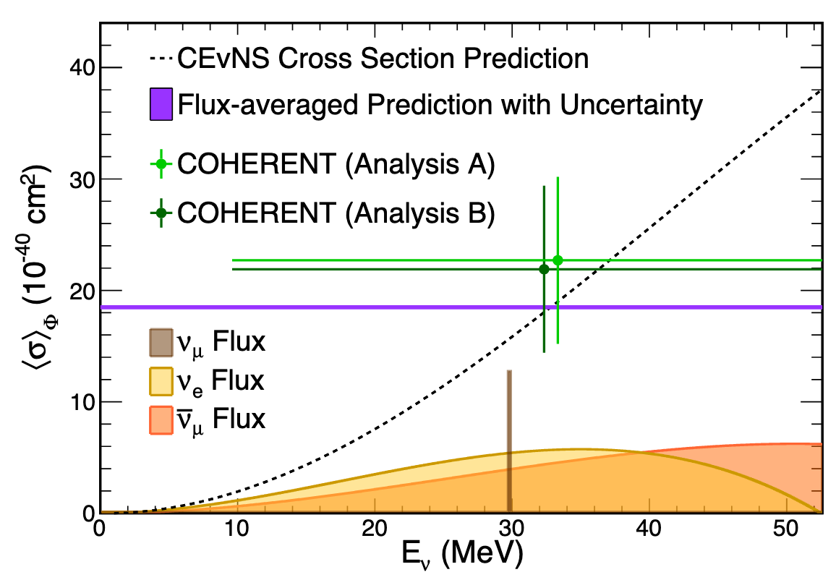
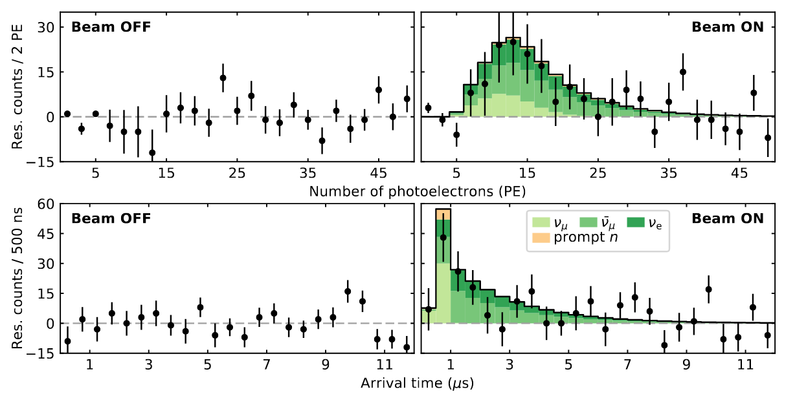
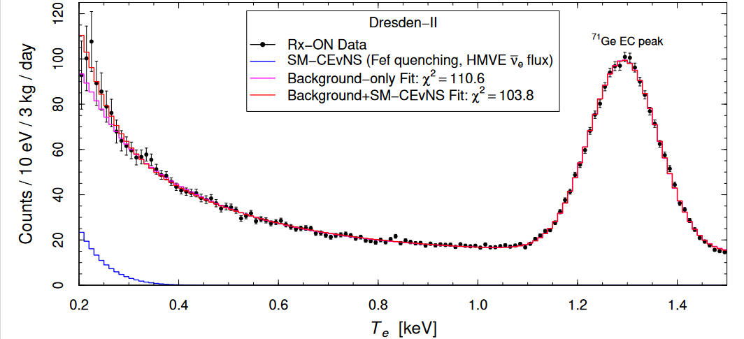
Coherent Elastic Neutrino Nucleus Scattering (CEvNS)
first theorized
first observed at 3𝜎 (CENNS-10, COHERENT)
1974
2017
2020
2022
first observed at 6.7𝜎 (CsI, COHERENT)
first observed from reactor (Dresden-II)

Slide 6
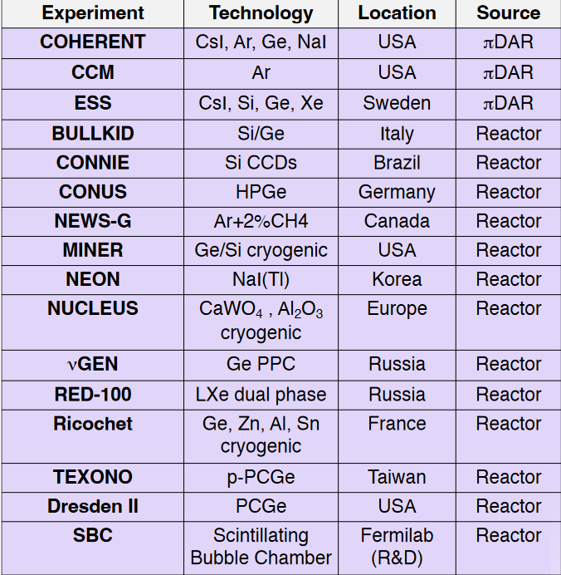
Coherent Elastic Neutrino Nucleus Scattering (CEvNS)
NOW… There are many CEvNS experiments
Enectali Figueroa-Feliciano / Magnificent CEvNS / Mar 2023

Slide 7
CEvNS related physics
Supernova
Dynamics
Nuclear Form Factor
Non-Standard Interactions (NSI)
Sterile Neutrino
Dark Matter Background (Neutrino Floor)
Beam Produced Dark Matter
Weak Mixing Angle
Neutrino EM property

Slide 8

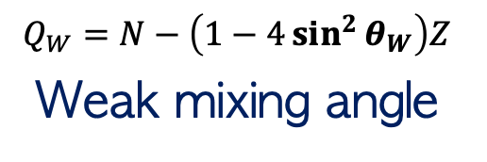
CEvNS related physics
SM CEvNS cross section
$$\frac{dσ}{dT}≅\frac{G_{F}^{2}M}{2π}\frac{Q_{W}^{2}}{4}F^{2}\left(Q\right)\left(2−\frac{MT}{E_{ν}^{2}}\right)$$
$$Q_{W}=N−\left(1−4\sin^{2}{θ_{W}}\right)Z$$
Weak mixing angle
Nuclear Form Factor

Slide 9
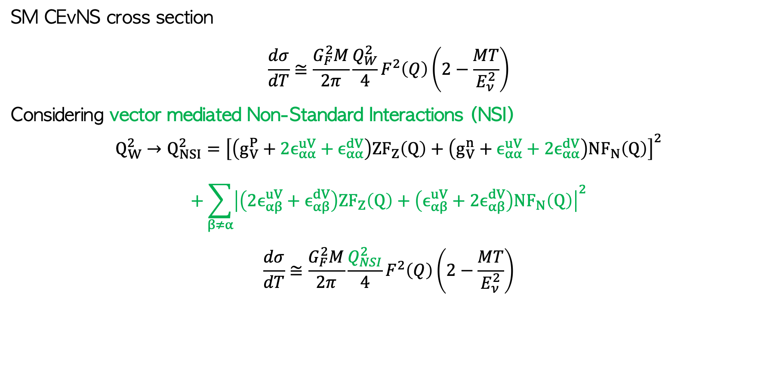
CEvNS related physics
SM CEvNS cross section
$$\frac{dσ}{dT}≅\frac{G_{F}^{2}M}{2π}\frac{Q_{W}^{2}}{4}F^{2}\left(Q\right)\left(2−\frac{MT}{E_{ν}^{2}}\right)$$
Considering vector mediated Non-Standard Interactions (NSI)
$$Q_{W}^{2}→Q_{NSI}^{2}={\left[\left(g_{V}^{P}+2ϵ_{αα}^{uV}+ϵ_{αα}^{dV}\right)ZF_{Z}\left(Q\right)+\left(g_{V}^{n}+ϵ_{αα}^{uV}+{2ϵ}_{αα}^{dV}\right)NF_{N}\left(Q\right)\right]}^{2}$$
$$+\sum_{β≠α}{{\left|\left(2ϵ_{αβ}^{uV}+ϵ_{αβ}^{dV}\right)ZF_{Z}\left(Q\right)+\left(ϵ_{αβ}^{uV}+2ϵ_{αβ}^{dV}\right)NF_{N}\left(Q\right)\right|}^{2}}$$
$$\frac{dσ}{dT}≅\frac{G_{F}^{2}M}{2π}\frac{Q_{NSI}^{2}}{4}F^{2}\left(Q\right)\left(2−\frac{MT}{E_{ν}^{2}}\right)$$

Slide 10

CEvNS related physics
SM CEvNS cross section
$$\frac{dσ}{dT}≅\frac{G_{F}^{2}M}{2π}\frac{Q_{W}^{2}}{4}F^{2}\left(Q\right)\left(2−\frac{MT}{E_{ν}^{2}}\right)$$
Considering neutrino EM moment
$$\frac{dσ_{ν_{α}−N}}{dT}=\frac{G_{F}^{2}M}{π}\left(2−\frac{MT}{E_{ν}^{2}}\right){\left[−\frac{1}{2}NF_{N}\left(Q\right)+\left(\frac{1}{2}−2\sin^{2}{θ_{W}}\right)ZF_{Z}\left(Q\right)\right]}^{2}$$
$$+\frac{πα^{2}}{m_{e}^{2}}\left(\frac{1}{T}−\frac{1}{E_{ν}}\right)Z^{2}F_{Z}^{2}\left(Q\right)\frac{μ_{ν_{α}}^{2}}{μ_{B}^{2}}$$

Slide 11
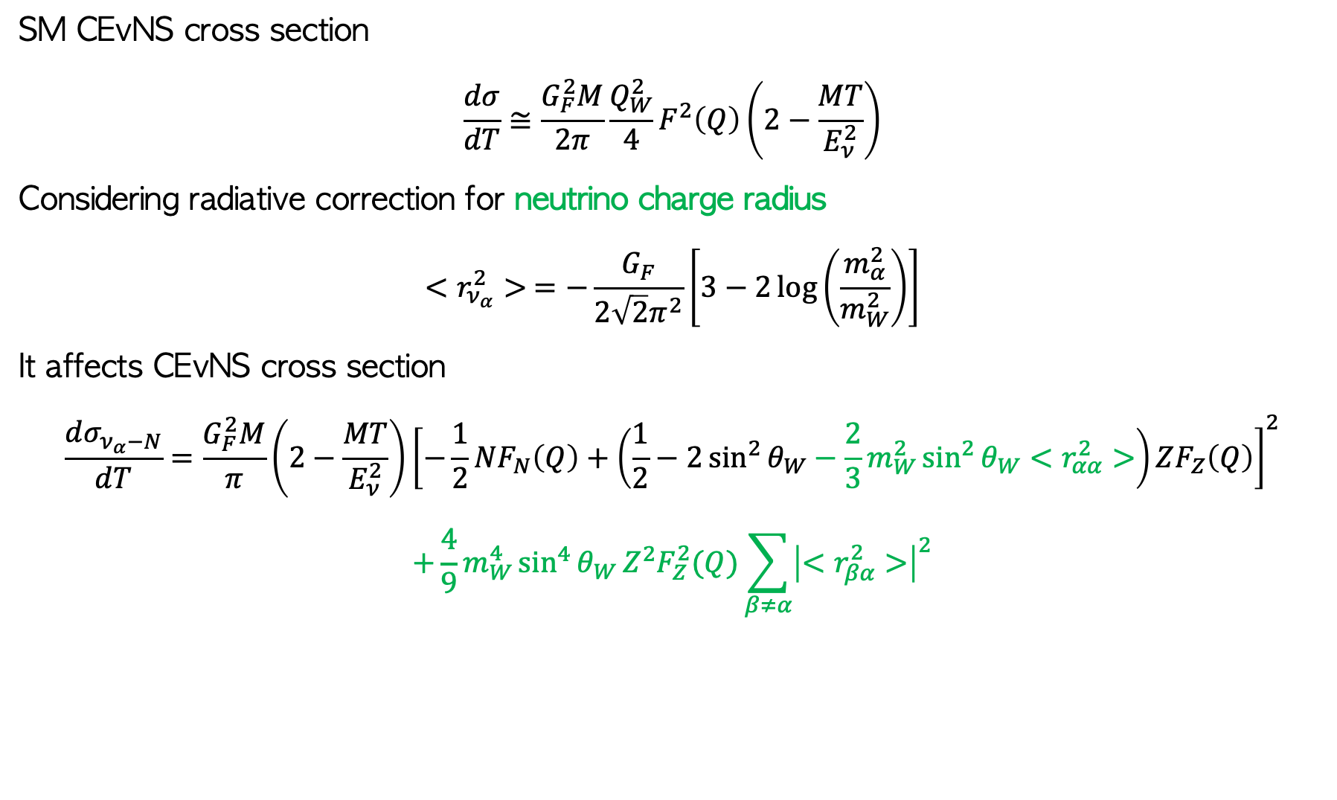
CEvNS related physics
SM CEvNS cross section
$$\frac{dσ}{dT}≅\frac{G_{F}^{2}M}{2π}\frac{Q_{W}^{2}}{4}F^{2}\left(Q\right)\left(2−\frac{MT}{E_{ν}^{2}}\right)$$
Considering radiative correction for neutrino charge radius
$$<r_{ν_{α}}^{2}> =−\frac{G_{F}}{2\sqrt{2}π^{2}}\left[3−2\log\left(\frac{m_{α}^{2}}{m_{W}^{2}}\right)\right]$$
It affects CEvNS cross section
$$\frac{dσ_{ν_{α}−N}}{dT}=\frac{G_{F}^{2}M}{π}\left(2−\frac{MT}{E_{ν}^{2}}\right){\left[−\frac{1}{2}NF_{N}\left(Q\right)+\left(\frac{1}{2}−2\sin^{2}{θ_{W}}−\frac{2}{3}m_{W}^{2}\sin^{2}{θ_{W}}<r_{αα}^{2}>\right)ZF_{Z}\left(Q\right)\right]}^{2}$$
$$+\frac{4}{9}m_{W}^{4}\sin^{4}{θ_{W}}Z^{2}F_{Z}^{2}(Q)\sum_{β≠α}{{\left|<r_{βα}^{2}>\right|}^{2}}$$

Slide 12
CEvNS related physics
Precision measurement of CEvNS is important
for many physics opportunities
But hard to detect

Slide 13
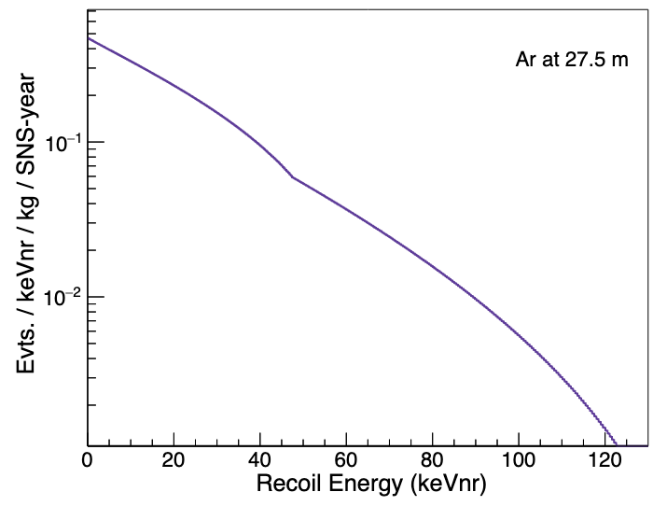

How did CENNS-10 Measure CEvNS?
Measurable CEvNS Observable: O(10keV) nuclear recoil
Max recoil energy $≅$ $2E_{ν}^{2}/M$
For 10 MeV neutrino:
Max recoil energy = 5.4keV

Slide 14
How did CENNS-10 Measure CEvNS?
Spallation Neutron Source
(SNS)
High background rejection factor
well-known neutrino energy & timing spectra
Liquid Argon
high scintillation yield
easily distinguish electron recoil by PSD
Low threshold & Low background

Slide 15
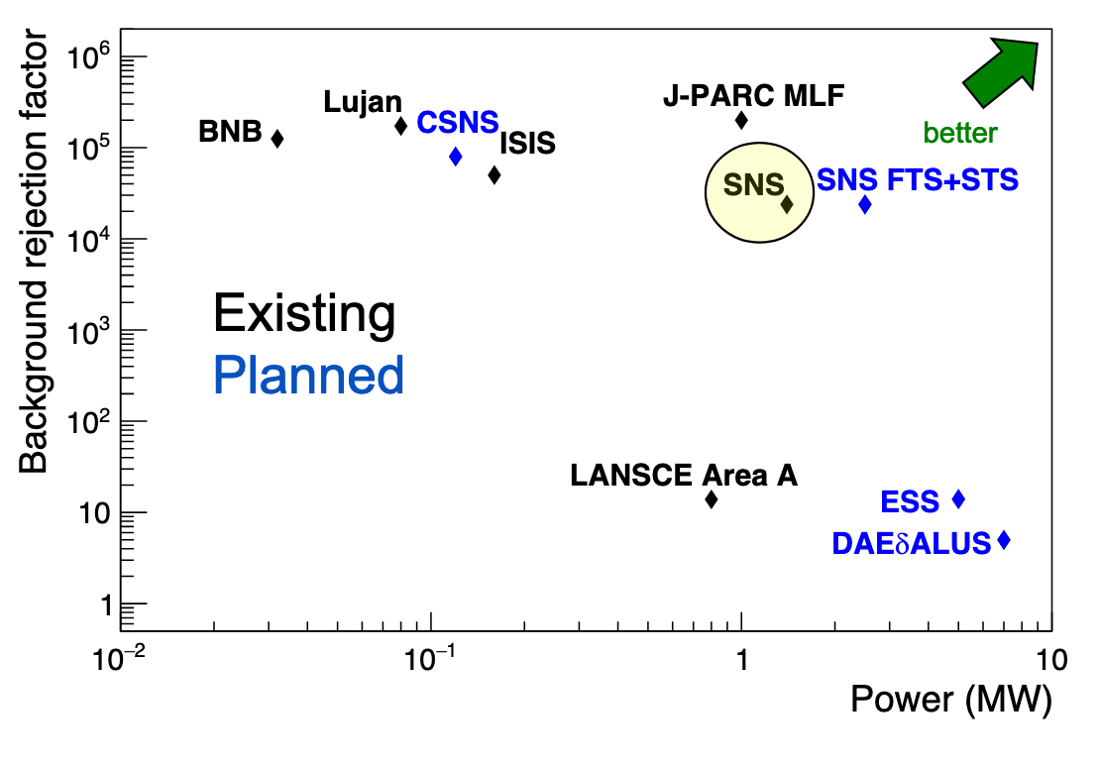
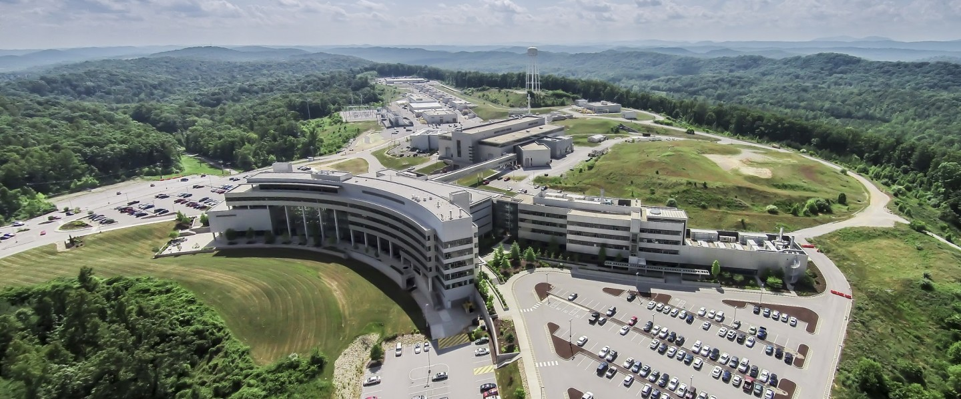
Spallation Neutron Source (SNS)
Neutron Source in Oak Ridge National Laboratory (ORNL)
Produce neutron by p-Hg collision (spallation)
Neutrino is by-product from stopped pion decay
(2020 data)

Slide 16
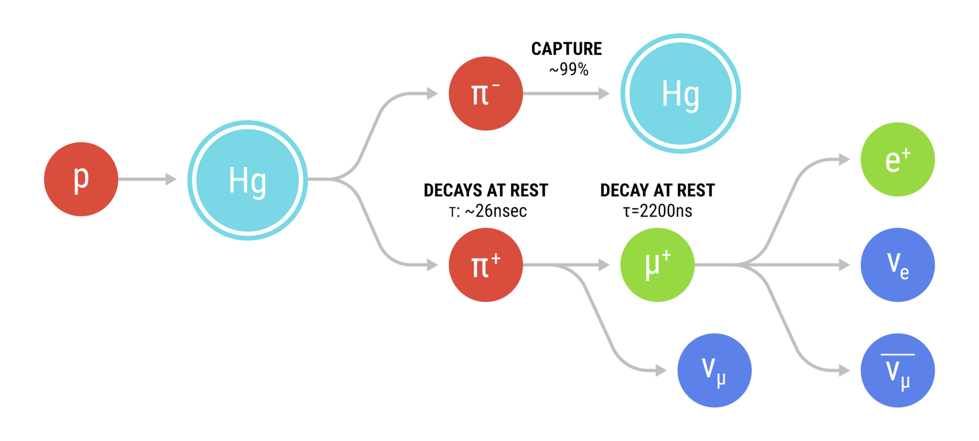
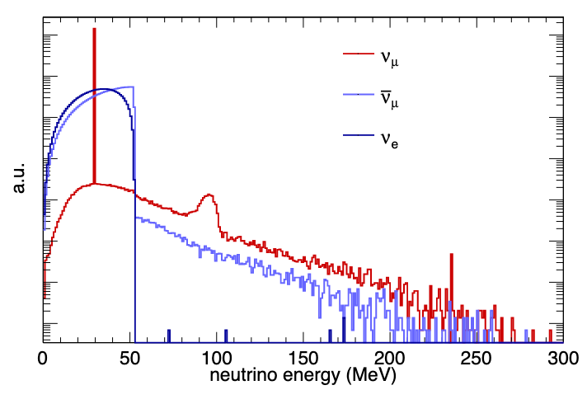
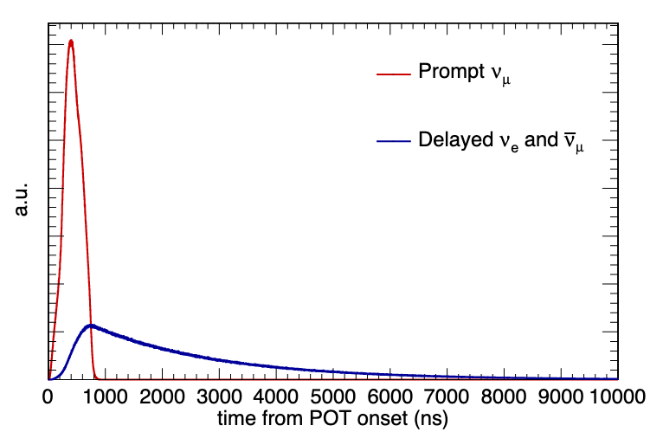





Spallation Neutron Source (SNS)
Well known neutrino energy & timing spectrum from $π$-DAR
1GeV 60Hz proton beam with 1.4 MW
~7000 MWhr/year, ~4.25E22 neutrinos/year
$π$-DAR
$μ$-DAR
$π$-DAR
$μ$-DAR

Slide 17
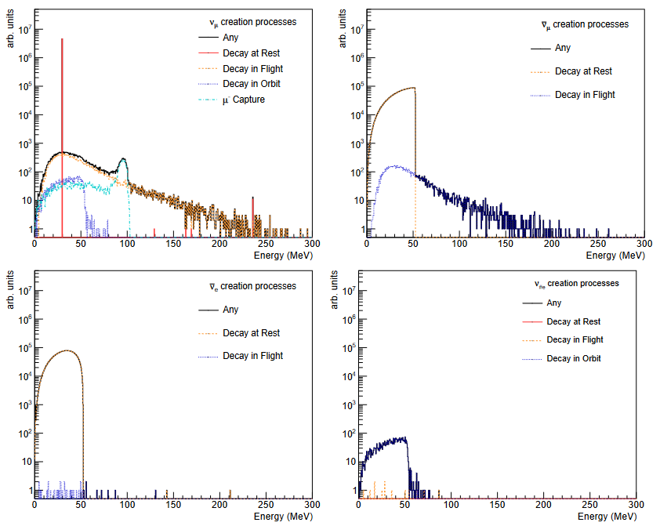
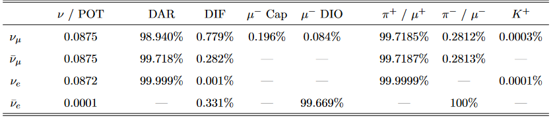
neutrino flux simulation at SNS using Geant4

Slide 18
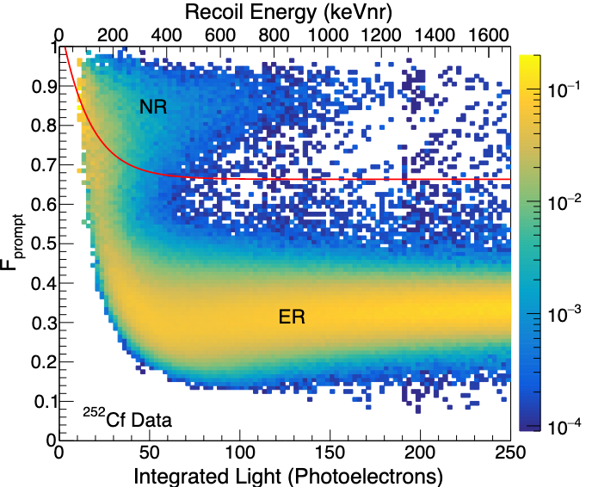
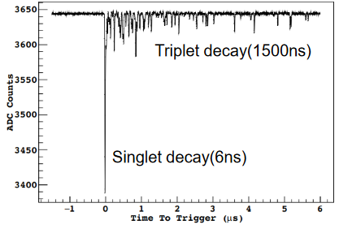
Liquid Argon
very high scintillation yield (~40 photons/keVee)
two excited states allow to distinguish nuclear recoil (NR) from electron recoil (ER)
Use ratio
singlet decay to triplet decay

Slide 19
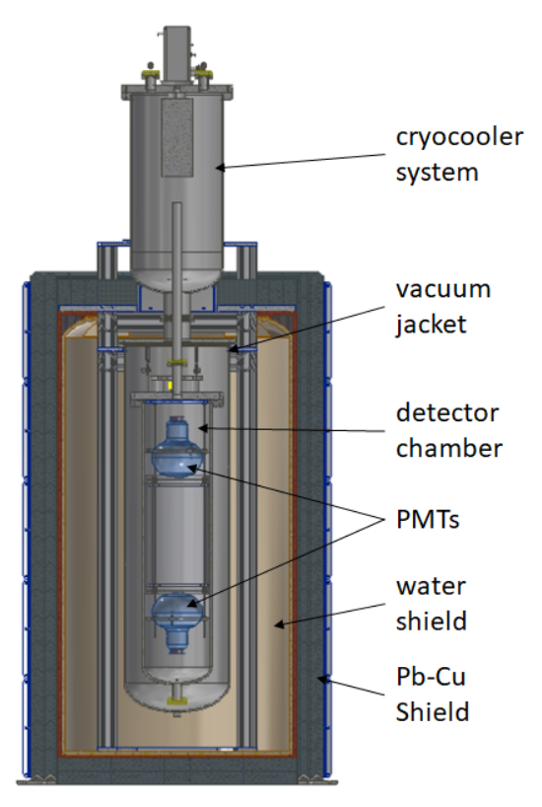
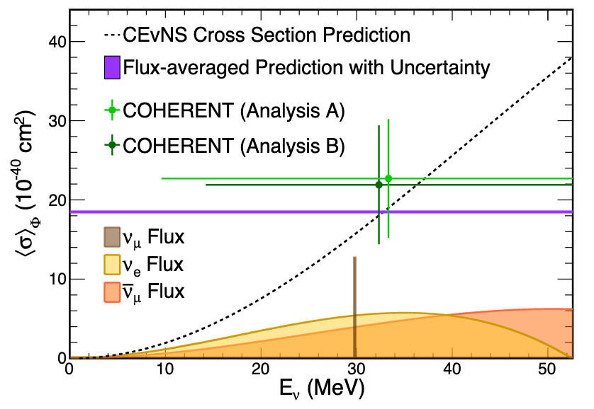

CENNS-10
24-kg Liquid Argon detector at Spallation Neutron Source
Low threshold: 20 keVnr / 4keVee
Measured CEvNS cross section in 2020 (Reject null hypothesis at $>$3$σ$)
Final analysis with x2 more data in progress

Slide 20
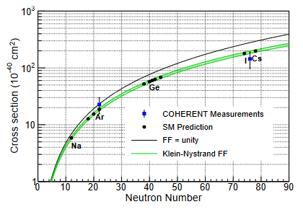
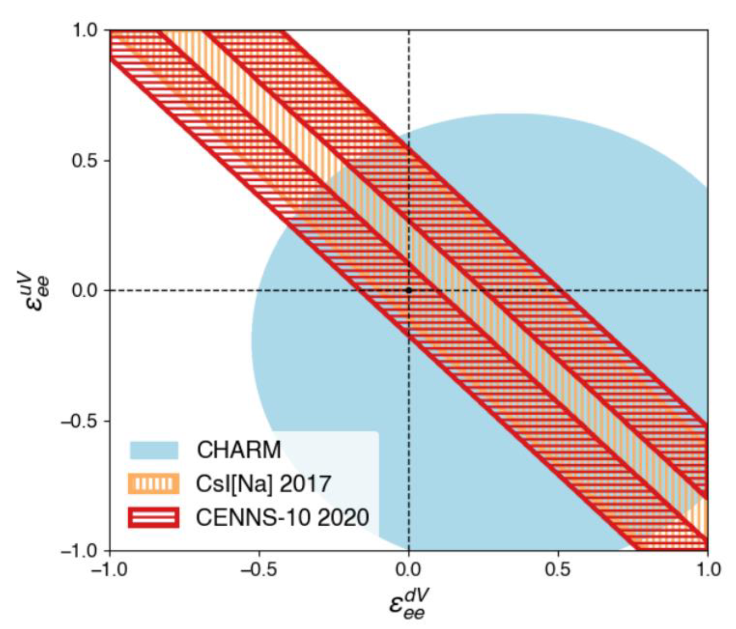
CENNS-10
Confirm N² dependence with the result of CsI detector
Improved limits on non-standard interaction parameter

Slide 21
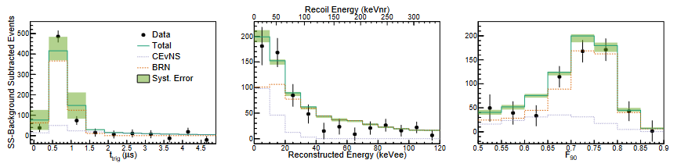
CENNS-10
signals from three events: SSB, BRN, CEvNS
Remove SSB (steady-state background) by subtracting beam-off from beam-on
Calculate BRN (beam related neutron) by simulating with no water-shielding data
Use time – energy – F90 3D distribution to extract CEvNS from background

Slide 22
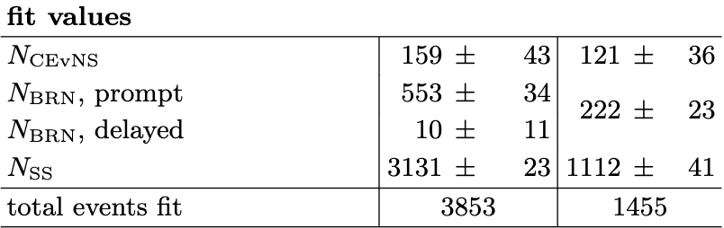
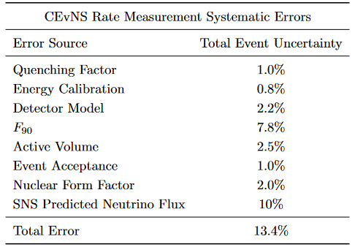
CENNS-10
(without systematic error)
Statistical uncertainty: ~30%
Systematic uncertainty: ~13%
  Neutrino flux: ~10%
US analysis
Moscow analysis
~30% statistical uncertainty
in CEvNS

Slide 23
precision measurement strategy
Statistical uncertainty
CENNS-1ton
~30% → ~4%
Neutrino Flux
D2O detector
~10% → ~5% (theoretical limit = 3%)
Steady-State Background
Use underground argon (UAr) instead of atmospheric argon (AAr)
→ reduce ³⁹Ar decay background
Beam Related Neutron
(BRN)
MARS detector
→ precision measurement of BRN

Slide 24
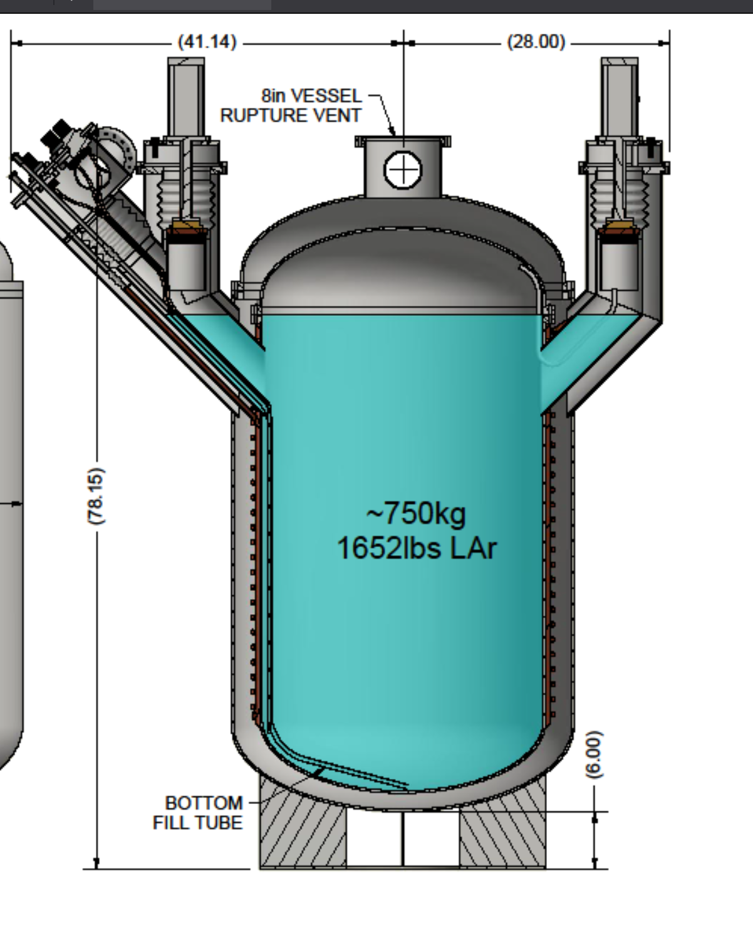
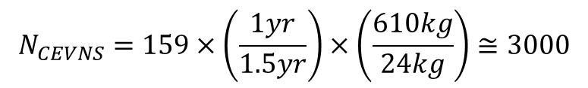
CENNS-1ton
750-kg Liquid Argon detector replacing CENNS-10
Observe ~3000 CEvNS/year
Reduce statistical error from ~30% to ~4% within 3 years
Construct in 2023~2024
$$N_{CEVNS}=159×\left(\frac{1yr}{1.5yr}\right)×\left(\frac{610kg}{24kg}\right)≅3000$$
CENNS-10 data
159 CEvNS for 1.5 yr
fiducial volume

Slide 25
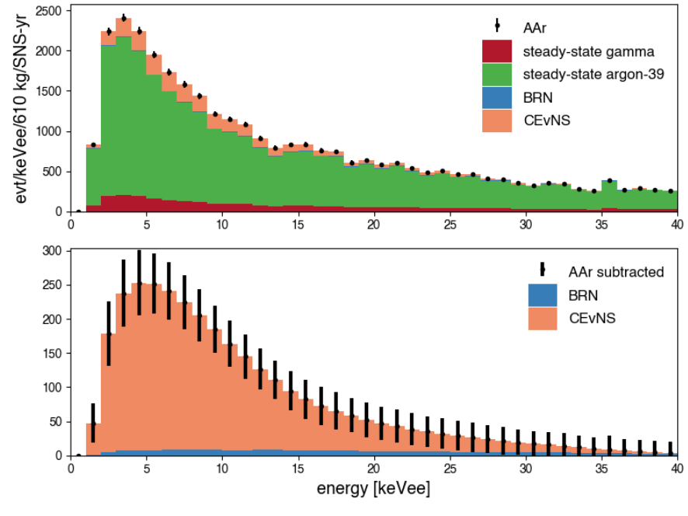
CENNS-1ton
750-kg Liquid Argon detector replacing CENNS-10
Observe ~3000 CEvNS/year
Reduce statistical error from ~30% to ~4% within 3 years

Slide 26
Future Analysis with CENNS-1ton
Non-Standard Interaction (NSI)
Light Dark Matter search
Inelastic neutrino-nucleus scattering cross section
Weak mixing angle
Nuclear Form Factor
Supernova neutrino
Sterile neutrino

Slide 27
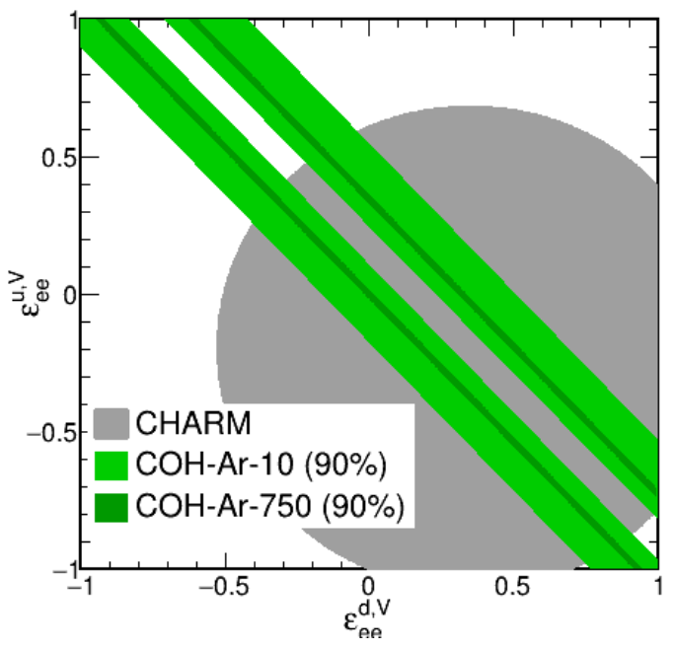
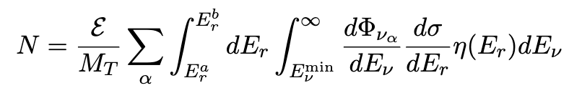

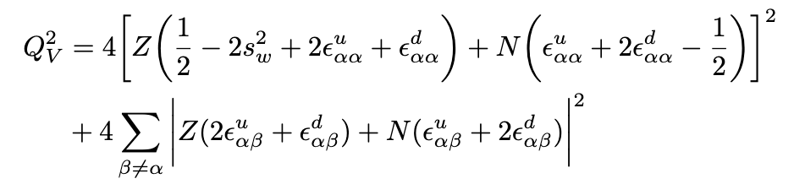
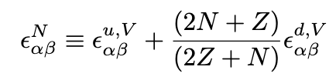

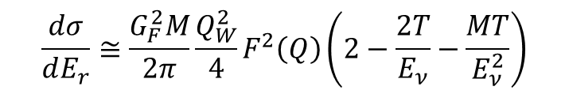
Non-Standard Interaction (NSI)
NSIs affect weak charge & N_{CEvNS}
After 3 years of running CENNS-1ton
$$\frac{dσ}{dE_{r}}≅\frac{G_{F}^{2}M}{2π}\frac{Q_{W}^{2}}{4}F^{2}\left(Q\right)\left(2−\frac{2T}{E_{ν}}−\frac{MT}{E_{ν}^{2}}\right)$$
CHARM
CENNS-10
CENNS-1ton
$ε_{αβ}$: NSI parameter
phenomenological NSI parameter:

Slide 28
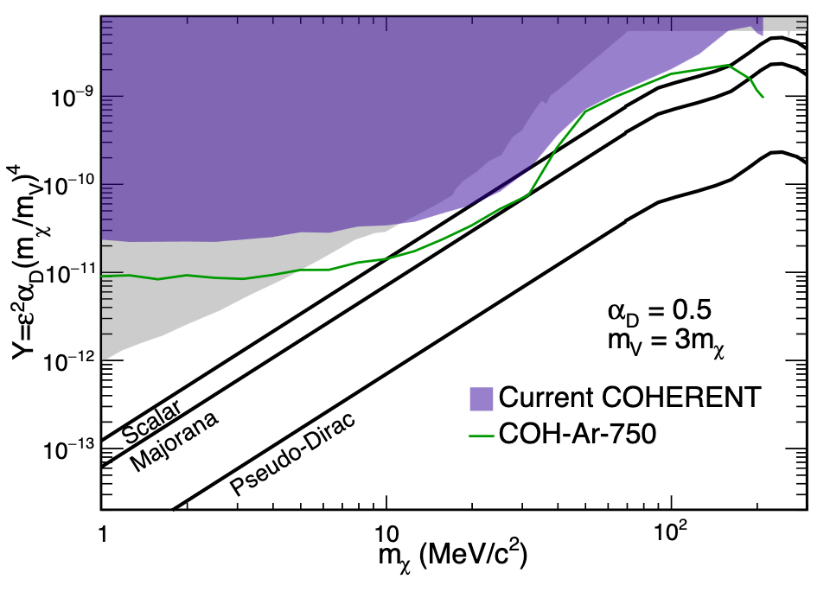
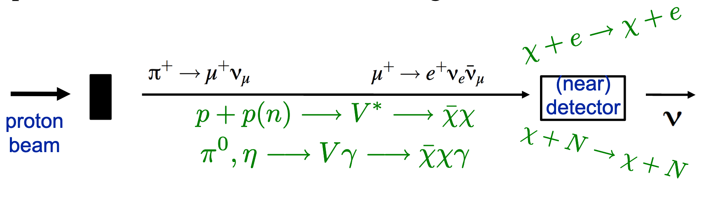

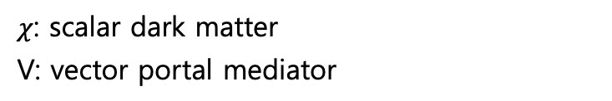
Beam produced Dark Matter search
1 GeV proton beam can produce Light Dark Matter ($m_{χ}<$ GeV)
Benchmark model: 1 scalar dark matter with vector portal mediator
Dark Matter is relativistic
Can distinguish DM with CEvNS by timing cut
After 3 years of running CENNS-1ton
$χ$: scalar dark matter
V: vector portal mediator
CHARM
CENNS-10
CENNS-1ton
Current COHERENT
CENNS-1ton

Slide 29
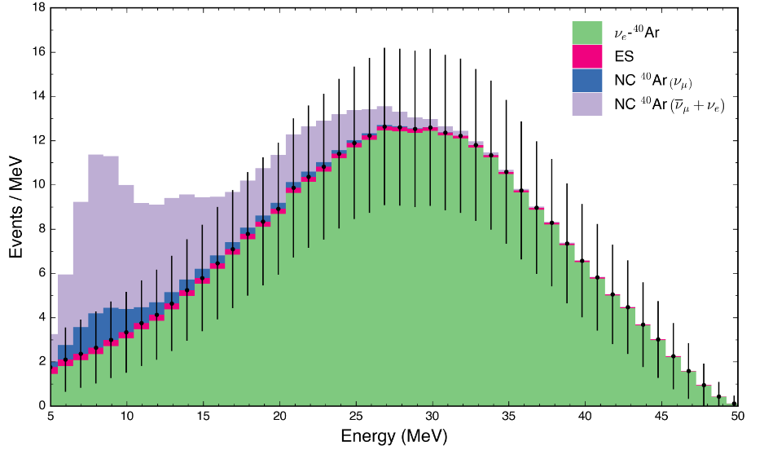

inelastic scattering
Inelastic neutrino-argon scattering ($ν_{e}+40Ar →e^{−}+40K^{∗}$)
Record ~340 $ν_{e}$ CC/year and ~100 NC/year of all flavors (calculated by MARLEY)
After 1 years of running CENNS-1ton

Slide 30
Summary
CENNS-10
24-kg LAr detector
Observe CEvNS on Argon
Check N² dependence to test Standard Model
CENNS-1ton
750-kg LAr detector
Precision measurement of CEvNS on Argon
Study CEvNS related physics
Construct in 2023~2024

Slide 31
Backup

Slide 32

Result of CENNS-10
SM prediction: 128$±$17 events
US analysis: 159$±$43(stat.)$±$14(sys.)
Moscow analysis: 121$±$36(stat.)$±$15(sys.)

Slide 33


Steady-State background of CENNS-10
Mainly came from 39Ar decay
x1400

Slide 34
CEvNS Detectors by COHERENT
Argon
CsI
Other
1st
Observe CEvNS
Check N² dependence
CENNS-10
24kg LAr
CsI-1
14kg CsI
Ge-1
18kg HPGe PPC
2nd
Precision measurement of CEvNS
Study Beyond SM
DM, NSI, neutron radius, …
CENNS-1ton
750kg LAr
CryoCsI-1
10kg cryogenic CsI
NaI-2
3.4t NaI[Tl] crystal
3rd
Using CEvNS as experimental tool
With STS (upgraded version of SNS)
SN neutrino, Sterile neutrino, …
CENNS-10ton
10ton LAr
CryoCsI-2
700kg cryogenic CsI

Slide 35

Near-Future Detectors by COHERENT

Slide 36



D2O detector
Cross section of $ν_{e}+d →p+p+e$ is well understood than others
With 592kg D₂O, statistical uncertainty to 5% within 2 years
Reduce neutrino flux uncertainty approaching theoretical uncertainty 2~3%
Also, can study $ν_{e}+O →e^{−}+16F^{∗}$, valuable for supernova detection
Operating with H₂O since 2022
for measuring $ν_{e}+O$ background

Slide 37


MARS detector
Multiplicity and Recoil Spectrometer (MARS) monitor and characterize BRN background
Fast neutron elastically interacts with hydrogen
Lose energy in scintillator until Gd capture (~18.7 μs)
Appropriate for low energy neutron (<50 MeV)

Slide 38


Upgrade Plan of SNS
Today
First Target Station (FTS)
After 2024
Proton Power Upgrade (PPU)
After 2032
Second Target Station (STS)
1.4 MW
1 GeV
60Hz
2.0 MW
1.3 GeV
60Hz
2.8 MW
1.3 GeV
60Hz
STS
0.7MW
15 pulses/sec
FTS
2MW
45 pulses/sec

