Slide 1



A neutrinoless double beta decay investigation with ¹⁰⁰Mo in AMoRE
KIM Hanbeom,
On Behalf of the AMoRE Collaboration
2023 SNU Nuclear and Particle Physics Workshop
Mar. 30th –Apr. 1st , 2023
Notes:
Hello, everyone. Nice to meet you here in the LLWI 2023. I’m Han-Beom Kim, from the Institute for Basic Science, South Korea. Today, I am going to introduce AMoRE and its current phase, AMoRE-I, briefly and present some results of our data analysis.

Slide 2
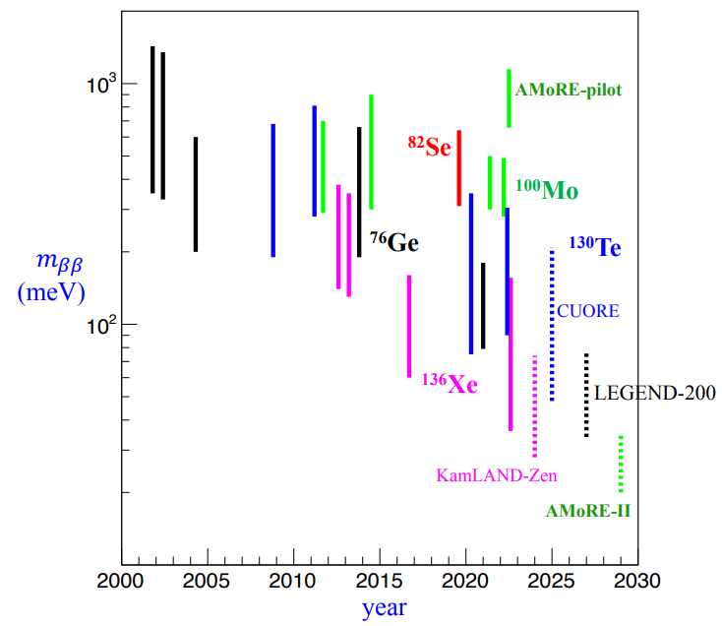
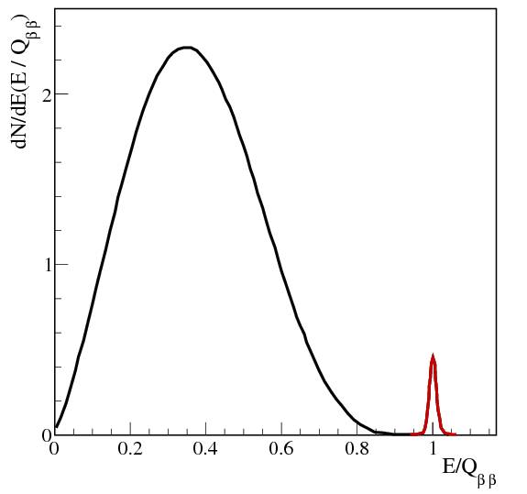
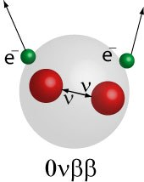
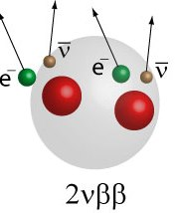

Neutrinoless double beta decay
AMoRE:
A search for neutrinoless double beta (0νββ) decay of ¹⁰⁰Mo using Mo-based scintillating crystals and low-temperature sensors.
$$\left(Z,A\right)→\left(Z+2,A\right)+2e^{−}+2{\overline{ν}}_{e}$$
$$\left(Z,A\right)→\left(Z+2,A\right)+2e^{−}$$
2ν ββ decay
- 2nd order beta decay
- Rare nuclear decay
- (>10¹⁸ years of half life)
0ν ββ decay
- Massive neutrino
- Majorana particle
- Beyond the SM model
- >10²⁵ years of half-life
Neutrinoless double beta decay:
  Direct measure of Majorana nature of neutrino.
  Lepton number violation process.
  Effective neutrino mass.
Notes:
AMoRE is an experiment project to search for neutrinoless double beta decay (0νββ) of ¹⁰⁰Mo using Mo-based scintillating crystals and low-temperature sensors.
The observation of such a rare process will help us to answer the unresolved physics questions, such as majorana nature of neutrino and effective neutrino mass. Also, neutrinoless double beta decay is an expected lepton number violation process.

Slide 3
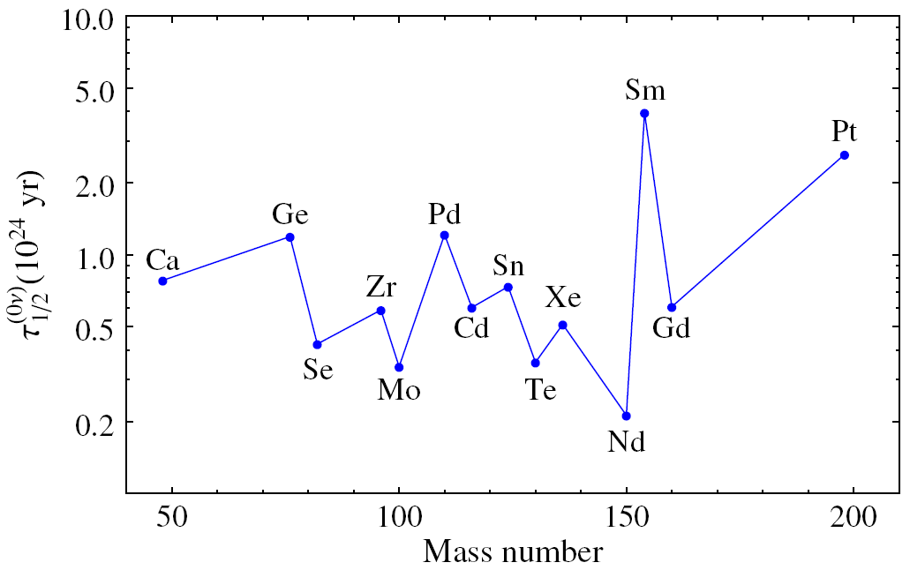
0νββ search using ¹⁰⁰Mo
¹⁰⁰Mo:
High Q_{ββ} = 3034 keV
High natural abundance: 9.7 %
Scintillation crystals with ¹⁰⁰Mo enrichment > 95% —XMoaOb (XMO):
  X=Ca, Li2, Na2, Zn, Sr, Pb, …
  Detection of light/heat signal ➔ rejection of surface-α background.
Relatively short half life (0νββ) in theoretical expectation
ββ-decay nuclei with Q > 2 MeV | Q (MeV) | Abund. (%)
⁴⁸Ca → ⁴⁸Ti | 4.271 | 0.187
⁷⁶Ge → ⁷⁶Se | 2.040 | 7.8
⁸²Se → ⁸²Kr | 2.995 | 9.2
⁹⁶Zr → ⁹⁶Ru | 3.350 | 2.8
¹⁰⁰Mo → ¹⁰⁰Ru | 3.034 | 9.7
¹¹⁰Pd → ¹¹⁰Cd | 2.013 | 11.8
¹¹⁶Cd → ¹¹⁶Sn | 2.802 | 7.5
¹²⁴Sn → ¹²⁴Ge | 2.228 | 5.8
¹³⁰Te → ¹³⁰Xe | 2.528 | 34.2
¹³⁶Xe → ¹³⁶Ba | 2.479 | 8.9
¹⁵⁰Nd → ¹⁵⁰Sm | 3.367 | 5.6
Light/Heat Ratio
β/γ signals
β/γ signals
Scintillation
α signals
α signals
Phonon
Energy
Barea et al., Phy. Rev. Lett. 109, 042501 (2012)
Notes:
The Q-value of 100Mo is about 3 MeV which is higher than 2.6 MeV gamma peak. It also has a high natural abundance of 9.7 %, so it is rather good for enrichment. We have applied CMO and LMO crystals in the experiment, and are also studying the other crystals.
Moreover, the theoretical half-life of the neutrinoless double beta decay is short. Therefore, the molybdenum is chosen as target material for many neutrinoless double beta decay studies.
We simultaneously measure the phonon and photon signals from the decay, so we can discriminate the alpha and beta/gamma events. The absorption of beta and gamma produces stronger scintillation so we can reject a background by comparing light heat ratio.

Slide 4
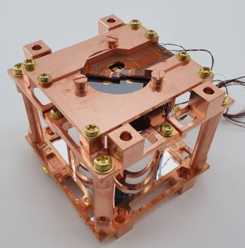
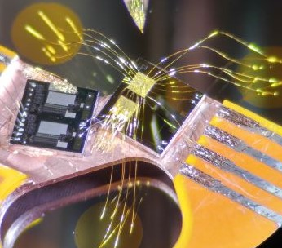
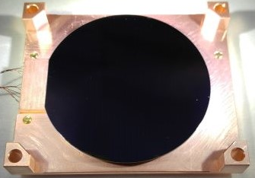
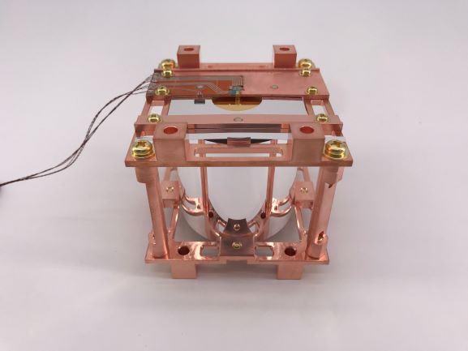
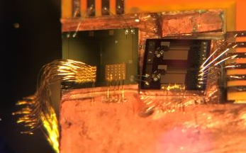

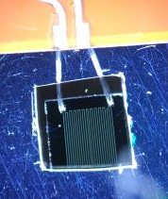
Detector Module
Cylindrical CMO and LMO crystals, sizes vary Φ ≥ 4 cm / H ≲ 5 cm.
  CMO: ⁴⁸Ca depleted, Qββ (⁴⁸Ca) = 4271 keV.
Metallic magnetic calorimeter (MMC) + SQUID:
  Fast signal timing: a few millisecond rise-time for phonon signals at mK.
  Low random coincidence background.
  Energy resolution ~ 10 keV FWHM at 2.6 MeV.
  Wide dynamic range
  High linearity
Photon sensors
MMC
Crystal:
48deplCaMoO4 /
Li2MoO4
SQUID
Reflective film
Light absorber
(Ge/Si wafer)
Phonon sensors
Phonon collector
(Au film)
Stabilization heater
MMC
SQUID
Notes:
Our detector modules are composed of such components listed on the slide.
In AMoRE project, we use enriched molybdate scintillating crystal as source and detector. Crystals are elliptic cylinders and their diameters and heights are various. In case of CMO, 48Ca is depleted because it is a 2vbb isotope..
Each of heat and light sensor contains an MMC. We chose MMC as sensor for its advantages like.
The gold film, deposited on the crystal and wafer, are connected to MMC by annealed gold wires.

Slide 5
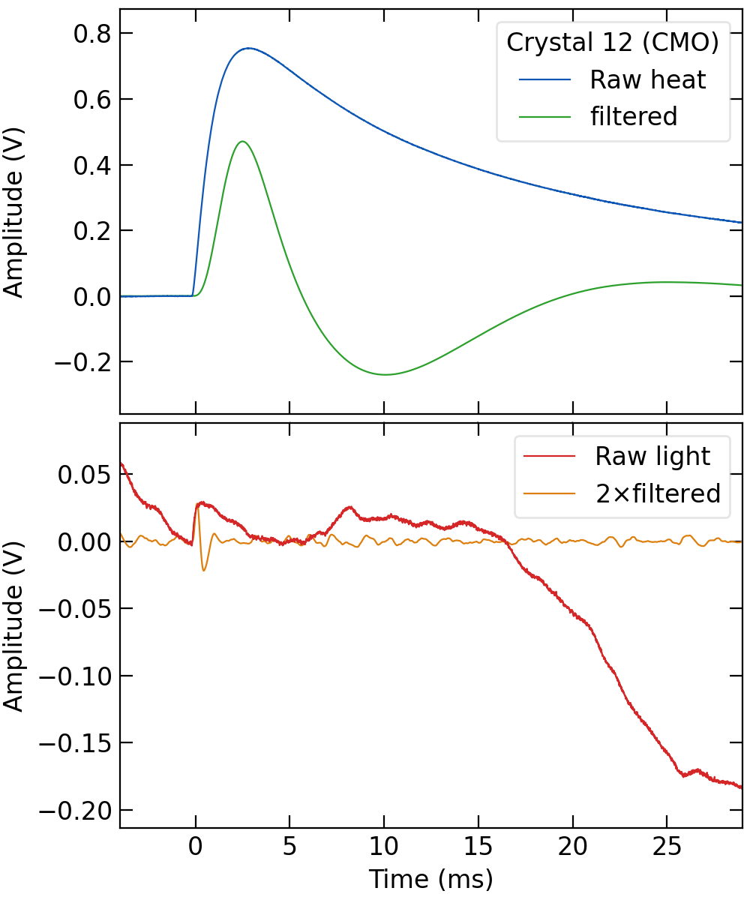

Signal Processing & Analysis
Photon sensors
ADCs:
18-bit resolution,
100 kHz sampling
Software trigger for phonon signal, using Butterworth bandpass filter.
Trigger threshold:
30-200 keV.
Crystal:
48deplCaMoO4 /
Li2MoO4
Reflective film
Phonon sensors
Raw waveform:
  baseline/noise informations.
  timings (rise/fall): pulse shape discrimination (PSD).
Reconstruction for improving energy resolution and β/α discrimination power (DP):
  Butterworth bandpass filter— mainly for noise suppression:
    pulse amplitude: pulse height or a least square fit to the template signal.
  Stabilization heater signal every 10 seconds to gain drift corrections.
Notes:
The heat change detected by sensors are converted to digital signal with ADCs in 18-bit resolution and 100 kHz sampling rate. The software trigger for phonon signal with thresholds between 30-200 keV was applied to choose signals from the data.
With raw waveform we achieved baseline and noise, and also timing informations of signals for pulse shape discrimination.
Butterworth bandpass filter is used to suppress the noise. Stabilization heater response signals are generated every 10 seconds to gain drift corrections.

Slide 6
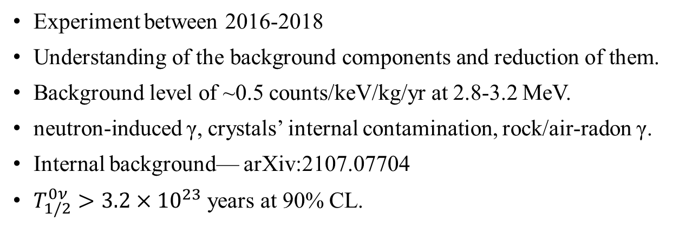
AMoRE-pilot final result
Experiment between 2016-2018
Understanding of the background components and reduction of them.
Background level of ~0.5 counts/keV/kg/yr at 2.8-3.2 MeV.
neutron-induced γ, crystals’ internal contamination, rock/air-radon γ.
Internal background— arXiv:2107.07704
$T_{1/2}^{0ν}>3.2×{10}^{23}$years at 90% CL.
Notes:
Through the AMoRE-pilot experiment from 2016 to 2018, we understood the background components and their reduction. Its bkg level was around 0.5 ckky at 2.8-3.2 MeV region, and the final half-life limit was 3.2 times 10 over 23 year at 90% C.L.
The detail of this result is introduced on the other paper.

Slide 7
Cryostat & Shielding
Cryogen-free dilution refrigerator.
For AMoRE-pilot and AMoRE-I.
Now operating at 12 mK with ~1 μW cooling power.
Pb (γ), boron, and polyethylene (n).
Plastic scintillator muon counter.
Yangyang Underground Laboratory (Y2L) at 700 m depth.
Yangyang Pumped Storage Power Station
700 m
overburden
Notes:
The cryogen-free dilution refrigerator, which was installed for AMoRE-pilot, is also used for AMoRE-I. It is installed in Y2L at 700m depth. Currently the operation is at 12 mK with about 1 uW cooling power. Around the cryostat is shielding system including lead, boron, polyethylene, and more over, muon veto.

Slide 8

AMoRE-pilot → AMoRE-I
6 CMO (1.886 kg) ➔ 13 CMO (4.582 kg) + 5 LMO (1.609 kg)
  Total crystal mass = 6.193 kg, ¹⁰⁰Mo mass = 3.0 kg
Stabilization heater for all crystals. + 1 additional MMC for temperature regulation
MMC sensor upgrade: Au:Er ➔ Ag:Er. (~1/T² heat capacity component associated with nuclear quadrupole moments removed)
Using same cryostat + two stage temperature control: ⟨ΔT⟩ < 1 μK.
Shielding enhancements:
  Outer Pb: 15 ➔ 20 cm; neutron shields: boric acid silicon + more PE / B-PE.
  More muon counter coverage. (~4π)
  More supply of Rn-free air.
σ = 0.58 μK
Notes:
There are some improvement in AMoRE-I, in both quantity and quality. We apply 18 scin. crystals. 5 are LMO, and 13 and CMO. Among them, 6 CMO are the ones used in pilot. As mentioned above, stabilization heaters are installed on all crystals. The paramagnetic material of MMC was changed from Au:Er to Ag:Er.
We also improve the temperature control system and add more shieldings.

Slide 9
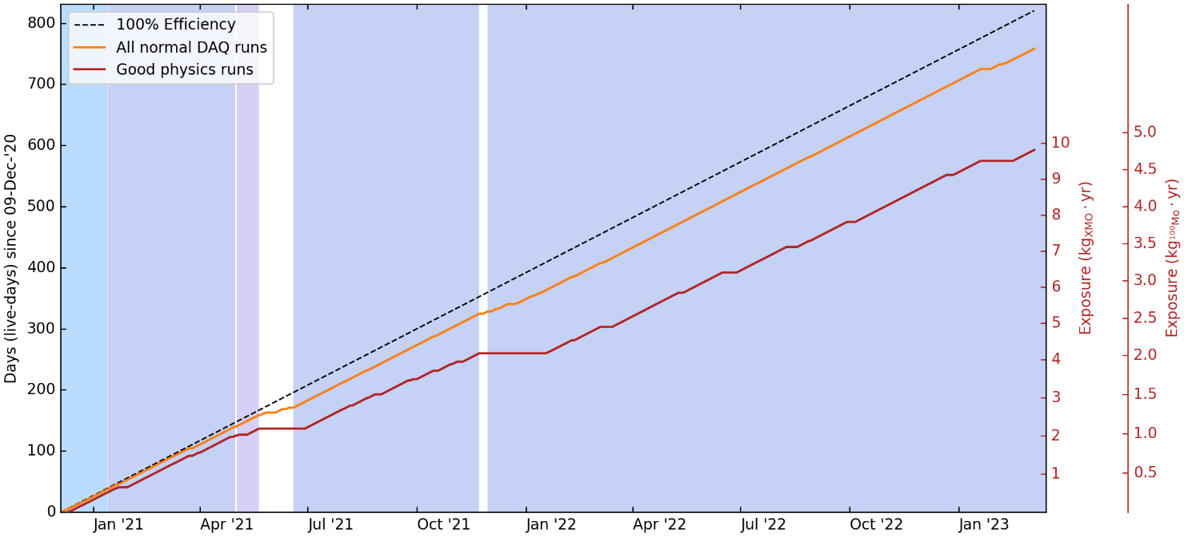
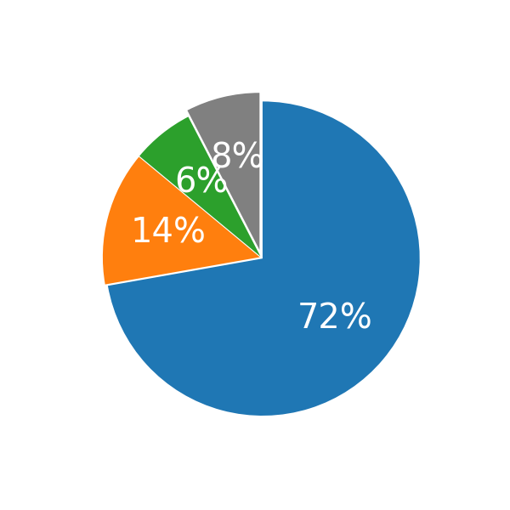
AMoRE-I data taking
12 mK
12 mK
10
mK
14 mK
12 mK
Physics
Calibration
Test
Down
DR temperature control
Recovery from power outage
DR temperature control
Data taking is still ongoing
7.59 kg ∙ year crystal (3.66 kg ∙ year ¹⁰⁰Mo) exposure is presented here
Notes:
The data taking began on Dec. 2020 and the DAQ duty factor is more than 90%. 74% of accumulated data are from good physics runs. It will continue until at least the end of this year.
Here, analysis on 4.68 kg ∙ year crystal exposure is presented.

Slide 10
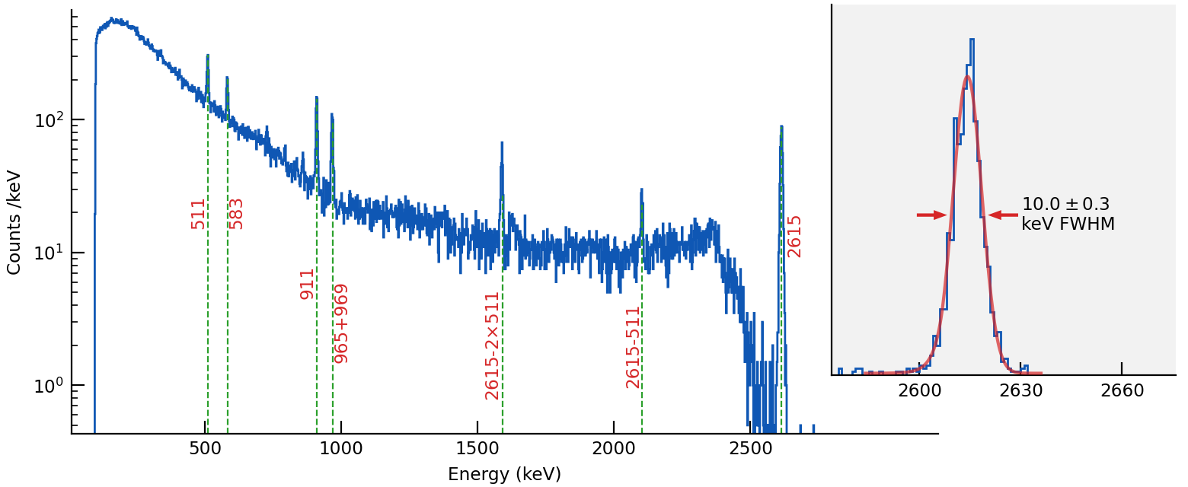
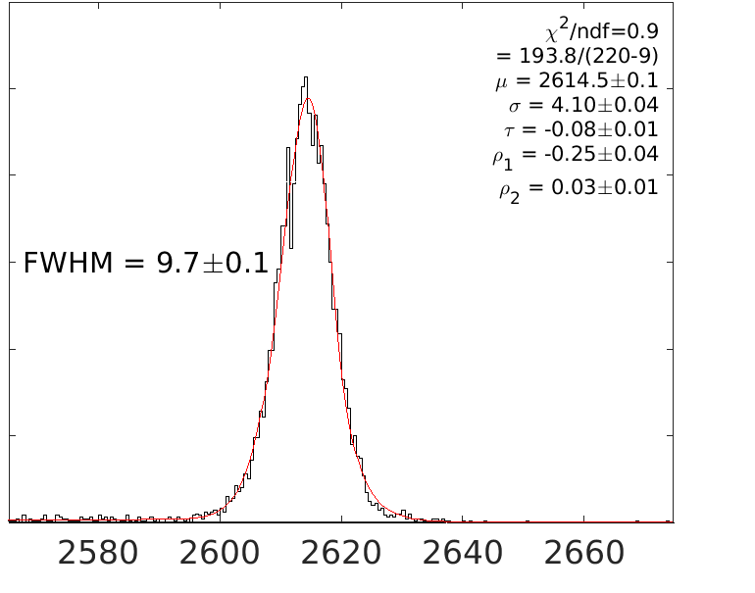
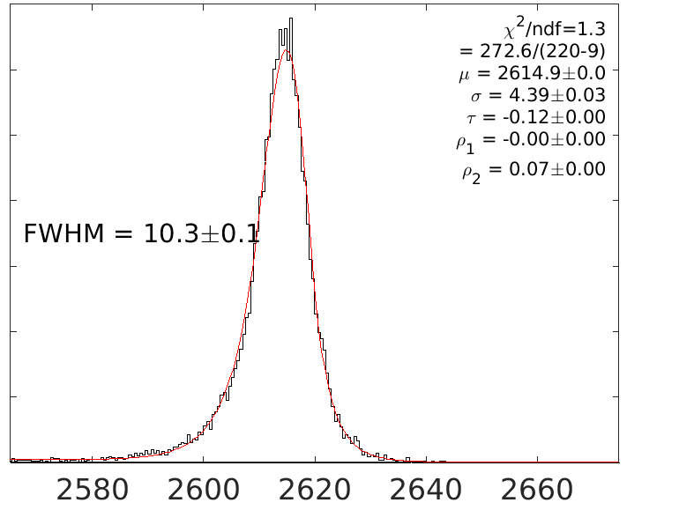
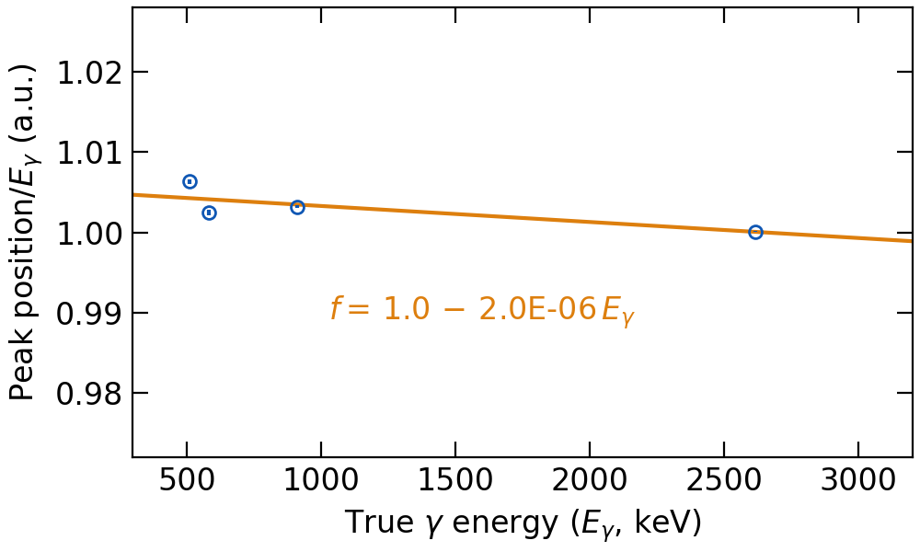
Energy Calibration
XMO06 (LMO)
XMO11 (CMO)
Calibration source: ²³²Th-rich welding rods just outside of OVC
Slight non-linearity between signal amplitude and energy.
Bukin instead of gaussian/tailed gaussian – better fit to right tails
https://root.cern.ch/doc/master/classRooBukinPdf.html
Notes:
For energy calibration, we locate a 232Th-rich welding rods just outside of cryostat and choose 4 identified gamma peaks including 2.6 MeV. There is slight non-linearity between signal amplitude and energy.

Slide 11
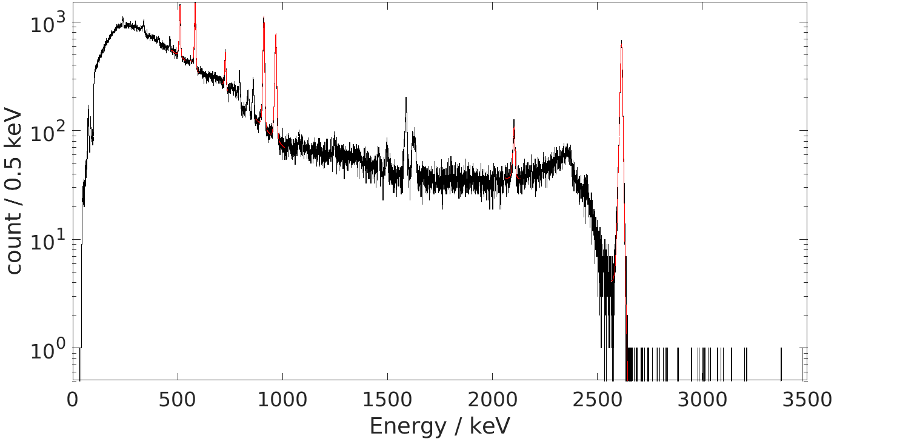
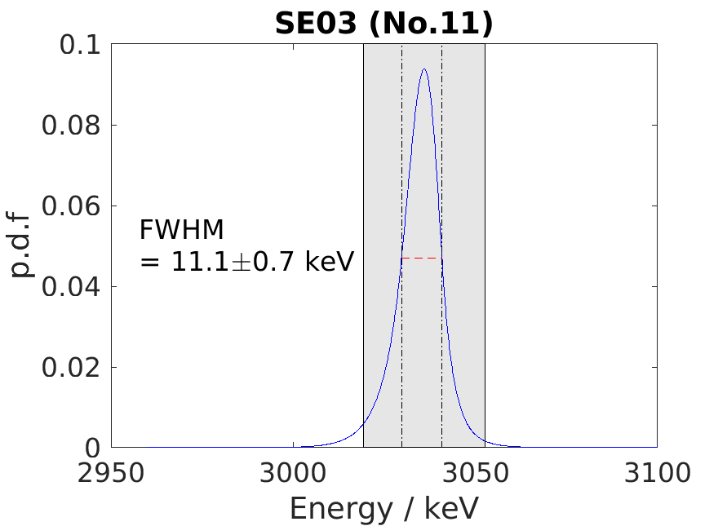
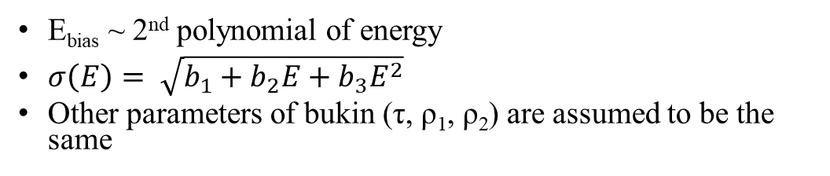
ROI estimation
# | Name | FWHM@Q_{ββ} (keV)
1 | SB29 | 13.7±1.0
2 | SE01 | 11.9±0.8
3 | SE02 | 16.5±0.9
4 | SE08 | 12.2±0.8
5 | LMO2 | 27.5±2.3
6 | LMO4 | 10.2±0.8
7 | LMO3 | 11.3±1.1
8 | S35 | 15.7±0.7
9 | SS68 | 14.4±0.6
10 | LMOCUP | 19.3±0.5
11 | SE03 | 11.1±0.7
12 | SE07 | 14.1±1.0
13 | SE09 | 14.9±0.7
15 | SB28 | 22.9±1.1
16 | SE04 | 19.3±0.8
17 | SE05 | 16.3±0.7
18 | SE06 | 11.4±0.6
E_{bias} ~ 2nd polynomial of energy
$σ\left(E\right)= \sqrt{b_{1}+b_{2}E+b_{3}E^{2}}$
Other parameters of bukin (τ, ρ₁, ρ₂) are assumed to be the same
Notes:
With both pulse shape discrimination parameters and light signal information, CMO shows better discrimination power. It is considered due to higher light yield of CMO.
On the other hand, LMO has much less alpha contamination.

Slide 12
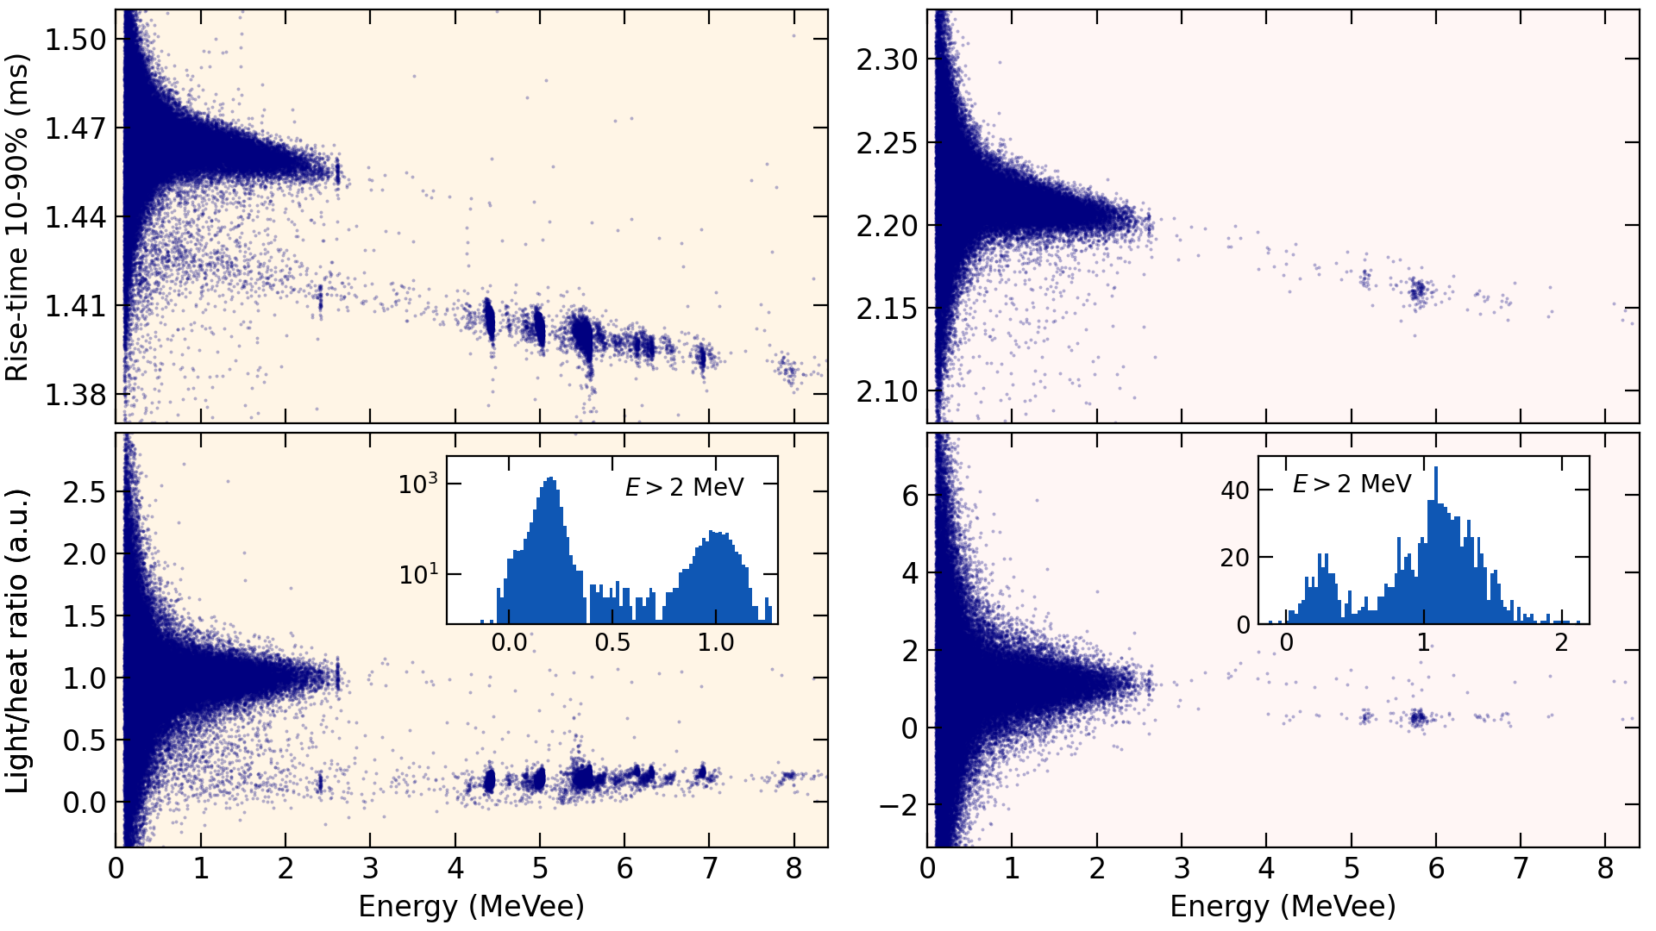
Particle Identifications, CMO and LMO
CMO shows better discrimination power — light yield: CMO > LMO.
LMO has much less α contamination.
ε_{PaID} ~ 91.6 % (±3 median absolute deviations (~±2σ) gives 95.70 % C.L.)
Notes:
With both pulse shape discrimination parameters and light signal information, CMO shows better discrimination power. It is considered due to higher light yield of CMO.
On the other hand, LMO has much less alpha contamination.

Slide 13
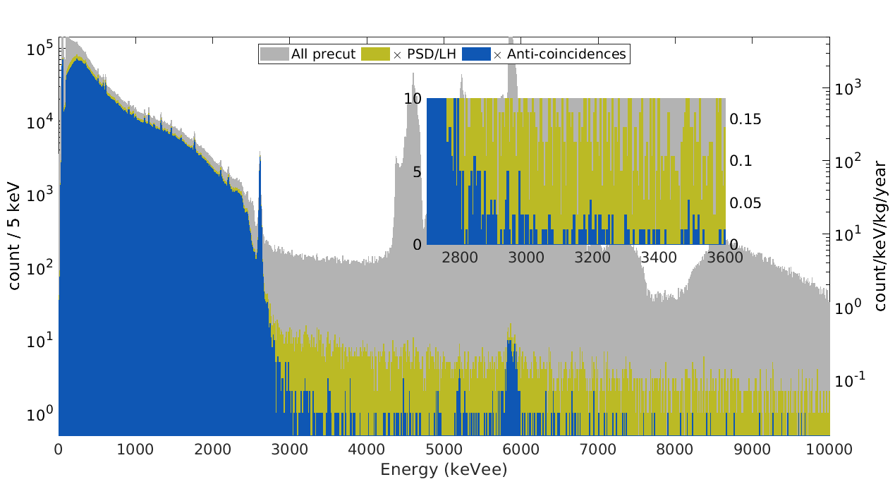
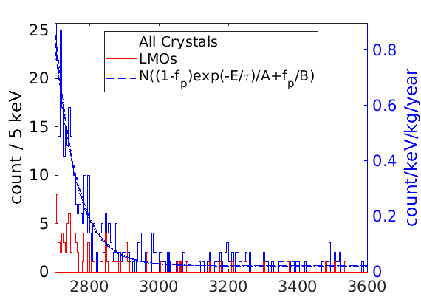
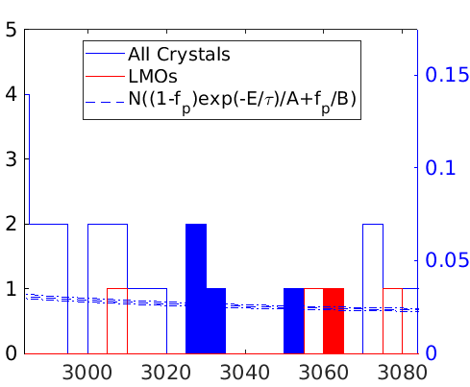
Background Spectrum
AMoRE-I Preliminary
(Faced: ROI events (Q_{ββ} ±1.5 FWHM),
not involved in bkg. rate calculation)
All crystal excluding 1 LMO for very poor β/α discrimination power:
  13 CMO + 4 LMO: exposure = 7.59 kgXMO・yr = 3.66 kgISO・yr. (¹⁰⁰Mo live exposure: 2.96 kg・yr)
Anti-coincidence cuts reject events:
  coincident at multiple crystals within 2 ms (ε ~ 99.8%),
  within 10 ms after a muon counter event (ε ~ 99.8%),
  within 20 minutes after a ²¹²Bi α-decay event candidate (ε ~ 98%).
Live exposure | @ Q_{ββ}
Total (6.12 kg y) | 0.024±0.001 ckky
CMO (4.70 kg y) | 0.025±0.001 ckky
LMO (1.43 kg y) | 0.020±0.002 ckky
Notes:
Here is the background spectrum of all crystals excluding 1 LMO for very poor DP.
We also rejected three types of anti-coincidence events, which are multiple hits, muon veto events, and following events of 212Bi alpha decay. The selection efficiency is listed on the slide.

Slide 14
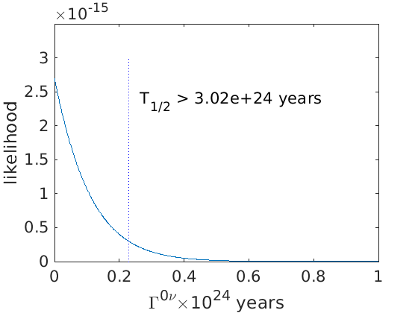
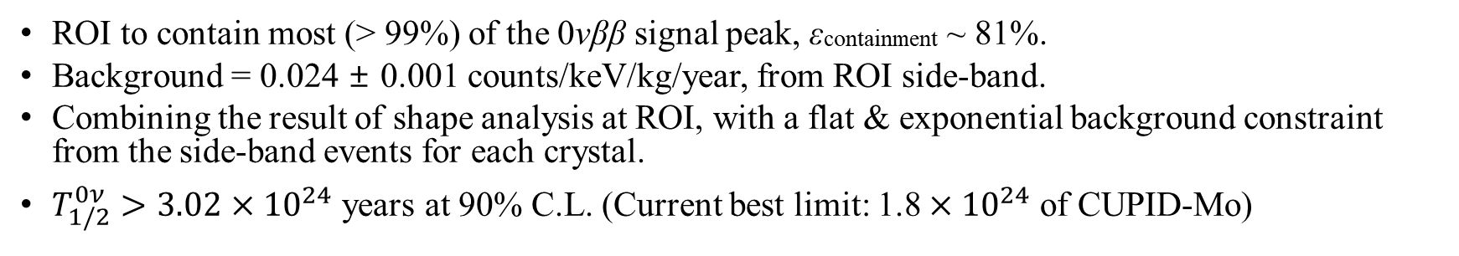
Preliminary ¹⁰⁰Mo 0νββ limit from AMoRE-I
ROI to contain most (> 99%) of the 0νββ signal peak, εcontainment ~ 81%.
Background = 0.024 ± 0.001 counts/keV/kg/year, from ROI side-band.
Combining the result of shape analysis at ROI, with a flat & exponential background constraint from the side-band events for each crystal.
$T_{1/2}^{0ν}>3.02×{10}^{24}$ years at 90% C.L. (Current best limit: 1.8 $×{10}^{24}$ of CUPID-Mo)
Notes:
Combining the result of counting analysis at ROI with a flat bkg constraint from the side-band events for each crystal, we gained a background level of 0.024+-0.001 ckky and preliminary half-life limit of $3.02×{10}^{24}$ years at 90% C.L. 210-320
Answer for Q: Statistical fluctuation, 보수적인 결과 (conservative result), fitting method improvement 예정

Slide 15
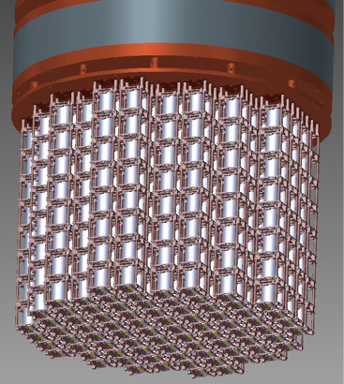
AMoRE-II in preparation
AMoRE-II
Detector module
178 kg LMO at final
AMoRE-pilot/I
AMoRE-II
90 modules (~27 kg LMO)
for the first stage
Notes:
As keep taking the AMoRE-I data, we are preparing the next phase. AMoRE-II is a larger-scale experiment with more crystals. For the first stage we will apply 90 modules of 27 kg LMO, 178 kg of LMO will be used at final.

Slide 16
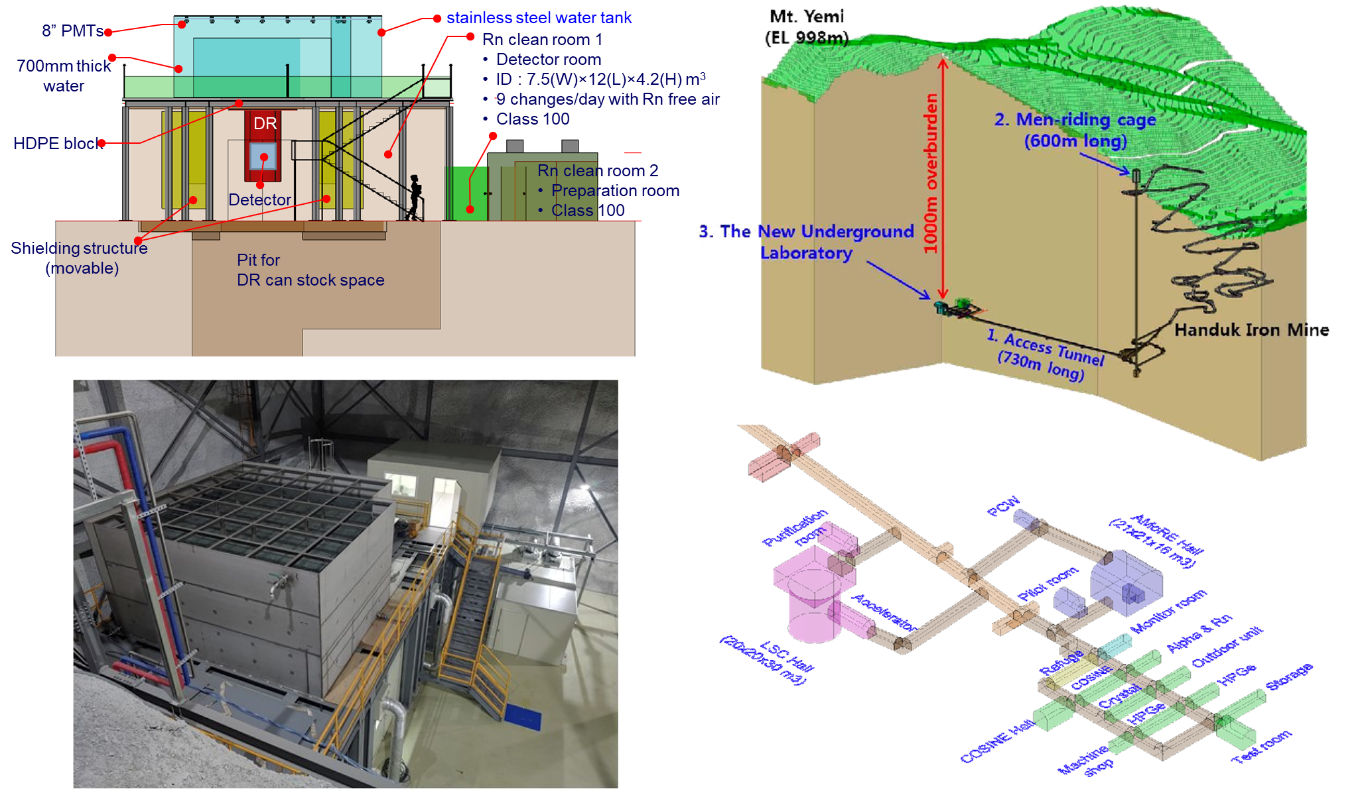
AMoRE-II in YemiLab
Notes:
AMoRE-II is being installed in YemiLab, a new underground laboratory of 1 km depth in JeongSeon. It includes larger enhanced cryostat and shieldings.

Slide 17
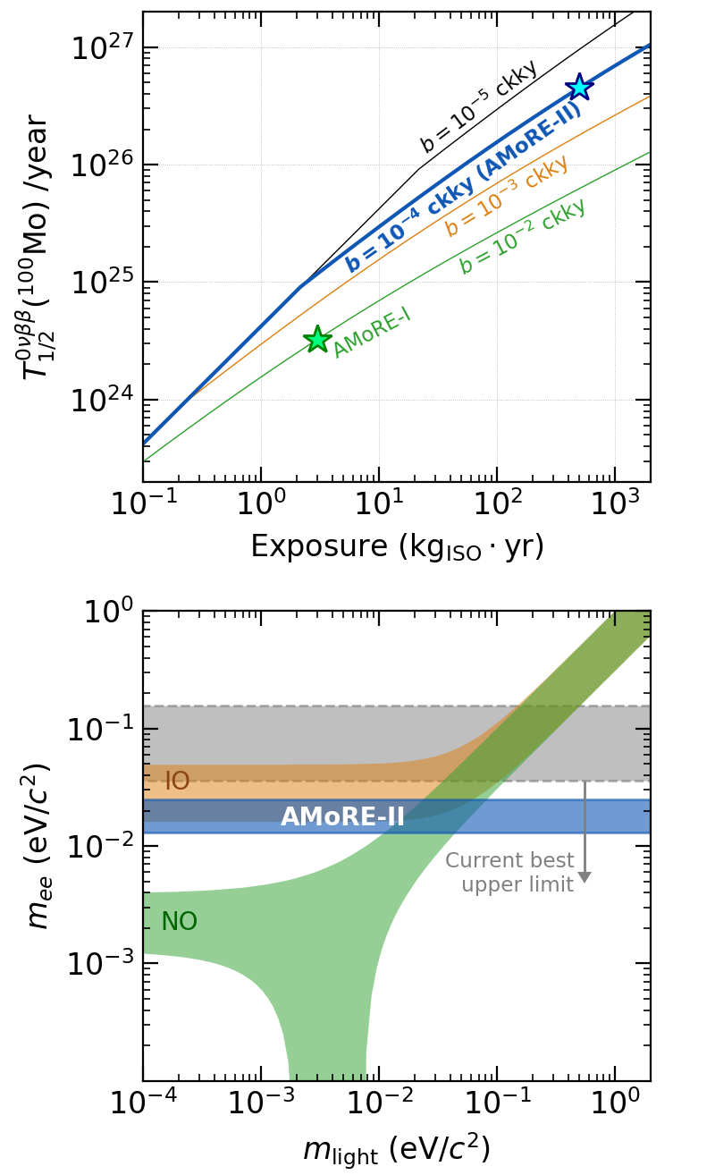
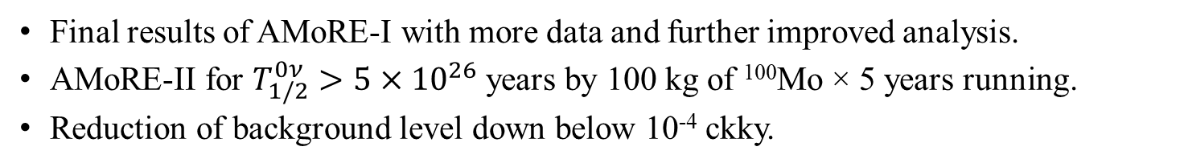
Limits & Sensitivities
AMoRE-I preliminary
Final results of AMoRE-I with more data and further improved analysis.
AMoRE-II for $T_{1/2}^{0ν}>5×{10}^{26}$years by 100 kg of ¹⁰⁰Mo × 5 years running.
Reduction of background level down below 10⁻⁴ ckky.
Notes:
As mentioned in previous slides, there are still more data, some are not analyzed yet and other are still being collected. The final results of AMoRE-I will be with further improved analysis.
The goal of AMoRE-II is 5$×{10}^{26}$years by 100 kg of ¹⁰⁰Mo × 5 years running and reduction of background level down below 10⁻⁴ ckky.

Slide 18
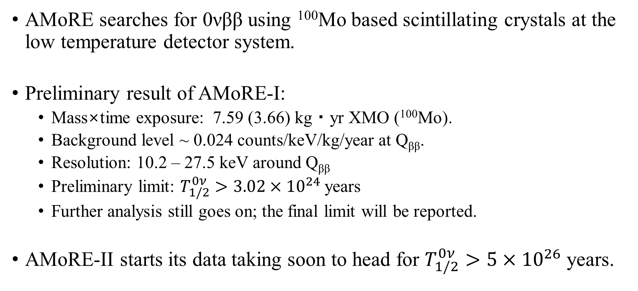
Summary
AMoRE searches for 0νββ using ¹⁰⁰Mo based scintillating crystals at the low temperature detector system.
Preliminary result of AMoRE-I:
  Mass×time exposure: 7.59 (3.66) kg・yr XMO (¹⁰⁰Mo).
  Background level ~ 0.024 counts/keV/kg/year at Q_{ββ}.
  Resolution: 10.2 – 27.5 keV around Q_{ββ}
  Preliminary limit: $T_{1/2}^{0ν}>3.02×{10}^{24}$years
  Further analysis still goes on; the final limit will be reported.
AMoRE-II starts its data taking soon to head for $T_{1/2}^{0ν}>5×{10}^{26}$years.
Notes:
Here is the summary.
The AMoRE searches for 0νββ using ¹⁰⁰Mo-based scintillation crystals at the low temperature detector system.
With 4.68 kg yr crystal exposure, equivalent to 2.24 kg y 100Mo, we achieved preliminary results of 0.03 ckky bkg level and $1.05×{10}^{24}$years half-life limit for AMoRE-I. Its data taking will continue at least until end of this year, and the final result will be with almost doubled data and improved analysis.
The next phase, AMoRE-II will start the data taking soon to head for $T_{1/2}^{0ν}>5×{10}^{26}$years.

Slide 19
Thank you!
Notes:
감사합니다.

Slide 20
backup

Slide 21
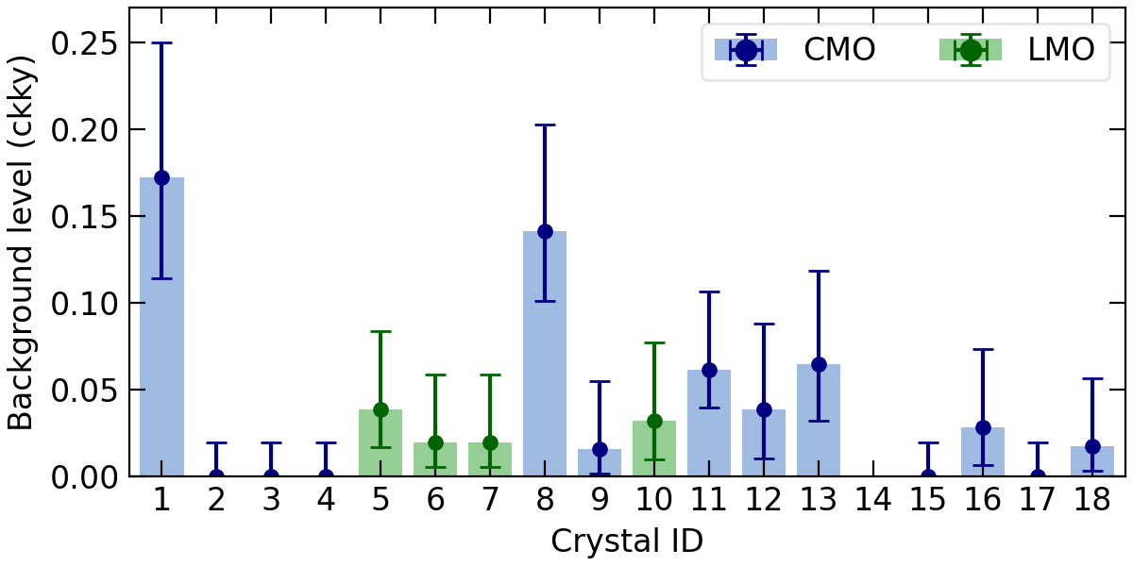
CMO internal background
arXiv:2107.07704
0.1 ckky!

Slide 22
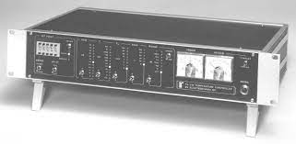
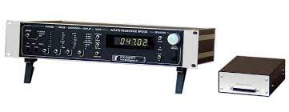
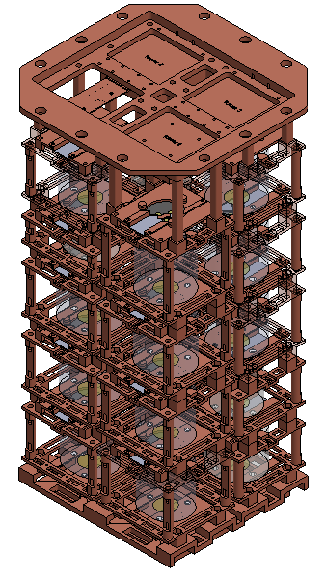
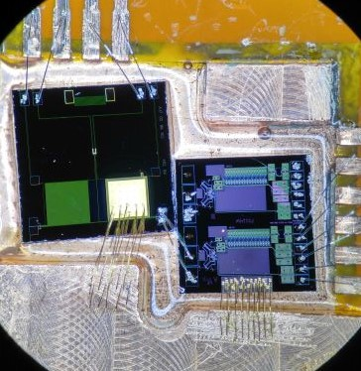
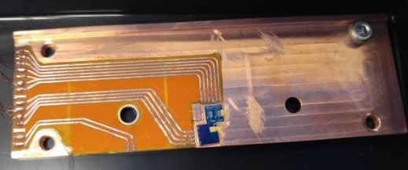








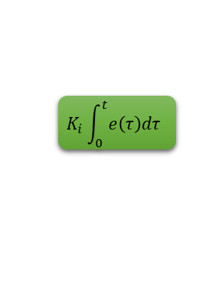


Two stage temperature control
TS530
AVS-47B
$1^{st}$-PID system
$$K_{p}∙e\left(t\right)$$
$$SP\left(t\right)$$
$$+$$
$$∑$$
$$e\left(t\right)$$
$$K_{i}\int_{0}^{t}{e\left(τ\right)dτ}$$
$$∑$$
Heater
$$PV(t)$$
$$−$$
$$K_{d}\frac{d e\left(t\right)}{dt}$$
$$Ruthenium Oxide Thermometer$$
Heater
$2^{nd}$-PID system
MMC

Slide 23
Live time

Slide 24
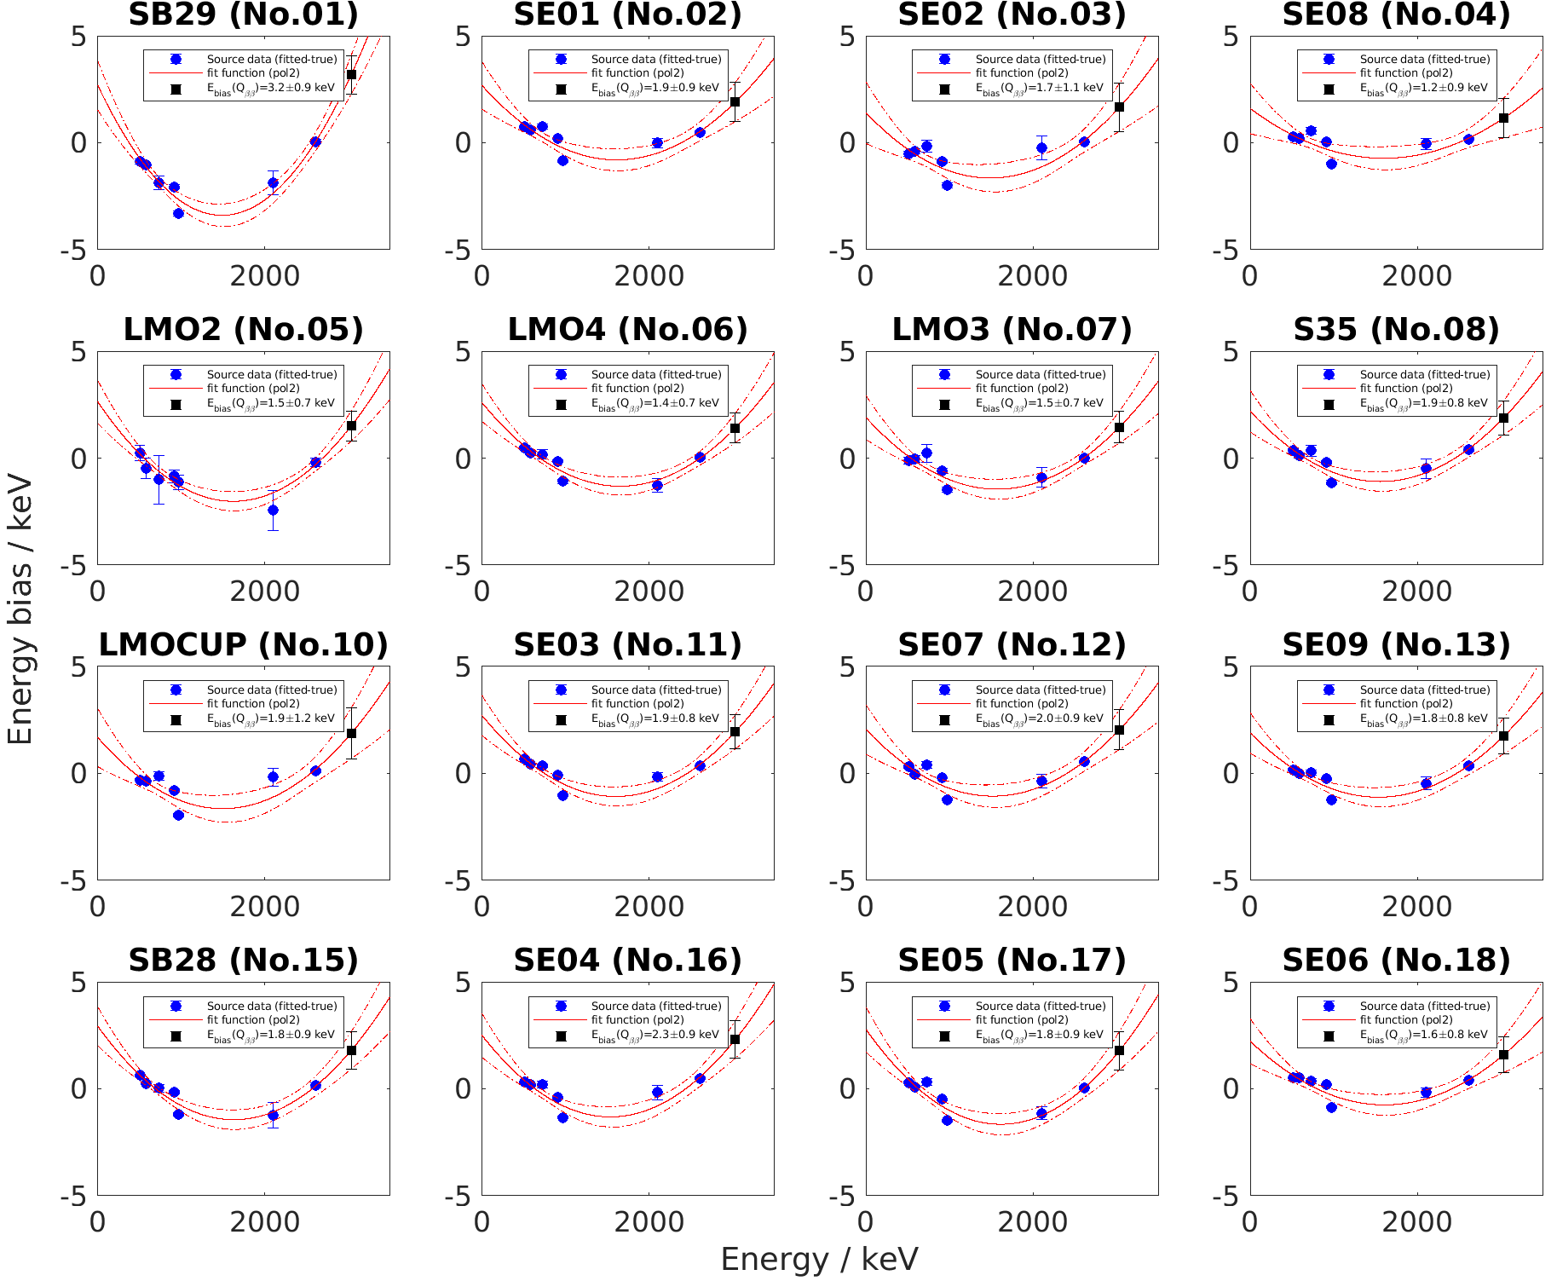
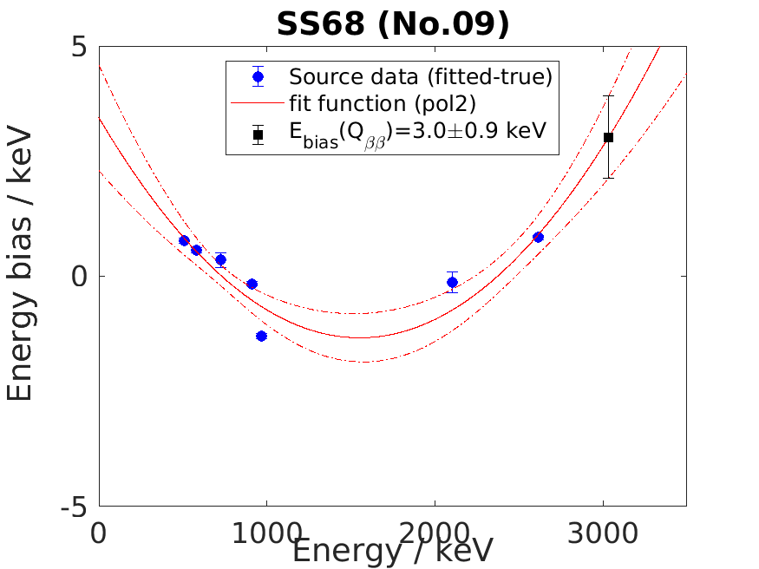
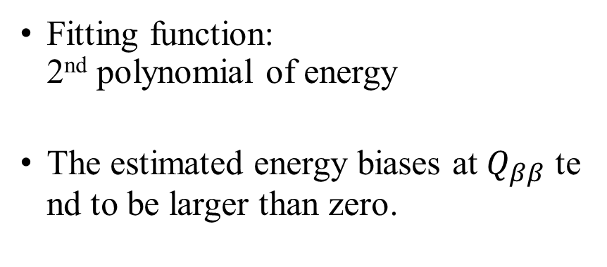
ROI estimation
Fitting function:
2nd polynomial of energy
The estimated energy biases at $Q_{ββ}$ tend to be larger than zero.

Slide 25
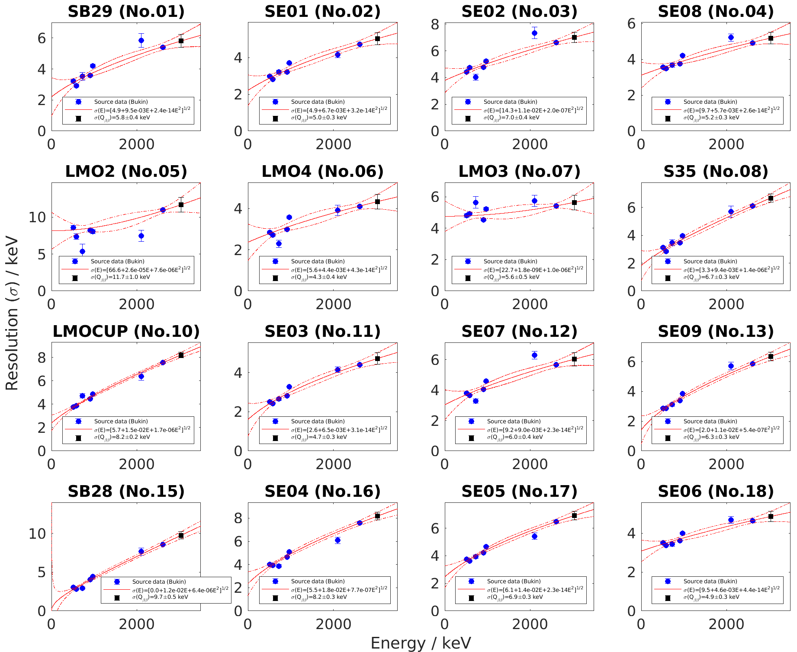
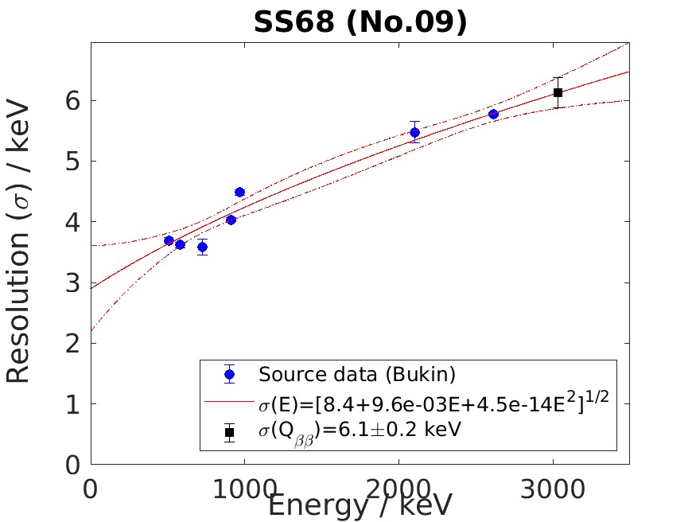

ROI estimation
Fitting function:
$σ\left(E\right)= \sqrt{b_{1}+b_{2}E+b_{3}E^{2}}$

Slide 26
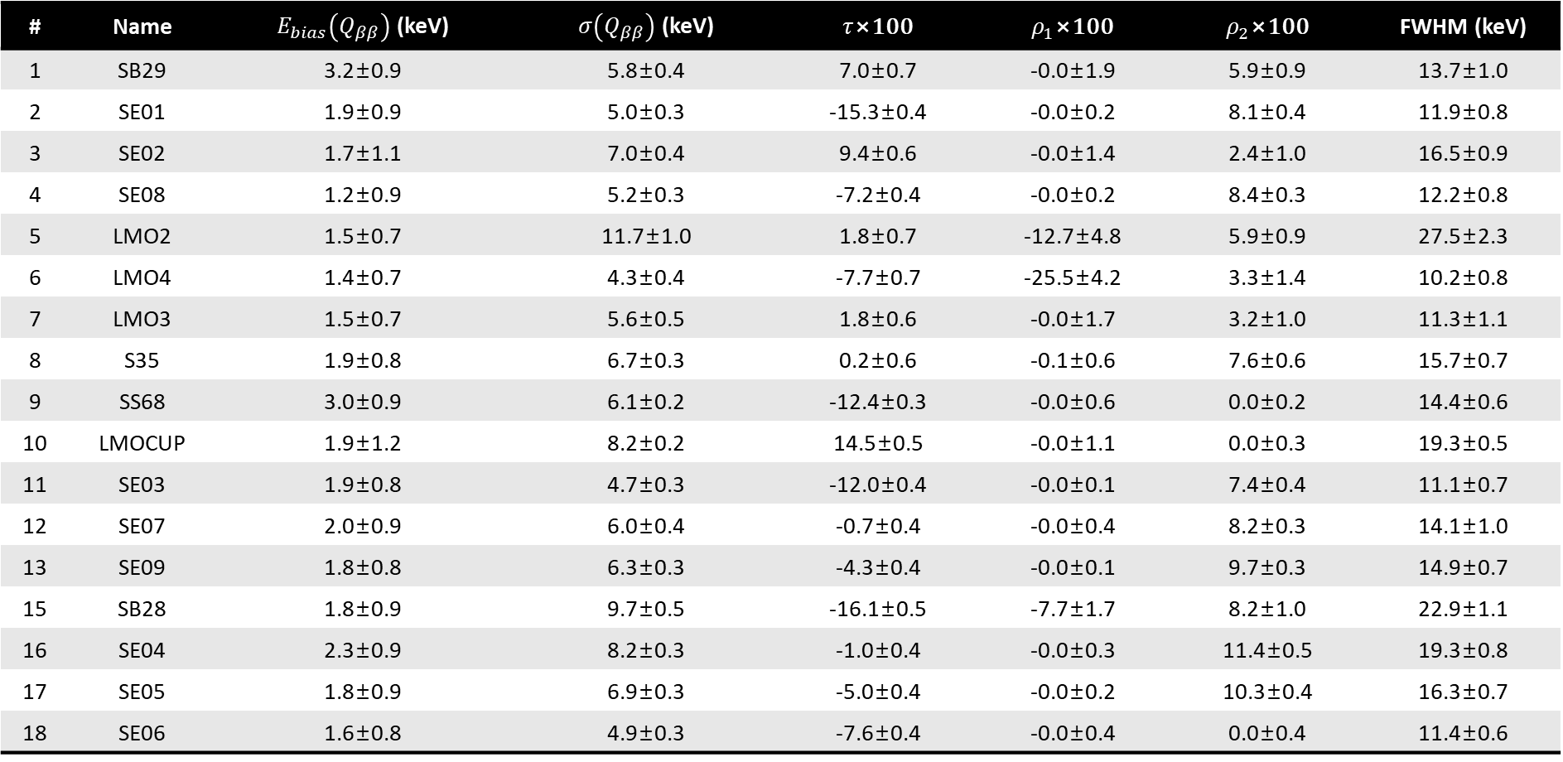
ROI estimation
# | Name | $E_{bias}\left(Q_{ββ}\right)$ (keV) | $σ\left(Q_{ββ}\right)$ (keV) | $τ$×100 | $ρ_{1}$×100 | $ρ_{2}$×100 | FWHM (keV)
1 | SB29 | 3.2±0.9 | 5.8±0.4 | 7.0±0.7 | -0.0±1.9 | 5.9±0.9 | 13.7±1.0
2 | SE01 | 1.9±0.9 | 5.0±0.3 | -15.3±0.4 | -0.0±0.2 | 8.1±0.4 | 11.9±0.8
3 | SE02 | 1.7±1.1 | 7.0±0.4 | 9.4±0.6 | -0.0±1.4 | 2.4±1.0 | 16.5±0.9
4 | SE08 | 1.2±0.9 | 5.2±0.3 | -7.2±0.4 | -0.0±0.2 | 8.4±0.3 | 12.2±0.8
5 | LMO2 | 1.5±0.7 | 11.7±1.0 | 1.8±0.7 | -12.7±4.8 | 5.9±0.9 | 27.5±2.3
6 | LMO4 | 1.4±0.7 | 4.3±0.4 | -7.7±0.7 | -25.5±4.2 | 3.3±1.4 | 10.2±0.8
7 | LMO3 | 1.5±0.7 | 5.6±0.5 | 1.8±0.6 | -0.0±1.7 | 3.2±1.0 | 11.3±1.1
8 | S35 | 1.9±0.8 | 6.7±0.3 | 0.2±0.6 | -0.1±0.6 | 7.6±0.6 | 15.7±0.7
9 | SS68 | 3.0±0.9 | 6.1±0.2 | -12.4±0.3 | -0.0±0.6 | 0.0±0.2 | 14.4±0.6
10 | LMOCUP | 1.9±1.2 | 8.2±0.2 | 14.5±0.5 | -0.0±1.1 | 0.0±0.3 | 19.3±0.5
11 | SE03 | 1.9±0.8 | 4.7±0.3 | -12.0±0.4 | -0.0±0.1 | 7.4±0.4 | 11.1±0.7
12 | SE07 | 2.0±0.9 | 6.0±0.4 | -0.7±0.4 | -0.0±0.4 | 8.2±0.3 | 14.1±1.0
13 | SE09 | 1.8±0.8 | 6.3±0.3 | -4.3±0.4 | -0.0±0.1 | 9.7±0.3 | 14.9±0.7
15 | SB28 | 1.8±0.9 | 9.7±0.5 | -16.1±0.5 | -7.7±1.7 | 8.2±1.0 | 22.9±1.1
16 | SE04 | 2.3±0.9 | 8.2±0.3 | -1.0±0.4 | -0.0±0.3 | 11.4±0.5 | 19.3±0.8
17 | SE05 | 1.8±0.9 | 6.9±0.3 | -5.0±0.4 | -0.0±0.2 | 10.3±0.4 | 16.3±0.7
18 | SE06 | 1.6±0.8 | 4.9±0.3 | -7.6±0.4 | -0.0±0.4 | 0.0±0.4 | 11.4±0.6

Slide 27
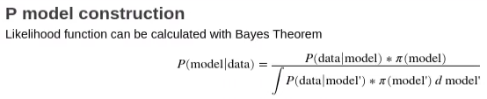
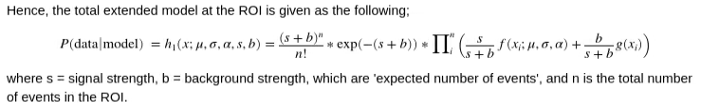
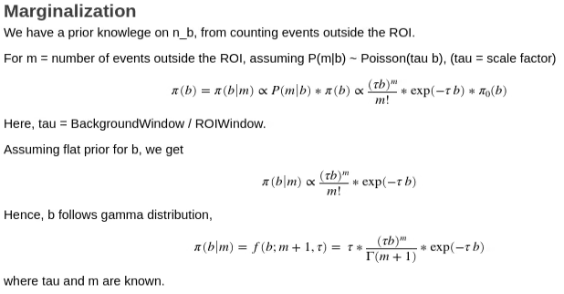

Likelihood calculation

Slide 28

















Likelihood calculation

Slide 29

Likelihood calculation

Slide 30
Background budget for AMoRE-II
for each item

