Slide 1
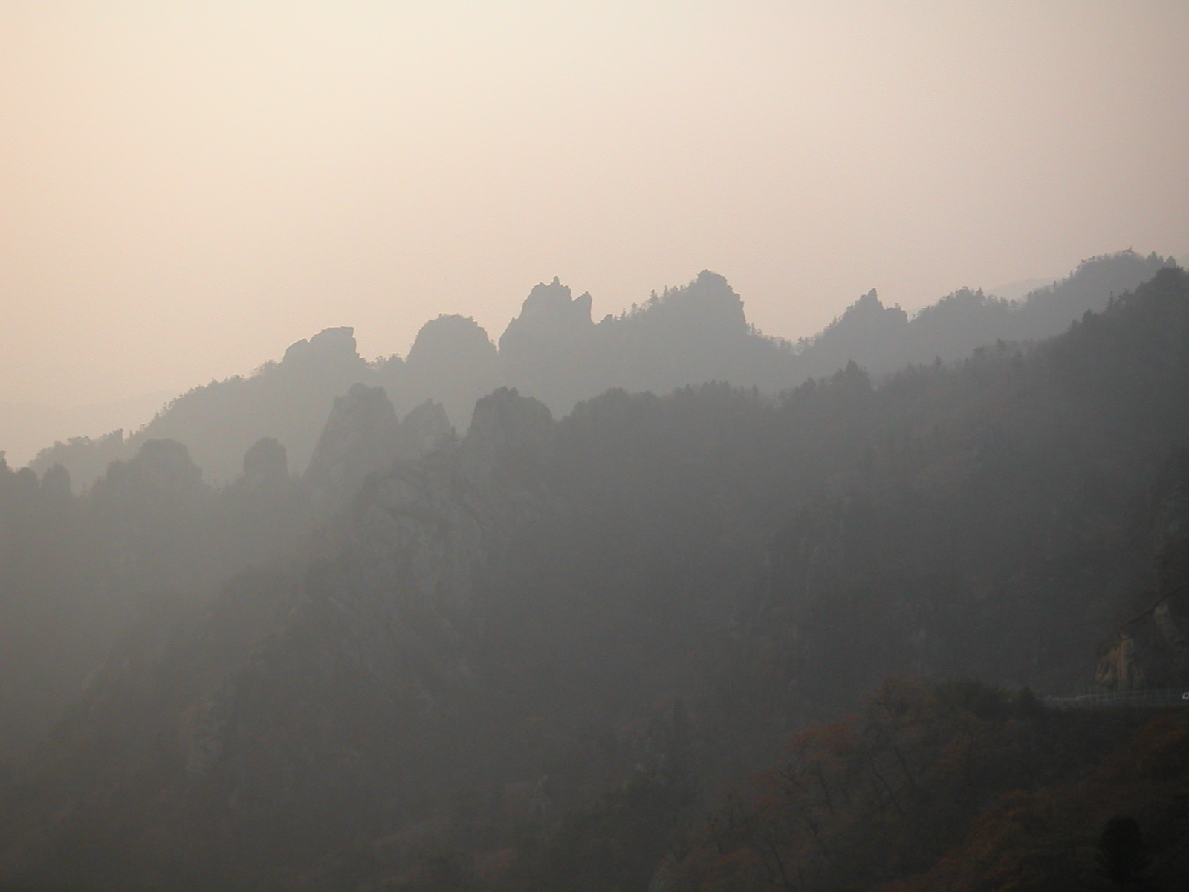
전
서울대 핵입자천체물리연구소 워크숍, 강릉
2023.03.31
김 선 기

Slide 2
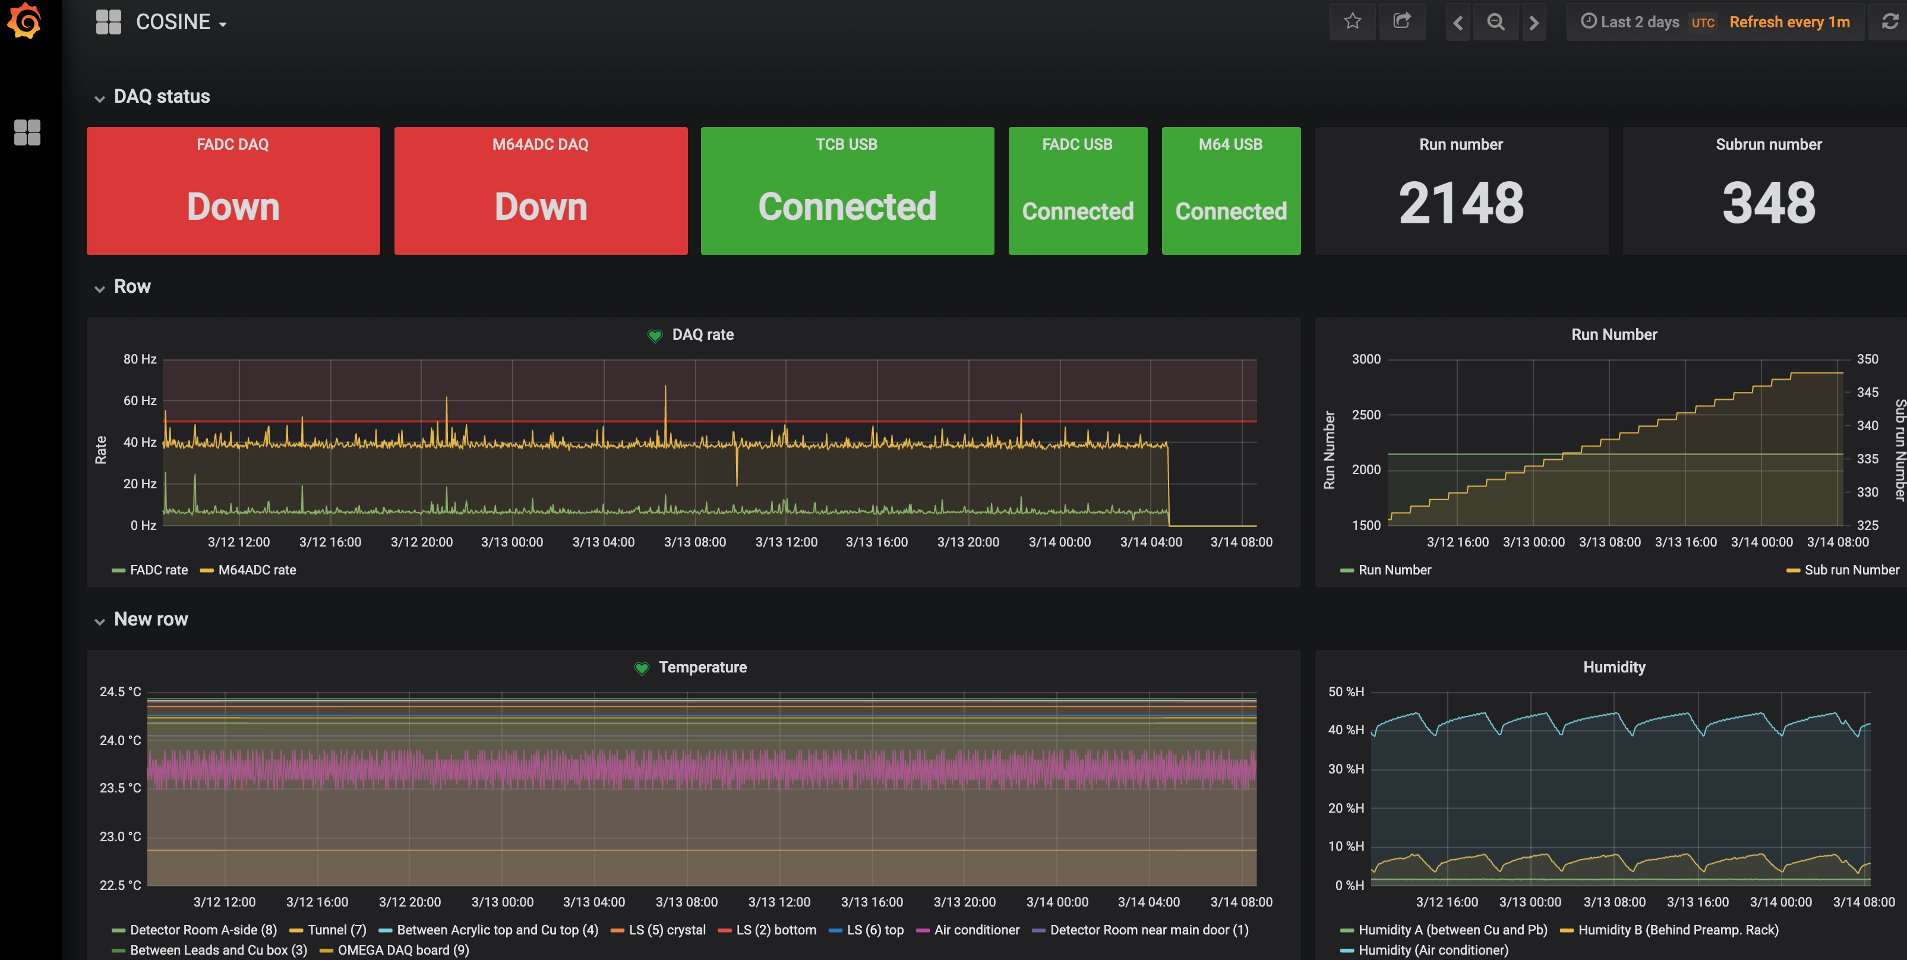
COSINE on-line monitoring shift
The last COSINE shift at Y2L ! 2023.3.14

Slide 3
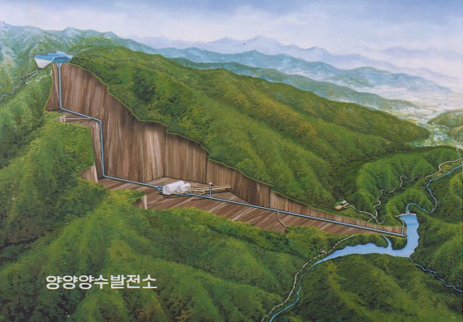
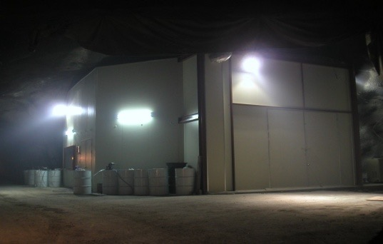
Yangyang Underground Laboratory
Korea Middleland Power Co.
Yangyang Pumped Storage Power Plant
(Upper Dam)
2003-2023
KIMS
COSINE
AMoRE-I
(Power Plant)
(Lower Dam)
Minimum depth : 700 m / Access to the lab by car (~2km)

Slide 4
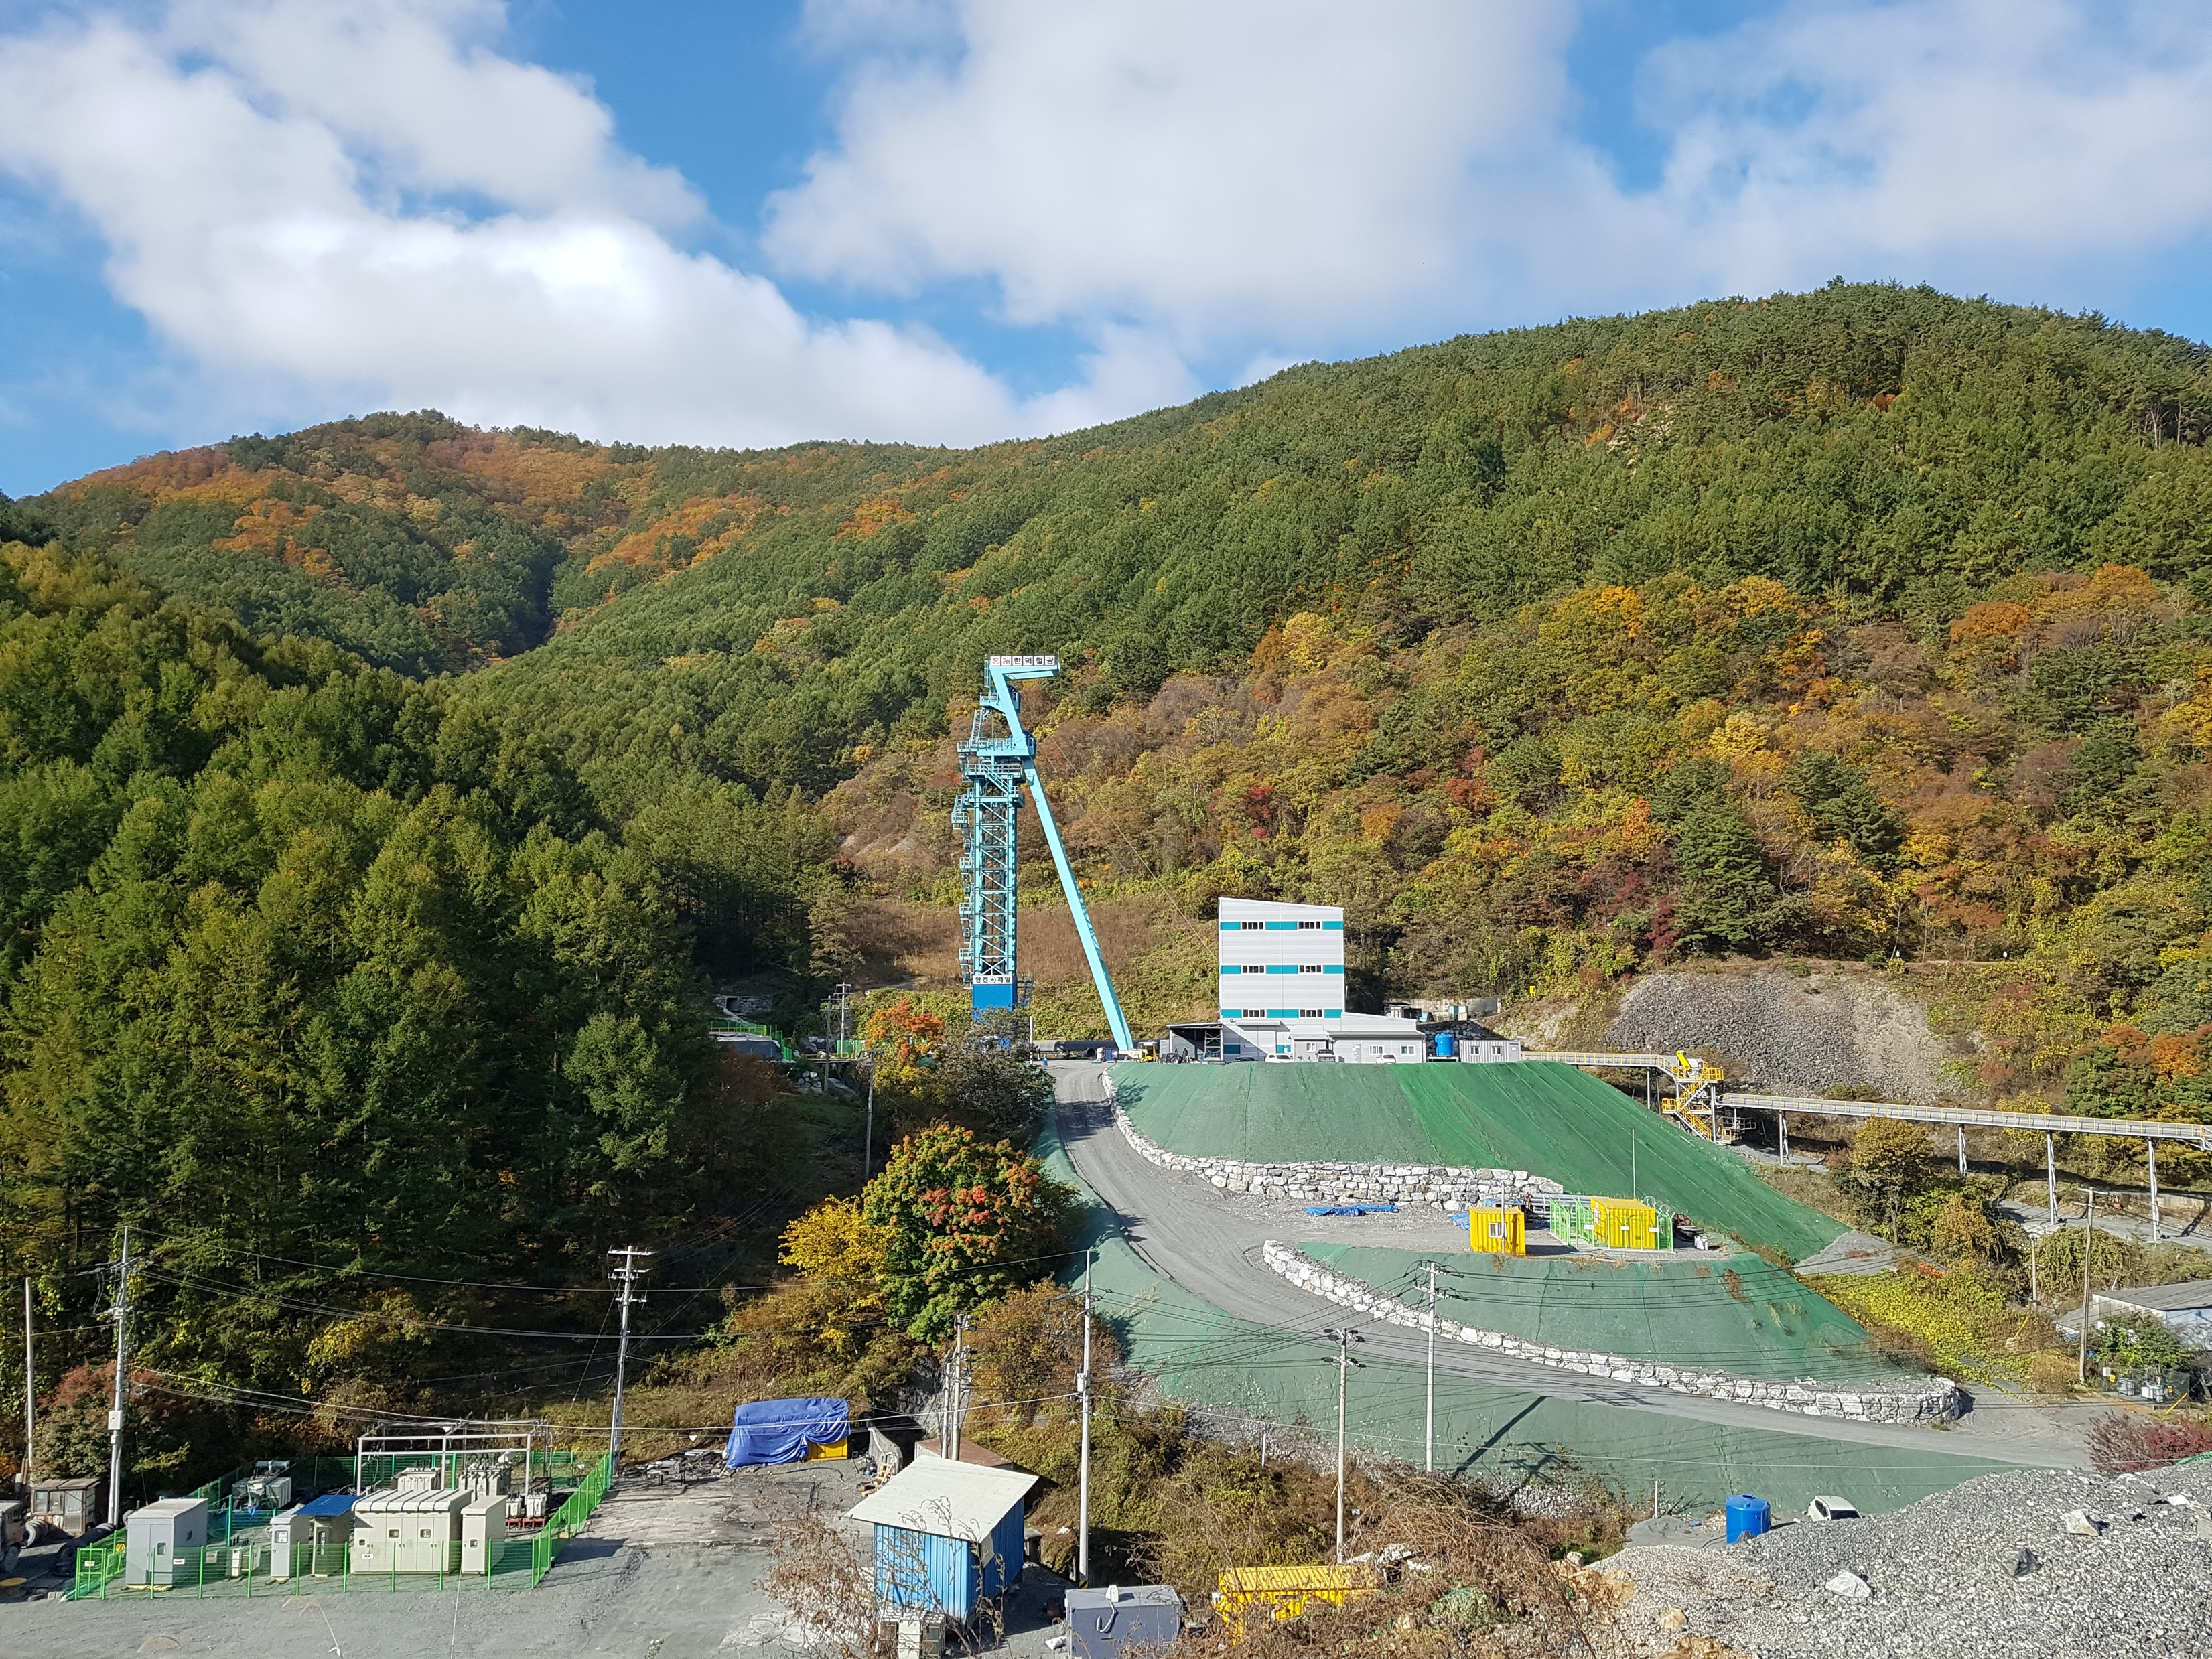
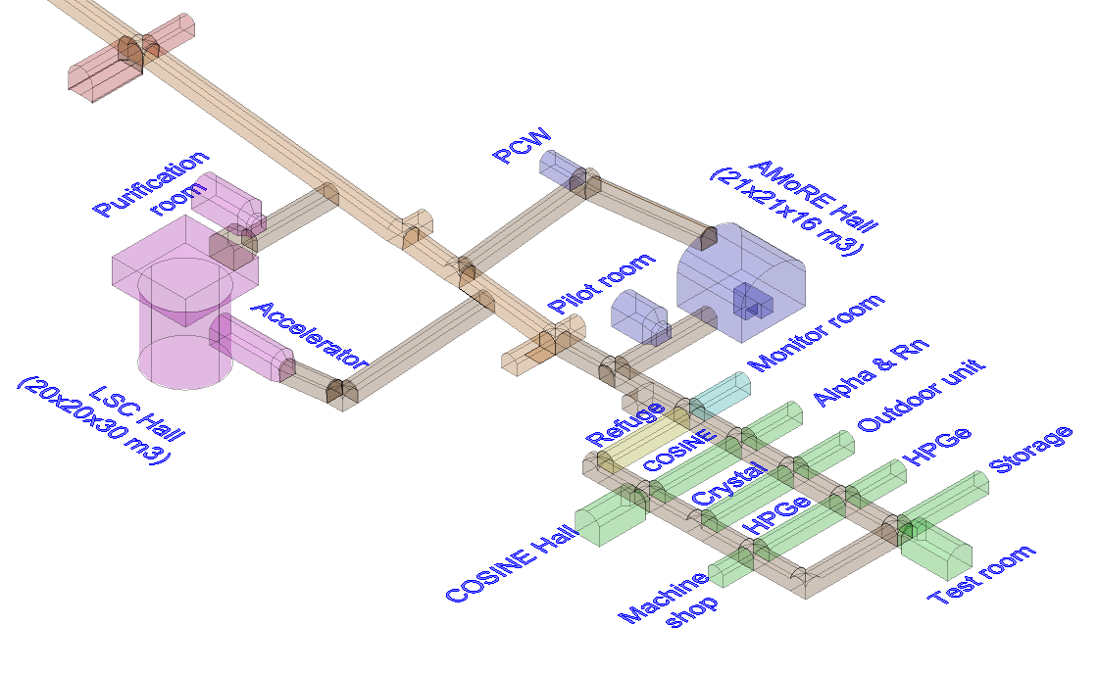
Yemilab
Area
  4000m² for tunnel,
  1000 m² for maintenance,
  3000m² for experiments
Mechanical
  39000m³/hour ventilation
  200kW cooling power
  Radonless air supply (~10000 m³/hour from ground)
Electrical
  2MW for electric power supply
  180kW UPS for 40 minutes for AMoRE-II
  360kW emergency generator
2022-
COSINE 200
AMoRE-II
LSC
 | Y2L | Yemilab
Depth (m) | 700 | 1000
Area (m²) | 350 | 3000
Rock Radioactivity (ppm) | U : 3.9(1.4) Th : 10.5(6.5) K : 40000 | U : 0.8(0.3) Th : 3.3(0.4) K : 11,800

