Slide 1
Study of nuclear structure around the N = 126 shell closure using multi-nucleon transfer reaction
Youngju Cho
Department of physics and astronomy, SNU
Center for Exotic Nuclear Studies, IBS
Notes:
Good morning. I am Youngju belongs to Nuclear Physics Laboratory. I will present about nuclear structure study around the N = 126 shell closure using MNT reaction

Slide 2
List
Brief description about nuclear shell model and nuclear structure
Motivation of our experiment and the setup
Particle Identification (PID)
  Supervised learning for the ion charge state (Q) identification
  Semi-supervised learning for the atomic number (Z) identification
Kinematics with CATLIFE (second arm detector)
  - by Yonghyun Son
Study of nuclear structure using gamma-ray spectroscopy
Summary
Notes:
Here is the list of my presentation. I will start with a simple description about nuclear shell model and nuclear structure, and then introducing the motivation and setup of our experiment.
Some machine learning techniques for particle identification will be talked, and some ongoing analysis result of gamma-ray spectroscopy will be presented.

Slide 3
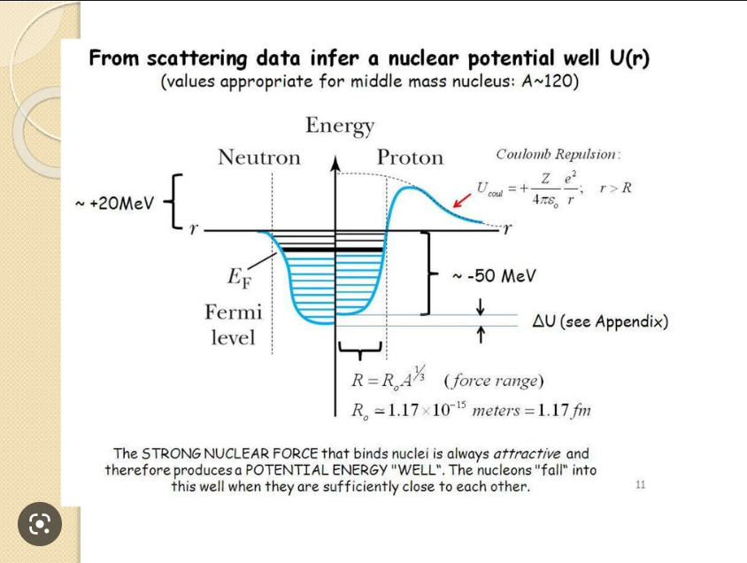
Atomic nucleus
Attractive short-range strong nuclear force among nucleons
Repulsive long-range Coulomb force among protons
Stability of a nucleus depends on the balance between the two forces
Notes:
I will start with atomic nucleus

Slide 4
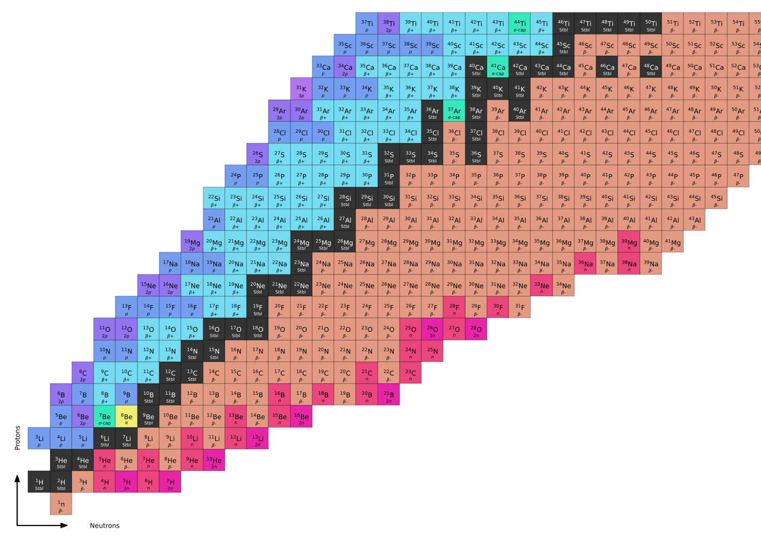
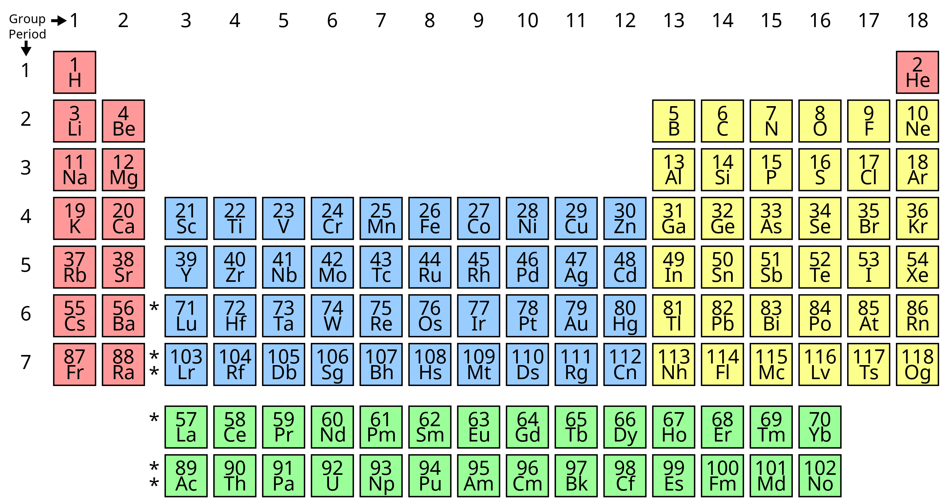
Nuclear Chart (Segre Chart)
~ Periodic table in chemistry
Organize subatomic particles into a table based on the proton & neutron number
About 3000 known nuclei, but additional 4000 nuclei (expected to be existed) are not discovered yet
Visual representation of various properties such as binding energy, stability, decay mode, half-life, separation energy, 1st excited state level, etc.

Slide 5
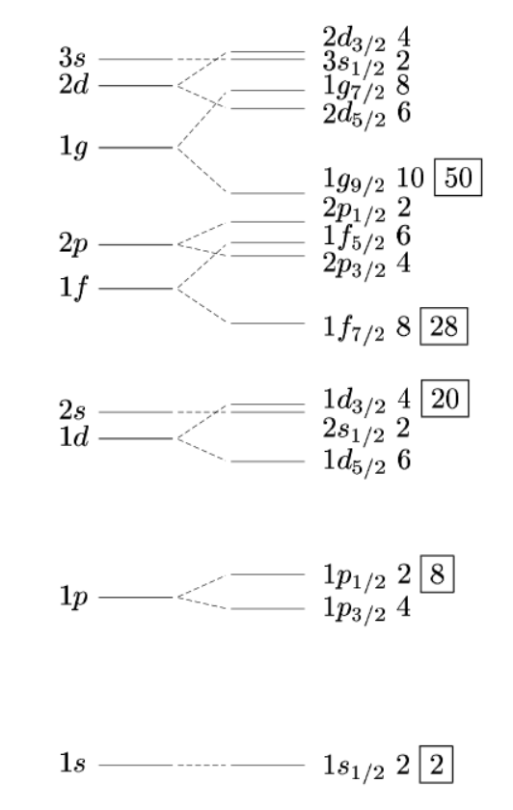
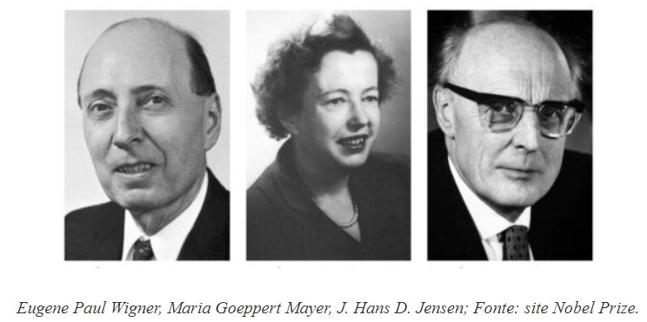
Nuclear Shell Model
Magic number of nucleons
  Binding energy of the (N+1, Z) or (N, Z+1) nucleus is significantly less than the (N, Z) at some N, Z
  Particularly stable at 2, 8, 20, 28, 50, 82, 126
  Analogous to the atomic shell model
Nuclear shell model
  Nucleons in a nucleus occupy certain energy levels (“shells”) following Pauli exclusion principle
  Energy levels formed by strong nuclear force
  Successful in explaining various nuclear properties such as binding energy, excited states, electromagnetic transition rate, etc
Nobel prize (1963) : Discovery of the nuclear shell model of the atomic nucleus
Harmonic Oscillator Potential
Spin-Orbit Coupling
+
Notes:
Nuclear shell model is motivated by the special pattern of the binding energies of nuclei. The binding energy is the mass difference between the nucleus and the sum of proton and neutron masses of that nucleus. When we add a nucleon step by step, the binding energy of the nucleon is significantly less at some specific neutron number or proton number. Such particularly stable numbers are 2, 8, 20, 28, 50, 82, 126. This behavior shows analogy to the atomic shell model.
Naturally, nuclear shell model was developed to explain such “magic number”. The model assumes nucleons in a nucleus occupy certain energy levels following Pauli exclusion principle. Such energy levels are formed by strong nuclear force. This model was successful in explaining various nuclear properties such as binding energy, properties of excited states, EM moment, and so on.
By this achievement, three people, Wigner, Mayer, Jensen got the Nobel prize in 1963.

Slide 6
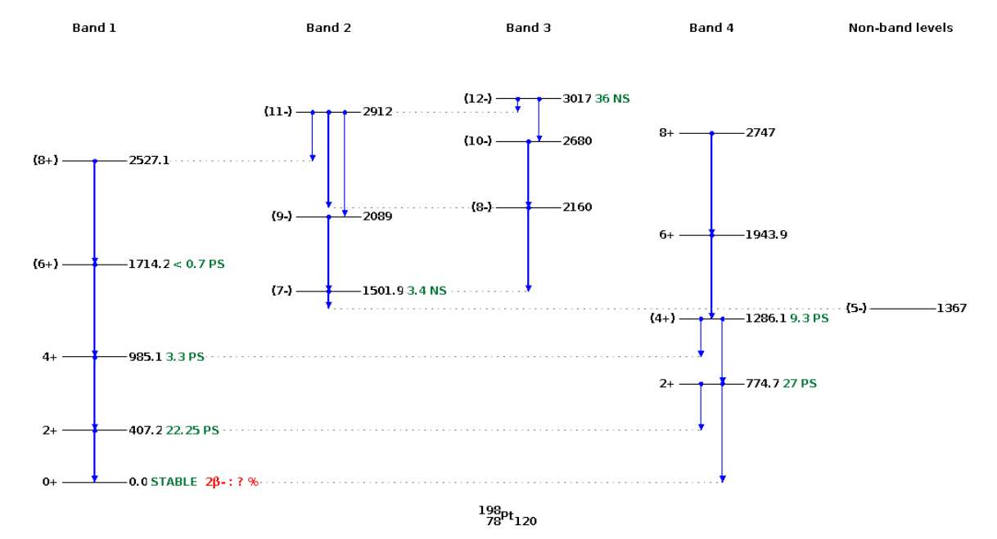
Nuclear Structure
Characterized by various properties such as
  Binding energy
  Spin/parity and energy level of excited states
  Nuclear shape (deformation)
  Electromagnetic moments
Nuclear shell model can calculate those properties in a unified method
Experimental data of excited states (e.g. by gamma-ray spectroscopy) near the closed shell is needed for the reliable shell model calculation
Excited states of ¹⁹⁸Pt
Notes:
The nuclear structure is characterized by various properties just as mentioned in previous slide. Although nuclear shell model can calculate those properties in a unified method, experimental data of excited states near the closed shell is needed for the reliable calculation.
The right figure is an example of the excited states, which usually called level scheme, of the 198Pt.

Slide 7
Multi-Nucleon Transfer (MNT) Reaction
MNT reaction
  Binary reaction between projectile and target nucleus
  Occur at near Coulomb barrier energy (several MeV/u)
  Large energy dissipation (relative kinetic energy convert to internal excitation energy)
  Higher cross-section near N ~ 126 compared to other reactions such as fragmentation or fission
Notes:
Next, I will briefly explain about the multi-nucleon transfer reaction which was used for our experiment.

Slide 8
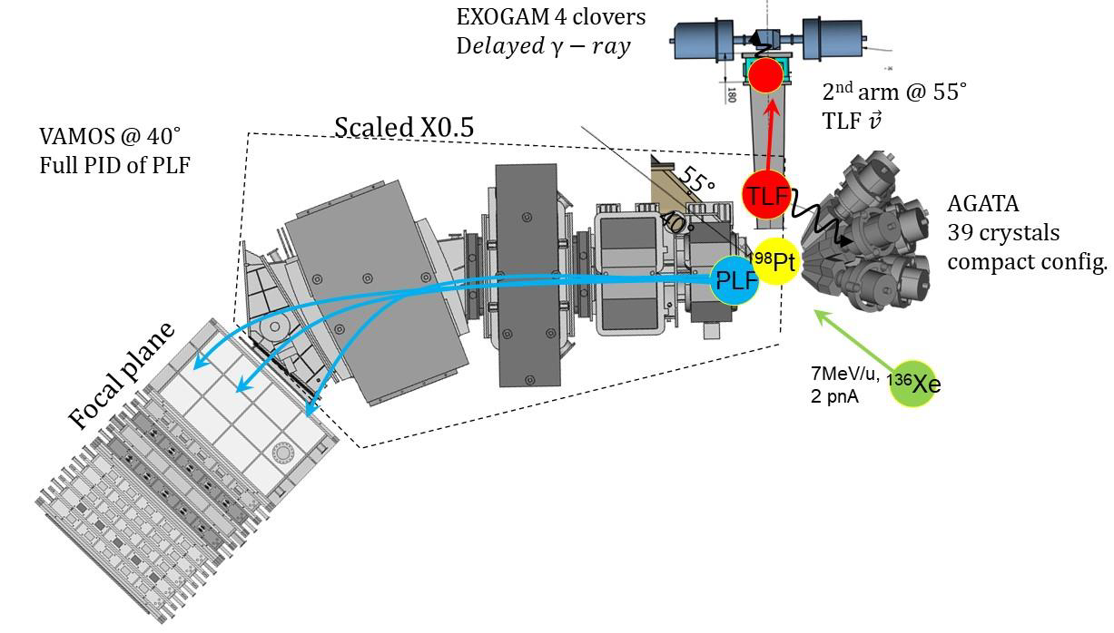
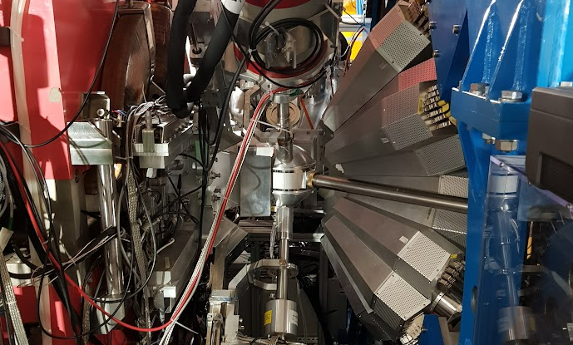
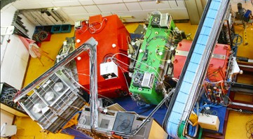
Experimental Setup
CATLIFE
(will be presented by Yonghyun)
AGATA 39 Crystals
HPGe Tracking Array
Prompt gamma ray detection
Projectile-like fragments (PLFs) are separated and identified by VAMOS++
Multi-nucleon transfer (MNT) reaction
Multi-wire proportional counters
(Position, TOF -> Bρ, Path)
Segmented ion chamber
(Ion Energy)
Notes:
To produce such nuclei, MNT reaction between 136Xe beam and 198Pt target was used.
The PLFs are identified by VAMOS++ magnetic spectrometer. There are two multi-wire proportional counters near focal plane which measure the position and time of flight of ions.
Brho and Path length of ions are reconstructed by this measurement.
Important part for this presentation is the segmented ion chamber at the end of VAMOS which measure the ion energy.
When PLFs are identified, the TLFs are deduced by the binary characteristic of the MNT reaction with the aid of velocity vector measured by second arm.

Slide 9
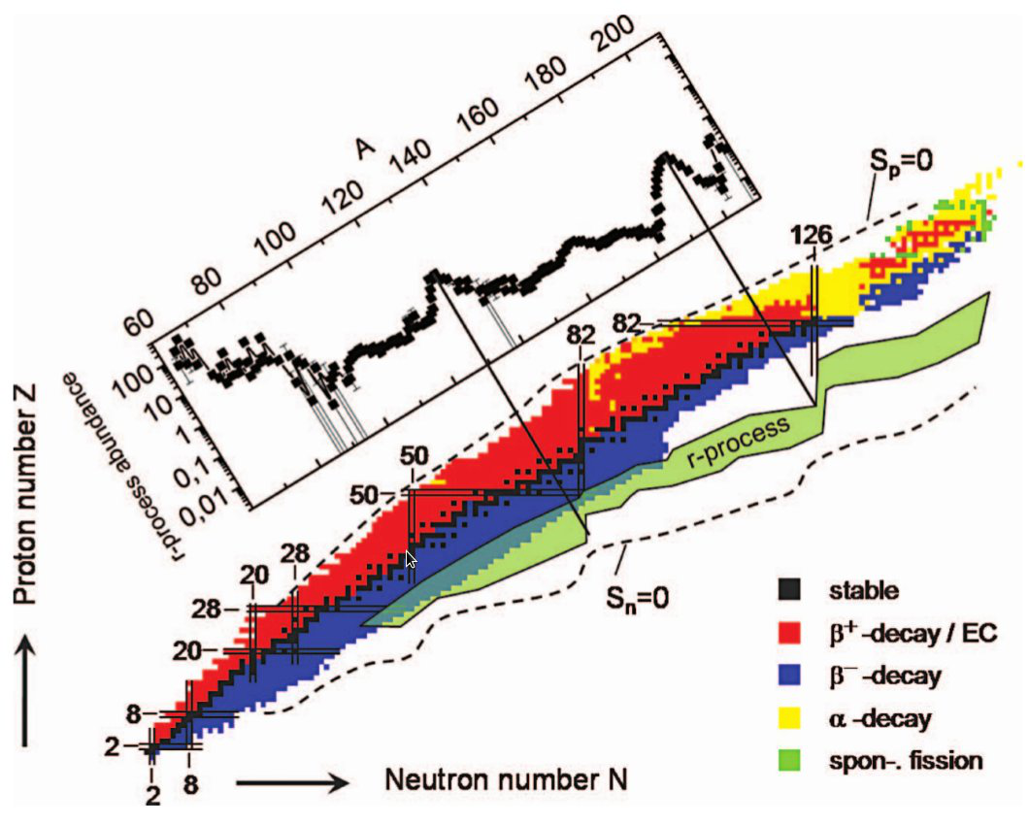
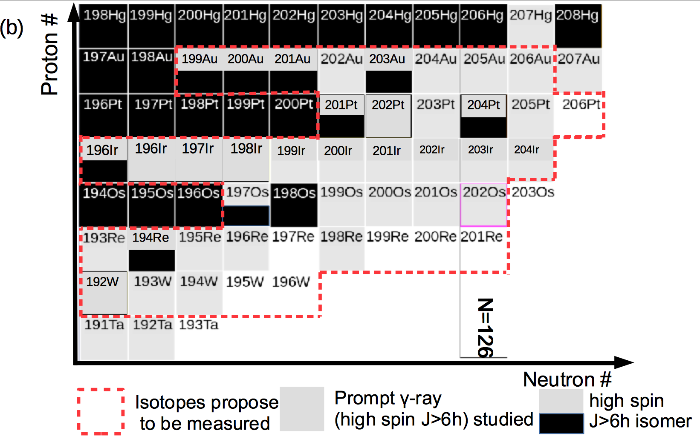

Motivation of our experiment
νf_{5/2}
νP_{1/2}
Drawn by Y. H. Kim
πd_{3/2}
￼
￼
￼
Blank spot
πh_{11/2}
Stable nuclei
Proposed isotopes to be measured
Nuclei studied with isomer or beta decay
Nuclear structures around N = 126 are not well known
Important for understanding the nuclear interaction in this region
Particularly, nuclear properties of N = 126 isotones are crucial for constraining astrophysical nucleosynthesis
Reiner Krucken, Contemporary Physics Vol. 52, No. 2(2011) 101–120
Astrophysical r-process : A nucleosynthesis process expected to explain the half of heavy nuclei abundance in the universe
Expected to occur at neutron star merger or type-2 supernovae
Notes:
We performed the experiment at GANIL, which is the accelerator facility located at France, to investigate the nuclear structure around neutron number 126.
The nuclear structure
The motivation of our experiment at GANIL was studying nuclear properties of neutron number near 126 neutron-rich nuclei below 198Pt isotopes.

Slide 10
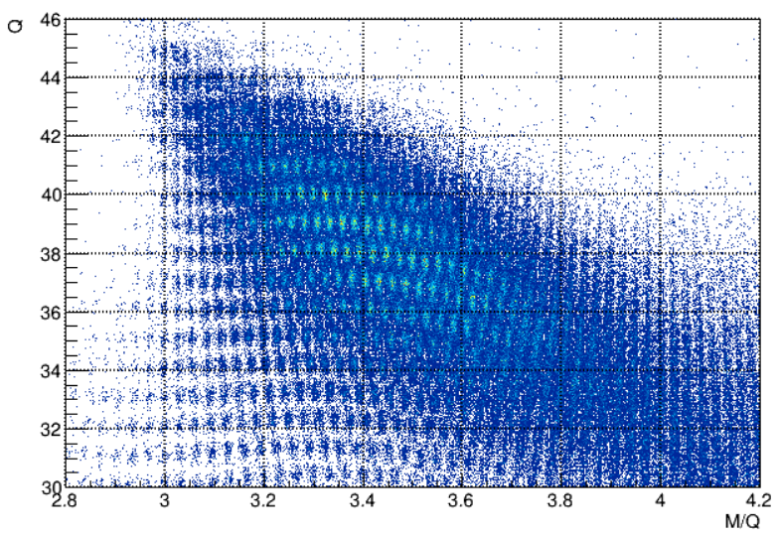
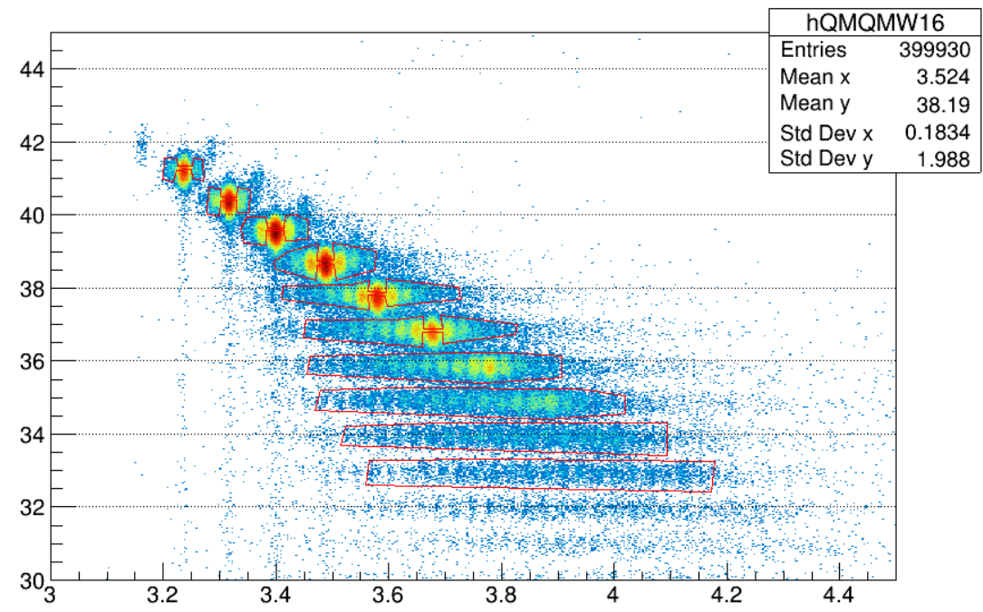
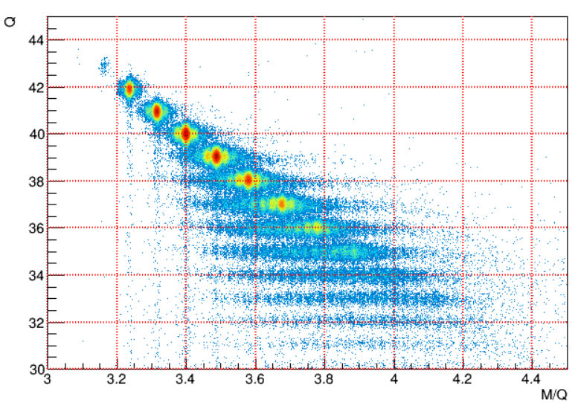


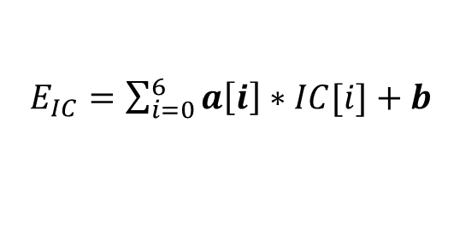
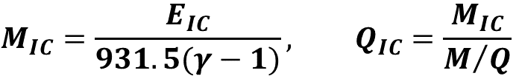
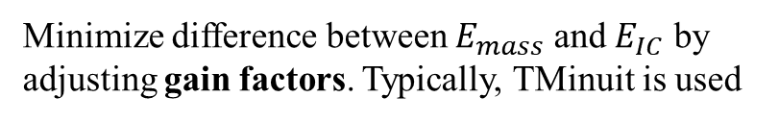
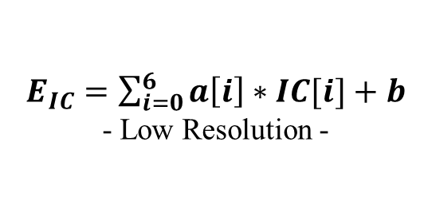
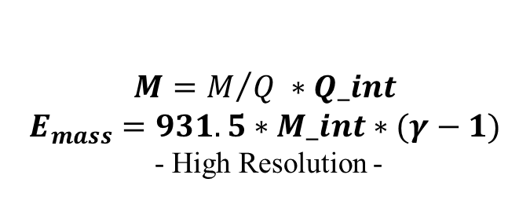
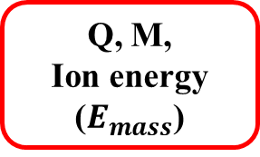
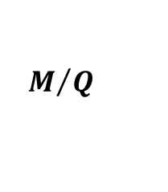
Conventional PID procedure and limitation
$$Q_{IC}$$
$$M=M/Q ∗Q_int$$
$$E_{mass}=931.5∗M_int∗(γ−1)$$
- High Resolution -
Measurement
- Bad alignment at different energy range
- Non-linear correction needed for low energy
- Complicated and unpromising
$$M_{IC}=\frac{E_{IC}}{931.5(γ−1)}, Q_{IC}=\frac{M_{IC}}{M/Q}$$
After gain factors optimization
Energy loss at segmented IC
Ion energy ($E_{IC}$)
Q, M,
Ion energy ($E_{mass}$)
Q_int = 42
$E_{IC}=\sum_{i=0}^{6}{a\left[i\right]∗IC[i]}+b$
- Low Resolution -
Q_int = 39
M/Q
$E_{IC}=\sum_{i=0}^{6}{a\left[i\right]∗IC[i]}+b$
Q_int = 36
PLFs
Minimize difference between $E_{mass}$ and $E_{IC}$ by adjusting gain factors. Typically, TMinuit is used
Reconstructed
Q_int = 33
Velocity
Energy loss at 7 sections : IC[0] to IC[6]
$$M/Q$$
Notes:
This is the starting point of PID procedure of VAMOS data. Some factors are omitted for simplicity.
Our focusing point is the calculation of ion energy by using the energy loss at segmented ion chamber.
The ion chamber is segmented by 7 sections. When an ion pass through it, it measure the energy loss at each sections.
Then, total ion energy can be calculated by sum among segmented energy loss with linear gain factors. The gain factors are adjusted by hand at first.
This energy has low resolution which is characteristic of ion chamber. (챔버 자체의 resolution 값 ~ 1%?)
Then, we can calculate the ion charge state by ion energy, velocity, and M/Q by following equations. Velocity and M/Q are calculated by reconstructed Brho and Path length.
Since the gain factors are not optimized yet, the first ion charge state versus M/Q looks as the figure.
In principle, ion charge states should be aligned at integers. So it implies we need to improve the ion energy calculation.
For that, we usually make graphical cuts for them, assign integer charge values, and calculate ion energy inversely from integer mass and velocity.
This energy, Emass has high resolution because it only depends on the high resolution measurement variables. (~0.1% : TOF + reconstruction resolution)
So there are two calculated energies for an ion. One with low resolution, and another with high resolution.
Then, we can adjust the gain factors to minimize the difference between these two energies. Typically, Tminiuit is used for this.
By this optimization, resolution of ion charge states and selectivity for integer values of them is increased. So this ultimately leads to good mass selection.
The result after gain factors adjustment looks like this picture.
They are aligned well at now, but this is only for a part of total data which has relatively high energy and includes more elastic-like events.
So, if we go to another data set which has lower energy range, charge states are not aligned again.
As you can see, the conventional method didn’t work well for whole energy range at once, so one should calculate different gain factors for different energy range.
Furthermore, it starts to need some non-linear correction terms as ion energy goes lower and lower because of Bragg peak.
So it’s complicated and unpromising.

Slide 11
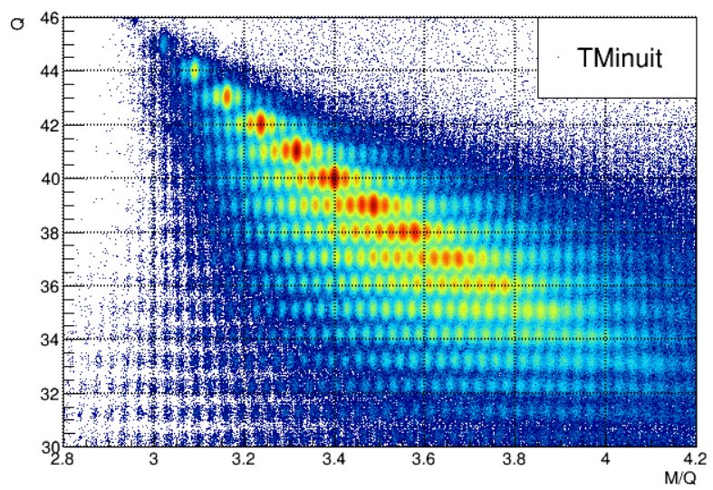
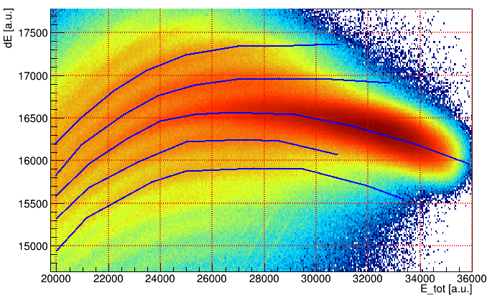
Particle IDentification (PID)
Prerequiesite for nuclear structure study
Q, A, Z are calculated using measured Bρ, velocity, kinetic energy of ion, etc
MNT reaction produces nuclei in a broad range of ion charge state (Q), mass number (A), atomic number (Z) in wide angular and energy distribution
  Difficulty of PID because of this broad ranges
Unambiguous PID is needed to observe the rare nuclei of interest
Therefore, a new PID method using machine learning was developed

Slide 12
Supervised learning for Q identification
Supervised learning (SL) : Finding best approximate function from inputs to target
Inputs : IC[0~6], X & Y in front of ion chamber
Target : E_{HR} (High Resolution ion energy)
Two types of SL methods
Deep Neural Network (DNN) : IC[0~6] → E_{HR}
Boosted Decision Tree (BDT) : IC[0], X & Y → E_{HR} - E_{DNN}
tanh
Raw data
Residual data 1
Residual data 2
IC0
tanh
RELU
IC1
Tree 1
Tree 2
RELU
Emass
(Linear)
RELU
1
IC6
tanh
Final output
7
3
10
Notes:
Therefore, we tried machine learning methods to calculate total ion energy for whole energy range with the hope of finding some hidden patterns from segmented energy loss and some other measurements.
We used the machine learning methods in TMVA, which is toolkit for multivariate data analysis embedded in ROOT program.
The first energy calculation was done by DNN, and some correction was done by BDTG.

Slide 13
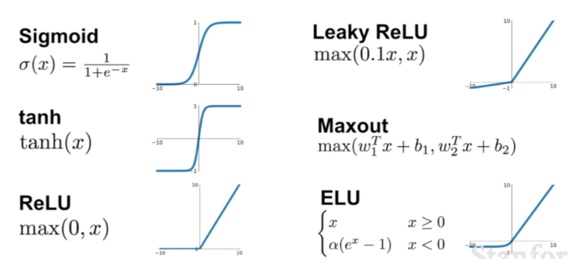

TMVA Deep Neural Network
tanh
Inputs : IC[0~6]
Target : $E_{mass}$= 931.5*Mint*(r-1)
Output : considered as $E_{IC}$
Can treat the non-linear correction terms easily
IC0
tanh
RELU
IC1
RELU
Emass
(Linear)
RELU
IC6
tanh
Notes:
To use the DNN for first ion energy calculation, we prepare the segmented energy loss as inputs and high resolution energy Emass as the target, which means the correct answer for the neural network.
The first hidden layer structure was designed with some intuition from our setup.
The neural network was trained as to minimize the difference between this target, Emass and the output of neural network which can be considered as energy from ion chamber.
There are many parameters for DNN, and those are adjusted for the best performance of the neural network.

Slide 14
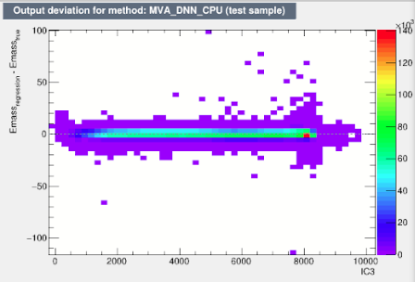
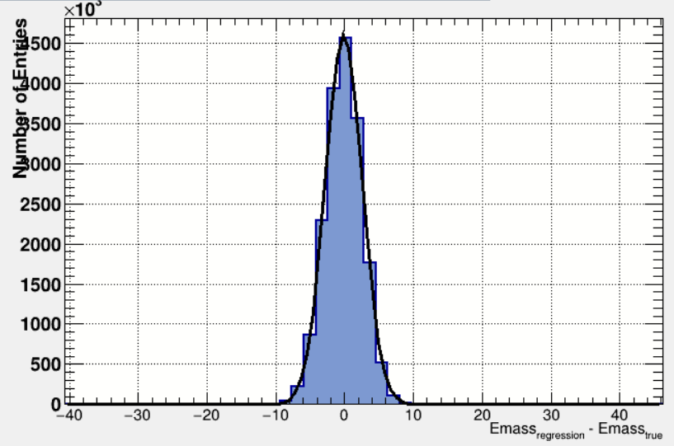
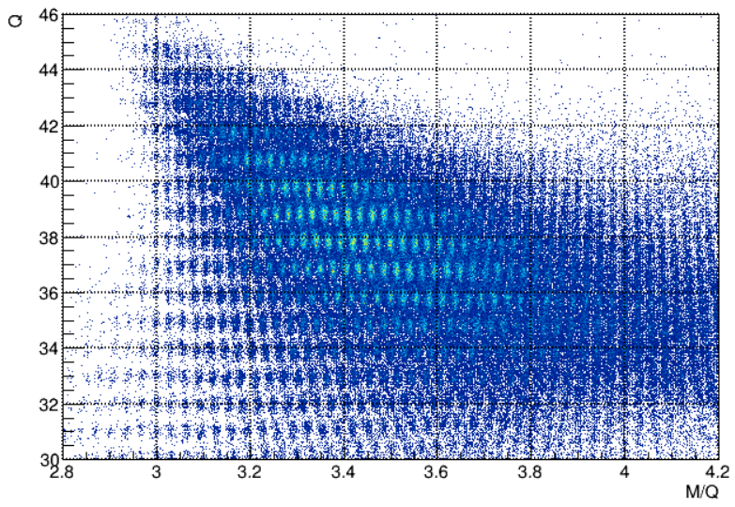
DNN performance
Output - Target
Mean Error (Train / Test, truncated)
Deviation of TMVA calculation from the target versus input variables
Weight file of DNN : Can be used to calculate the ion energy, and then charge state (Q)
ΔE(FWHM) = 6.33 MeV
E range = 300~700 MeV
A segmented energy loss
Notes:
DNN performance can be checked by Mean error of train set and test set. These are useful to check whether there was overfitting or not.
Also, deviation of DNN output from the target v.s an segmented energy loss can be drawn as the left figure.
We can check that DNN is actually well trained to minimize the difference between its output and target.
When we make the projection to Y and check the FWHM, it was 6.33 MeV for energy range 300 to 700 MeV
And then, the trained weight file of DNN can be used to calculate the ion energy, and the charge state.
The left is the previous Q:M/Q hist with low energy region, and the right one is made by DNN application.
You can see better alignment obviously.

Slide 15
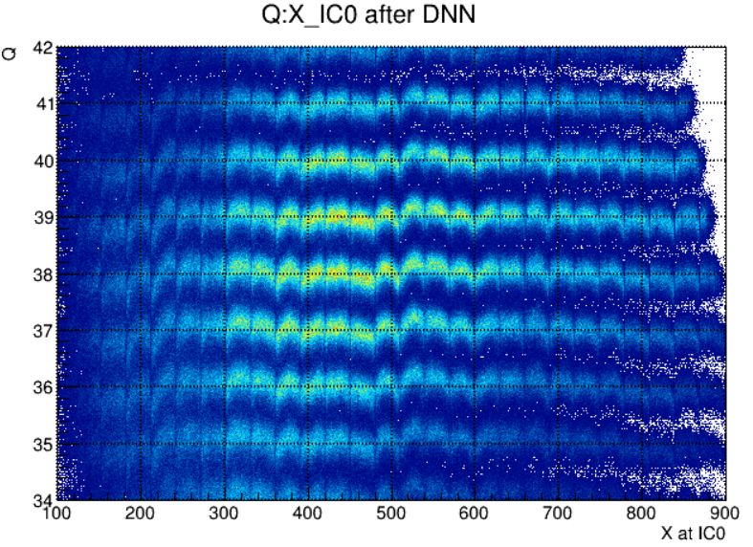
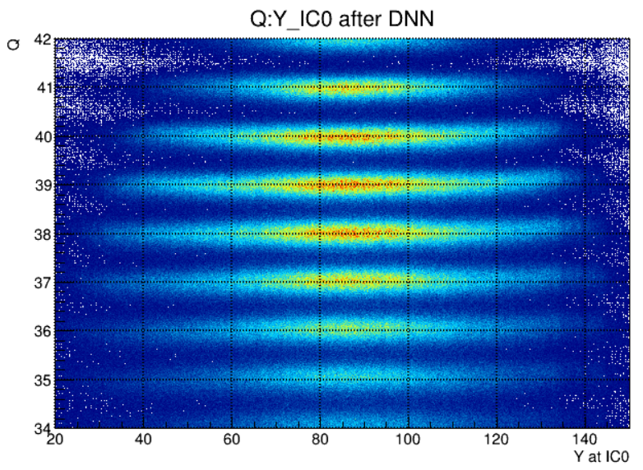
Q:Position hist after DNN application
Ion charge states should have integer values !
Position dependence of energy because of mylar foil expansion structure in front of IC
Try DNN with additional inputs of xIC0 yIC0 and different parameters, but hard to make correction
Try boosted decision tree – gradient (BDTG)
Notes:
However, the charge states v.s. positions in front of ion chamber are not fully aligned as these two pictures.
As I said before, the ion charge states should have the integer values in principle. So, they should aligned well at integers.
The reason of this trend is shape of mylar foil expansion in front of ion chamber and this was not considered in DNN training.
Therefore, I tried DNN again with addition of position inputs, but hard to make good result.
So, we tried boosted decision tree with gradient method for this position dependence correction.

Slide 16
Boosted Decision Tree (Gradient) description
Target
Raw data
Residual data 1
Residual data 2
y1
y3
Tree 1
Tree 2
y2
Final output
x1
x2
Input
Notes:
So, why we used boosted decision tree?
I will briefly introduce this method.
First, a single decision tree is trained to select boundaries (red line) and return a mean value of target (blue line) between the boundaries as a output. It will find the best boundaries which can minimize the difference between these output and the target
However, a single tree has problem of high variance which means small change in the input data can result in very different tree structure.
-> One usually overcome such defects by “Bagging” or “Boosting
We tried specific type of boosting, “Gradient”.
For the “Gradient” method, it first train a tree with raw data. And then, it calculate the residuals between the target and output of trained tree.
These residual data are used as a new input data and train a new tree. By iterative training, it reduces the residual as much as possible.
The final output is calculated by taking average of all trees’ outputs.
Now, you can guess why this method looks suitable for our problem.
Because BDT just decided the boundaries and return the mean as output, we thought it will show strong performance for such segmented non-linear behavior.

Slide 17
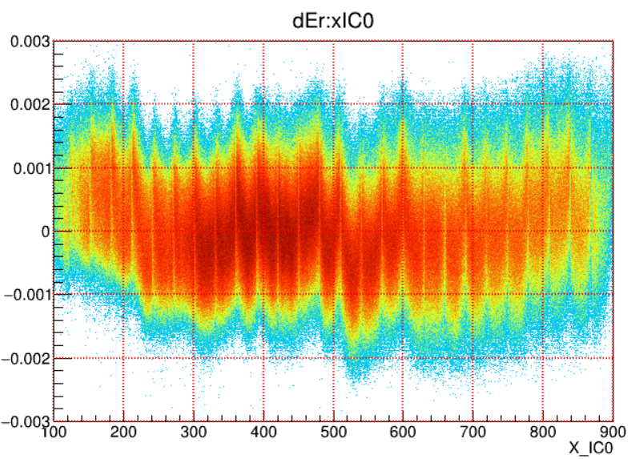
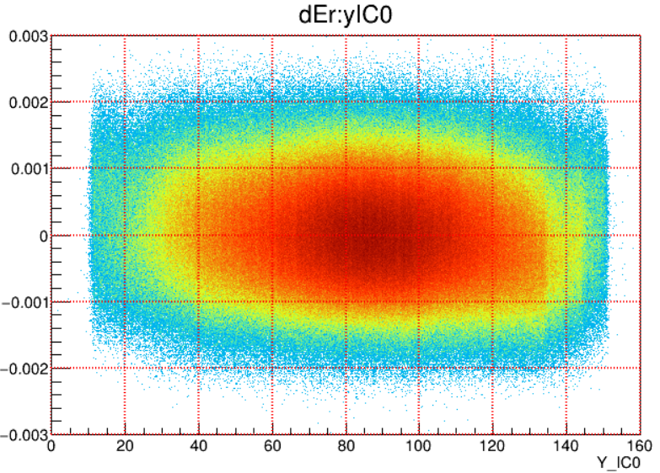
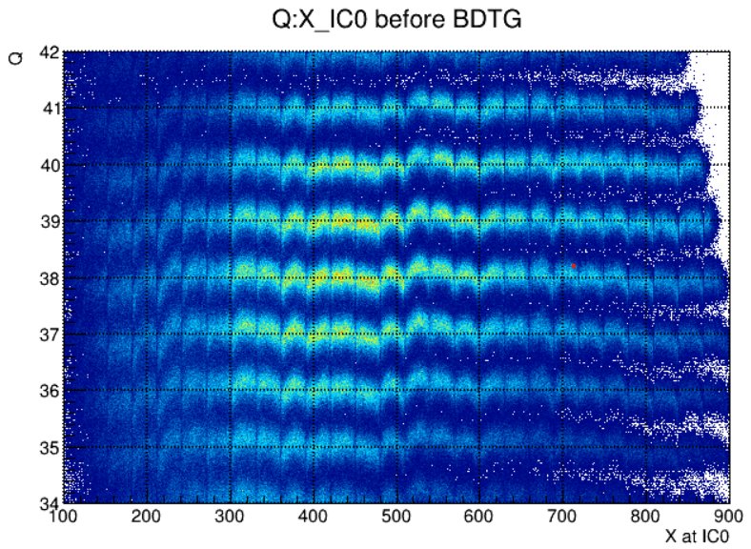
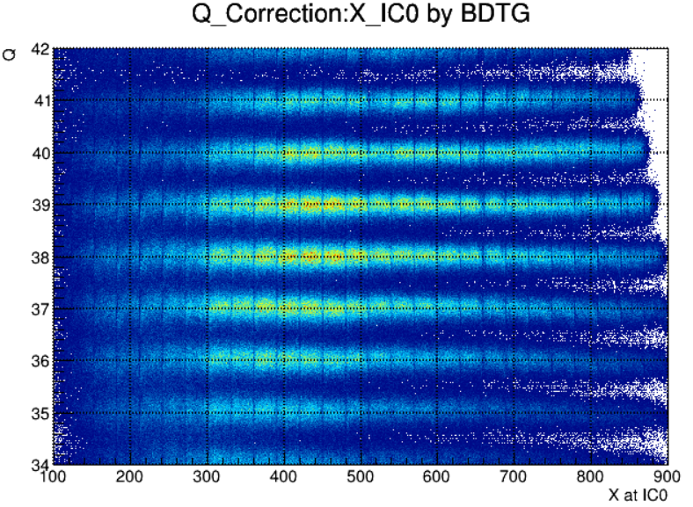
Data Preparation for BDTG
Input : X and Y in front of IC0
Target : dEr = (Emass – E_DNN)/IC[0]
After training BDTG, E_BDTG = E_DNN + IC[0] * BDTG_output
Notes:
To use the BDTG method for the energy correction, we need to prepare a new form of data.
Positions at first ion chamber segment should be input for this correction.
Since what we want is to find the pattern of energy deviation of DNN output from its target Emass,
we used the new target as the ratio of this energy deviation with respect to energy loss at the first segment.
Those looks like above historgrams.
After training the BDT, ion energy can be corrected by following equation, and one can re-calculate the ion charge state.
Actually, this correction method works well as right figure.
The ion charge states are well aligned after the BDTG correction.

Slide 18
Parameters of BDTG
Inputs : xIC0, yIC0
Target : dEr
Data preprocessing : Normalize [min, max] of each input to [-1, 1]
Train / Test set : 50% / 50% from prepared data
Parameters for TMVA_BDTG (with bagging)
  Ntrees = 500 – How many iterations for boosting
  MaxDepth = 4 – Maximum depth of a tree
  MinNodeSize = 0.2% - Minimum fraction of events needed to make a node
  BoostType = Grad
  nCuts = 20 – Number of binary searching points
  Shrinkage = 0.5 ~ learning late in DNN
  BaggedSampleFraction = 0.5 ~ Fraction of dataset for make a new tree (random selection to avoid high variance)
Can treat the correlation among input variables at once
(Hard to be done by profile correction method)

Slide 19
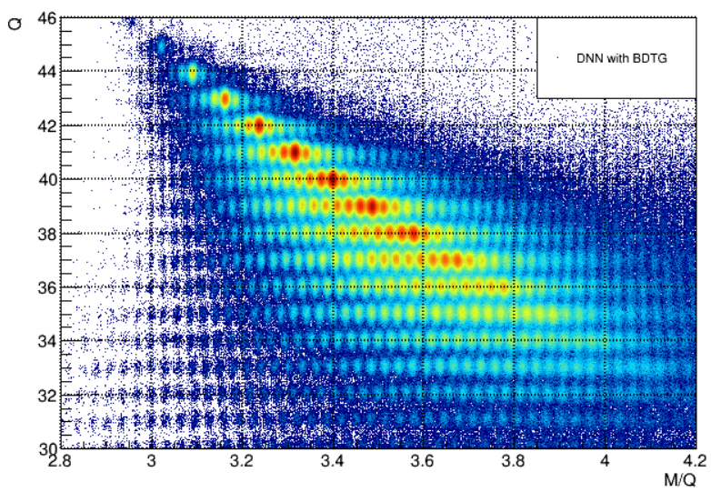
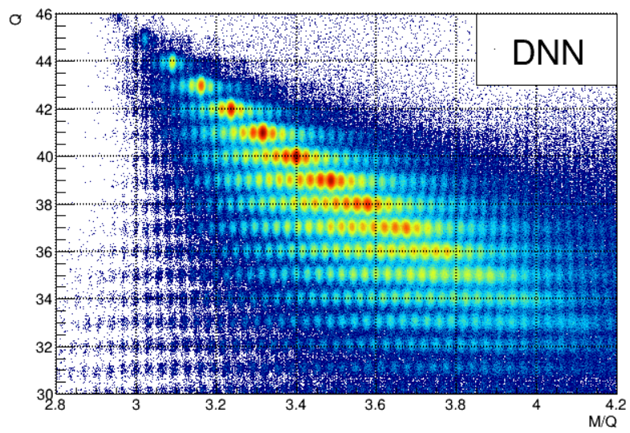
Q:M/Q histograms comparison
Notes:
The left figure is Q:M/Q for whole energy range with the conventional method. The linear gain factors are changed for several different energy regions
The right figure is with the DNN method. And then, addition correction is applied by BDTG.
You can see the improvement of charge states alignment

Slide 20
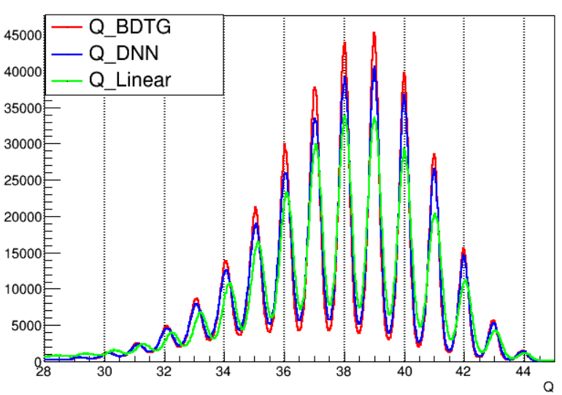
Q state histograms comparison
Y. Cho et al., submitted NIM B
Method | Resolution (Q/ΔQ)
Q_Linear | 68
Q_DNN | 78
Q_BDTG | 86
Notes:
This figure is the comparison of 1d Q state histogram among the different methods.
Green line is with conventional method, blue line is with DNN, red line is with DNN and BDTG
Resolution defined as Q/FWHM is improved from 68 to 86 after final calculation.

Slide 21
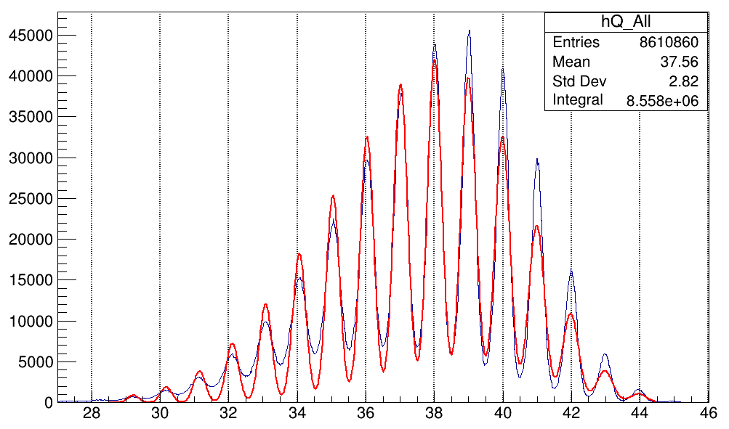
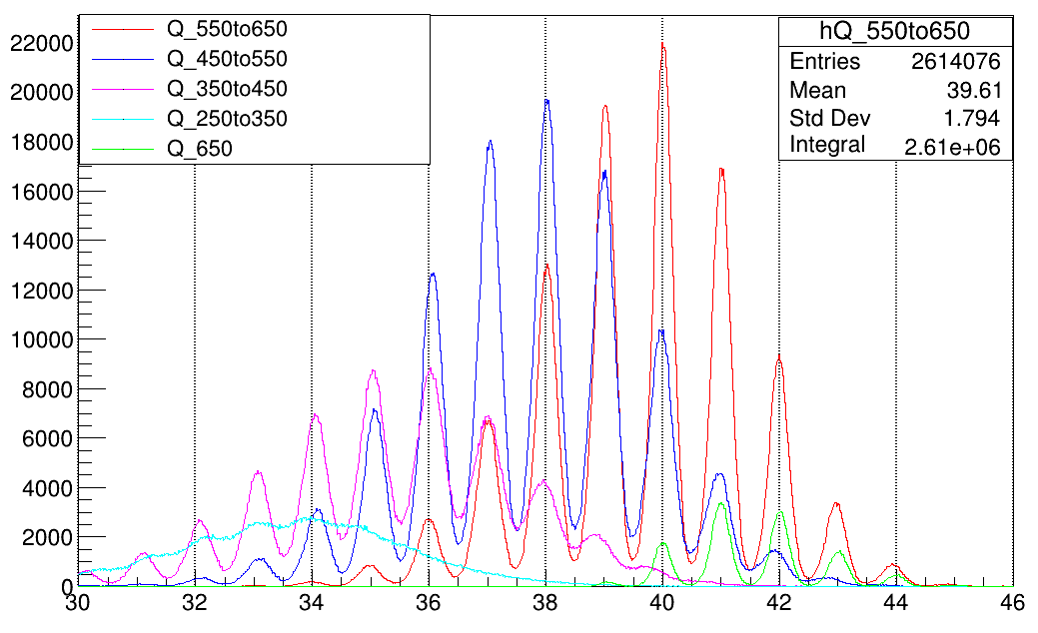
Q state w.r.t different energy ranges
Q state hist for whole energy range
Q state hist for each 100MeV energy range
When fitting with same resolution parameter (dQ/Q), it doesn’t work well

Slide 22
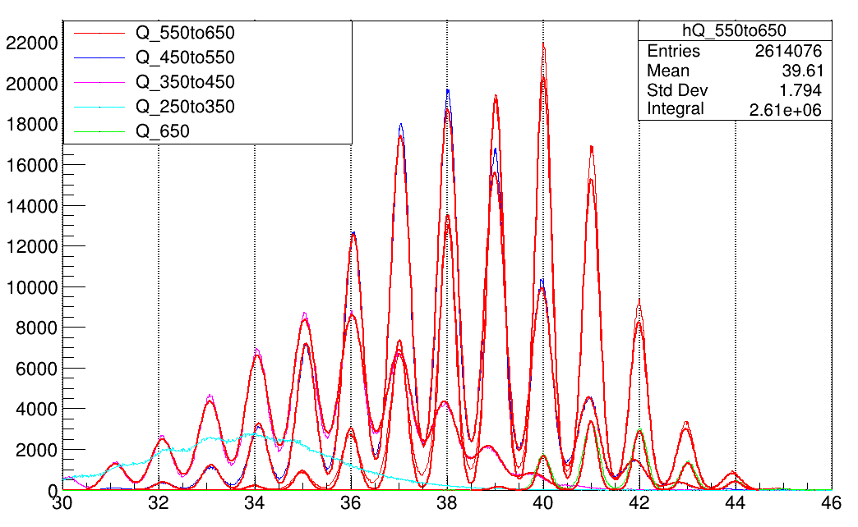
Q resolution variation
One can check Q resolution variation w.r.t energy range
Energy range (MeV) | dQ(FWHM) / Q
650 ~ | 1 / 110.8
550 ~ 650 | 1 / 94.0
450 ~ 550 | 1 / 77.1
350 ~ 450 | 1 / 59.7
250 ~ 350 | Can’t fit

Slide 23
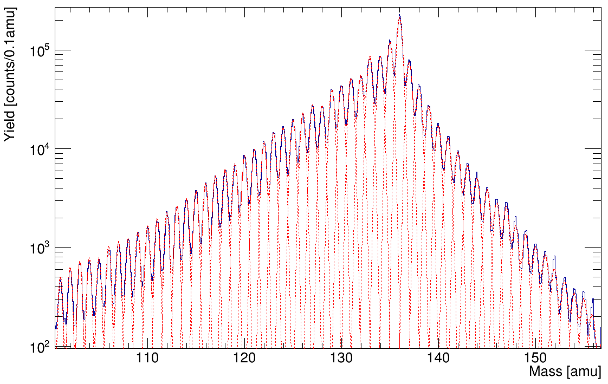
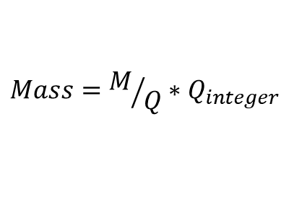
Mass histogram
$$Mass=M/Q∗Q_{integer}$$
Resolution (M/ΔM) ~ 210

Slide 24
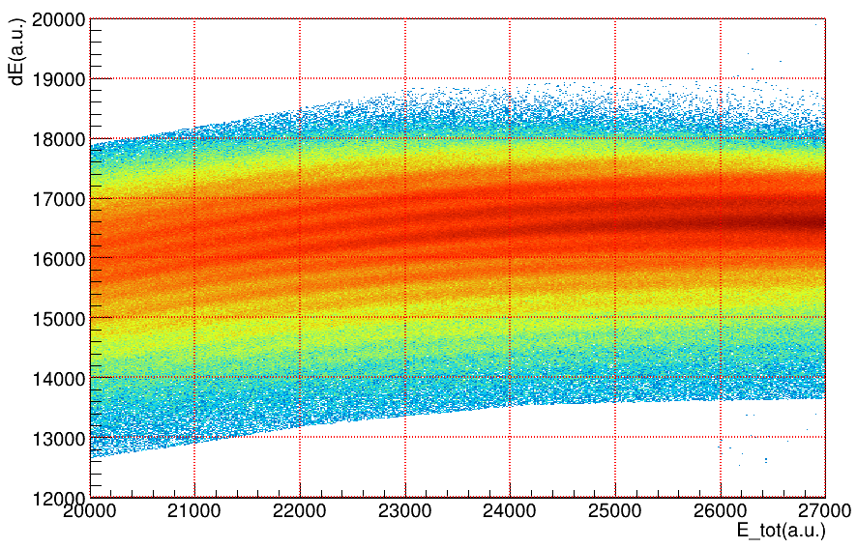
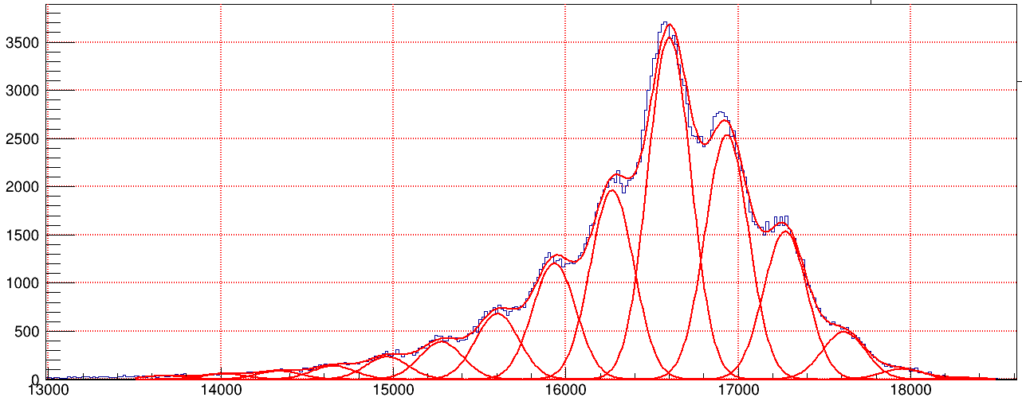
Atomic number (Z) identification
Conventional atomic number (Z) identification : dE-E method
  dE = sum of (a[i]*IC[i]), i=0~2 or 0~3
  E = sum of (a[i]*IC[i]), i=0~6
Hard to fully separate high-Z events (ion chamber resolution ~ 1/60)
There can be some better alternative functions of ( IC[i]’s + others ) which separate each Z events
  dE_2 and dE_3 shows different dE-E pattern
  Mass, velocity, ion charge state, ... can be related with Z numbers
How to find such function? -> M. L.

Slide 25
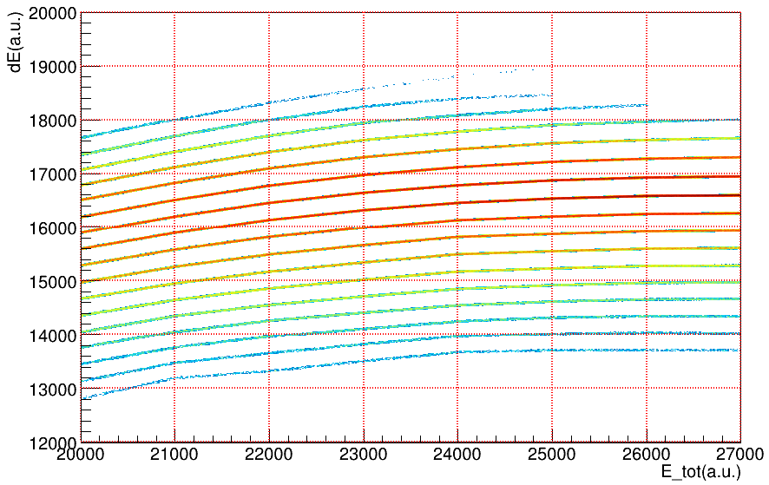
Atomic number (Z) identification by M.L.
Problem situation
  We know some high-confident Z events by dE-E method (central part of each Z-lines)
  We don’t know the real Z number of events in the overlapped region
  i.e. we know answer for some events (labeled), but not for others (unlabeled).
Semi-supervised learning : combining a small amount of labeled(Z) data with a large amount of unlabeled data during the training
  There are several methods, and we use Self-Training method

Slide 26

DNN for classification
Typical deep neural network (DNN) for classification has multiple outputs corresponding to the number of classes (Z’s for our case)
  For the ion state (Q) calculation, we calculated the energy (a continuous output), which was a regression problem
These outputs can be regarded as a prediction probability of belonging to each class
z0
P(Z=45)
IC0
tanh
tanh
IC0/dx
z1
P(Z=46)
tanh
tanh
softmax
IC6
IC6/dx
M_int
tanh
tanh
z16
P(Z=61)
Velocity
20
20
Number of Z’s : 17 (45 ~ 61)
~ Prediction probability
for each Z number
Inputs related to Z

Slide 27
Semi-supervised learning for Z identification
Semi-supervised learning (SSL) : Combining a small amount of labeled data with a large amount of unlabeled data during the training
  Inputs : IC[0~6], ΔIC/Δx[0~6], V, A, Q, etc.
  Labeled Target : Z (Atomic number) of highly confident events (blue lines)
  Unlabeled Target : Events with low confidence (other parts)
Self-Training : Iterative training with pseudo-label generation
DNN is iteratively trained starting from highly confident events
Self-Training procedure
High confident
events (labeled)
First classifier
(trained DNN)
1.
2.
Low confident
events (unlabeled)
First classifier
Pseudo-labels
High confident
events (labeled)
Mixed
dataset
New classifier
Probability Predictions
3.
Most confident
pseudo-labels

Slide 28
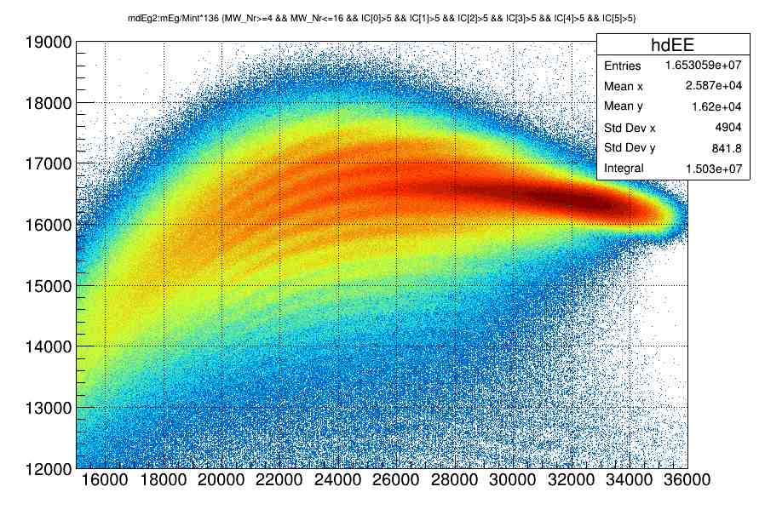
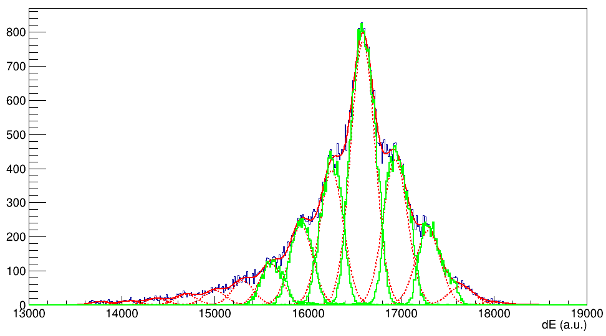
Z identification using semi-supervised ML
Check a specific energy cut
DNN atomic state classification
ΔE [arb. unit]
IC0
z0
P(Z=45)
tanh
tanh
Xe
IC0/dx
z1
P(Z=46)
tanh
tanh
softmax
IC6
IC6/dx
M_int
tanh
tanh
z16
P(Z=61)
Velocity
20
20
E [arb. unit]
Number of Z’s : 17 (45 ~ 61)
~ Prediction probability
for each Z number
Inputs related to Z
Xe
Low Z resolution ΔE-E
-> most difficult for unambiguous PID
Semi-supervised ML deep neural network to find hidden pattern (Self-training)
ML result Roughly reproduces ΔE Gaussian fitting
Need to confirm using prompt γ-ray
But failed to reproduce the statistics from mass dependance
ML Z identification
ΔE Gaussian fitting
I
Cs
Te
Ba
Sb
Sn
La
Ce
ΔE [arb. unit]

Slide 29
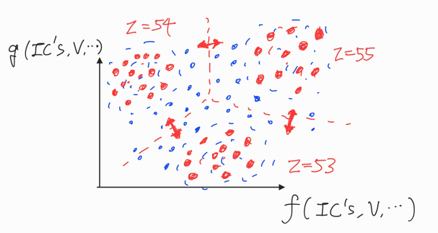
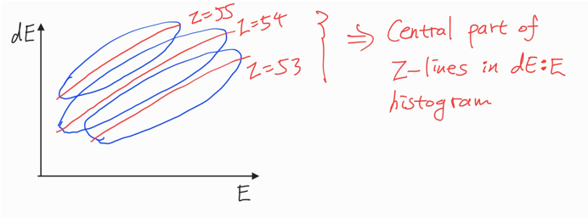
Self-Training procedure
Training
High confident events (labeled)
First classifier (trained DNN)
1.
2.
Low confident events (unlabeled)
First classifier
Pseudo-labels
High confident events (labeled)
Training
Mixed dataset
New classifier
Probability Predictions
3.
Most confident pseudo-labels

Slide 30

Result – Prob(Z)>0.5 events
Red lines : Multi-gaussian fitting of dE histogram
Green hist : Events whose prediction probability belongs to a specific Z > 0.5
Check the gamma-ray hist for the overlapped regions to check whether the selectivity is increased or not
Check a specific energy cut

Slide 31



Result – 134I, 134Xe Gamma hist comparison
PLF γ-ray selecting
area in ΔE-E
Xe
PLF γ-ray selecting
area with ML
I
ML Z identification
Xe
ΔE Gaussian fitting
Selected with ΔE-E
Selected with ML
Cs
I
Te
Ba
Blue hist : From I peak to multi-gaussian crossing point
Red hist : From I peak to Xe peak with Prob(Z=53)>0.5
Xe gammas are suppressed quite well
SSL method can distinguish Xe and I mixed in the ΔE:E histogram
Sb
Sn
La

Slide 32
CATLIFE
Complementary Arm for Target Like FragmEnts
  Made by Seoul National University
Can measure pre-evaporation mass of fragments using kinematics
Will be presented by Yonghyun Son

Slide 33



Second arm detector
TLF velocity vector measurement
Experiment with similar setup was performed at Legnaro (NOSE detector)
TLF mass calculation by kinematics
  Momentum conservation (2 equations)
  Mass conservation (1 equation)
  Assuming no preference in direction of neutron emission
  Unknown : M_{PLF}, M_{TLF}, Reaction point (Depth) in the target
  Correction of energy loss in the MWPC, target by SRIM

Slide 34

Determination of reaction point
At a given interaction point,
  PLF energy (by VAMOS) + PLF energy loss (at MWPCs, at target) -> PLF momentum at reaction
  Beam energy – beam energy loss -> Beam momentum at reaction
  Calculation of TLF velocity at reaction by beam momentum and PLF momentum
  TLF energy – TLF energy loss (at target) -> kinematic TLF velocity (after the target)
  Calculation of difference between kinematic TLF velocity and measured TLF velocity
Find the reaction point whose difference is minimum
Then, TLF mass can be calculated

Slide 35






TLF mass histogram
With Xe cut
With Xe cut && TT cut (~ Elastic)

Slide 36

TLF mass histogram w.r.t reaction region
Reaction at 0~1/6 of target thickness
1/6 ~ 2/6
2/6 ~ 3/6
FWHM of 136 partner : ~3.5
3/6 ~ 4/6
4/6 ~ 5/6
5/6 ~ 6/6
FWHM of 136 partner : ~2.

Slide 37
Gamma-ray spectroscopy
After the reaction, fragments in an excited state can be generated
Excited fragments transit to the ground state with emission of particles or gamma-rays
Level scheme of the excited states can be studied by the gamma-gamma coincidence measurement
AGATA HPGe tracking array
Doppler correction can be done by the tracking

Slide 38



Example of GG coincidence (²⁰⁰Pt)
398
464
633
470

Slide 39
Summary
Nuclei near N ~ 126, which is important for understanding nuclear interaction of heavy nuclei and astrophysics, are generated using MNT reaction
A new calibration method for PID using machine learning was developed for the unambiguous identification
  Charge state identification using supervised learning
  Atomic number identification using semi-supervised learning
Analysis of gamma-ray spectroscopy for nuclear structure study is ongoing
Please stay tuned for exciting result to come!

